Slide 1
TOPIC: Chemical Properties of Organic Compounds
NSB 111/ MSB 100: BASICS OF BIOMEDICAL SCIENCES
LECTURER: DR. G. K. MAIYOH
DEPARTMENT OF BIOCHEMISTRY AND CLINICAL CHEMISTRY

Slide 2
ORGANIC CHEMISTRY
Organic chemistry describes the structures, properties, preparation, and reactions of a vast array of molecules that we call organic compounds.
All organic molecules contain carbon (C), virtually all of them contain hydrogen (H), and most contain oxygen (O) and/or nitrogen (N) atoms.
Many organic molecules also have halogen atoms such as fluorine (F), chlorine (Cl), bromine (Br), or iodine (I).
Other atoms in organic compounds include sulfur (S), phosphorous (P), and even boron (B), aluminum (Al), and magnesium (Mg).

Slide 3
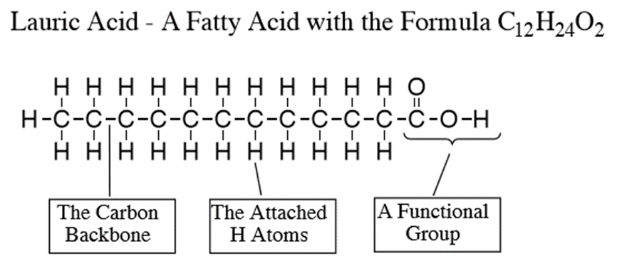
BONDING
The number of different types of atoms in organic compounds suggests they are structurally complex.
Fortunately, we find these atoms in a relatively few specific arrangements because of their preferred bonding characteristics.
For example, C atoms primarily bond to each other to form the molecular skeleton or backbone of organic molecules, while H atoms bond to the various C atoms, or to other atoms such as N and O, almost like a "skin" surrounding the molecule.

Slide 4
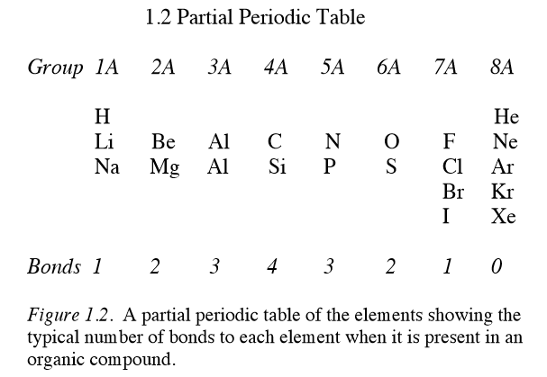

BONDING
Most of the atoms that we have mentioned above are in the first three rows of the periodic table.
However, it is their location in a particular column of the periodic table that tells us how many chemical bonds they usually form to other atoms in a molecule.
For example, C and Si are in the fourth column (Group 4A) and they each typically have four bonds in their molecules, while F, Cl, Br, and I are in Column 7A and they typically form just one bond.

Slide 5
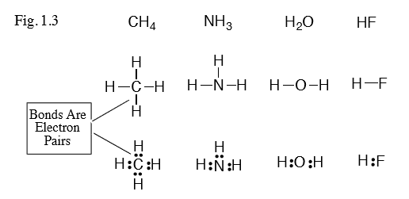
NUMBER OF CHEMICAL BONDS
For example:
You can see that each atom in these molecules has the preferred number of bonds to H that we listed at the bottom of our partial periodic table (last slide)
CH4, NH3, H2O, and HF

Slide 6
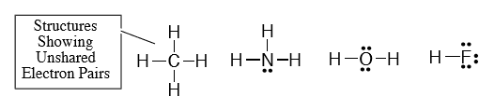
UNSHARED ELECTRONS
Besides their chemical bonds (bonding electron pairs), N, O, and F have unshared electron pairs that are not in chemical bonds
C = 2:4
N = 2:5
O = 2:6
F = 2:7
Unshared electrons are also referred to as Lone pair of electrons

Slide 7
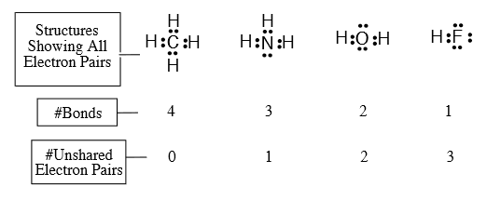
TOTAL NUMBER OF ELECTRON PAIRS
The combined total of number of bonds and number of unshared electron pairs that we show equals 4 for C, N, O, or F.
Since each chemical bond contains 2 electrons, the drawings of these molecules show 8 electrons on C, N, O, or F that come from their bonds and these unshared electron pairs.

Slide 8
THE “OCTET RULE”
Because each of these atoms has 8 electrons in bonds and unshared pairs, they satisfy the "octet rule".
The "octet rule" states that atoms in rows 2 and 3 of the partial periodic table prefer to form compounds where they have 8 electrons in their outer valence electron shell.
C, N, O, and F obey this rule not only in these compounds, but in all stable organic compounds.

Slide 9
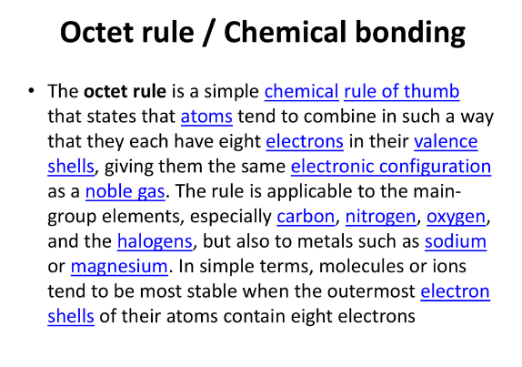
IN OTHER WORDS…….

Slide 10
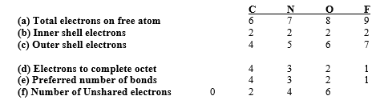
WHAT IS THE BASIS FOR THE NUMBER OF BONDS AND UNSHARED ELECTRONS ON C, N, O, AND F
The number of bonds and unshared electrons on C, N, O, and F in their compounds depends on the total number of electrons of each free atom as follows:
0 2 4 6

Slide 11
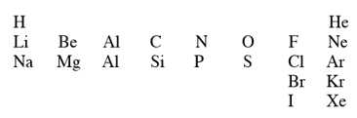
CONCLUSIONS FROM BONDING
The total number of electrons is identical to the atomic number of the atom.
C, N, O, or F each has 2 inner shell electrons (not shown in the drawings.)
The number of outer shell electrons equals [total electrons (a) - inner shell electrons (b)].
The number of electrons to complete an octet is [8 - number of outer shell electrons].
The preferred number of bonds to C, N, O, or F is identical to the number of electrons to complete an octet (d) since each new electron comes from another atom that forms a bond containing the new electron and one of the outer shell electrons of C, N, O, or F.
The number of unshared electrons on C, N, O, or F is the number of outer shell electrons not involved in forming chemical bonds to other atoms and this equals (c)-(d).
B
AL

Slide 12
Bonding in Carbon Compounds
The property of carbon that makes it unique is its ability to form bonds with itself and therefore allows a large number of organic chemicals with many diverse properties.
Carbon has the property of forming single, double and triple bonds with itself and with other atoms.
This multiple bond ability allows carbon compounds to have a variety of shapes.
In all carbon compounds, carbon forms four bonds.
The types of bonds used by the carbon atom are known as sigma (δ)and pi (∏) bonds.
Different combinations of these bonds lead to carbon single bonds, double bonds and triple bonds
Alkane: Compound composed of only carbon and hydrogen and single bonds

Slide 13
Compounds with Four Single Bonds to C
We can think of CH4 as the simplest organic compound since it contains just one C with its four bonds to H atoms.
Now let's look at other examples where C bonds not only to H, but to other C's, as well as to N, O, or X.
These compounds include alkanes (C and H), haloalkanes (C, H, and X), alcohols and ethers (C, H, and O), and amines (C, H, and N).
(see next slide)
Where X is a halogen (F, Cl, Br etc.)

Slide 14
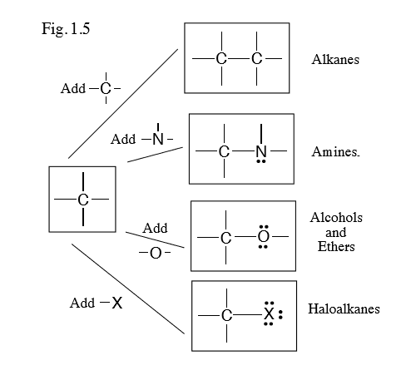

Slide 15
HOMOLOGOUS SERIES •
There are millions of different organic compounds and chemists have devised a method of classifying them into families with similar formulae and properties.
Each family of organic compounds is called a homologous series.
• A homologous series is a family of compounds with the same general formula, same functional group and similar chemical properties.
For example: Alkanes, Alkenes, Alcohols and Carboxylic acids

Slide 16
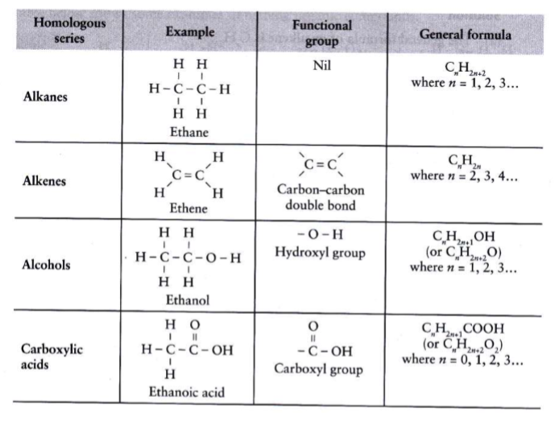
Homologous series

Slide 17
HOMOLOGOUS SERIES CHARACTERISTICS
Organic compounds in the same homologous series have the following characteristics:
Same general formula
Same functional group
Similar chemical properties but varying in reactivity
Physical properties vary gradually along the series
Each member of the series differs from the next by a –CH2- unit.

Slide 18
Alkanes
The alkanes comprise a series of compounds that are composed of carbon and hydrogen atoms with single covalent bonds.
This group of compounds comprises a homologous series with a general molecular formula of C _{n} H ₂ _{n+2} , where n equals any integer.

Slide 19
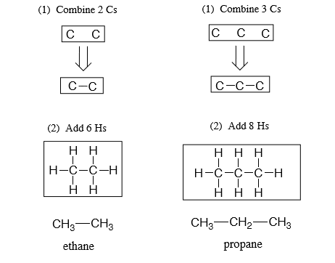
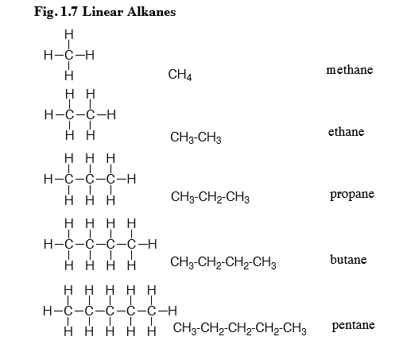

Slide 20
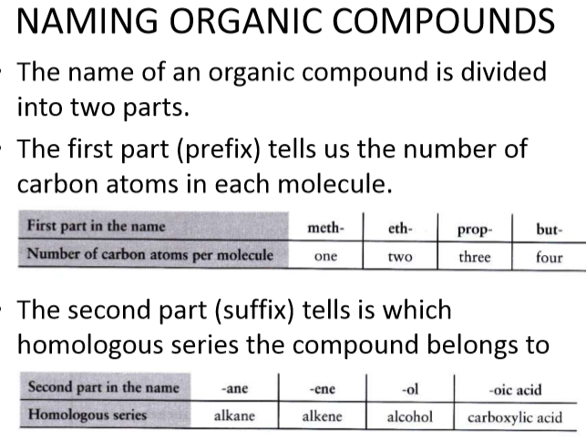

Slide 21
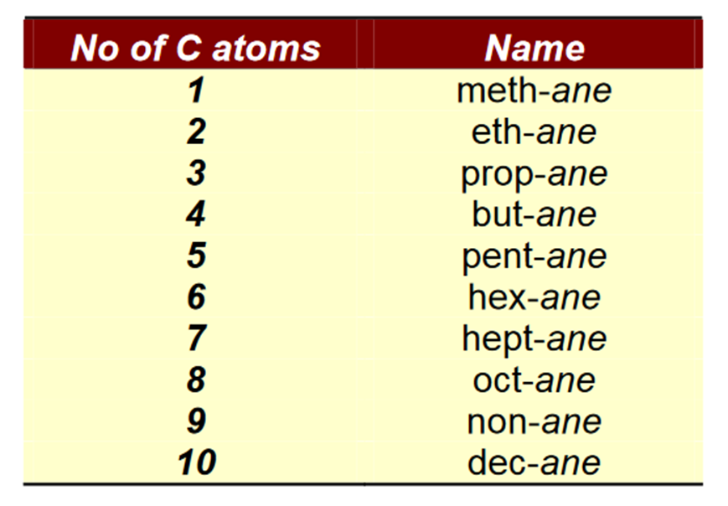
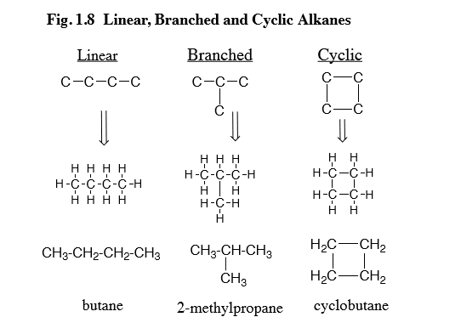
Nomenclature
Cycloalkane: cyclic compound containing only carbon and hydrogen

Slide 22
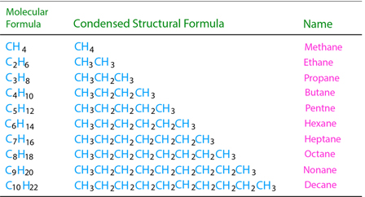
Molecular vs condensed structural formulae

Slide 23
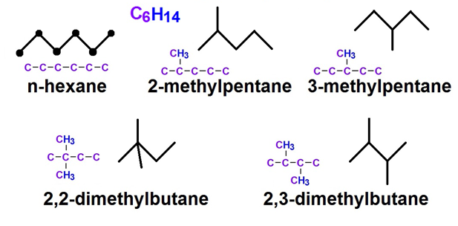
Branched alkanes
Alkanes that have carbons that are bonded to more than 2
Carbons
Example the skeletal isomers of hexane

Slide 24
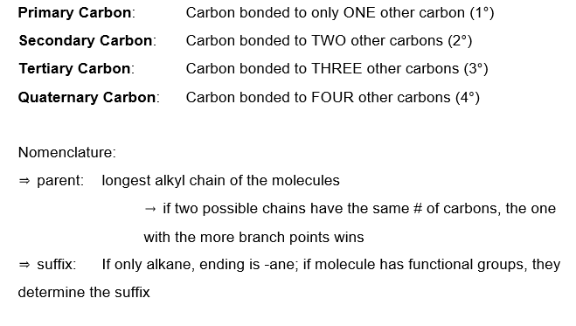

Slide 25
CARBON ATOMS TYPES
S = SECONDARY: Two carbons attached to carbon in question
T = TERTIARY: Three carbons attached to carbon in question
PRIMARY: One carbon attached to carbon in question
QUATENARY: Four carbons attached to carbon in question
METHYL: Zero carbons attached to carbon in question

Slide 26
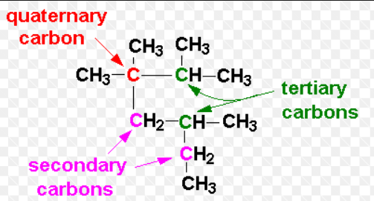

Slide 27
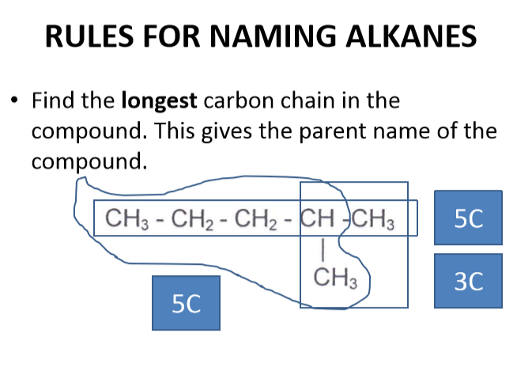

Slide 28
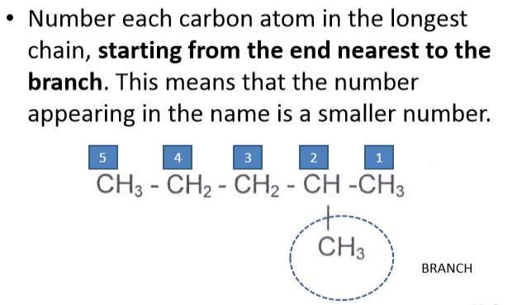

Slide 29
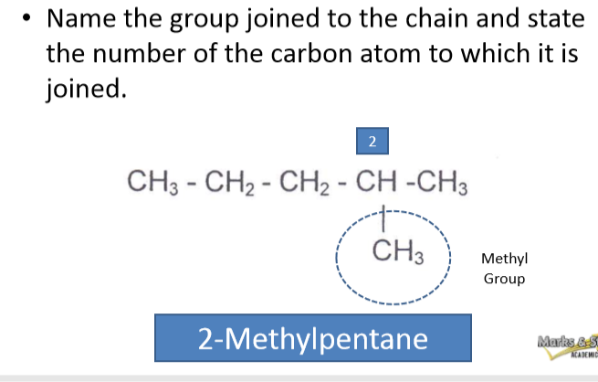

Slide 30
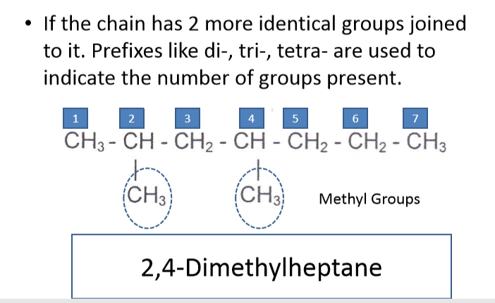

Slide 31
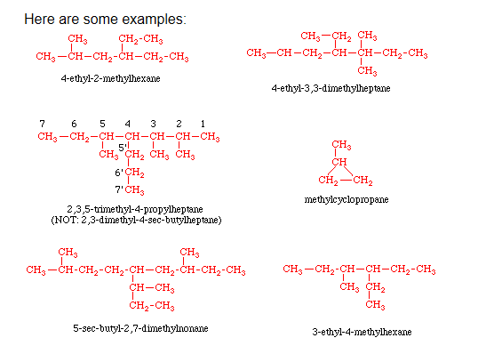

Slide 32
Learning check: Draw the following
propane
octane
2-methylpentane
3-ethyl-4-propyloctane
3-t-butylhexane
5-s-butyldecane
3-isopropylpentane
ethylcyclobutane
4-isobutyl-1-methylcyclohexane

Slide 33
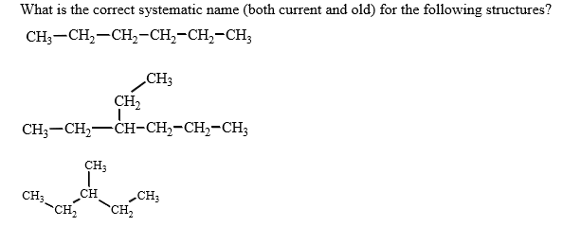
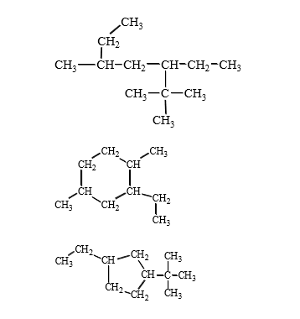
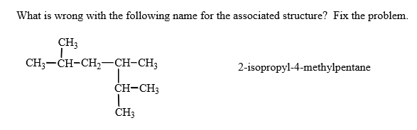
A
C
B
E
D
F
I

Slide 34
Functional groups
A functional group is an atom or group of atoms that gives a compound its characteristic chemical properties.
Organic compounds in the same homologous series have similar chemical properties due to the same functional group.
Functional groups define the class to which the organic molecule belongs.
Functional groups therefore, determine the physical properties and chemical reactions of their particular class of compounds.

Slide 35
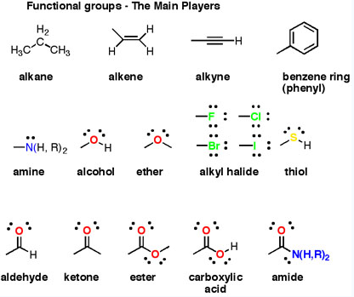

Slide 36
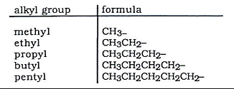
Alkyl group (R-)
The general formulas R-X, R-OH, and R-NH2 symbolize the great variety of possible haloalkanes, alcohols, and amines.
They indicate that an X atom, an OH group, or an NH2 group replaces an H atom in an alkane or cycloalkane (R-H) to give a haloalkane, alcohol, or amine
R represents all of the bonded C and H atoms other then the X, OH, or NH2 groups.
The OH group is called a hydroxyl (or hydroxy) group, or simply an alcohol group, while NH2 is an amino group.

Slide 37
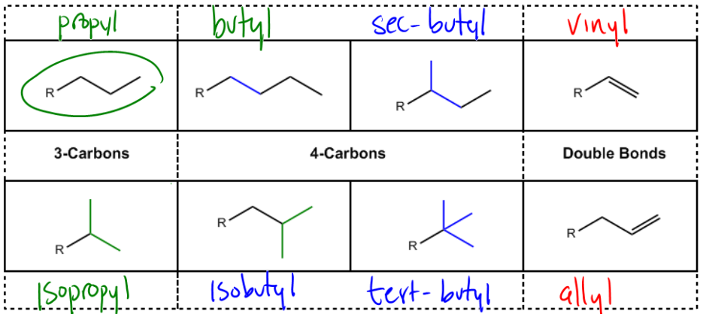
Alkyl groups

Slide 38
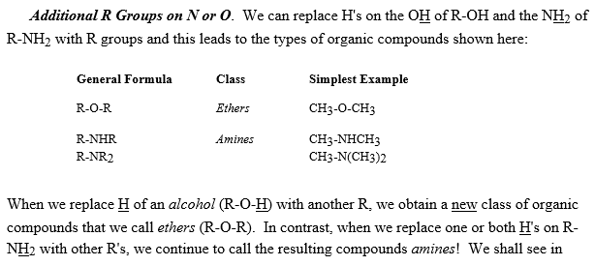

Slide 39
Compounds with Double and Triple Bonds to C
So far, all organic compounds that we have seen have C atoms with 4 single bonds to 4 other atoms.
Although C always prefers four bonds, we can provide these four bonds with 3 atoms or even 2 atoms using double or triple bonds.
We find such double and triple bonds in alkenes (C=C), alkynes (C≡C), imines (C=N), nitriles (C≡N), and aldehydes or ketones (C=O).

Slide 40
Physical properties of alkanes
Generally, alkanes have low melting and boiling points. This is due to the weak intermolecular forces of attraction (van der Waals’ forces) which can be overcome by a small amount of heat energy.
As the alkane molecules become larger (increase in the number of carbon atoms in the molecules, the intermolecular forces of attraction become stronger.
More heat energy is needed to overcome the intermolecular forces of attraction to separate the molecules and the melting and boiling points increase.

Slide 41

Viscosity
As the number of carbon atoms in the molecules increases, they become less viscous (flow less easily).
This is due to the stronger intermolecular forces of attraction and
Larger molecules get tangled together easily

Slide 42
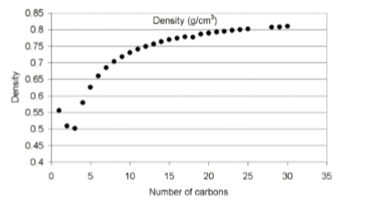
Change in density
As the number of carbon atoms in the molecules increases, their densities also increase.
Liquid alkanes have densities less than 1g/cm3 and they float on water.

Slide 43
Flammability
As the number of carbon atoms in the molecules increases, they become less flammable (more difficult to burn).
The larger alkane molecules contain a higher percentage of carbon and this makes it more difficult to burn.
The larger alkanes also tend to produce a smokier flame due to incomplete combustion of the alkane molecules.

Slide 44
Solubility
Alkanes are insoluble in water but soluble in organic solvents such as tetra chloromethane (CCl4).

Slide 45
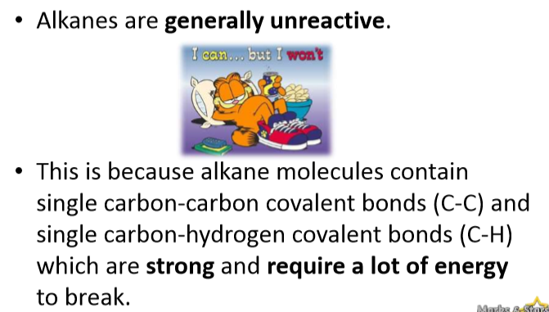
Chemical properties of Alkanes

Slide 46
Reactions of Alkanes
A) Combustion —
i. Complete combustion:
Alkane + oxygen —> carbon dioxide + water + HEAT
CH4 + 2 O2 —> CO2 + 2 H2O + HEAT
C2H6 + 7/2 O2 —> 2 CO2 + 3 H2O + HEAT
C3H8 + 5 O2 —> 3 CO2 + 4 H2O + HEAT
The reaction is highly exothermic and a large amount of heat energy is released. This is why alkanes make good fuels.

Slide 47
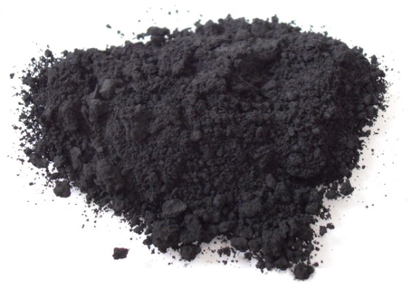
ii) Incomplete combustion
In addition to carbon dioxide, water and heat a variety of products are possible.
One such product is the odorless, poisonous gas, carbon monoxide, CO.
Another is carbon black, a sooty material produced by burning hydrocarbons in a limited amount of air.
It has a high carbon to hydrogen ratio and is used in the manufacture of automobile tires, increasing the durability of the rubber in the tires.
carbon black

Slide 48
Substitution Reactions
A substitution reaction is one in which an atom or group of atoms replace other atoms in a molecule.
It is usually a slow reaction that is difficult to control and a mixture of products is usually obtained.

Slide 49
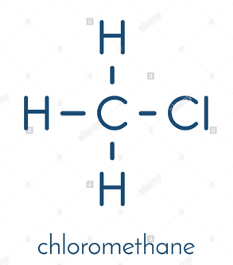
B) Halogenation
A substitution reaction, where hydrogen is replaced by halogens e.g. Cl or Br.
As an example, consider the reaction of methane with chlorine gas.
No reaction takes place between the two gases at room temperature, but if the mixture is heated or ultraviolet light shines on the mixture a reaction takes place.
The first product formed, chloromethane, CH3Cl, results from replacement of one H on CH4 by a Cl.

Slide 50
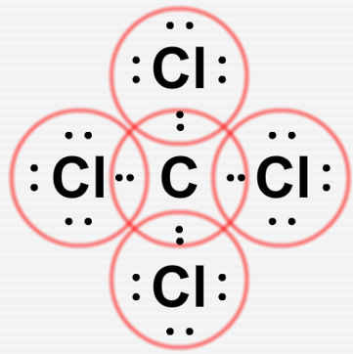
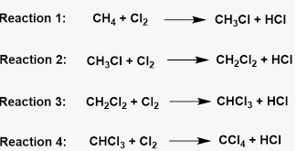
The second product formed, dichloromethane, CH2Cl2, results from replacement of one H on CH3Cl by a Cl.
The third product formed, trichloromethane, CHCl3, results from replacement of one H on CH2Cl2 by a Cl.
The fourth product formed, tetrachloromethane, CCl4, results from replacement of the H on CHCl3 by a Cl.
Overall:
Heat or UV
CH4 + Cl2 ---------------> CH3Cl + CH2Cl2 + CHCl3 + CCl4 + HCl

Slide 51
ISOMERISM
Isomers are compounds with the same molecular formula but different structural formulae.
Isomers have different melting and boiling points.
Isomers may or may not belong to the same homologous series.

Slide 52
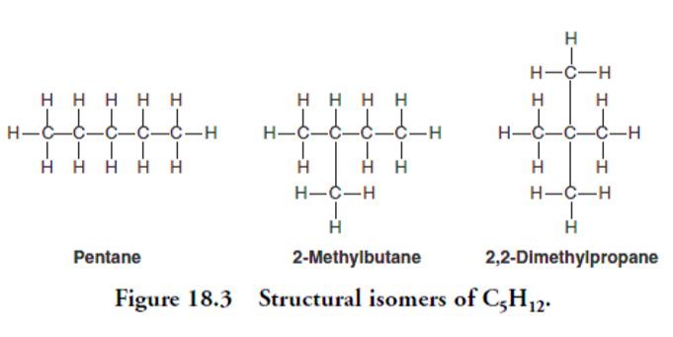

Slide 53
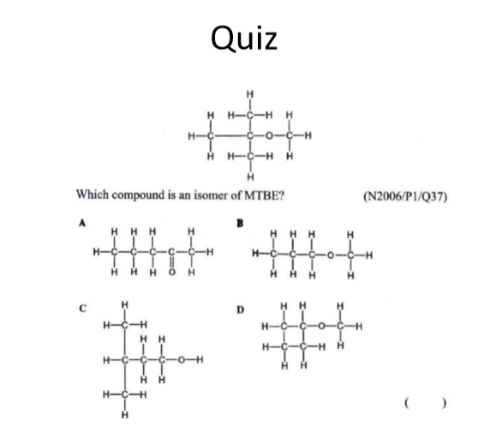

Slide 54
Alkenes and Akynes
Alkene: Hydrocarbon with at least one carbon-carbon double bond (olefins)
Alkynes: Hydrocarbon with at least one carbon-carbon triple bond

Slide 55
Properties of Alkenes and Alkynes
NO rotation around double and triple bonds
Similar to Alkanes (bp and mp)
Isomerism
cis and trans:

Slide 56
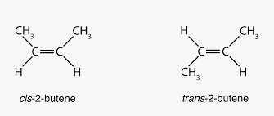
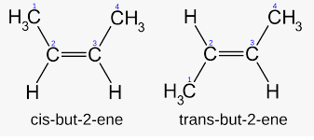
Cis Trans Isomerism
Same side = cis while opposite side = trans

Slide 57
E/Z Nomenclature:
If you have four different substituents around a double bond cis/trans does not work
Each substituent is assigned a priority
The substituent with the highest priority on each carbon is determined
If these substituents are on the same side of the molecule, the configuration is Z
(zusammen (meaning together))
If these substituents are opposite from each other, the configuration is E
(entgegen (meaning opposite))

Slide 58
How to determine the group priorities?
The greater the atomic number the higher the priority
If the two substituents on an sp2 carbon have the same atomic number (there is a tie), the atomic numbers of the atoms that are attached to the "tied" atoms must be considered
If an atom is doubly bonded to another atom, the priority system treats it as if it were a singly bonded to two of these atoms
In the case of isotopes, the mass number is used to determine the priority

Slide 59
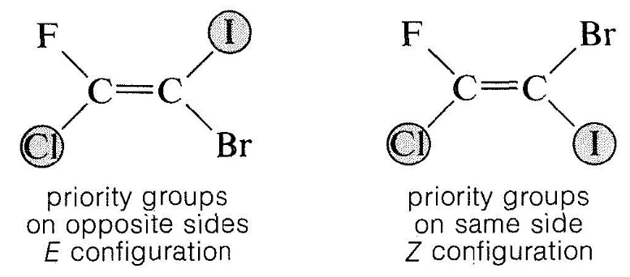
Consider priority about each of the double bond C atoms (C=C), one at a time

Slide 60

Have a great evening Stay safe

