Slide 1
MSB 100-PROTEINS, Enzymes, Vitamins- STRUCTURE & function
Prof. A. Kwena

Slide 2
Amino acids are organic compounds that contain both amino and carboxylic acid functional groups.
Although hundreds of amino acids exist in nature, by far the most important are the alpha-amino acids, which comprise proteins.
Only 22 alpha amino acids appear in the genetic code.

Slide 3
Amino acids can be classified according to the locations of the core structural functional groups, as alpha- (α-), beta- (β-), gamma- (γ-) or delta- (δ-) amino acids; other categories relate to polarity, ionization, and side chain group type (aliphatic, acyclic, aromatic, containing hydroxyl or sulfur, etc.).
In the form of proteins, amino acid residues form the second-largest component (water being the largest) of human muscles and other tissues.

Slide 4
Beyond their role as residues in proteins, amino acids participate in a number of processes such as neurotransmitter transport and biosynthesis.
It is thought that they played a key role in enabling life on Earth and its emergence.

Slide 5
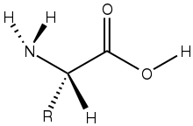
Amino acid

Slide 6
Amino acid
C
R
NH2
H
COOH

Slide 7
In the structure shown at the top of the page, R represents a side chain specific to each amino acid.
The carbon atom next to the carboxyl group is called the α–carbon.
Amino acids containing an amino group bonded directly to the α-carbon are referred to as α-amino acids.
These include proline and hydroxyproline, which are secondary amines. In the past they were often called imino acids, a misnomer because they do not contain an imine grouping HN=C

Slide 8
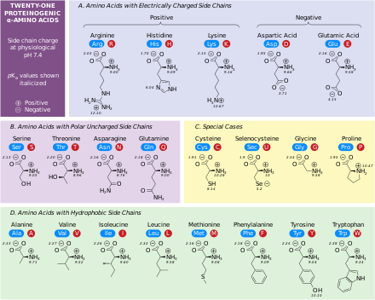

Slide 9
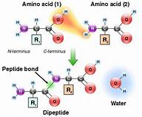
Dipeptide bond formation

Slide 10
Background-Different Levels of protein Structure
Primary Structure
Secondary Structure
Tertiary Structure
Quaternary Structure

Slide 11
Primary
Sequence of residues in the polypeptide

Slide 12
Secondary
A local regulary structure in proteins and is mainly found with hydrogen bonds between backbone atoms.
There are two types of stable secondary structures : Alpha helices and β-pleated sheets- usually located inside the protein with loops on the outer regions.

Slide 13
Tertiary Structure
Describes the packing of alpha-helices, beta-sheets and random coil to each other on the level of one whole polypeptide chain.
Stable and not affected by denaturation that occurs in proteins.
Examples include : Alcohol Dehydrogenase that converts ethanol to acetaldehyde (Alcohol metabolism), Myoglobin.

Slide 14
Quaternary Structure
Only exists if there is more than one polypeptide chain present in the protein.
It describes the spatial organization of the chains.
Examples include liver Alcohol Dehydrogenase, Haemoglobin.

Slide 15
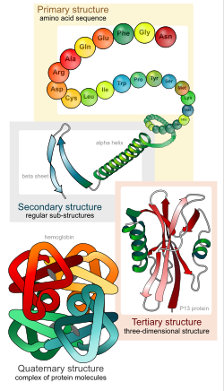

Slide 16
Motifs and Domains
Motifs and Domains are combinations of secondary structures.
Motifs only consist of the outer part of secondary structures They may but need not have a function.
Domains are more complicated and are defined as a modular functional unit folding independently.

Slide 17
The particular series of amino acids that form a protein is known as that protein's primary structure.
This sequence is determined by the genetic makeup of the individual.

Slide 18
Proteins have several, well-classified, elements of local structure formed by intermolecular attraction, this forms the secondary structure of protein.
They are broadly divided in two, alpha helix and beta sheet, also called beta pleated sheets.

Slide 19
Alpha helices are formed of coiling of protein due to attraction between amine group of one amino acid with carboxylic acid group of other.
The coil contains about 3.6 amino acids per turn and the alkyl group of amino acid lie outside the plane of coil

Slide 20
Beta pleated sheets are formed by strong continuous hydrogen bond over the length of protein chain.
Bonding may be parallel or antiparallel in nature. Structurally, natural silk is formed of beta pleated sheets.
Usually, a protein is formed by action of both these structures in variable ratios.

Slide 21
Coiling may also be random.
The overall 3D structure of a protein is termed its tertiary structure.
It is formed as result of various forces like hydrogen bonding, disulfide bridges, hydrophobic interactions, hydrophilic interactions, van der Waals force etc.

Slide 22
When two or more different polypeptide chains cluster to form a protein, quaternary structure of protein is formed.
Quaternary structure is a unique attribute of polymeric and heteromeric proteins like hemoglobin, which consists of two alpha and two beta peptide chains.

Slide 23
Chemical Properties
Ninhydrin Reaction- The N- terminal of the protein reacts with Ninhydrin compound producing a yellow coloured compound.
Biuret Reaction-Treatment of a polypeptide or protein with Cu2+ gives a purple Cu2+-peptide complex which can be measured quantitatively using a spectrophotometer.

Slide 24
Acid Base properties similar to amino acids.

Slide 25
Physical properties
Peptide properties- formation of peptide bonds
Optical properties- Stereoisomarism

Slide 26
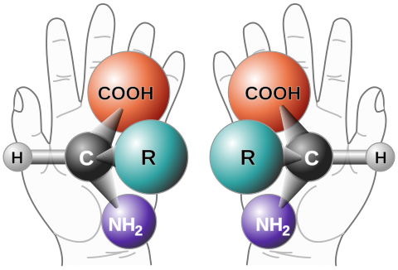
stereoisomers

Slide 27
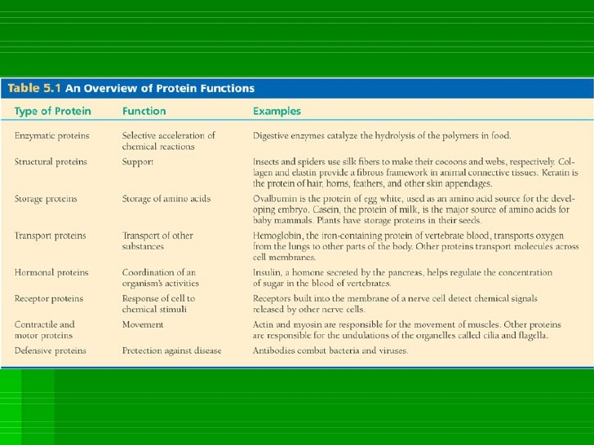
Functions

Slide 28
Summary

Slide 29
PROTEIN STRUCTURE
There are four levels of protein structure. These levels are distinguished from one another by the degree of complexity in the polypeptide chain (linked amino acids).
The four levels of protein structure are primary, secondary, tertiary, and quaternary structure.
A single protein molecule may contain one or more of these protein structure types. The structure of a protein determines its function.

Slide 30
For example, collagen has a super-coiled helical shape.
It is long, stringy, strong, and resembles a rope.
This structure is great for providing support.

Slide 31
Hemoglobin, on the other hand, is a globular protein that is folded and compact.
Its spherical shape is useful for maneuvering through blood vessels.

Slide 32
PROTEIN FUNCTIONS
Antibodies - are specialized proteins involved in defending the body from antigens (foreign invaders).
They can travel through the bloodstream and are utilized by the immune system to identify and defend against bacteria, viruses, and other foreign intruders. One way antibodies counteract antigens is by immobilizing them so that they can be destroyed by white blood cells.

Slide 33
Contractile Proteins - are responsible for movement.
Examples include actin and myosin.
These proteins are involved in muscle contraction and movement.

Slide 34
Enzymes - are proteins that facilitate biochemical reactions.
They are often referred to as catalysts because they speed up chemical reactions.
Examples include the enzymes lactase and pepsin. Lactase breaks down the sugar lactose found in milk.
Pepsin is a digestive enzyme that works in the stomach to break down proteins in food.

Slide 35
Hormonal Proteins - are messenger proteins which help to coordinate certain bodily activities.
Examples include insulin, oxytocin, and somatotropin.
Insulin regulates glucose metabolism by controlling the blood-sugar concentration.
Oxytocin stimulates contractions in females during childbirth.
Somatotropin is a growth hormone that stimulates protein production in muscle cells.

Slide 36
Structural Proteins - are fibrous and stringy and provide support.
Examples include keratin, collagen, and elastin.
Keratins strengthen protective coverings such as skin, hair, quills, feathers, horns, and beaks.
Collagens and elastin provide support for connective tissues such as tendons and ligaments.

Slide 37
Storage Proteins - store amino acids.
Examples include ovalbumin, casein, ferritin. Ovalbumin is found in egg whites and casein is a milk-based protein.
Ferritin stores iron in hemoglobin.

Slide 38
Transport Proteins - are carrier proteins which move molecules from one place to another around the body.
Examples include hemoglobin and cytochromes.
Hemoglobin transports oxygen through the blood via red blood cells.
Cytochromes operate in the electron transport chain as electron carrier proteins.

Slide 40
Enzymes
By
Prof. A. Kwena

Slide 41
C
R
NH2
H
COOH

Slide 42
Highly effective and extremely specific catalysts
They are biologic polymers or proteins in nature that catalyse chemical reactions that make life possible.
Substrates Products
        enzymes

Slide 43
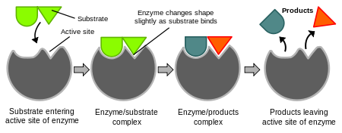
Lock and Key model of enzyme action

Slide 44
Experience
Using plastic models of different colours, construct a model depicting the lock and key hypothesis.

Slide 45
Assessment
Describe the lock and key model of enzyme action.

Slide 46
Enzymes are proteins but all proteins are not enzymes
Those factors that denature proteins will reduce the activity of enzymes. These include changes in pH, temperature, and ionic strength.
Function - they are catalysts. Catalysts act to reduce the amount of activation energy required for a reaction to occur.

Slide 47
For example, a very common reaction in your cells is the conversion of sugars such as glucose to carbon dioxide and water
Enzymes increase the rate of a given reaction by reducing the need for activation energy

Slide 48
General properties
They are neither consumed nor permanently altered
Highly selective as catalysts
Specific for
  Type of rxn catalysed
  Single substrate catalysed
  Small set of closely related substrates
  Stereospecific- L-sugar catalysed by different enzyme from D-sugar

Slide 49
Properties of Enzymes
Denaturation: Since all enzymes are proteins, their activity is dependent on maintaining the proper three dimensional conformation.
If the structure is disrupted, so is its function.

Slide 50
Changing factors such as pH, temperature and ionic strength can lead to a disruption of the structure (and thus the activity) of a protein hence the activity of enzymes .
This is known as denaturation.

Slide 51
Assessment
Briefly describe the general properties of enzymes.

Slide 52
Specificity: Enzymes catalyze specific reactions.
This catalysis occurs in a special site where the reactants (known as substrates in enzymatic reactions) bind and react to form the products.
This site is known as the active site of the enzyme.

Slide 53
The active site is specific for the substrates so that almost no other substances will bind there, and subsequently react.
This is similar to the relationship of a lock and key.
Thus each enzyme will catalyze only one specific reaction (there are a few exceptions, of course).

Slide 54
This specificity leads to another property - inhibition.
Some substances have similar structures to the true substrate of an enzyme.
An enzyme may not be able to distinguish between the true substrate and the imposter.

Slide 55
If the enzyme binds the imposter at the active site, usually the enzyme can not catalyze a reaction .
This imposter molecule will thus inhibit the activity of the enzyme.
In such conditions, the substrate and the imposter compete for the active site and so such inhibition is known as competitive inhibition.

Slide 56
Regulation: A cell does not always want an enzyme to be active. For example, there is an enzyme that synthesizes glycogen from glucose during starvation.
For many enzymes, the cell has the ability to turn up or down the activity of the enzyme depending on the conditions in the cell and in the body. Enzyme regulation generally occurs by one of two different methods - allosteric regulation and covalent modification.

Slide 57
In allosteric regulation, an enzyme has a second binding site that is not catalytic (it is not an active site).
This second site, known as an allosteric site, is specific for a particular molecule.
When this molecule binds to the allosteric site, the activity of the enzyme is altered.

Slide 58
In covalent modification, the enzyme structure is altered by the addition of another compound that is attached to the enzyme by a covalent bond.
The most common modification entails the addition of a phosphate (PO₄) group.

Slide 59
Phosphate is negatively charged so the addition of such a group alters the structure of the enzyme and thus its activity.
The addition of the phosphate group to the protein (known as phosphorylation) is regulated as well.

Slide 60
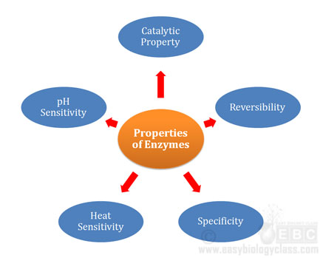

Slide 61
ENZYME NAMING
Except for some of the originally studied enzymes such as pepsin, rennin, and trypsin, most enzyme names end in "ase".
The International Union of Biochemistry (I.U.B.) initiated standards of enzyme nomenclature which recommend that enzyme names indicate both the substrate acted upon and the type of reaction catalyzed.

Slide 62
Under this system, the enzyme uricase is called urate: O₂ oxidoreductase, while the enzyme glutamic oxaloacetic transaminase (GOT) is called L-aspartate: 2-oxoglutarate aminotransferase.

Slide 63
Enzyme commission number (E.C)
According to IUB an enzyme must have
  a unique name and
  a code number
  e.g. Hexose-6-phosphate transferase
  E.C. 2.7.1.1 (Enzyme commission number)
  Which implies Hexose is a member of
  Class 2 (transferases)
  Sub-class 7 (Transfer of phosphoryl group)
  Sub-class 1 ( Alcohol is the phosphoryl acceptor)

Slide 64
Classification
Classified according to type of reaction catalysed followed by suffix –ase
Dehydrogenase (removes hydrogen atom)
Proteases (hydrolyse proteins)
Isomerases (facilitate isomerisation- configuration changes)

Slide 65
Classification based on International Union of Biochemistry (IUB).
IUB designed nomenclature to control naming of enzymes amid discovery of many enzymes
An enzyme must have:
  Unique name
  Code number : to reflect type of rexn catalysed and substrate involved.

Slide 66
Six classes of enzymes are found with each class having a sub-class:
  E.g. hexokinase, catalyses hexose sugar to hexose-6-phosphate in glycolytic pathway is designated as ATP D-hexose-6-phosphotransferase
  E.C. 2.7.1.1., which implies hexose is a member of class 2 (transferases)
  Subclass 7 (transfer of phosphoryl group)

Slide 67
Sub class 1(alcohol is the phosphoryl acceptor)

Slide 68
ENZYME CLASSIFICATION cont’d
1. OXIDOREDUCTASES
· catalyze oxidation-reduction reactions
· dehydrogenases, reductases
· lactate dehydrogenase (NAD+), acyl CoA dehydrogenase (FAD),
ketoacyl-ACP reductase (NADPH/H+)

Slide 69
Oxidoreductases cont’d
These are enzymes which catalyze the reduction or oxidation of a molecule. Remember that oxidation is the reverse of reduction and that an enzyme has to catalyze the forward and reverse reactions to the same degree.
Any enzyme which catalyzes a reduction has to also catalyze the reverse (oxidation) reaction, thus the double-barreled name "oxidoreductase."

Slide 70
2.TRANSFERASES
These enzymes catalyze the transfer of a group of atoms from one molecule to another. A common example involves transfer of a phosphate between ATP and a sugar molecule.
catalyze functional group transfers
· kinases, aminotransferases, thiolases
· glucokinase (ATP), aspartate aminotransferase (PLP), b-ketothiolase

Slide 71
3.HYDROLASES
As the name suggests, these enzymes catalyze hydrolysis reactions (and their reverse reactions). The hydrolysis of an ester would be an example of such a reaction.
catalyze hydrolysis reactions
· peptidases, glycosidases, lipases, phosphatases
· trypsin, amylase, triacylglycerol lipase,
fructose-1,6-bisphosphatase

Slide 72
4.LYASES
Reactions which add a small molecule such as water or ammonia to a double bond (and the reverse, elimination, reactions) are catalyzed by lyases.
catalyze elimination (or addition) of groups to form (or break) double bonds
· synthases, decarboxylases, dehydratases
· citrate synthase, pyruvate decarboxylase (TPP), fumarase

Slide 73
5.ISOMERASES
These enzymes catalyze the conversion of a molecule into an isomer. The cis-trans interconversion of maleate and fumarate is an example.
catalyze reactions that alter structure, not composition (optical, geometric, or structural isomers)
· isomerases, mutases
· glucose-6-phosphate isomerase, phosphoglycerate mutase

Slide 74
6.LIGASES
These enzymes catalyze reactions which make bonds to join together (ligate) smaller molecules to make larger ones.
catalyze coupling of two compounds along with hydrolysis of a phosphoanhydride bond
· synthetases, carboxylases, polymerases
· glutamine synthetase (ATP), pyruvate carboxylase (biotin), DNA polymerase

Slide 75
Isoenzymes
Distinct (different) enzyme forms that catalyse the same rexn.
Exhibit differences in properties such as
  Sensitivity to particular regulatory factors
  Substrate affinity
  Survival enhancement by providing back-up copy of essential enzymes
  Differentiated experimentally by electrophoresis
  Each isoenzyme is focused at a specific PI.

Slide 76
Apoenzymes
An apoenzyme is the inactive storage and generally secretory form of a protein.
This is required to protect the secretory cell from the activity of that protein.
Apoenzymes becomes active enzyme on addition of a cofactor.
Cofactors can be either inorganic (e.g., metal ions and iron-sulfur clusters) or organic compounds, (e.g., flavin and heme).

Slide 77
Organic cofactors can be either prosthetic groups, which are tightly bound to an enzyme, or coenzymes, which are released from the enzyme's active site during the reaction.

Slide 78
Factors Affecting Enzyme Activity
Several factors affect the rate at which enzymatic reactions proceed - temperature, pH, enzyme concentration, substrate concentration, and the presence of any inhibitors or activators.

Slide 79
1.Enzyme Concentration
In order to study the effect of increasing the enzyme concentration upon the reaction rate, the substrate must be present in an excess amount; i.e., the reaction must be independent of the substrate concentration.
Any change in the amount of product formed over a specified period of time will be dependent upon the level of enzyme present.

Slide 80
Reaction Orders with Respect to Substrate Concentration
Order Rate Equation Comments
1.zero rate = k rate is independent of substrate concentration
2.first rate = k[S] rate is proportional to the first power of substrate concentration

Slide 81
Reaction Orders with Respect to Substrate Concentration
Order Rate Equation Comments
3.second rate = k[S][S]=k[S]² rate is proportional to the square of the substrate concentration
second rate = k[S₁][S₂] rate is proportional to the first power of each of two reactants

Slide 82
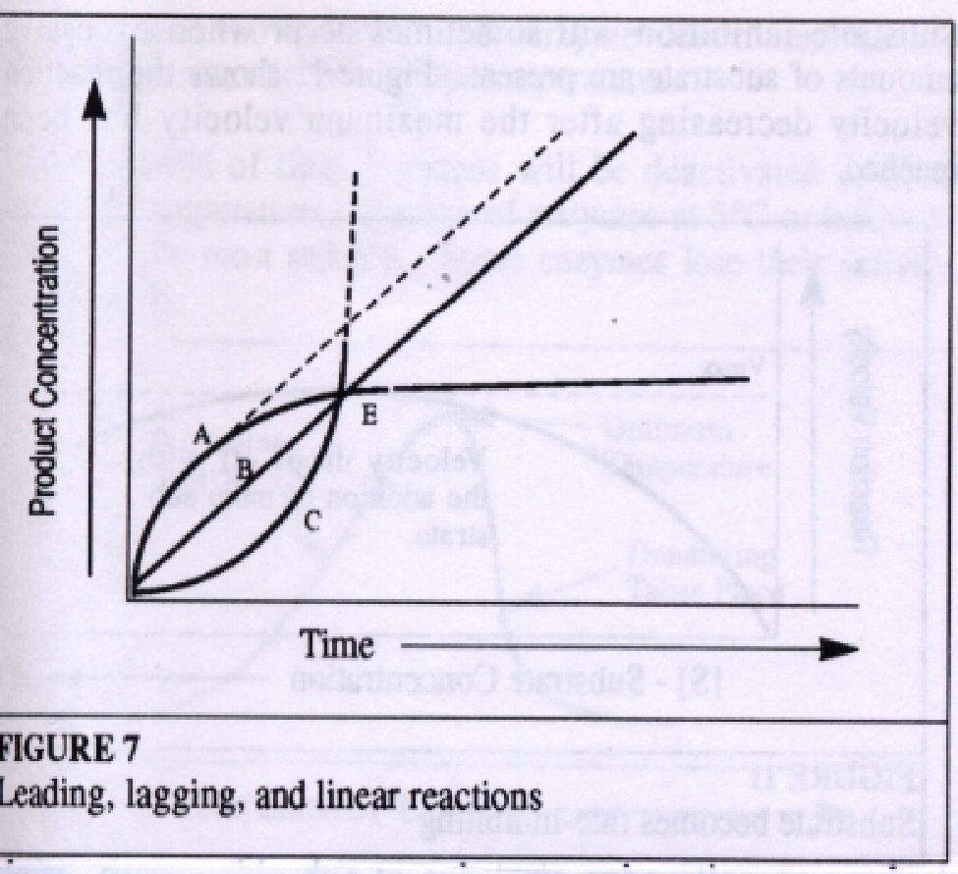
Three types of reactions which might be encountered in enzyme assays

Slide 83
B is a straight line representing a zero order reaction which permits accurate determination of enzyme activity for part or all of the reaction time.

Slide 84
A represents the type of reaction that was shown earlier.
This reaction is zero order initially and then slows, presumably due to substrate exhaustion or product inhibition.
This type of reaction is sometimes referred to as a "leading" reaction. True "potential" activity is represented by the dotted line.

Slide 85
Curve C represents a reaction with an initial "lag" phase. Again the dotted line represents the potentially measurable activity.
Multiple determinations of product concentration enable each curve to be plotted and true activity determined.
A single end point determination at E would lead to the false conclusion that all three samples had identical enzyme concentration.

Slide 86
2. Substrate Concentration
If the amount of the enzyme is kept constant and the substrate concentration is then gradually increased, the reaction velocity will increase until it reaches a maximum.
After this point, increases in substrate concentration will not increase the velocity (∆A / ∆T).

Slide 87
Michaelis developed a set of mathematical expressions to calculate enzyme activity in terms of reaction speed from measurable laboratory data.

Slide 88
The Michaelis constant Km is defined as the substrate concentration at 1/2 the maximum velocity.
This is shown in Figure ahead. Using this constant and the fact that Km can also be defined as:
K_{m}=K₋₁ + K₂ / K₊₁
K⁺¹, K⁻¹ and K⁺² being the rate constants.

Slide 89
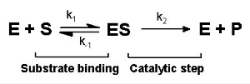
Michaelis–Menten equation

Slide 90
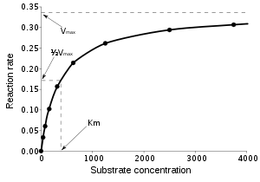

Slide 91
Michaelis constants have been determined for many of the commonly used enzymes. The size of Km tells us several things about a particular enzyme.
A small Km indicates that the enzyme requires only a small amount of substrate to become saturated. Hence, the maximum velocity is reached at relatively low substrate concentrations.

Slide 92
A large Km indicates the need for high substrate concentrations to achieve maximum reaction velocity.
The substrate with the lowest Km upon which the enzyme acts as a catalyst is frequently assumed to be enzyme's natural substrate, though this is not true for all enzymes.

Slide 93
3.Effects of Inhibitors on Enzyme Activity
Enzyme inhibitors are substances which alter the catalytic action of the enzyme and consequently slow down, or in some cases, stop catalysis.
There are three common types of enzyme inhibition - competitive, non-competitive and un-competitive.

Slide 94
Most theories concerning inhibition mechanisms are based on the existence of the enzyme-substrate complex ES.
As mentioned earlier, the existence of temporary ES structures has been verified in the laboratory.

Slide 95
Competitive inhibition occurs when the substrate and a substance resembling the substrate are both added to the enzyme.
A theory called the "lock-key theory" of enzyme catalysts can be used to explain why inhibition occurs.

Slide 96
Non-competitive inhibitors are considered to be substances which when added to the enzyme alter the enzyme in a way that it cannot accept the substrate.

Slide 97
4.Temperature Effects
The reaction rate increases with temperature to a temperature, pH, enzyme concentration, substrate concentration, and the presence of any inhibitors or activators until
maximum level, then abruptly declines with further increase of temperature. Because most animal enzymes rapidly become denatured at temperatures above 40°C, most enzyme determinations are carried out somewhat below that temperature.

Slide 98
Over a period of time, enzymes will be deactivated at even moderate temperatures. Storage of enzymes at 5°C or below is generally the most suitable.
Some enzymes lose their activity when frozen.

Slide 99
5. Effects of pH
Enzymes are affected by changes in pH. The most favorable pH value - the point where the enzyme is most active - is known as the optimum pH.
Extremely high or low pH values generally result in complete loss of activity for most enzymes. pH is also a factor in the stability of enzymes.
As with activity, for each enzyme there is also a region of pH optimal stability.

Slide 100
The optimum pH value will vary greatly from one enzyme to another

Slide 101
pH for Optimum Activity
Enzyme pH Optimum
Lipase (pancreas) 8.0
Lipase (stomach) 4.0 - 5.0
Lipase (castor oil) 4.7
Pepsin 1.5 - 1.6
Trypsin 7.8 - 8.7
Urease 7.0
Invertase 4.5
Maltase 6.1 - 6.8
Amylase (pancreas) 6.7 - 7.0
Amylase (malt) 4.6 - 5.2
Catalase 7.0

Slide 102
In addition to temperature and pH there are other factors, such as ionic strength, which can affect the enzymatic reaction.
Each of these physical and chemical parameters must be considered and optimized in order for an enzymatic reaction to be accurate and reproducible.

Slide 103
Enzyme Kinetics
The study of the rate at which an enzyme works is called enzyme kinetics.
Let us examine enzyme kinetics as a function of the concentration of substrate available to the enzyme.

Slide 104
At time zero, we add a fixed amount of the enzyme preparation. Over the next few minutes, we measure the concentration of product formed.
If the product absorbs light, we can easily do this in a spectrophotometer.
Early in the run, when the amount of substrate is in substantial excess to the amount of enzyme, the rate we observe is the initial velocity of V_{i}.

Slide 105
Plotting V_{i} as a function of [S]

Slide 106
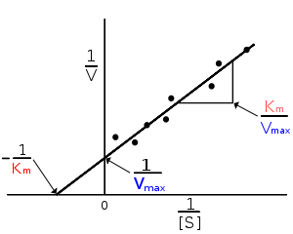
"double-reciprocal" or Lineweaver-Burk plot.

Slide 107
At low values of [S], the initial velocity,V_{i}, rises almost linearly with increasing [S].
But as [S] increases, the gains in V_{i} level off (forming a rectangular hyperbola).
The asymptote represents the maximum velocity of the reaction, designated V_{max}
The substrate concentration that produces a V_{i} that is one-half of V_{max} is designated the Michaelis-Menten constant, K_{m}(named after the scientists who developed the study of enzyme kinetics).

Slide 108
Michaelis–Menten equation

Slide 109
The Michaelis-Menten kinetic model of a single-substrate reaction is shown in the previous slide.
There is an initial bimolecular reaction between the enzyme E and substrate S to form the enzyme–substrate complex ES.
Although the enzymatic mechanism for the unimolecular reaction can be quite complex
Michaelis-Menten equation is the basis for most single-substrate enzyme kinetics.

Slide 110

Michaelis-Menten equation

Slide 111

constants

Slide 112
K_{m} is (roughly) an inverse measure of the affinity or strength of binding between the enzyme and its substrate.
The lower the K_{m}, the greater the affinity (so the lower the concentration of substrate needed to achieve a given rate).

Slide 113
Plotting the reciprocals of the same data points yields a "double-reciprocal" or Lineweaver-Burk plot.
This provides a more precise way to determine V_{max} and K_{m}.

Slide 114
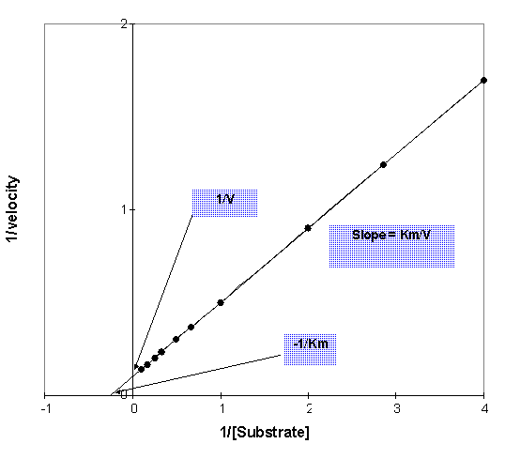
"double-reciprocal" or Lineweaver-Burk plot.

Slide 115
ENZYMES
Inhibitors

Slide 116
Kinetics of Enzyme Inhibitors
One of the important uses of kinetic analysis is the study of enzyme inhibitors.
Inhibitors are compounds which interact with an enzyme to slow down its rate of reaction.

Slide 117
They may occur naturally in cells, where they might be used for controlling metabolic reaction rates, or artificially, where they might be used as experimental tools in the study of enzyme reactions.

Slide 118
Many toxic compounds are enzyme inhibitors, being toxic because they inhibit enzymes responsible for vital reactions.
Some of these toxic inhibitors are specific for individual organisms, or groups of organisms, and can be used as antibiotics, pesticides, herbicides, and so on.

Slide 119
Inhibitors can interact with an enzyme in different ways and enzyme kinetics is a major tool in distinguishing between these mechanisms.

Slide 120
Reversible Enzyme Inhibitors:
Enzyme inhibitors can be used to stop a catalytic reaction.
Many drugs, like the anticancer drug methotrexate work by resembling a substrate/coenzyme structure like dihydrofolate and competitively inhibit key metabolic enzymes like dihydrofolate reductase.
Reversible inhibitors undergo a rapid association-dissociation with enzymes.
Inhibitors prevent binding of substrate to enzyme.

Slide 121
Reversible and Irreversible Inhibitors
Reversible inhibitors bind to the enzyme using weak bonds, similar to those used in binding the substrate. These bonds are formed rapidly, but also break easily.
In consequence reversible inhibitors are effectively instantaneous in their action, but do not permanently disable the enzyme.
The inhibitor comes to an equilibrium with the enzyme, to form an enzyme-inhibitor complex:

Slide 122
Irreversible inhibitors are also known as enzyme inactivators.
They combine with the enzyme by forming a strong, usually covalent bond:

Slide 123
Since the reaction is more or less irreversible, the enzyme is effectively permanently disabled.
Unlike reversible inhibitors these inactivators take some time to react with the enzyme as covalent bonds are slower to form.
Consequently irreversible inhibitors usually display time dependency, the degree of inhibition increasing with the time with which the enzyme is in contact with the enzyme.

Slide 124
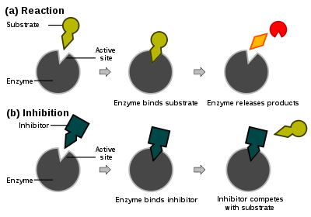

Slide 125
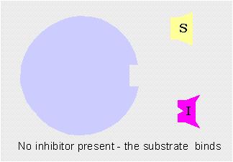
Competitive Inhibitors

Slide 126
Competitive inhibitor
A Competitive inhibitor competes with substrate for enzyme (forms an enzyme-inhibitor complex) as shown in the mechanism.
These inhibitor drugs resemble the structure of the substrate for this enzyme.
The apparent KM is altered by inhibitor but inhibition can be overcome by increasing [S].
Hence, at saturating [S] the Vmax is unaltered in presence of inhibitor.

Slide 127
a competitive inhibitor is a compound which bears a close structural and chemical similarity to the substrate of the enzyme.
the inhibitor binds to the active site in place of the substrate - a sort of molecular mistake
because the substrate and inhibitor are not identical the enzyme is unable to convert the inhibitor into product.

Slide 128
The inhibitor simply blocks the active site. While it's there the substrate can't enter and consequently the enzyme can't convert it to product.
Similarly, though, if the substrate binds to the active site before the inhibitor, the inhibitor is incapable of binding.
The two are said to be mutually exclusive

Slide 129
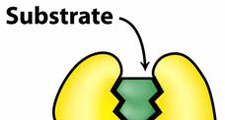
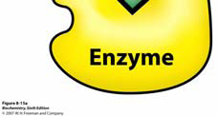

Slide 130
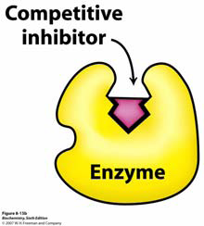

Slide 131
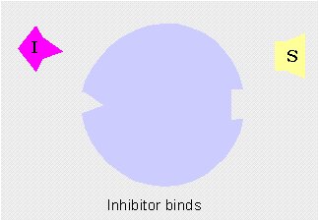
Competitive inhibition by conformational change

Slide 132
Simple substrate complex or inhibitor
E + S = ES
E + I = EI
Tertiary enzyme reaction
EI + S ≠ EIS
ES + I = EIS

Slide 133
Competitive inhibitor

Slide 134
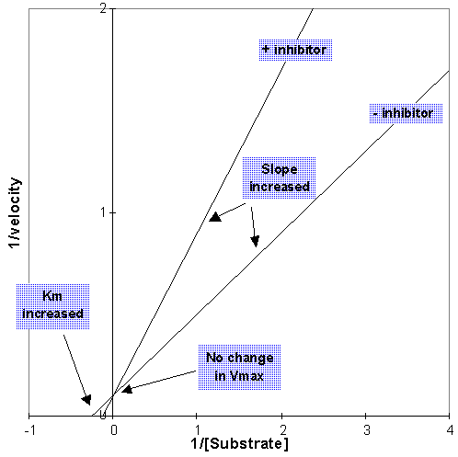
Kinetics of Competitive Inhibitors

Slide 135
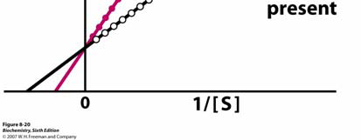
Competitive inhibitor

Slide 136
Effects on K_{m &} V_{max}
A competitive inhibitor reduces enzyme-substrate affinity, or increases K_{m}.
Competitive inhibitors do not slow the reaction at high substrate concentrations and there is no change in V_{max}.

Slide 137
The efficiency of an enzyme inhibitor is evaluated by kinetic assays. The effect of different [I] inhibitor concentrations on initial velocity at different [S] is examined as shown in the saturation plot below.
In a reciprocal plot, the line for no inhibitor and that with competitive inhibitor intersect on the 1/V axis.

Slide 138
Non-competitive inhibitor
A non-competitive inhibitor forms both enzyme-inhibitor and enzyme-substrate-inhibitor complexes as shown in the mechanism below.
Both Vmax and apparent KM are affected.
Inhibition cannot be overcome with increasing [S].
In reciprocal plot, the lines intersect on the 1/[S] axis.

Slide 139
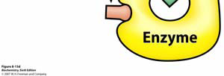
Non competitive inhibitor

Slide 140
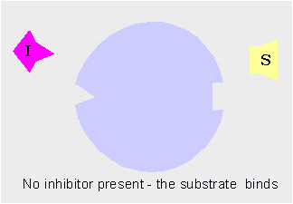
Noncompetitive/Mixed Inhibitors

Slide 141
Non-competitive inhibitor

Slide 142
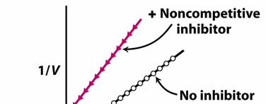
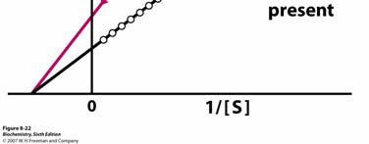
Noncompetitive inhibition

Slide 143
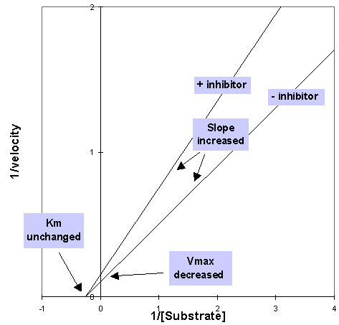

Slide 144
A noncompetitive inhibitor binds to an inhibitor site on the enzyme which is remote from the active site and brings about a conformational change in the active site.
In this sense it's very similar to one of the competitive inhibitor types.

Slide 145
The difference is that this time the change in the active site is such that it does not prevent substrate binding but, rather, prevents the enzyme from converting the bound substrate to product.

Slide 146
Simple enzyme complex
E + S = ES
E + I = EI
Tertiary enzyme complex
EI + S = EIS
ES + I = EIS

Slide 147
Effects on K_{m &} V_{max}
A classical noncompetitive inhibitor has no effect whatsoever on substrate binding so the enzyme-substrate affinity, and hence the K_{m}, are unchanged.
Noncompetitive, of both the classical and mixed varieties, inhibit at high substrate concentrations so the V_{max} is decreased.

Slide 148
Uncompetitive inhibitor
An uncompetitive inhibitor combines with ES to form a non-reactive ESI complex.
Vmax is decreased by inhibitor but apparent KM is unaltered.
Inhibition cannot be overcome with increasing [S]. In reciprocal plot, the lines are parallel.

Slide 149

Uncompetitive

Slide 150
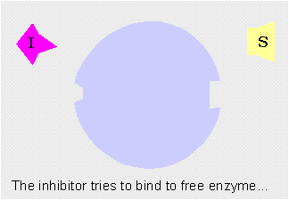
Uncompetitive Inhibitors

Slide 151
Probably the main claim to fame of uncompetitive inhibitors is the frequent confusion of names between them and non-competitive inhibitors!

Slide 152
The key feature of these inhibitors is they are incapable of binding to free enzyme.
They can only bind to the enzyme-substrate complex.
This could be because the substrate is itself directly involved in binding the inhibitor or because it brings about a conformational change in an inhibitor binding site which was previously incapable of binding the inhibitor.

Slide 153
Once the inhibitor has bound it prevents the enzyme from turning the substrate into product. Again this could be some kind of direct interaction, or due to a change in conformation of the active site.

Slide 154
E + S = ES
ES + I = EIS
E + I ≠ EI

Slide 155
Uncompetitive inhibitor

Slide 156
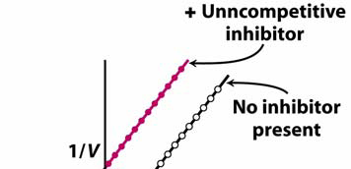
Uncompetitive inhibitor

Slide 157
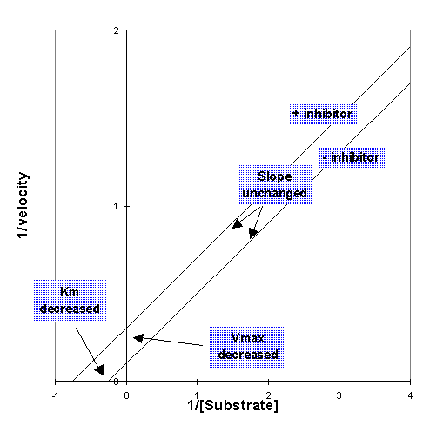

Slide 158
Effects on K_{m &} V_{max}
a decrease in K_{m}.
decreases V_{max}.

Slide 159
Uncompetitive and non-competitive inhibition vs. competitive inhibition are preferred in drug design because inhibition cannot be fully overcome by increasing [S].

Slide 160
Irreversible Enzyme Inhibitors
Irreversible enzyme inhibitors modify functional groups in enzyme active sites to inhibit activity. Penicillin is an irreversible enzyme inhibitor that works very effectively by covalently modifying a bacterial glycopeptide transpepidase necessary for cell wall crosslinking of D-Ala to Gly residues.

Slide 161
This is an important step in synthesis of bacterial cell walls (peptidoglycan structures).
The enzyme mechanism involves the formation of an acyl-group.

Slide 162
CATALYSIS- mechanisms of enzyme action.
Facilitated by the presence of an active site.
  Three dimensional
  Shields substrates from the solvent
  Substrates bind to the active site at a specific region. This simultaneously aligns the functional group of the substrate ( usually the peptidyl aminoacyl residues) in position for the chemical reaction or change.

Slide 163
Catalysis-cont’d
The active site also binds and orients cofactors or prosthetic groups
Active site is 3-dimensional in structure due to amino acyl residues from diverse portions of the polypeptide chain.

Slide 164
Mechanisms of catalysis
Catalysis by proximity: the higher the substrate concentration, the more frequently the chances of the substrate and enzyme to meet and the greater the rate of reaction.
Acid-base catalysis: Depends on the acidic or basic nature of the ionisable functional group of the amino acyl side chain or prosthetic groups.

Slide 165
  Specific acid or base catalysis-depends on conc. Of proton donors or acceptors irrespective of substrate concentration
  General acid or base catalysis- depend on all acids or bases present

Slide 166
Catalysis by strain: Strain that causes stretching or distortion of the bond targeted by the enzyme. This weakening of the bond makes it vulnerable to cleavage or breakage during catalysis (Koshland’s induced fit model)
Covalent catalysis: Involves formation of a covalent bond between the enzyme and one or more substrates.

Slide 167
  The modified enzyme reacts during the process of catalysis. Covalent bonding facilitates the reaction pathway.
  At the completion of the rexn, the bond is brocken and the enzyme returns to its original unmodified state.
  Common in enzymes catalysing group transfer rexns e.g groups containing cysteine, serine and occassionaly histidine.
  Also reffered to as ping-pong mechanism

Slide 168
Ping-pong- first substrate binds and its product released before second substrate binds.e.g Chymotrypsin, Fructose-2,6-bisphosphatase.

Slide 169
Enzyme catalysis
It is the catalysis of chemical reactions by specialized proteins known as enzymes.

Slide 170
1.Induced fit
The initial interaction between enzyme and substrate is relatively weak, but that these weak interactions rapidly induce conformational changes in the enzyme that strengthen binding.

Slide 171
2. Catalysis by bond strain
This is the principal effect of induced fit binding, where the affinity of the enzyme to the transition state is greater than to the substrate itself.
This induces structural rearrangements which strain substrate bonds into a position closer to the conformation of the transition state, so lowering the energy difference between the substrate and transition state and helping catalyze the reaction.

Slide 172
3. Catalysis by proximity and orientation
This increases the rate of the reaction as enzyme-substrate interactions align reactive chemical groups and hold them close together.
This reduces the entropy of the reactants and thus makes reactions such as ligations or addition reactions more favorable, there is a reduction in the overall loss of entropy when two reactants become a single product.
Analogous to an effective increase in concentration of the reagents.

Slide 173
4. Acid/Base Catalysis
Proton donors and acceptors, i.e. acids and bases, may donate and accept protons in order to stabilize developing charges in the transition state.

Slide 174
5. Electrostatic catalysis
Involves formation of ionic bonds.
These bonds can either come from acidic or basic side chains found on amino acids such as lysine, arginine, aspartic acid or glutamic acid or come from metal cofactors such as zinc.
Metal ions are particularly effective and can reduce the pKa of water enough to make it an effective nucleophile.

Slide 175
6. Covalent catalysis
Involves a substrate forming a transient covalent bond with residues in the active site or with a cofactor. This adds an additional covalent intermediate to the reaction, and helps to reduce the energy of later transition states of the reaction.
The covalent bond must, at a later stage in the reaction, be broken to regenerate the enzyme.

Slide 176
This mechanism is found in enzymes such as proteases like chymotrypsin and trypsin, where an acyl-enzyme intermediate is formed.
Schiff base formation using the free amine from a lysine residue is another mechanism, as seen in the enzyme aldolase during glycolysis.

Slide 177
Conclusion.
Most enzyme mechanisms involve a combination of several different types of catalysis.

Slide 179
FAT SOLUBLE VITAMINS
A,D,E,K

Slide 180
Fat soluble vitamins
(Lipid-soluble, apolar, hydrophobic)
Derivitives of isoprene molecule
Cannot be synthesised by the body in adequate amounts – must be supplied from diet
Absorbed efficiently when normal fat absorption is taking place.
Once in blood, transported to destination like other lipids.

Slide 181

Isoprene structure

Slide 182
Functions of fat soluble vitamins
Vit A-useful for good vision
Vit D- useful for calcium and phosphate metabolism in the body
Vit E- useful as an antioxidant
Vit K- useful for blood clotting

Slide 183
VITAMINS- Defn.
A group of organic nutrients required in small quantities for a variety of biochemical functions.
Cannot generally be synthesised in the body
Must be supplied from diet.

Slide 184
Biomedical(clinical) importance
Vit A- deficiency leads to night blindness and xerophthalmia
Vit D- deficiency leads to rickets in young children and osteomalacia(loss of bone mass) in adults
Vit E- deficiency (very rare) leads to neurologic disorders and anaemia especially in newborn.
Vit K- Deficiency (rare) leads to bleeding and hamorrhage in new born

Slide 185
Vitamin A
Structure- Cyclohexenyl ring
- Isoprenoid compound
-Stored as retinol esters in the liver
-Other derivatives of retinol are
-retinal
-retinoic acid
-Retinoids are both natural and synthetic analogs of retinol e.g.
- retinaldehyde

Slide 186
Vitamin A-cont’d
B- Carotene
  -provitamin form of vitamin A.
  2 molecules of retinal joined at aldehyde end of their carbon chains.
          B-Carotene
          Retinol + Retinaldehyde
          All-trans-retinoic acid + 9-cis-retinoic acid

Slide 187
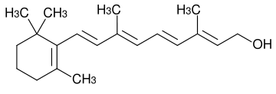

Slide 188
Vitamin D
Not strictly a vitamin but considered a hormone. Because it can be synthesised in the skin. This is its major source.
Only when sunlight is inadequate is dietary source required.

Slide 189
Vitamin D- functions
Regulation of calcium absorption and homeostasis.
Actions mediated by way of nuclear receptors that regulate gene expression

Slide 190
Vit D- Deficiency
Rickets in children
Osteomalacia in adults.

Slide 191
Vitamin D- Synthesis
Occurs in the skin
A)7-Dehydrocholesterol b) pre-vitamin D
c)Cholecalciferol d) Calcidiol(25-hydroxy cholecalciferol)
e)Calcitriol (1,25-hydroxycholecalciferol)
f)(24-hydroxycalcidiol-inactive)
g)Calcitetetrol-(active)

Slide 192

7-dehydrocholesterol to pre vit D₃
_{(Liver)}

Slide 193
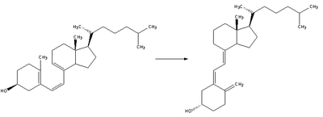
Pre vit D₃ to vit D₃ (isomerization)

Slide 194
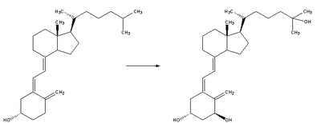
Vit D₃ to 25-hydroxycholecalceferol (calciol)

Slide 195
Kidney
Calcidiol ----- 24-hydroxycalcidiol (inactive)
Calcitriol ------ Calcitetetrol (Active)

Slide 196
Vitamin D-regulation
Regulated by calcium homeostasis i.e. vit. D metabolism is regulated by factors that respond to plasma concentrations of calcium and phosphate
Deficiency- i. Rickets in children ii. Osteomalacia in adults.

Slide 197
Vitamin E.
Does not have any defined metabolic function.
But acts as a lipid soluble anti-oxidant in cell membrane.
Two classes occur: i. Tocopherols ii. Tocotrienols
Structure:
2 hexyl rings and isoprenoid compound. The compound has three double bonds in Tocotrienols.

Slide 198

Tocopherol

Slide 199
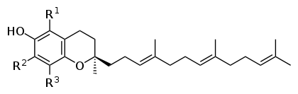
Tocotrienol

Slide 200
Vit E, Cont’d
1.Alpha-tocopherol and tocotrienol
R1 & R2 are all-CH3 groups
2. In Beta tocopherol R2 is –H group
3. In gama tocopherol R1 is –H group
4. In delta tocopherol R1 &R2 are both –H group.
D-alpha tocopherol is the most active vitaminer with biologic activity.

Slide 201
Vitamin E-functions
Chain breaking, free radical trapping antioxidant in cell membranes and plasma lipoproteins.

Slide 202
Vitamin E is one of the most important and efficient antioxidants for the human body.
The cells in a human body are constantly being bombarded by free radicals generated through metabolism and exposure to the sun’s rays, environmental pollution, cigarette smoke and chemicals.
Antioxidants neutralize these free radicals and limit the damage to healthy body cells.

Slide 203
A new study (2014) casts doubt on the theory that oxidative stress shortens lifespan.
Researchers have identified mutations in 10 different genes of worms (genes believed to have counterparts in humans) that extend their lifespan without reducing the level of oxidative stress the worms suffer.

Slide 204
The results contradict the popular theory that production of toxic reactive oxygen species in tissues is responsible for aging.

Slide 205
Currently, the most common form of Vitamin E available in health supplements is alpha-tocopherol.
However, alpha-tocotrienol is 40-60 times more potent than alpha-tocopherol as an antioxidant.

Slide 206
Deficiency:
Unknown in humans but can occur due to malarbsorption resulting from various illnesses such as cystic fibrosis.

Slide 207
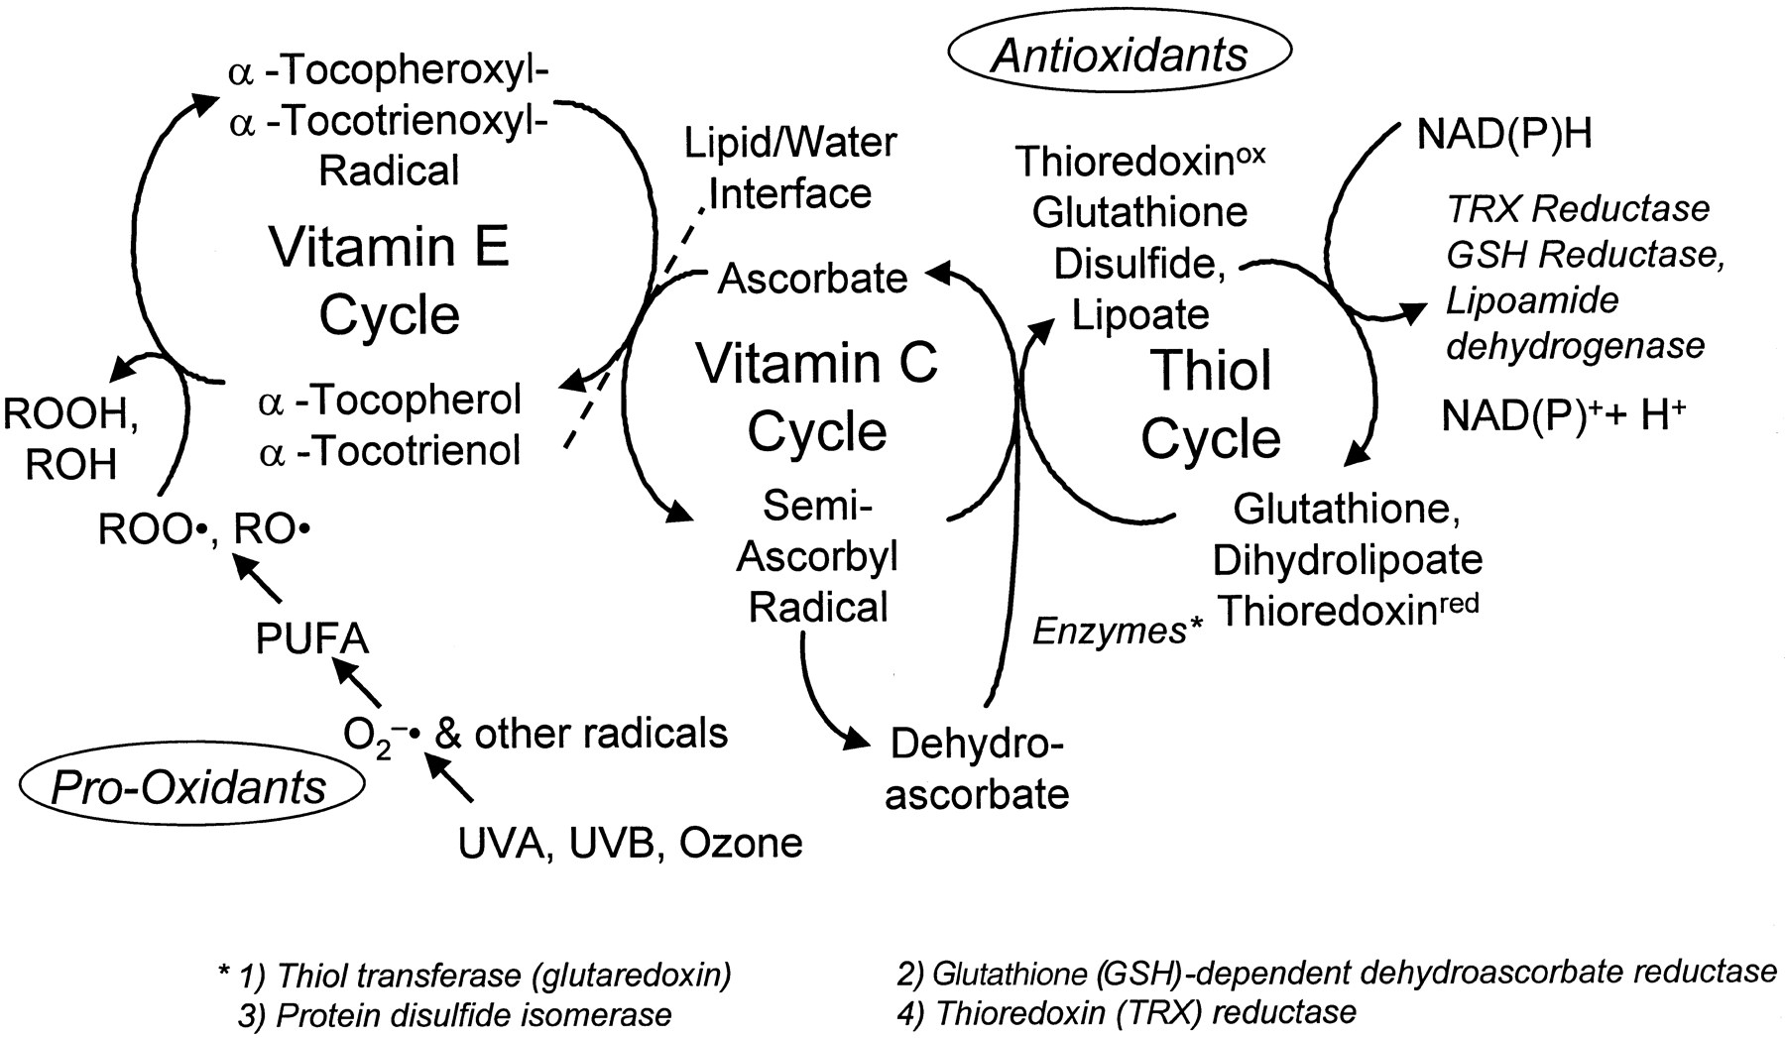

Slide 208
Vitamin K
Structure:
Three compounds with biologic activity of Vit. K.
i. Phylloquinone(normal- green vegetables)
2-Hexyl rings and isoprenoid tail of N=3 length
ii. Menaquinones (intestinal flora)
2-Hexyl rings with N=infinity isoprenoid chain.

Slide 209
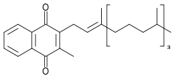
Phylloquinone

Slide 210
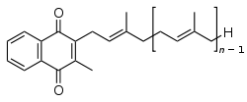
Menaquinone

Slide 211
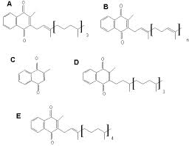
Phylloquinone, Menoquinone, Menadione,

Slide 212
Vit K, Cont’d
iii. Menadione (2-Hexyl rings), menadiol (2-hexyl rings) & menadiol acetate ( 2- hexyl rings with 2 acetate attached).
Functions:
Co- factor to carboxylase enzyme that acts on glutamate residues of clotting factor precursor proteins. This enables the proteins to chelate calcium.

Slide 213
Vitamin C (ascorbic acid)
Water soluble antioxidant whose function is to maintain Vit E and many metal cofactors in the reduced state.
Structure:
3 forms occur
i. Ascorbate
ii.Monodehydroascorbate
iii. Dehydroascorbate

Slide 214
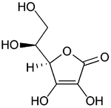
Ascorbic acid

Slide 215
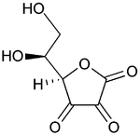
Dehydro-ascorbic acid

Slide 216
Vitamin C- deficiency
Causes scurvy.( skin changes, frigility of blood capillaries, gum decay, tooth loss and bone fructure) due to deficient collagen synthesis.
Evidence is unconvincing that high doses of vit C prevent common cold or reduce the duration of symptoms.

Slide 218
Water-Soluble Vitamins
Prof. A. Kwena

Slide 219
Water-soluble vitamins dissolve in water and are not stored in the body.
They are eliminated in urine. We need a continuous supply of them in our diets.
They are easily destroyed or washed out during food storage or preparation.
The water-soluble vitamins are the B-complex group and vitamin C.

Slide 220
The B-complex group is found in a variety of foods: cereal grains, meat, poultry, eggs, fish, milk, legumes and fresh vegetables.
Citrus fruits are good sources of vitamin C.
Use of megadoses of vitamins is not recommended.

Slide 221
Vitamin B-Complex
Eight of the water-soluble vitamins are known as the B-complex group:
Thiamin (vitamin B₁), riboflavin (vitamin B₂), niacin, vitamin B₆, folate, vitamin B₁₂, biotin and pantothenic acid.
These vitamins are widely distributed in foods.
Their influence is felt in many parts of the body.

Slide 222
They function as coenzymes that help the body obtain energy from food.
They also are important for normal appetite, good vision, healthy skin, healthy nervous system and red blood cell formation.

Slide 223
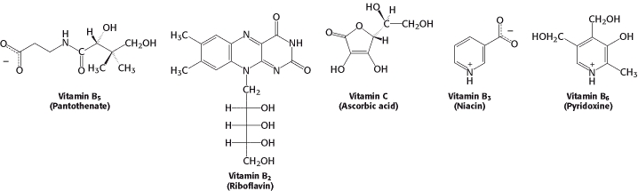
Structures

Slide 224



Thiamin (vitamin B₁ )

Slide 225


Thiamin : vitamin form
Pyrimidine ring
Thiazole ring
Thiamin pyrophosphate: coenzyme form

Slide 226
Major functions
Helps release energy from foods;
Promotes normal appetite;
Important in function of nervous system.

Slide 227
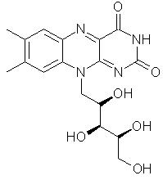
Riboflavin (vitamin B₂)

Slide 228
Major functions
Helps release energy from foods;
Promotes good vision, healthy skin.

Slide 229
Niacin (nicotinamide, nicotinic acid)-B3

Slide 230

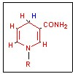
Nicotinic Acid (Plant form)
Nicotinamide (animal form)
(reduced form)

Slide 231
Major functions
Energy production from foods;
Aids digestion, promotes normal appetite;
Promotes healthy skin, nerves.

Slide 232
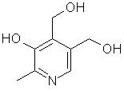
Vitamin B₆ (pyridoxine, pyridoxal, pyridoxamine)

Slide 233
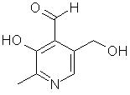
Pyridoxal

Slide 234
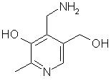
Pyridoxamine

Slide 235
Major functions
Aids in protein metabolism, absorption;
Aids in red blood cell formation;
Helps body use fats.

Slide 236
This is the coenzyme form of the vitamin. It is needed for: Metabolism of amino acids
Cellular metabolism of carbohydrate, protein and fat
Formation of neurotransmitters
Production of nicotinic acid (vitamin B3)

Slide 237
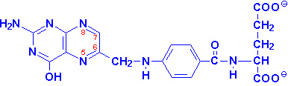
Folic Acid / Folacin
Structure
  pteridine ring - PABA - glutamate
Stability
  very sensitive to heat
  easily oxidized
  leached

Slide 238
Major functions
Aids in protein metabolism;
Promotes red blood cell formation;
Prevents birth defects of spine, brain;
Lowers homocystein levels and thus coronary heart disease risk.

Slide 239
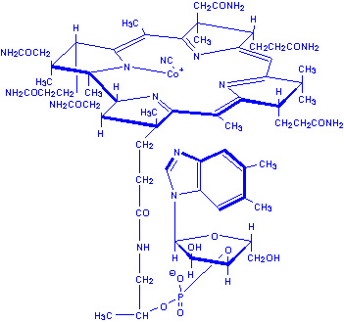
Vitamin B-12
Structure
cobalamine
methyl cobalamine
  transport and coenzyme form
adenosyl cobalamine
  storage and coenzyme form

Slide 240
Major functions
Aids in building of genetic material;
Aids in development of normal red blood cells;
Maintenance of nervous system.

Slide 241

Pantothenic acid (B-5)

Slide 242
Major functions
Involved in energy production;
Aids in formation of hormones.

Slide 243
As part of coenzyme A, panthothenic acid is essential for: Cellular metabolism
Production of:
  Sterols such as cholesterol
  Hormones
  Neurotransmitters (e.g. acetylcholine)
  Phospholipids
  Porphyrin (constituent of haemoglobin)
  Antibodies

Slide 244
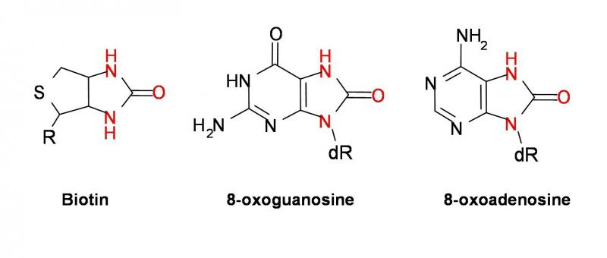
Biotin

Slide 245
Major functions
Helps release energy from carbohydrates;
Aids in fat synthesis.

Slide 246
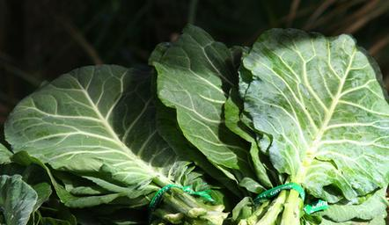
Vitamins in leafy greens help your body burn fat.

Slide 247
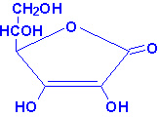
Vitamin C - Ascorbic Acid
Structure
Metabolism
  oxidation/reduction
  dehydroascorbic acid
  dehydroascorbate reductase
  glutathione (GSH)
    glutamate-cysteine-glycine

Slide 248
Major functions
Formation of collagen (a component of tissues), helps hold them together;
Wound healing;
Maintaining blood vessels, bones, teeth;
Absorption of iron, calcium, folacin;
Production of brain hormones, immune factors; antioxidant.

Slide 249
Other micronutrients-Trace elements
Trace metals are the metals subset of trace elements;
these are metals that are normally present in small but measurable amounts in animal and plant cells and tissues.

Slide 250
Some of these trace metals are a necessary part of nutrition and physiology.
Some biometals are trace metals. Ingestion of, or exposure to, excessive quantities can be toxic.
However, insufficient plasma or tissue levels of certain trace metals can cause pathology, as is the case with iron.

Slide 251
Examples of other micronutrients-Trace elements
L-carnitine-Niacin, vitamin B-6 and iron increase metabolism by assisting with the production of L-carnitine, an amino acid that promotes fat burning,

Slide 252
Coenzyme Q10- also known as CoQ10 or ubiquinone, is directly involved in the production of energy in the mitochondria of every cell in your body.
By making more oxygen available to muscle cells, CoQ10 can help increase the strength and efficiency of muscles.

Slide 253
This is particularly effective in heart muscle and enables people with heart conditions to exercise longer and burn more fat.

Slide 254
Creatine-a compound that muscles use to store energy, is widely used as an ergogenic aid to enhance athletic performance.
While creatine is a ready source of fuel for muscles, it is rapidly depleted and muscle cells can only store small amounts of creatine. This supplement, derived from animal products, is often found in low levels in vegetarians.

Slide 255
Iron-part of the hemoglobin molecule, carries oxygen to your muscles that enables them to burn fat.
Low iron levels lead to low energy levels and a lower metabolic rate.

Slide 256
Iron deficiency also reduces your aerobic capacity, physical endurance and athletic performance.
Iron-deficiency anemia is the most common nutritional deficiency in the United States.

Slide 257
others
The generally accepted trace elements are iron, chlorine, cobalt, copper, zinc, manganese.

