Slide 1

Overview of Cell Biology: History, Structures, Functions with Clinical Correlates
Prof. Innocent Edagha, PhD
Fulbright Fellow, New York University
Dept of Human Anatomy, MUSOM

Slide 2
LEARNING OBJECTIVES
Cell Type: History and origin. Prokaryotic and Eukaryotic cell. Difference between Prokaryotic and Eukaryotic cell.
Plasma Membrane: History, Ultra structure, and chemical composition of plasma membrane (Lamellar-models, micellar models and fluid mosaic model). Functions of plasma membrane .
Mitochondria: History and structure of mitochondria, biogenesis and functions of mitochondria (Respiratory chain complex and Electron transport mechanism).
Endoplasmic Reticulum, Ribosome, Golgi Bodies: History, structure, functions and importance.
Lysosomes, Centrioles, Microtubules: History, structure, functions and Importance.
Nucleus: History, structure, functions and importance.
Chromosomes: History, types and functions of chromosomes. Giant chromosomes, Polytene chromosome and Lampbrush chromosome.
Cell Division: Mitosis (cell cycle stages, cytokinesis) Meiosis (reproductive cycle stages, synoptonemal complex, recombination nodules). Comparison between meiosis and mitosis

Slide 3
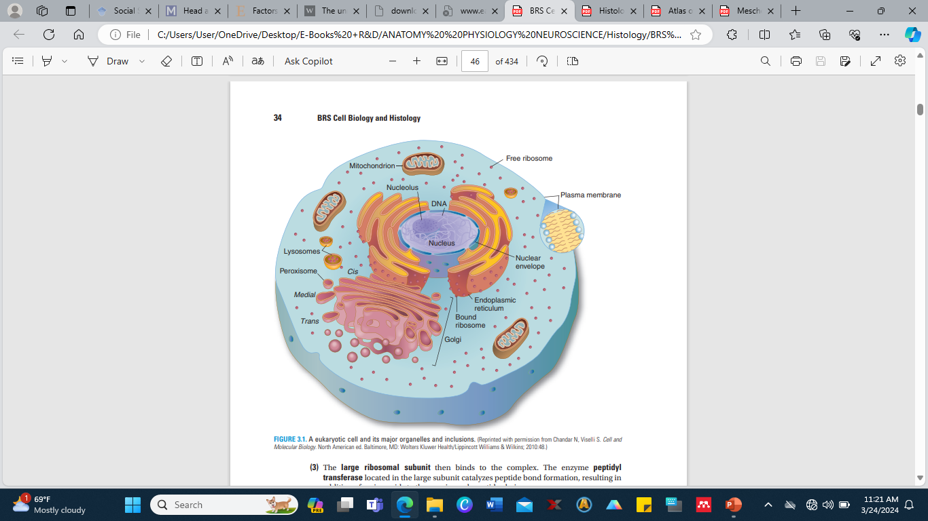
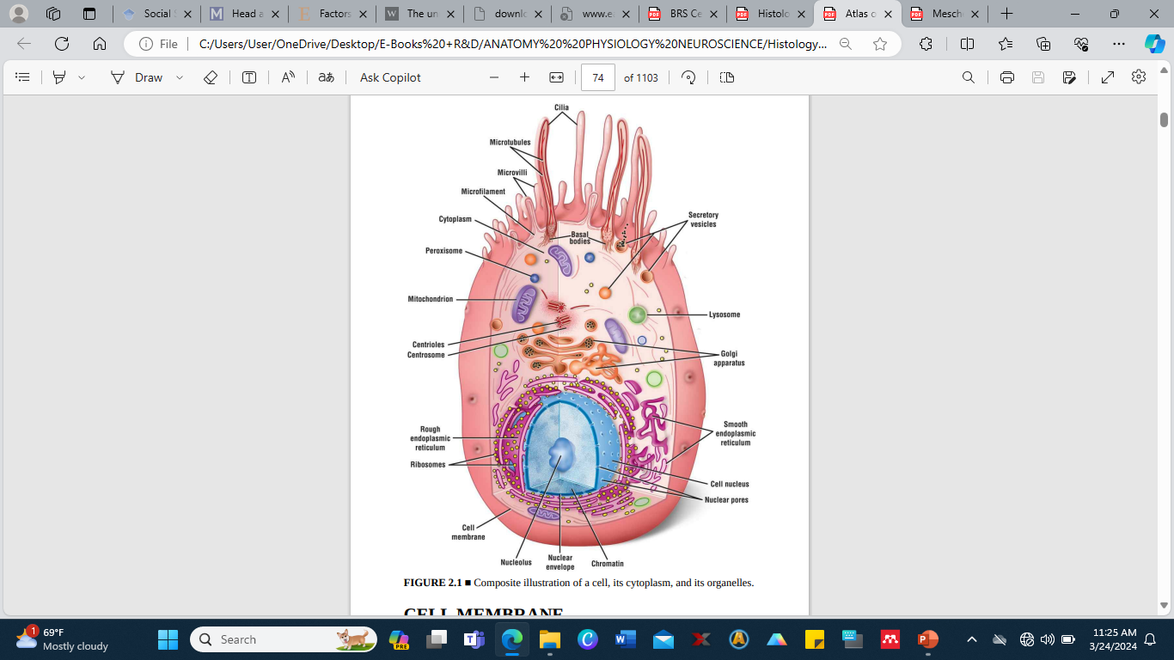
■ A eukaryotic cell and its major organelles and inclusions.
(Reprinted with permission from Chandar N, Viselli S. Cell and Molecular Biology. North American ed. Baltimore, MD: Wolters Kluwer Health/Lippincott Williams & Wilkins; 2010:48.)
■ Composite illustration of a cell, its cytoplasm, and its organelles

Slide 4
Cell is defined as the basic structural and functional unit of all living organisms. Cells are often referred to as the "building blocks of life."
They are enclosed by a membrane, which separates the internal contents of the cell from the external environment. Within the cell membrane, various organelles perform specific functions necessary for the cell's survival and replication.
Cells come in different shapes and sizes and can vary greatly in complexity depending on the organism and its specialized functions.
Despite these differences, all cells share some common features, such as genetic material (DNA or RNA), ribosomes for protein synthesis, and metabolic pathways for energy production.
There are two main types of cells: prokaryotic and eukaryotic.
Prokaryotic cells, found in bacteria and archaea, lack a distinct nucleus and other membrane-bound organelles.
Eukaryotic cells, found in plants, animals, fungi, and protists, have a defined nucleus containing the genetic material and membrane-bound organelles such as mitochondria, endoplasmic reticulum, and Golgi apparatus.

Slide 5
Biology is defined is the scientific study of life and living organisms.
It encompasses the exploration of a wide range of topics, including the structure, function, growth, evolution, distribution, and taxonomy of living organisms.
Biologists seek to understand the underlying mechanisms that govern life processes at various levels of organization, from molecules and cells to organisms, populations, ecosystems, and entire biospheres.
The field of biology is vast and diverse, encompassing numerous sub-disciplines such as genetics, microbiology, ecology, physiology, evolutionary biology, and many others.
Biologists use a variety of techniques and approaches, including experimentation, observation, mathematical modeling, and bioinformatics, to investigate and understand the complexities of life on Earth.
The knowledge gained from biological research has far-reaching applications in medicine, agriculture, environmental science, biotechnology, and numerous other fields, contributing to advancements that improve human health, food production, and the sustainability of ecosystems.

Slide 6
Introduction to Prokaryotic cell and Eukaryotic cell
A structure containing a mass of cytoplasm surrounded by semi-permeable membrane called plasma membrane is called a cell.
It encloses cytoplasm, many cell organelles along with nucleus or nuclear material.
On the basis of organization of membranes, variety and structure of cytoplasmic organelles and complexity of nuclear region, the cells are classified into two types: Prokaryotic cell and Eukaryotic cell.
These terms were suggested by Hans Ris in 1960s.

Slide 7
History and Origin of the Cell
A cell was defined as “unit of biological activity delimited by a semi permeable membrane and capable of self-reproduction in a medium free of other living systems” by Loewy and Siekevitz (1963). The study of cell has been made possible with the help of light microscope.
Robert Hooke (1665) with the help of light microscope discovered that a section of cork is made up of small cavities surrounded by firm walls. He used the term “cell” for the first time to describe his investigations on the “texture of a piece of cork”.
Later on A. Van Leeuwenhoek (1632-1723) observed various unicellular organisms and cells like bacteria, protozoan’s, red blood cells and sperm etc. He observed nucleus in some erythrocytes and all this was made possible with the improved microscopes. In 1809, Mirble M. stated that all plant tissues are composed of cells.
In the same year, importance of cells in living organisms was described by J.B. Lamarck.
Robert Brown in 1831 observed nucleus in certain plant cells.
Mimosa cells were boiled in nitric acid by Dutrochet (1837) to separate the cells to conclude that all organic tissues are composed of globular cells, united by simple adhesive forces.
“All living organism are composed of cells” was stated by Schwann, T. (1839) after examining a variety of animals and plant tissues.

Slide 8
BASIC COMPONENTS OF PROKARYOTIC AND EUKARYOTIC CELL
Prokaryotic Cells
Are the most primitive cells and have simple structural organization. It has a single membrane system. They include bacteria, viruses, blue-green algae, mycoplasmas, rickettsias, spirochetes etc. Cyanobacteria or blue green algae are the largest and most complex prokaryote, in which photosynthesis of higher plants type have evolved.
Prokaryotes are included in the kingdom Monera and the super kingdom Prokaryota.
The Prokaryotes have the following characters:
1. The size of prokaryotic cells ranges between 1 to 10 µm. They occur in a variety of forms.
2. Prokaryotic cell consists of three main components: (I) Outer covering: It is composed of inner cell or plasma membrane, middle cell wall and outer slimy capsule.

Slide 9
a. Cell membrane: Cell membrane made up of lipids and proteins, is thin and flexible and controls the movement of molecules across the cell.
Respiratory enzymes are carried by it for energy releasing reactions.
Mesosomes, the in-folds of plasma membrane bears respiratory enzymes and these are considered analogous to mitochondria of eukaryotic cells.
Similarly, the pigments and enzymes molecules that absorb and convert the light into chemical energy in photosynthetic cells are also associated with the plasma membrane’s in-folds called photosynthetic lamella.
These lamellae are analogous to the chloroplast of eukaryotic cells.
Plasma membrane plays role in replication and division of nuclear material.
Since the in-folds remain continuous with the cell membrane, they are not considered as separate compartments.

Slide 10
Thus, prokaryotic cell is non-compartmentalized.
b. Cell wall : It is a rigid or semi-rigid non-living structure that surrounds the cell membrane and its thickness ranges between 1.5 to 100 µm.
Chemically it is composed of peptidoglycans.
Some bacteria such as mycoplasmas lack cell wall.
c. Slimy capsule: A gelatinous coat outside the cell wall is the slimy capsule.
It is composed of largely of polysaccharides and sometimes it may have polypeptides and other compounds also.
It protects the cell against desiccation, virus attacks, phagocytosis and antibiotics
(II) Cytoplasm: Prokaryotic cytoplasm contains proteins, lipids, glycogen and inorganic ions along with enzymes for biosynthetic reactions and ribosomes, tRNA and mRNA for protein synthesis.

Slide 11
Prokaryotic cytoplasm has some special features as follows:
a. It lacks cell organelles like endoplasmic reticulum, mitochondria, Golgi apparatus, Centrosomes, vacuoles, Lysosomes, microfilaments, intermediate filaments and microtubules.
b. The only cytoplasmic organelle found in prokaryotic cells is the ribosomes. They are smaller than eukaryotic ribosomes i.e., 70S and lie free in the cytoplasm. They form poly-ribosomes at the time of protein synthesis. They are the sites of protein synthesis.
c. Like eukaryotic cells, the cytoplasm of prokaryotic cell does not show streaming movement or cyclosis.
d. Gas vacuoles are also formed in some prokaryotic cells.
e. The cell does not show phagocytosis, pinocytosis and exocytose, substances enter and leave the cell through the cell membrane.
f. They may contain deposits of polysaccharides or inorganic phosphates.
(III) Nucleoid: Nuclear envelope is absent in prokaryotic cell and the genetic material lies directly into the cytoplasm. Such nuclear material is known as nucleoid. Nucleoid consists of greatly coiled single pro-chromosome. It shows the following special features:

Slide 12
a. A short and simple pro-chromosome is present which is attached at least at one point on cell membrane.
b. Mostly there is single copy of chromosome, the prokaryotic cell is haploid.
c. The DNA is naked as it is not associated with basic histone proteins. It is double stranded, helical and circular.
d. The amount of DNA is lesser than eukaryotic cell and it codes fewer proteins. Replication of DNA is continuous throughout the cell cycle. Transcription and translation occurs in cytoplasm and processing of mRNA is not required.
e. The processes like meiosis, gamete formation or fertilization are absent. Conjugation is seen in some bacteria.
f. Mitotic apparatus absent.
g. There is no nucleolus.
h. Cell membrane folds or mesosomes help to segregate the replicated products of chromosomes into daughter cells.

Slide 13
3. Plasmids: In some prokaryotic cells, in addition to nucleoid, a small circular double stranded DNA molecule is present. It is called plasmid.
Plasmids have 1000 to 30,000 base pairs and they generally encode proteins required by the organism to resist antibiotic and other toxic material.
4. Flagellum: It is a whip like locomotory structure found in many bacteria. It is 150Å thick and 10 to 15µm long. As the flagellum does not have any surrounding membrane, it grows at the tip. It has two main parts: Filament and basal body.
(i) Filament- Filament extends out of cell into the medium and it is composed of many intertwined spiral chains of the subunits of a protein called flagellin. Flagellin differs from actins or tubulin.
(ii) Basal Body- The basal body attaches the flagellum to the cell and generates the force to rotate it. It is composed of many components and numerous proteins. It has two parts: shaft and hook.
5. Pili: These are short, rod like non-motile processes or fimbriae present on many bacteria. These are formed of pilin protein. They are usually less than 10 nm thick. They help in attachment of bacteria to surfaces or food or to one another.
Tubular sex Pili are present in some bacteria. Prokaryotic cells have all the biochemical mechanisms required to synthesize complex organic materials from simple organic precursors necessary for life. Thus, inspite of being simple in structure prokaryotes are more versatile in their synthetic activities than eukaryotes.

Slide 14
Eukaryotic Cells
The internal organization of eukaryotic cell is more developed than prokaryotic cells from which they are believed to have been evolved.
They are evolved to have double membrane system. Primary membranes are the one that surrounds the cell, celled cell or plasma membrane and the secondary membrane surround the nucleus and other cellular organelles. Eukaryotic cells occur in protists, fungi, plants and animals.
Eukaryotic cells have the following characteristics:
1. Number- In multicellular organisms the numbers of cells are correlated with the body size. The human blood contains about 30 quadrillion (3 × 10¹⁵) corpuscles and a 60 kg human being has about 60 × 1015 cells.
All multicellular organisms begin their life with a single cell “Zygote” and then become multicellular by its mitotic division during development.
2. Shape- A cell may be spherical, cuboidal, oval, disc-like, polygonal, columnar, spindle like or irregular. Thus, cells acquire a variety of shapes not only in various organisms but also in different tissues of the same organism.
The shape of cell is correlated with its functions like the shape of muscles and nerve cells are well adapted to their functions.
Many factors such as cell functions, age of cell, presence or absence of cell wall, viscosity of cytoplasm etc. are responsible for various shapes of cells.

Slide 15
3. Size- Most of the eukaryotic cells is microscopic and their size ranges between 10 to 100µm. Sporozoits of malaria parasite (Plasmodium vivax) is among the smallest cells having the size equal to 2µm long. While the Ostrich egg measures 175 × 120mm. Nerve cells are the longest having the size of its fiber to be of few meters long. Human cells generally range from 20 to 30µm.
4. Components of a cell- Three main components of the eukaryotic cells are cell membrane, cytoplasm and nucleus. The cytoplasm and the nucleus further have several components. Various cell components are discussed below:
(i) Cell membrane- Cell membrane, plasma membrane or plasmalemma is a thin elastic living covering that surrounds the cell keeping the cell contents in place, provides shape to the cell and controls the transfer of materials across it.
It is composed of lipid-protein complex. It lacks respiratory enzymes. In many protists and animal cells it allows endocytosis and exocytosis.
In certain protists, many fungi and all plant cells, the cell membrane is covered by a thick, rigid non-living cell wall that protects and supports the cell. In prokaryotes the cell wall surrounding the plasma membrane has a different structure in comparison to eukaryotes.

Slide 16
(ii) Cytoplasm- The cytoplasm or the cytosome is a semi-fluid, homogeneous, translucent ground substance known as cytoplasmic matrix or cytosol which is present between the cell membrane and the nucleus.
In the protozoan cell the outer firm layer of cytoplasm is called ectoplasm and the inner layer around the central fluid mass is called the endoplasm.
The cytosol shows “cyclosis” or the streaming movement. The eukaryotic cytoplasm has the following features:-
a. Organelles: The organized structures having the specific functions and capacity of growth and multiplication in some cases are known as organelles.
Mitochondria, centrosomes, Golgi bodies, plastids and vacuoles are the organelles that can be observed under light microscope, while endoplasmic reticulum, ribosome, microfilaments, microtubules, intermediate filaments and micro bodies can only be seen under electron microscope.
These organelles are often described as protoplasmic structures.
The cells having cilia or flagella have their basal bodies at the bases are in the cytoplasm while rest of its part extends out of cytoplasm. These organelles are described as follows:

Slide 17
I. Mitochondria: The rod like or globule shaped structures scattered in the cytoplasm are found singly or in groups. They are bounded by double membrane of lipoproteins.
The inner membrane gives out finger like structure known as cristae which partially subdivide the inner chamber of mitochondrion.
On the inner surface of cristae are present mushroom like structures, oxysomes that are related to phosphorylation. The space between the membranes and its lumen is filled with mitochondrial matrix. Both the membranes and the matrix contain many oxidative enzymes and coenzymes.
Since mitochondria contain DNA molecules and ribosomes, they synthesize certain proteins. They produce the energy and reserve it in the form of adenosine triphosphate (ATP). Due to the presence of its own DNA and ability of protein synthesis along with its duplication, the mitochondria are called semi autonomous organelle. The DNA of mitochondria resembles that of bacterial cell; hence it is also called as endo-symbiotic organelle.
II. Centrosomes: (9+0) there is a clear zone around centrioles, near the nucleus, that includes a specialized portion of cytoplasm, called centrospheres. Its matrix is called kinoplasm that bears two rounded bodies the “centrioles”.
Each centriole consists of nine fibrillar units and each of them is found to contain three microtubules arranged in a circle. Both the centrioles are arranged at right angle to each other.
Centrioles form the spindles of microtubules at the time of cell division. Centrioles are absent in plant cell and the spindle is formed without their help.

Slide 18
III. Golgi bodies: These are the stack of flattened parallel-arranged sacs and vesicles found in association of endoplasmic reticulum. They are composed of many lamellae, tubules, vesicles and vacuoles.
Their membranes are supposed to be originated from ER and are composed of lipoproteins.
In plant cells the Golgi complex is called dictyosome that secretes required materials for the formation of cell wall at the time of cell division.
It helps in the formation of acrosome of sperms, release of hormones, enzymes and other synthetic materials.
IV. Plastids: These organelles are found in plant cells and are absent in animal cells. They may be colored like chloroplast or chromoplasts or colorless like leucoplast.
Since the leucoplast store and metabolise the starch and lipids, they are called amyloplast and lipoplast respectively.
Chloroplast contains the green pigment the chlorophyll that helps in photosynthesis and protein storage.
Chloroplast has a double outer membrane, the stroma, that bears many soluble enzymes, and a complex system of membrane bound compartments called thalakoids constituting granna.
Like mitochondria, chloroplast also has their own DNA, ribosomes and complete protein synthetic machinery. Hence these are also called endo-symbiotic and semi-autonomous organelle.

Slide 19
V. Metaplasm: The particles like vacuoles, granules and other cytoplasmic bodies such as ribonucleoprotein molecules are represented by it.
VI. Cilia, basal bodies and flagella: Cilia are the minute structures covering the surface in some cells.
Both cilia and flagella originate from the basal bodies or blepharoplast lying in cytoplasm.
They consist of nine outer fibrils with the two larger fibrils in the centre. Each fibril consists of two microtubules, or has 9+2 arrangement.
Cilia and Flagella are the structure born by certain cells.
They are composed of microtubules made of the protein tubulin. They have 9 + 2 plan of microtubule.
Both grow at the base. They act as locomotory organelles, moves by their beats or undulations for they get the energy by breakdown of ATP molecule.

Slide 20
VII. Microtubules: The ultra fine tubules of protein (tubulin) traversing the cytoplasm of plant and animal cells providing the structural framework to the cell, determine the cell shape and general organization of the cytoplasm are known as microtubules.
Tubules are made up of 13 individual filaments. Microtubules help in transport of water and ions, cytoplasmic streaming (cyclosis) and the formation of spindles during cell division.
VIII. Basal granules: The spherical bodies found at the base of cilia and flagella are called the basal bodies. Each of them is composed of nine fibrils and each fibril consists of the three microtubules, out of which two enter the cilia or flagella.
IX. Ribosome’s: Ribosome is the minute spherical structures that originate in nucleolus and are found attached with the membrane of endoplasmic reticulum and in the cytoplasm.
They are mainly composed of ribonucleic acids (RNA) and protein. They are mainly responsible for protein synthesis.

Slide 21
b. Inclusions: These are the non-living or deutoplasmic structures which are incapable of growth and multiplication.
Common cell inclusions are stored organic materials such as starch grains, glycogen granules, aleuron grains, fat droplets, pigment granules and inorganic crystals.
Cytoplasm is stores raw materials needed for the metabolism in both the cytoplasm and the nucleus.
Many metabolic processes like biosynthesis of fatty acids, nucleotides, proteins and oxidation take place in cytoplasm. It distributes the nutrients, metabolites and enzymes in a cell and brings about exchange of materials between the organelles as well as with the environment or extracellular fluid also.
c. Nucleus: In a eukaryotic cell the genetic material is enclosed by a distinct nuclear envelope that forms a prominent spherical organelle the “Nucleus”.
The nuclear envelope bears pores for the exchange of materials between the cytoplasm and the nucleoplasm.

Slide 22
Differences between Prokaryotic Cells and Eukaryotic Cells
S/N. | Prokaryotic Cells | Eukaryotic Cells
1. | A prokaryotic cell is surrounded by a single membrane layer. | A eukaryotic cell is surrounded by a double membrane layer.
2. | In most cases the cell wall surrounds the plasma membrane and it is composed of carbohydrates, lipids proteins and certain amino acids. | Cell wall is present in protists, most fungi and plants and is composed of chitin in most fungi and or cellulose in others.
3. | Respiratory enzymes are present on cell membranes. | Absent on the cell membrane
4. | Thalakoids occurs free in cytoplasm. | They occur within the chloroplast
5. | Cytoplasm lacks organelles like centrosomes, endoplasmic reticulum, mitochondria, Golgi apparatus, microfilaments, intermediate filaments, microtubules and micro bodies. While ribosomes are present | All the cell organelles are present in the cell along with ribosomes.
6. | Gas vacuoles may occur while sap vacuoles are absent. | Sap vacuoles are commonly present.
7. | 70S ribosomes are present that lie free in cytoplasm or attached to mRNA. | 80S ribosome’s are present, either free or bound to ER and nuclear envelope or mRNA.

Slide 23
S/N. | Prokaryotic Cells | Eukaryotic Cells
8. | Endocytosis and exocytose do not occur. | These processes take place in many protists and in animals.
9. | Process of meiosis or gamete formation or true fertilization does not occur. | In these cells the process of meiosis, gamete formation and true fertilization occur in most cases of sexual reproduction.
10. | Cells are haploid. | Cells are diploid, while haploid cells also occur.
11. | Nuclear envelope is absent and nuclear material lie in cytoplasm and is called nucleoid. Nucleoid contains a single chromosome. | Nuclear envelope surrounds the nuclear material. The structure is called nucleus. It contains two to many chromosomes.
12. | Nucleolus absent. | One or more nucleoli are present within the nucleus.
13. | Circular DNA is present without associated proteins. | Nuclear DNA is linear and is associated with proteins, while extra nuclear DNA is present without proteins.
14. | Flagella if present are simple, consist of a single fibril and are formed of a protein flagellin. | Flagella, if present are complex, have 9+2 pattern of microtubules formed of a protein tubulin.
15. | Plasmids and pili occur in many prokaryotic cells. | These structures are absent.
16. | Most prokaryotes are asexual organisms. | Most of them are asexual organisms.

Slide 24
GLOSSARY
Cytoplasm: Gel like substance enclosed within the cell membrane excluding nucleus.
Plasma membrane: It is the biological membrane that separates the interior of the cell from the outside environment.
Prokaryote: The cell that lacks a distinct nucleus and other specialized membrane bound organelles.
Eukaryote: an organism whose cell contains a membrane bound distinct nucleus along with other specialized organelles enclosed in membranes.
Mesosome: The in-folding of plasma membrane in some bacterial cells that carry respiratory enzymes.
Poly-ribosome: It is a group of ribosomes associated with a single messenger RNA during the translation process.
Phagocytosis: The process by which a cell engulfs a solid particle to form an internal vesicle known as phagosome is called phagocytosis, also called eating of cell.
Pinocytosis: The process of intake of liquid into a cell by the budding of small vesicles from the cell membrane is called pinocytosis, also called drinking of cell.
Exocytosis: In the process of exocytosis materials are exported outside the cell by using energy from ATP molecules.
Conjugation: When the genetic material is transferred from one bacterial cell to other either by direct contact or by a bridge like connection between two cells is called conjugation.

Slide 25
Multiple Choice Questions:
1. There is no organized nucleus in: (a) Bacterial cell (b) Green algae cell (c) Animal cell (d) Plant cell
2. The prokaryotic cells are characterized by: (a) A distinct nuclear membrane (b) Absence of chromatin material (c) Distinct chromosome (d) Absence of nuclear membrane
3. In a prokaryotic cell, DNA is: (a) Enclosed by nuclear envelop (b) Lacking (c) Not a genetic material (d) without a membrane
4. Cell wall is found around the: (a) Prokaryotic cells (b) Algal cells (c) Plant cells (d) All the above
5. Chemical energy of food stuffs is converted into biologically useful forms by: (a) Ribosomes (b) Golgi complex (c) Mitochondria (d) Plastids
6. Sun radiant energy is converted into chemical energy of organic compound by: (a) Mitochondria (b) Chloroplast (c) Ribosomes (d) Centrosomes
7. Which structure is present only in animal cell? (a) Cell membrane (b) Lysosomes (c) Centrioles (d) Ribosomes
8. Single envelope system is characteristic of: (a) Prokaryotic cell (b) Eukaryotic cell (c) None (d) Both
9. Prokaryote and eukaryotes have the common: (a) Mitotic apparatus (b) Histone (c) Genetic code (d) Mitochondria
10. Unicellular microscopic organisms were first studied by: (a) Robert Hooke (b) Priestley (c) Pasteur (d) Leeuwenhoek

Slide 26
Overview – The Plasma Membrane (Plasmalemma; Cell Membrane)
A. Structure
Is approximately 7.5 nm thick and consists of two leaflets, known as the lipid bilayer that houses associated integral and peripheral proteins.
1. The inner leaflet of the plasma membrane faces the cytoplasm, and the outer leaflet faces the extracellular environment.
2. When examined by transmission electron microscopy, the plasma membrane displays a trilaminar (unit membrane) structure.
B. Function
1. It envelops the cell and maintains its structural and functional integrity.
2. It acts as a semipermeable membrane between the cytoplasm and the external environment.
3. It permits the cell to recognize macromolecules and other cells as well as to be recognized by other cells.
4. It participates in the transduction of extracellular signals into intracellular events.
5. It assists in controlling interaction between cells.
6. It maintains an electrical potential difference between the cytoplasmic and extracellular sides.

Slide 27
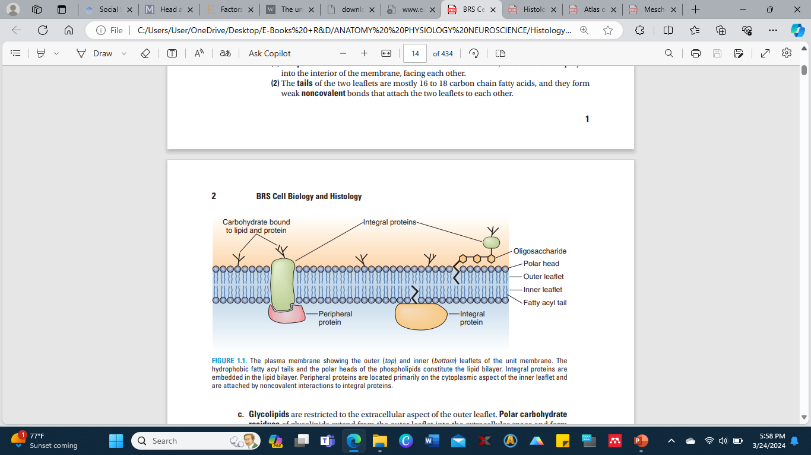
The plasma membrane showing the outer (top) and inner (bottom) leaflets of the unit membrane. The hydrophobic fatty acyl tails and the polar heads of the phospholipids constitute the lipid bilayer. Integral proteins are embedded in the lipid bilayer. Peripheral proteins are located primarily on the cytoplasmic aspect of the inner leaflet and are attached by noncovalent interactions to integral proteins.

Slide 28
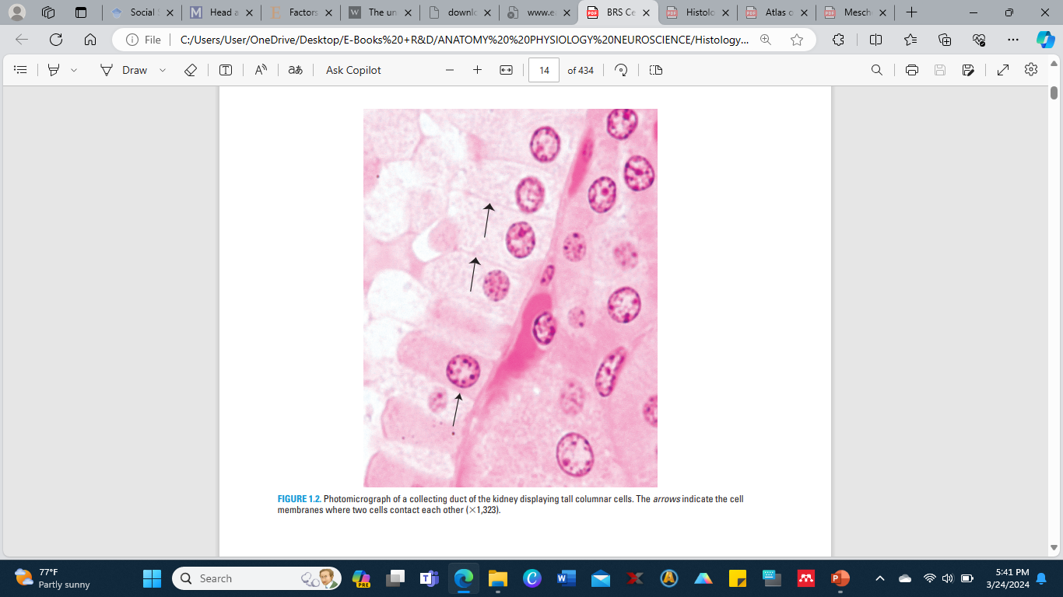
Photomicrograph of a collecting duct of the kidney displaying tall columnar cells. The arrows indicate the cell membranes where two cells contact each other (×1,323).

Slide 29
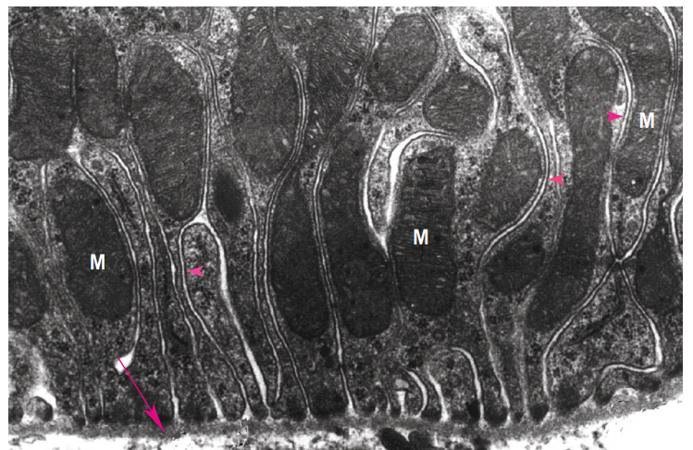
Transmission electron micrograph of the basal region of a columnar cell from a kidney-collecting tubule. The basal cell membrane forms numerous complex folds to increase its surface area. M, mitochondria; red arrowheads, plasmalemma; red arrow, basal lamina (×28,435).

Slide 30
II. FLUID MOSAIC MODEL OF THE PLASMA MEMBRANE
A. The lipid bilayer is freely permeable to small, lipid-soluble, nonpolar molecules but is impermeable to charged ions.
1. Molecular structure.
The lipid bilayer is composed of phospholipids, glycolipids, and cholesterol, of which, in most cells, phospholipids constitute the highest percentage.
a. Phospholipids are amphipathic molecules, consisting of one polar (hydrophilic) head and two nonpolar (hydrophobic) fatty acyl tails, one of which is usually unsaturated.
b. The two leaflets are not identical; instead the distribution of the various types of phospholipids is asymmetrical.
(1) The polar head of each molecule faces the membrane surface, whereas the tails project into the interior of the membrane, facing each other.
(2) The tails of the two leaflets are mostly 16 to 18 carbon chain fatty acids, and they form weak noncovalent bonds that attach the two leaflets to each other.

Slide 31
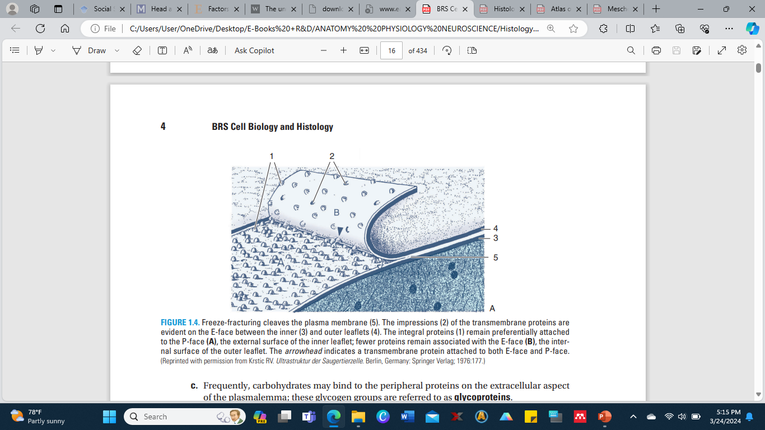
4. Freeze-fracturing cleaves the plasma membrane (5). The impressions (2) of the transmembrane proteins are evident on the E-face between the inner (3) and outer leaflets (4). The integral proteins (1) remain preferentially attached to the P-face (A), the external surface of the inner leaflet; fewer proteins remain associated with the E-face (B), the internal surface of the outer leaflet. The arrowhead indicates a transmembrane protein attached to both E-face and P-face. (Reprinted with permission from Krstic RV. Ultrastruktur der Saugertierzelle. Berlin, Germany: Springer Verlag; 1976:177.)

Slide 32
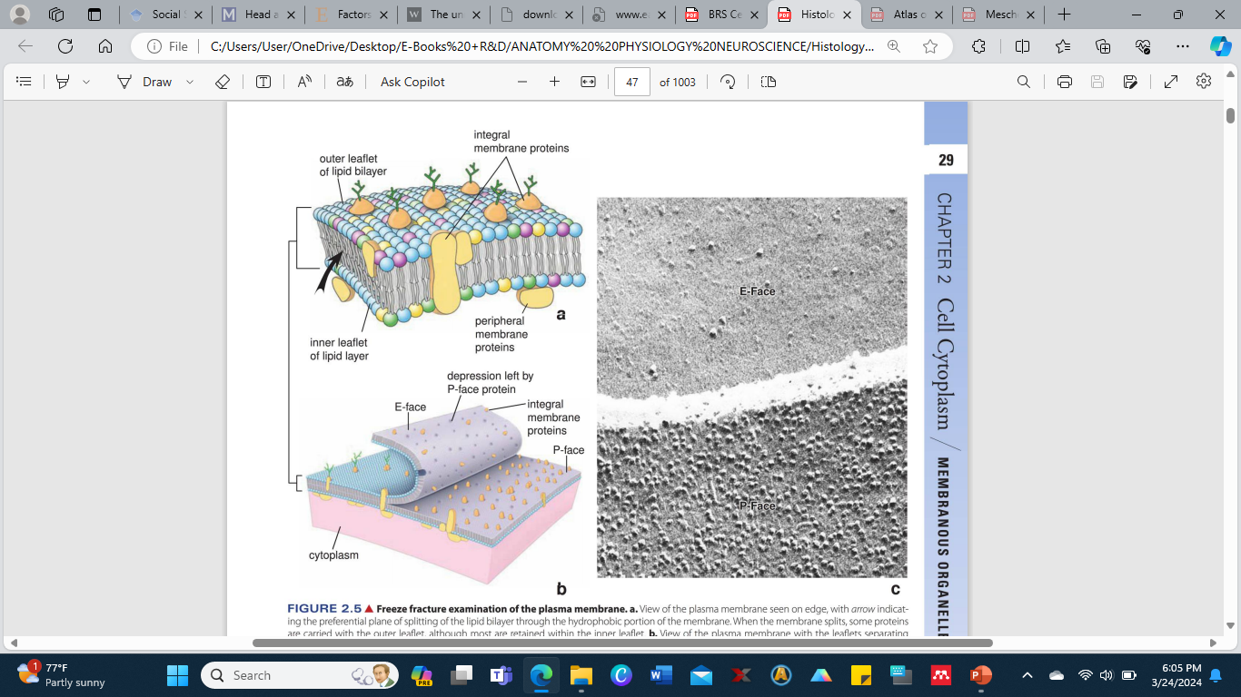
Freeze fracture examination of the plasma membrane. a. View of the plasma membrane seen on edge, with arrow indicating the preferential plane of splitting of the lipid bilayer through the hydrophobic portion of the membrane. When the membrane splits, some proteins are carried with the outer leaflet, although most are retained within the inner leaflet, b. View of the plasma membrane with the leaflets separating along the cleavage plane. The surfaces of the cleaved membrane are coated, forming replicas; the replicas are separated from the tissue and examined with the TEM. Proteins appear as bumps. The replica of the inner leaflet is called the P-face; it is backed by cytoplasm (protoplasm). A view of the outer leaflet is called the E-face-, it is backed by extracellular space, c. Electron micrograph of a freeze fracture replica shows the E-face of the membrane of one epithelial cell and the P-face of the membrane of the adjoining cell. The cleavage plane has jumped from the membrane of one cell to the membrane of the other cell, as indicated by the clear space (intercellular space) across the middle of the figure. Note the paucity of particles in the E-face compared with the P-face, from which the majority of the integral membrane proteins project. (Courtesy of Dr. Giuseppina d'Elia Raviola.)

Slide 33
Every cell, prokaryotic or eukaryotic, is surrounded by a thin layer of outermost boundary called the plasma membrane or cell membrane or plasma - lemma.
The plasma membrane is a discrete structure and is remarkably complex in its molecular organization.
It maintains the difference of the internal environment of the cell from its external environment by controlling the entrance and exit of the molecules and ions.
It checks the loss of metabolically useful substances and encourages the release of toxic metabolic byproducts of the cell.
Thus, it functions as semi-permeable or selectively permeable membrane. It is about 70-100Å in thickness. In plant cells plasma lemma is further covered by cellulosic cell wall.
It is an important cell organelle composed of lipids and proteins. It possesses devices for attachment to other cells for cell-to-cell communications, ion pumps for controlling internal milieu of the cell, receptors for hormones and mechanisms for the production of secondary messengers that activates the cell's physiological response.

Slide 34
History of the Plasma/Cell Membrane
It had been shown by Karl W. Nageli (1817-1891) that the cell membrane is semipermeable and is responsible for the osmotic and other related phenomena exhibited by living cells.
Before 1855, he used the term zellen membrane in his early papers.
The term plasma membrane was used in 1855 by him to describe the membrane as a firm protective film that is formed by out flowing cytoplasm of an injured cell when protein rich cell sap came in contact with water.

Slide 35
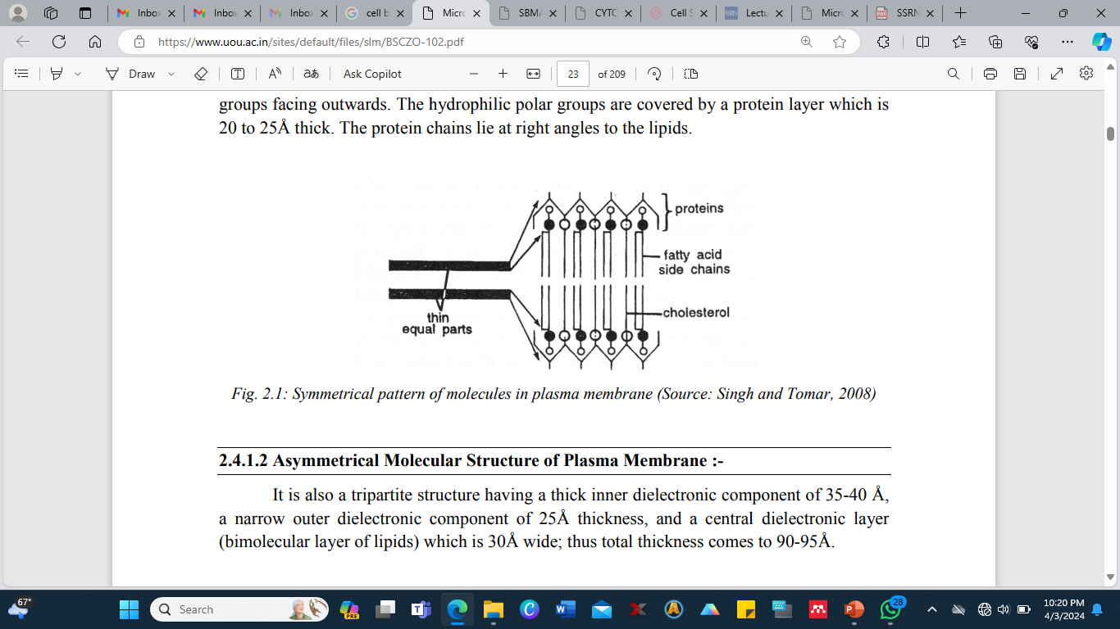
Symmetrical pattern of molecules in plasma membrane (Source: Singh and Tomar, 2008)

Slide 36
Chemical Composition of the Plasma membrane
Is primarily composed of protein and lipid, although carbohydrate is often present in association with protein (as glycoprotein) or lipid (as glycolipid).
However, the relative proportions of protein and lipid vary considerably in membranes from different sources.
Lipids The plasma membrane contains about 20 to 79% lipids mainly of three types like phospholipids, cholesterol and glycolipids.
The phospholipids which make up between 55% and 75% of the total lipid content, consists chiefly of lecithin and cephalin. The remainder consists of sphingolipids (with an amino group) and glycolipid conjugates with carbohydrates.
Phospholipids derived from glycerol are called phosphoglycerides.
A phosphoglycerides is made up of two fatty acid chains, a glycerol backbone and a phosphorylated alcohol.
The outer layer of phospholipids consists mainly of lecithin and sphingomyeline, while the inner layer is composed mainly of phosphatidyl ethanolamine and phosphatidyl serine (both are phosphoglycerides).
The glycolipids (sugar containing lipids) are mainly in the outer half of the bilayer

Slide 37
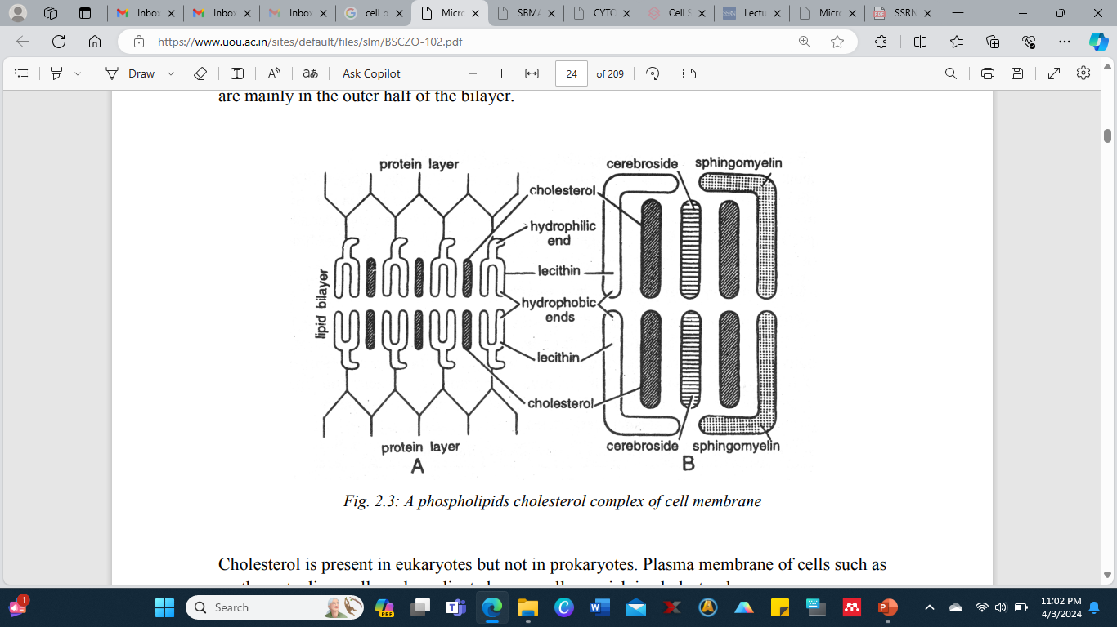
A phospholipids cholesterol complex of cell membrane

Slide 38
Cholesterol is present in eukaryotes but not in prokaryotes.
Plasma membrane of cells such as erythrocyte, liver cells and myelinated nerve cells are rich in cholesterol.
Membrane lipids are amphipathic molecules.
They contain both a hydrophobic and hydrophilic moiety.
Hydrophilic unit is also called the polar head groups, is represented by a circle and their hydrocarbon tails are depicted by straight or wavy lines.
Polar head groups have affinity for water, whereas their hydrocarbons tails avoid water.
This can be accomplished by forming a micelle, in which polar head groups are on the surface and hydrocarbon tails are directed inside.

Slide 39
Another arrangement of lipid molecule in a also called a lipid bilayer.
Phospholipids and glycolipids are key membrane constituents of bimolecular sheets.
Hydrophobic interactions are the major driving force for the formation of lipid bilayer.
The lipid bilayer of the membrane is interrupted only by the proteins that traverse it. This bilayer consists primarily of:
(a) Neutral Phospholipids and Cholesterol cerebroside, and sphingomyeline any electric charge at neutral pH and are closely packed in the bilayer along with cholesterol.

Slide 40
Proteins
Are the main component of plasma membrane. Myelin sheath (membrane surrounding some nerve axons) is composed of about 80% lipids and 20% protein and presence of lipid makes myelin an excellent insulator.
Eukaryotes membrane which serves primarily as permeability barriers possesses about 50% proteins and 50% lipid.
Plasma membrane that are actively involved in energy transfer, such as inner membrane of mitochondria, chloroplasts and membranes of aerobic prokaryotes have large amounts of proteins i.e. about 75%.
They not only provide mechanical support but also act as carriers or channels, serving for transport. In addition numerous enzymes, antigens and various kinds of receptor molecules are present in plasma membranes.
Membrane proteins are classified as integral (intrinsic) or peripheral (extrinsic) according to the degree of their association with the membrane (Singer, 1971).

Slide 41
(a) Peripheral Proteins: They are also called extrinsic proteins associated with membrane surface. These can be separated by addition of salts, soluble in aqueous solutions and usually free of lipids. They are bound to the surface by electrostatic and hydrogen bond interactions.
They form outer and inner layers of the lipid bilayer of plasma membrane. Common examples are cytochrome-C found in mitochondria, acetyl cholinesterase in electroplax membrane and spectrin found in erythrocytes.
(b) Integral or Intrinsic Proteins: These proteins penetrate the lipid layer wholly or partially and represent more than 70% of the two protein types. Their polar ends protrude from the membrane surface while non-polar regions are embedded in the interior of the membrane. Usually they are insoluble in water solutions and can be separate them from the membrane by detergents or organic solvents. The major integral proteins span the thickness of the membrane and have a small amount of carbohydrates on the pole at the outer surface.
This protein appears to be involved in the diffusion of anions across the membrane. Integral proteins may be attached to the oligosaccharides to form glycoprotein or to phospholipid to form lipoproteins or proteolipids.
Common intrinsic proteins are rhodopsin found in retinal rod cells and cytochrome oxidase found in mitochondrial membranes. Every protein in the cell membrane is distributed asymmetrically with respect to the lipid bilayer.

Slide 42
Enzymes
About 30 enzymes have been found in various membranes.
Those most constantly found are 5'-nucleotidase, Na+ -K+ activated ATPase, alkaline phosphatase, adenylcyclase, RNAse and acid phosphomonoestrase. Na+ -K+ activated Mg+ ATPase plays an important role in the ionic exchange and may also act as carrier protein or permease across the plasma membrane.
Some enzymes have a preferential localization.
For example, alkaline phosphatase and ATPase are more abundant in bile capillaries, while disaccharides are present in microvilli of the intestine.
Enzymes are asymmetrically distributed, for example in the outer surface of erythrocytes there are acetylcholinestrase, nicotinamide adenine dinucleotidase and Na+ -K+ ATPase.
In the inner surface there is NADH-diaphorase, G3PD, adenylate cyclase, protein kinase and ATPase.

Slide 43
Carbohydrates
The membranes of eukaryotic cells usually contain 2% to 10% carbohydrates in the form of glycolipids and glycoproteins.
Hexose, hexosamine, fucose and sialic acid are the commonest carbohydrates found in the membrane.
Plasma membranes of neuronal surface contain gangliosides (Lapertina, 1967) ) and are probably involved in the ion transfers.
The distribution of oligosaccharides is also highly asymmetrical.
Salts and water
They are also present in cell membranes.
Water in cell membranes forms parts of membrane structure as it does in all cell constituents.

Slide 44
Lamella-model of plasma membrane (Danielli-Davson model)
Danielli-Davson model (1934) suggested that the plasma membrane consists of two layers of lipid molecules arranged radially with their hydrophobic hydrocarbon chains toward each other and with their respective polar groups arranged outwardly and inwardly throughout the entire double layer of lipid molecules.
The polar ends of the lipid molecules are associated with a monomolecular layer of polar globular protein molecule.
The entire structure thus consisted of double layer of lipid molecule sandwiched between two continuous layers of protein.
The lipid molecules are set at right angles to the surface and are so arranged in two layers that their non-polar hydrophobic fatty acid tails face each other and their polar hydrophilic phosphate heads face the protein layer.
The proteins involved were thought to be globular.
Moreover, lamellar theory assumed the cell membrane to be a stable structure with little functional specificity and variability.

Slide 45
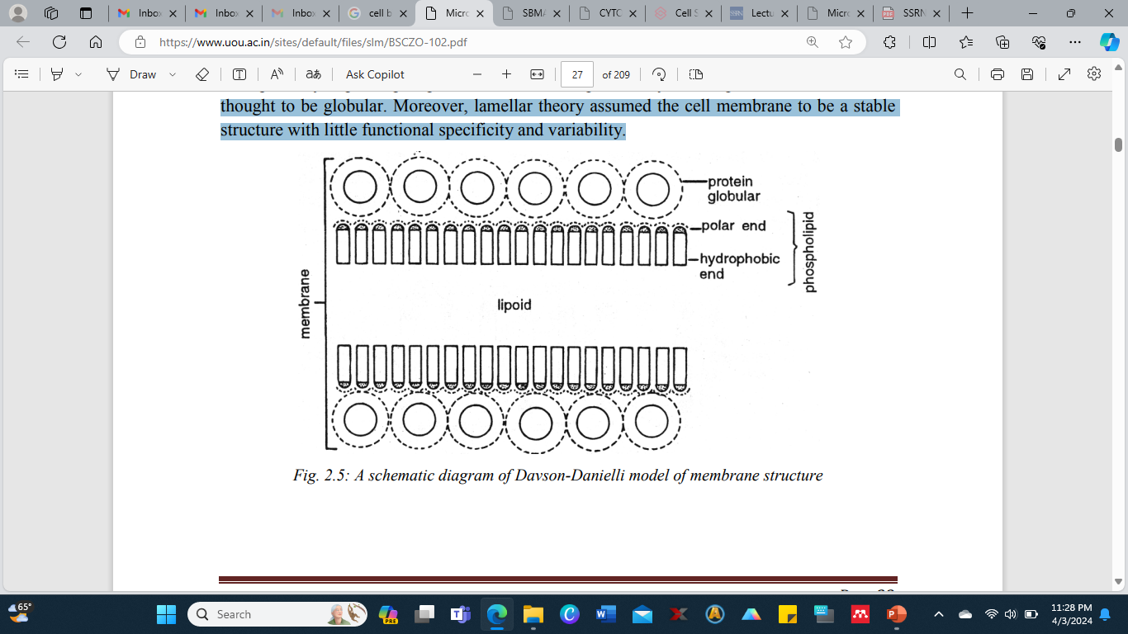
A schematic diagram of Davson-Danielli model of membrane structure

Slide 46
It was proposed by Singer and Nicholson (1972).
The lipids are thought to be arranged primarily in a bilayer in which proteins are embedded to varying degrees.
Singer classifies membrane proteins as peripheral or integral.
The proteins varied in size and dissolved to varying degrees in the lipid matrix are able to diffuse laterally in the plane of membrane, and the entire structure is hence dynamic.
In this model, lipid molecules may exhibit intra molecular movement or may rotate about their axis or may display flip-flop movement including transfer from one side of bilayer to the other.

Slide 47
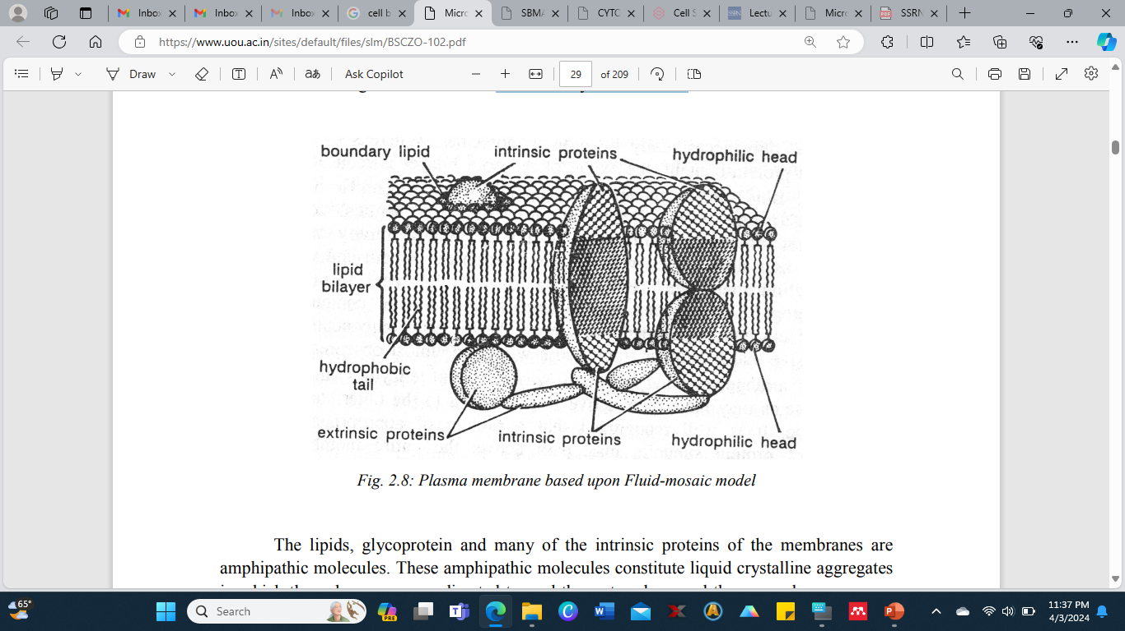
Plasma membrane based upon Fluid-mosaic model

Slide 48
Functions of Plasma Membrane
The plasma membrane serves many functions such as:
1. It maintains the individuality and form of the cell.
2. It keeps the cell contents in place and distinct from the environmental materials.
3. It protects the cell from injury.
4. It regulates the flow of materials into and out of the cell to maintain the concentration and kinds of molecules and ions in the cell.
5. A cell remains alive as long as the cell membrane is able to determine which materials should enter or leave the cell.
6. It forms organelles within the cytoplasm.
7. Its junctions keep the cells together.
8. It’s infolds help in the intake of materials by endocytosis (pinocytosis and phagocytosis).

Slide 49
It’s out folds (microvilli) increase the surface area for absorption of nutrients. The out folds also form protective sheaths around cilia and flagella.
Its receptor molecules permit flow of information into the cell.
Its oligosaccharide molecule helps in recognizing self from non-self.
By controlling flow of material and information into the cell, the plasma membrane makes metabolism possible.
It permits exit of secretions and wastes by exocytosis. It controls cellular interactions necessary for tissue formation and defense against microbes.
It helps certain cells in movement by forming pseudopodia as in Amoeba and leucocytes. The bio-membranes around the organelles help the latter to: (1) Maintain their identity and functional individuality. (2) Receive and turn out required material.

Slide 50
Clinical Correlates
1. Cystinuria is a hereditary condition caused by abnormal carrier proteins that are unable to remove cystine from the urine, resulting in the formation of kidney stones.
Cystic fibrosis is a hereditary disease involving a mutation in the cystic fibrosis transmembrane conductance regulator (CFTR) gene that produces malformed chloride channel proteins that are unable to transport chloride ions, causing an increase in the entry of Na+ ions into the cell.
The higher intracellular concentration of NaCl increases the flow of water into the cell, and the mucin that is released into the extracellular environment cannot become normally hydrated, thus making the mucus thicker than normal, which obstructs the very small bronchiolar passageways of the lungs.
As the disease progresses, infections result, the lungs become unable to function properly, and the individual succumbs to the disease and dies.

Slide 51
Clinical Correlates contd:
2. Multidrug-resistant (MDR) proteins are ABC transporters that are present in certain cancer cells that are able to transport the cytotoxic drugs administered to treat the malignancy.
It has been shown that in more than one-third of the cancer patients, the malignant cells develop MDR proteins that interfere with the treatment modality being used.
3. Ligand-gated ion channels are probably the location where anesthetic agents act to block the spread of action potentials.
4. Venoms, such as those of some poisonous snakes, inactivate acetylcholine receptors of skeletal muscle sarcolemma at neuromuscular junctions.
5. Autoimmune diseases may lead to the production of antibodies that specifically bind to and activate certain plasma membrane receptors. An example is Graves disease (hyperthyroidism)

Slide 52
Clinical Correlates contd:
6. Cholera toxin is an exotoxin produced by the bacterium Vibrio cholerae that alters Gs protein, so that it is unable to hydrolyze its GTP molecule. As a result, cAMP levels increase in the surface-absorptive cells of the intestine, leading to excessive loss of electrolytes and water and severe diarrhea.
7. Pertussis toxin, the product of the bacterium that causes whooping cough, inserts ADP-ribose into the α subunits of trimeric G proteins, causing the accumulation of the inactive form of G proteins resulting in irritation of the mucosa of the bronchial passages. Defective Gs proteins may lead to mental retardation, diminished growth and sexual development, and decreased responses to certain hormones.

Slide 53
Clinical Correlates contd:
7. Hereditary spherocytosis results from a defective spectrin that has a decreased ability to bind to band 4.1 protein. The disease is characterized by fragile, misshapen red blood cells, or spherocytes; destruction of these spherocytes in the spleen leads to anemia.
8. During high-speed car accidents and often in shaken baby syndrome, the sudden accelerating and decelerating forces applied to the brain cause shearing damage to axons, especially at the interface between white matter and gray matter. The stretching of the axons results in diffuse axonal injury, a widespread lesion whose consequence is the onset of a persistent coma from which only 10% of the affected individuals regain consciousness. Examination of the affected tissue displays irreparable cleavage of spectrin, with an ensuing destruction of the neuronal cytoskeleton, leading to loss of plasma membrane integrity and eventual cell death.

Slide 54
GLOSSARY
Plasma membrane - A microscopic membrane made up of lipids and proteins which forms the external boundary of the cytoplasm of a cell or encloses a vacuole, and regulates the passage of molecules in and out of the cytoplasm.
Permeability - The ability of a barrier to let any substance pass through it.
Ions - An atom or molecule with a net electric charge due to the loss or gain of one or more electrons.
Semi permeable - Allowing certain substances especially small molecules or ions to pass through it but not others, especially allowing the passage of a solvent but not of certain solutes.
Receptor - A receptor is a protein molecule in a cell or on the surface of a cell to which a substance such as a hormone, a drug, or an antigen can bind, causing a change in the activity of the cell.
Dielectric - Having the property of transmitting electric force without conduction.

Slide 55
Hydrophobic - The substances that have an affinity for water due to the formation of hydrogen bonds.
Hydrophilic - Hydrophilic molecules typically have polar groups enabling them to readily absorb or dissolve in water as well as in other polar solvents.
Micelles - It is an aggregate of molecules in a colloidal solution, such as those formed by detergents.
Peripheral proteins/extrinsic proteins - Peripheral membrane proteins are proteins that adhere only temporarily to the biological membrane with which they are associated. These molecules attach to integral membrane proteins, or penetrate the peripheral regions of the lipid bilayer.
Integral proteins/intrinsic proteins - An integral membrane protein (IMP) is a type of membrane protein that is permanently attached to the biological membrane. All trans membrane proteins are IMPs, but not all IMPs are trans membrane proteins.
Amphipathy - It is the property of a molecule having both polar (water-soluble) and non polar (not water-soluble) affinities in its structure.

Slide 56
SELF ASSESSMENT QUESTIONS AND POSSIBLE ANSWERS: Multiple Choice Questions
1. According to Fluid mosaic model, the correct sequences of substances in plasmalemma is: (a) L-P-P-L (b) P-L-L-P (c) P-P-L-L (d) L-P-L-P
2. Membrane occurs in: (a) Chromosomes, nuclei and mitochondria (b) Cytoplasm, chloroplasts and mitochondria (c) Cytoplasm, nuclei and starch grains (d) Chromosomes, chloroplasts and starch grains
3. Plasma membrane is: (a) Non-selective barrier (b) Selective barrier (c) Impermeable (d) made of cellulose
4. What limits Animal cells from outside? (a) Cell wall (b) Basement membrane (c) Shell membrane (d) Plasma membrane
5. Cell membrane consists of: (a) Protein double layer (b) Phospholipid proteins (c) Phosphoproteins (d) Glycoproteins
6. Non-membranous cell organelles are: (a) Ribosomes (b) centrioles and ribosomes (c) E.R. (d) Mitochondria
7. Which of the following theories explain that plasma membrane is selectively permeable: (a) Unit membrane theory (b) Cascade theory (c) Sandwich theory (d) Fluid Mosaic theory
8. The hydrophobic ends of phospholipid molecules are: (a) Polar (b) Non-polar (c) Neutral (d) Bipolar
9. The membrane protein that extend through both sides of lipid bilayer. (a) Acidic protein (b) Glycoprotein (c) Intrinsic protein (d) Glycolic acid
10. Two plant cells are connected with the help of: (a) Cell wall (b) Plasma membrane (c) Plasmodesmata (d) None of these

Slide 57
Very short questions:
1. What is the thickness of plasma membrane?
2. Who proposed the fluid mosaic hypothesis for the molecular structure of cell membrane?
3. What is the structure of plasma membrane?
4. What are the main lipid components of the plasma membrane?
5. What are the two types of proteins of the plasma membrane on the basis of their association with the membrane and their solubility?
6. What are tunnel proteins?
7. Why Na+ -K+ ATPase enzyme is most important?
8. Who proposed that plasma membrane contained a lipid bilayer and protein adhering to both lipid aqueous interfaces?
9. Who gave the unit membrane model of plasma membrane?
10. Give the two alternative name of cell membrane.
Terminal and Model Questions
1. Define plasma membrane.
2. Describe the structure and functions of plasma membrane.
3. Write notes on: a. Fluid Mosaic Theory b. Miceller Model of Plasma Membrane c. Lamella model of Plasma membrane d. Define phagocytosis and pinocytosis.
4. Explain in detail the ultra structure of plasma membrane.
5. Differentiate between integral and peripheral proteins.

Slide 58
Introduction to Mitochondria
Mitochondria (Gr., mito, thread; chondrion, granule) are thread like or granular structures of eukaryotic cells.
These may assume rod-like shape called chondriosomes which may enlarge or aggregate to form massive spheroidal bodies called chondriospheres.
These are not present in bacterial cells.
Mitochondria are the 'power plants' which by oxidation release the energy contained in the fuel molecules or nutrients and make other forms of chemical energy.
The main function of mitochondria is oxidative phosphorylation, which is an exergonic reaction, meaning that it releases energy.
In prokaryotes, oxidation of organic material is carried out by plasma membrane enzymes.

Slide 59
History of Mitochondria
Kölliker (1880) was the first who observed the mitochondria in insects muscle cells. He called them as 'sarcosomes’.
Flemming (1882) named the mitochondria as 'fila'. Altmann in 1894 observed them and named them Altmann's granules or bioblasts.
The term 'mitochondria' was applied by Benda (1897-98).
They were recognized as the sites of respiration by Hogeboom and his coworkers in 1948.
Lehninger and Kennedy (1948) reported that the mitochondria catalyze all the reactions of the citric acid cycle, fatty acid oxidation and coupled phosphorylation.

Slide 60
Structure of Mitochondria: Morphology of Mitochondria
Morphologically mitochondria may be in the form of filaments or small granules. These may assume rod-like shape called chondriosomes which may enlarge or aggregate to form massive spheroid bodies called chondriospheres.
1. Position - Mitochondria lie freely in cytoplasm, possessing power of independent movement and may take the form of filaments. In some cells they can move freely, carrying ATP where needed, but in others they are located permanently near the region of the cell where more energy is needed. E.g., in the rod and cone cells of retina mitochondria are located in the inner segment, in cells of kidney tubules they occur in the folds of basal regions near plasma membrane, in neurons they are located in the transmitting region of impulse, in certain muscle cells (e.g. diaphragm), mitochondria are grouped like rings or bracers around the I-band of myofibril. During cell division they get concentrated around the spindle.
2. Number - The number of mitochondria varies a good deal from cell to cell and from species to species. A few algae and some protozoan have only single mitochondria. Their number is related to the activity, age and type of the cell. Growing, dividing and actively synthesizing cells contain more mitochondria than the other cells. In Amoeba (Chaos chaos), there may be as many as 50,000 mitochondria. In rat liver cells, these are few in number, about 1000 to 1600. Some Oocytes contain as many as 3, 00,000 mitochondria.
3. Size - The average size of mitochondria is 0.5-1.0µ in diameter and about 2-8 µ in length. In exocrine cells of mammalian pancreas they are about 10 µ long and in oocytes of amphibian Rana pipiens are 20-40µ long. Yeast cells have the smallest mitochondria.

Slide 61
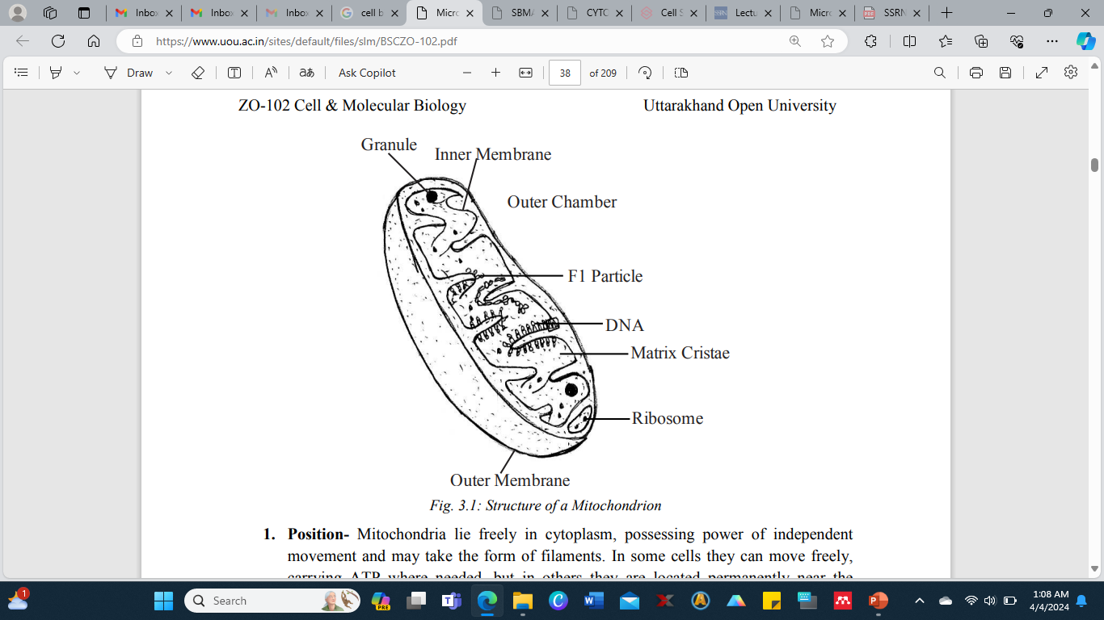
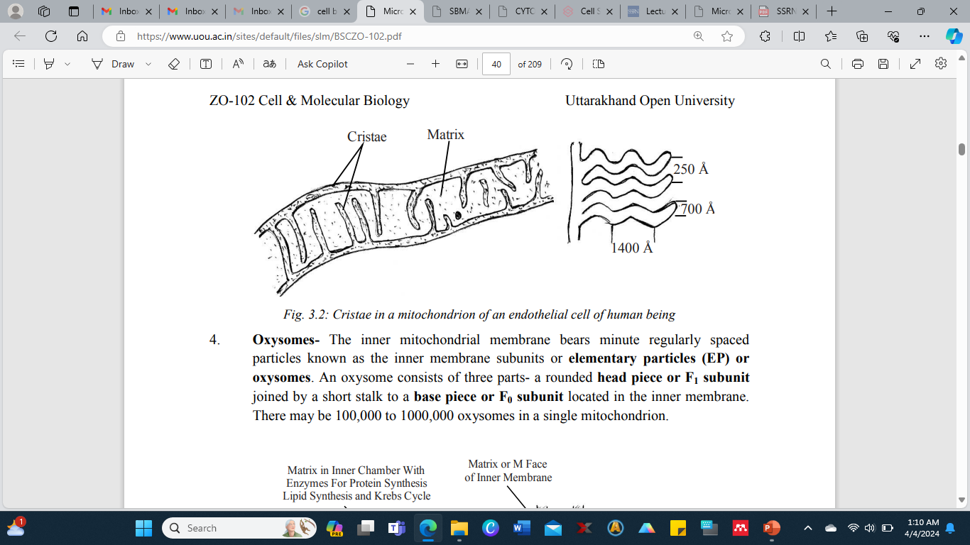
Cristae in a mitochondrion of an endothelial cell of human being
Structure of a Mitochondrion

Slide 62
Ultra structure of Mitochondria
The electron microscope shows the mitochondrion as the vesicles bounded by an envelope of two unit membranes and filled with a fluid matrix.
1. Membranes - Both the inner and the outer mitochondrial membranes resemble the plasma membrane in molecular structure.
Each of them is 60-70Å, trilamellar and composed of two layers of phospholipid molecules sandwiched between two layers of protein molecules.
However, the two membranes differ in the kinds of protein and lipids they have and also in their properties.
Both the outer and the inner membranes contain specific pumps or channels, for the transport of molecules through them.
The membranes may be connected at adhesion sites through which proteins are transferred from the outer to the inner membrane.

Slide 63
The outer and the inner membrane are separated from each other by a narrow space called the inter-membrane space or outer chamber or peri-mitochondrial space.
It is about 80Å wide.
It contains a clear homogeneous fluid.
(i) Outer Membrane- The outer membrane is smooth permeable to most small molecules, having trans-membrane channels formed by the protein 'porin’.
It consists of about 50% lipid, including a large amount of cholesterol.
It contains some enzymes but is poor in protein.
(ii) Inner Membrane- The inner membrane is selectively permeable and regulates the movement of materials into and out of the mitochondrion. It is rich in enzymes and carrier proteins permease.
It has a very high protein/lipid ratio (about 4:1 by weight).
It lacks cholesterol.
Cardiolipin is closely associated with certain integral proteins and is apparently required for their activity.

Slide 64
2. Matrix- The space between the cristae called the inner chamber is filled with a gel like material termed the mitochondrial matrix. It contains proteins, lipids, some ribosomes, RNA, one or two DNA molecules and certain fibrils, crystals and dense granules.
3. Cristae- The inner mitochondrial membrane bears plate like infoldings called the cristae.
They extend inwards to varying degrees, and may fuse with those from the opposite side, dividing the mitochondrion into compartments.
They are arranged in a characteristic manner in different cells. Normally they run at right angles to the long axis of the rod shaped mitochondria.
In cells of the proximal parts of the kidney tubules, the cristae are longitudinal folds parallel to the long axis of mitochondrion.
In many protozoans, in insect flight muscles cells and in adrenal endocrine cells the cristae are tubular.

Slide 65
Cristae are lamellar in hepatocytes. In heart muscle cells cristae are zig-zag.
They also vary in number.
The active cells may have numerous cristae whereas the inactive cells may have only a few.
The cristae have in them a narrow intra-crista space.
It is continuous with the inter-membrane space.
The cristae greatly increase the inner surface of the mitochondrion to provide enough space for housing enzyme assemblies.
The cristae also allow for expansion or swelling of mitochondria under different metabolic and environmental conditions.
4. Oxysomes - The inner mitochondrial membrane bears minute regularly spaced particles known as the inner membrane subunits or elementary particles (EP) or oxysomes.
An oxysome consists of three parts- a rounded head piece or F1 subunit joined by a short stalk to a base piece or F0 subunit located in the inner membrane.
There may be 100,000 to 1000,000 oxysomes in a single mitochondrion.

Slide 66
Biogenesis of Mitochondria
The formation of new mitochondria has been explained with the following hypothesis. 1. De Novo Synthesis - According to this hypothesis mitochondria arises de novo from precursors in the cytoplasm.
2. Origin from membrane - This hypothesis proposes that the mitochondria arises from the invaginations of plasma membrane, endoplasmic reticulum, Golgi apparatus or nuclear envelop. The membrane invaginates and extends into the cytoplasm as a tubular structure. It gradually becomes curved and folded and forms a double walled structure, the mitochondrion.
3. Develop from Micro bodies - It is held that they mitochondria are developed by the accumulation of micro bodies in the cytoplasm. A micro body consists of a single outer membrane and a dense matrix with a few cristae which eventually develops into fully formed mitochondria.

Slide 67
4. Prokaryotic Origin - It is believed that mitochondria are originated from bacteria. It is supported by many evidences.
(i) First is the localization of enzymes of respiratory chain, which in case of bacteria, are localized in plasma membrane which can be compared with the inner membrane of the mitochondrion.
(ii) In some bacteria, plasma membrane forms membranous projections (called mesosomes) like cristae of mitochondria. These mesosomes possess respiratory chain enzymes.
(iii) The mitochondrial DNA is circular as it is in bacteria. Replication process of mitochondria is similar to bacteria.
(iv) Ribosomes in mitochondria are smaller and similar in size to that of bacterial ribosomes.
(v) Chloramphenicol inhibits the synthesis of protein in mitochondria as well as in bacteria. Furthermore, in the process of protein synthesis, mitochondria depend partially on mitochondrial matrix and DNA and partially on nucleus and cytoplasm of the eukaryotic cells. It exhibits the symbiotic nature of mitochondria.
These evidences support the prokaryotic origin of mitochondria.

Slide 68
5. Replication - It is held that mitochondria are self-replicating organelles.
New mitochondria arise by some type of splitting process from pre-existing mitochondria.
The last hypothesis seems probable.
Since the mitochondria have their own DNA and ribosomes, they can replicate new mitochondria.
However, there is a nuclear control over the process as the mitochondria synthesize some of their proteins themselves and get others from the cytoplasm of the cell formed under the direction of the nuclear DNA.

Slide 69
Functions of Mitochondria
Mitochondria perform the following functions:-
1. Cell respiration takes place in mitochondria and so they are known as the 'power house' of the cell. They bring about stepwise oxidation of food stuffs or "low-grade" fuel of the cell and transfer the energy so released to the energy carrier ATP, the "high-grade" fuel of the cell. ATP is used to bring about the energy-requiring activities in the cells, namely, biosynthesis, active transport, transmission of nerve impulse, muscle contraction, cell growth and division and bioluminescence.
2. Mitochondria provide intermediates for the synthesis of important biomolecules such as chlorophyll, cytochromes, steroids etc.
3. Some amino acids are also formed in the mitochondria.
4. Mitochondria actively accumulate calcium ions as calcium phosphate precipitate. They regulate the calcium ions concentration in the cytoplasm by storing and releasing Ca+ . The calcium ions regulate numerous biochemical activities in the cell.

Slide 70
Glossary
Plasma membrane: The membrane forming the surface of cytoplasm and consisting of a bimolecular phospholipids layer between an inner and outer layer of protein molecules.
Neuron: The nerve cell with its outgrowths, structural unit of nervous system.
Adenosine Triphosphate (ATP): a molecule containing high energy bonds that provides energy for many biochemical cellular processes by undergoing enzymatic hydrolysis.
Diaphragm: a muscular or ligamentous partition that separates the thorax from the abdomen in mammals.
I-band: In a sarcomere, I-band is the zone of thin filaments that is not superimposed by thick filaments.
Myofibril: Myofibrils are the rod like units of muscle cells. They are composed of repeating sections of sarcomere, which appear under the as dark and light bands.
Oocytes: Oocyte is a female gametocyte or an immature ovum involved in reproduction. It is produced in the ovary during female gametogenesis and it undergoes meiotic division to form an ovum.
Vesicles: A vesicle is a small structure within a cell, consisting of fluid enclosed by a lipid bilayer membrane.

Slide 71
Porin: The beta barrel proteins that acts as transport protein which cross a cellular membrane and act as a pore through which molecules can diffuse. Porins are large enough to act as channels that are specific to different types of molecules.
Permease: The permease is membrane transport proteins that facilitate the diffusion of a specific molecule in or out of the cell by passive transport.
Cardiolipin: Cardiolipin is an important component of the inner mitochondrial membrane where it constitutes about 20% of the total lipid composition. It is essential for the optimal function of numerous enzymes that are involved in mitochondrial energy metabolism.
Cristae: A cristae is a fold in the inner membrane of the mitochondrion. It provides a large amount of surface area for the chemical reactions to occur on.
Oxysomes: It is a structural unit of cellular cristae.
De novo: De novo is a Latin expression meaning "from the beginning," "afresh," "anew," "beginning again."
Microbody: A microbody is a type of organelle that is found in the cells of plants, protozoa and animals and microbody include peroxisome, glyoxysome and glycosome.

Slide 72
Self Assessment Questions and Possible Answers: Multiple Choice Questions
1. Cell's power houses are its: (a) Lysosomes (b) Mitochondria (c) Ribosomes (d) Golgi apparatus
2. Mitochondrion is bounded by: (a) A single unit membrane (b) Two unit membranes (c) No membranes (d) Plasma membranes
3. New mitochondria arise: (a) De novo (b) By replication (c) From plasma membrane (d) from nuclear envelop
4. The ATPase enzyme is located in the mitochondria in: (a) Oxysomes (b) Outer membrane (c) Inner membranes (d) Matrix
5. The name mitochondria were given by: (a) Altman (b) Flemming (c) Benda (d) Kollikar
6. ETS is located in: (a) Outer mitochondrial membrane (b) Inter membrane space (c) Inner mitochondrial membrane (d) mitochondrial matrix

Slide 73
Very short questions
1. Where are ETS enzymes located in mitochondria?
2. Give the function of mitochondria.
3. What are cristae?
4. What type of DNA do mitochondria have? 5. Mention three parts of oxysome.
6. Who named mitochondria?
7. What kind of enzymes is present in the mitochondria?
8. Name the enzymes oxysomes represent.
9. Which is the most common energy carrier in cells?
10. Give alternative names of oxysomes.
Terminal and Model Questions
1. Give an account of history and structure of endoplasmic reticulum.
2. Show protein trafficking in a cell with the help of a labeled diagram.
3. Describe types and functions of ER.
4. Describe structure and functions of ribosomes.
5. Show the structure of 80S ribosome with the help of labeled diagram.
6. Give an account of history, structure and functions of Golgi bodies.
7. Describe the morphology of Golgi bodies.

Slide 74
Introduction to Endoplasmic Reticulum, Ribosome, Golgi Bodies
The matrix of cell contains various particles of different sizes called cytoplasmic constituents or organelles. They include rounded, globular, filamentous or granular mitochondria, network of endoplasmic reticulum, elongated secretary particles of Golgi apparatus, ribosomes, plastids, centrosomes and lysosomes.
Endoplasmic reticulum is a complex, finely divided vacuolar or tubular system, extending from nucleus through cytoplasm to the margins of the cells. This system is enclosed by double membrane.
Ribosomes are small dense and granular ribonucleoprotein (i.e. RNA and proteins) particles found attached to outer surface of endoplasmic reticulum and nucleus as well as freely scattered in cytoplasm, mitochondrial matrix and chloroplast.
Golgi bodies may consist of many flattened sacs. In plant cells they are collectively called as ‘dictyosome’. They are found scattered throughout the cytoplasm.
Golgi complex occupies different positions in different kinds of cells. In secretary and absorptive cells, it usually lies between the nucleus and the cell surface where secretion and absorption occurs. In nerve cells it surrounds the nucleus, and lies elsewhere in other cells.

Slide 75
Endoplasmic Reticulum
General History of Endoplasmic Reticulum
Early cytologists held that some sort of supporting network or cytoskeleton was present in the cells.
It was given various names — Nissil substance, ergastoplasm, basophilic bodies, etc.
In 1945, Porter, Claude and Fullman with the help of electron microscope noted a delicate membranous network in the cytoplasm.
It was later called endoplasmic reticulum (ER) by Keith Porter in 1953.
The ER originally seemed to be confined to the endoplasm of the cell, hence its name.

Slide 76
Structure of Endoplasmic Reticulum
In eukaryotic cells endoplasmic reticulum is generally the largest membrane which forms extensive system of intercommunicating membranous sacs or channels. It represents 30 to 60% of total membrane in a cell.
The membrane of endoplasmic reticulum may or may not have ribosomes attached to their outer membrane.
Accordingly these are classified as rough (RER) or smooth endoplasmic reticulum (SER). Rough endoplasmic reticulum is characterized by the presence of ribosomes of about 150Å in diameter and rich in protein and RNA.
Smooth endoplasmic reticulum lacks ribosomes. It comprises three types of elements: cisternae, tubules and vesicles.

Slide 77
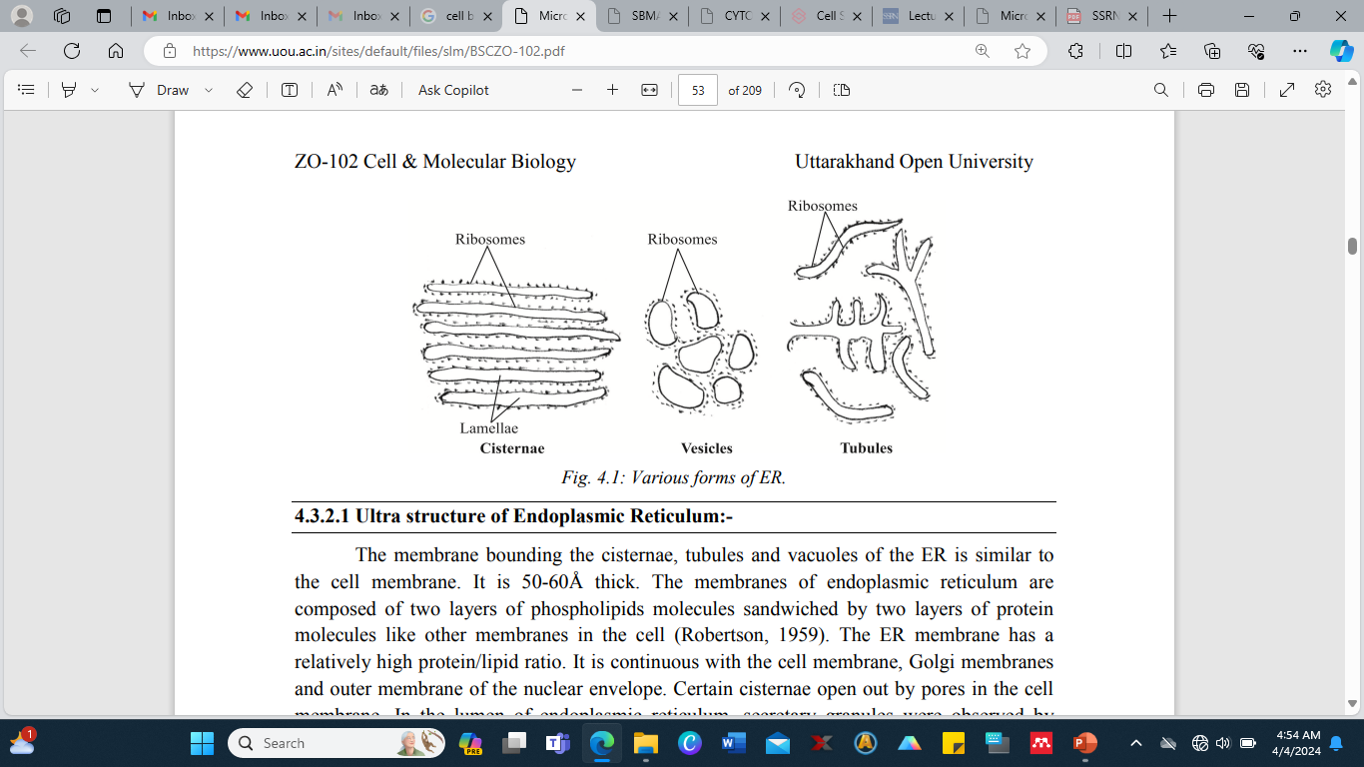
Various forms of ER.

Slide 78
Cisternae - These are flattened, unbranched, sac like elements with about 40-50µm in diameter. They lie in stacks (piles) parallel to but interconnected with one another.
They are separated from one another by cytosolic spaces. The small granular structures called the ribosomes may or may not be present on the surface of cisternae.
Tubules - These are irregular, branching elements, which form a network along with other elements. They are about 50-100µm in diameter, and are often free of ribosomes.
Vesicles - These are oval, vacuole like elements, about 25-500µm in diameter. They often occur isolated in the cytoplasmic matrix. They are also free of ribosomes. A fluid called the endoplasmic matrix is present in the lumen of ER. All the elements of ER freely communicate with one another

Slide 79
Ultra structure of Endoplasmic Reticulum
The membrane bounding the cisternae, tubules and vacuoles of the ER is similar to the cell membrane. It is 50-60Å thick.
The membranes of endoplasmic reticulum are composed of two layers of phospholipids molecules sandwiched by two layers of protein molecules like other membranes in the cell (Robertson, 1959).
The ER membrane has a relatively high protein/lipid ratio. It is continuous with the cell membrane, Golgi membranes and outer membrane of the nuclear envelope. Certain cisternae open out by pores in the cell membrane. In the lumen of endoplasmic reticulum, secretary granules were observed by Palade (1956).
The lumen acts as a passage for the secretary products. About 30-40 different enzymes are associated with the ER for the various synthetic activities.
These may be located on the cytoplasmic surface or luminal surface or both. Membrane bound endoplasmic reticulum spaces varies in shape and sizes in different cell types.

Slide 80
On the basis of absence or presence of ribosomes, two kinds of ER are found in cells.
1. Smooth Endoplasmic Reticulum: Ribosomes are absent on the walls of ER and so it appears smooth and hence called smooth or agranular ER.
It mainly occurs as tubular forms. The tubules forms irregular lattices and measures about 500-1000Å in diameter.
Smooth ER is commonly found in the cells involved in the synthesis of steroids or lipids i.e. non protein type of synthesis (Christensen and Fawcett, 1961) such as adrenal or sebaceous glands, gonadial interstitial cells.
Certain cells with carbohydrate metabolism (e.g. liver cells), impulse conduction (e.g. muscle cells), with pigment production (e.g., retinal pigment cell) and electrolyte excretion (e.g., chloride cells of fish gills) are also have more of SER in them.

Slide 81
2. Rough Endoplasmic Reticulum (RER): It is characterized by the presence of ribosomes on the surface of reticulum and so it is also known as granular ER.
It is in the form of flattened cisternae with the width of 400-500Å. RER occurs largely in the cells that are actively involved in the synthesis of proteins such as enzymes (e.g. pancreatic cells, plasma cells and liver cells) or mucus (goblet cells).
In exocrine cells of pancreas, RER consists of reticular sheets and fenestrated cisternae in the basal region of the cell.
These cisternae measures about 5-10 micron in length and their groups are 400-1000Å in diameter. In apical region of the cells, granular reticulum occurs in the form of vesicles.
Granular and agranular ER are in continuity of their membranes in the regions of contact.

Slide 82
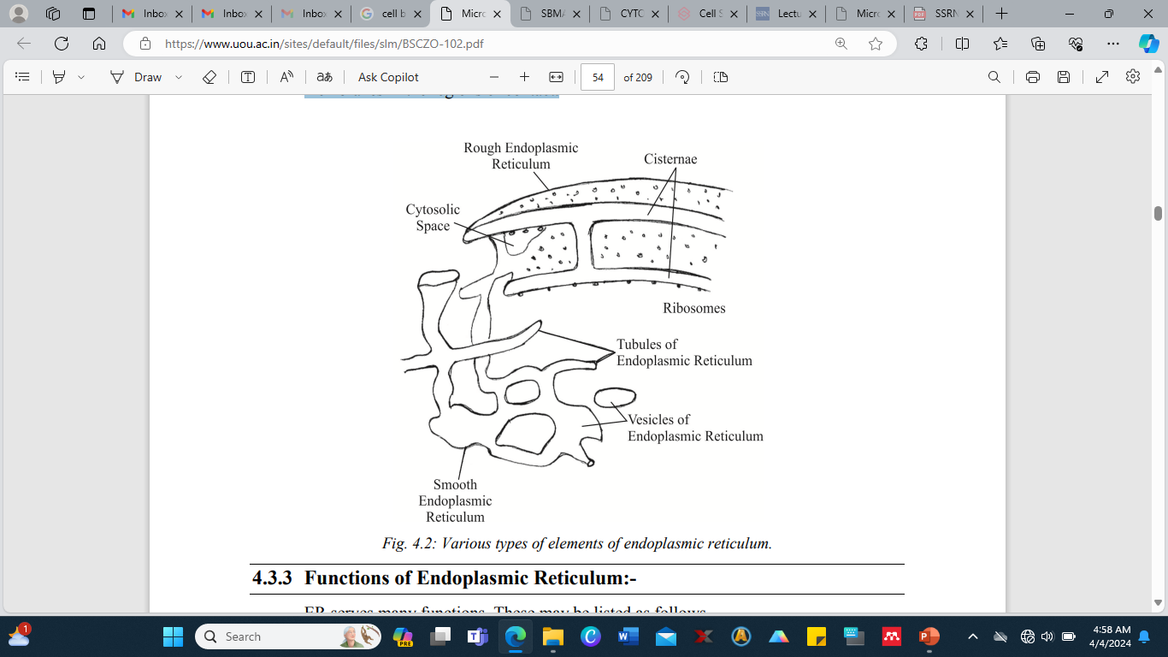
Various types of elements of endoplasmic reticulum.

Slide 83
Functions of Endoplasmic Reticulum
ER serves many functions. These may be listed as follows.Functions of smooth endoplasmic reticulum
1. Surface for Synthesis - The SER provides surface for the synthesis of fatty acids, phospholipids, glycolipids, steroids and visual pigments.
2. Glycogen Metabolism - The SER carries enzymes for glycogen metabolism in liver cells. Glycogen granules are attached in larger numbers to the outside of the SER’s membranes in liver cells.
3. Detoxification- The SER has enzymes that are involved in the detoxification in the liver, i.e., converts harmful materials such as carcinogens and pesticides, into harmless ones for excretion by the cell.
4. Formation of organelles - The SER produces Golgi apparatus, lysosomes, micro bodies and vacuoles.
5. Transport route - The proteins shift from RER through SER to Golgi apparatus for further processing.
6. Skeletal Muscle Contraction - The sarcoplasmic reticulum in skeletal muscle cells release Ca2+ ions to cause contraction and absorbs Ca2+ ions to bring about relaxation.
7. Fat Oxidation - The SER membranes carry out the initial reactions in the oxidation of fats.

Slide 84
Functions of rough endoplasmic reticulum
1. Surface for Ribosomes - The RER provides a large surface for the attachment of ribosomes.
2. Surface for synthesis - The RER offers extensive surface on which protein synthesis can be conveniently carried on by ribosomes. The newly formed proteins may enter the ER membranes, becoming a part of the membrane structure or pass into the ER lumen. The proteins becoming a part of ER membrane eventually move from the ER via membranes of other cell organelles, namely Golgi apparatus, secretary vesicles to become permanent plasma membrane proteins. The proteins entering ER lumen are packed for export.
3. Packaging - The proteins in ER lumen are processed and get enclosed in spherical membrane bound vesicles which get pinch off from the ER. These vesicles have various fates. Some remain in the cytoplasm as storage vesicles while others migrate to the plasma membrane and expel their contents by exocytosis. Some fuse with Golgi apparatus for further processing of their proteins for storage or release from the cell.
4. Smooth ER Formation - The RER gives rise to the smooth ER by loss of ribosomes.
5. Formation of Nuclear Envelope - The RER forms nuclear envelope around daughter cells in cell division.
6. Formation of Glycoproteins - The process of linking sugars to proteins to form glycoproteins starts in the RER and is completed in Golgi apparatus.

Slide 85
Importance of Endoplasmic Reticulum
1. Transport of Materials - The ER facilitates transport of materials from one part of the cell to another thus forming the cell's circulatory system.
2. Formation of Desmotubule - Tubular extension, called desmotubule, extends through plasmodesmata to make ER continuous in the two adjacent plant cells.
3. Support - The ER acts as an intracellular supporting framework, the cytoskeleton that also maintains the form of the cell.
4. Localization of Organelles - It keeps the cell organelles properly stationed and distributed in relation to one another.
5. Surface for Synthesis - The ER offers extensive surface for the synthesis of a variety of materials.
6. Storage of Materials - The ER provides space for temporary storage of synthetic products such as proteins and glycogen.
7. Exchange of materials - The ER helps in the exchange of materials between the cytoplasm and the nucleus.
8. Location of Enzymes - A variety of enzymes is located in the ER membranes to catalyze the biochemical reactions.

Slide 86
Ribosome
General History of Ribosome
George E. Palade (1953) was the first to observe dense particles or granules in animal cells under electron microscope.
These were thus called as Palade’s Particles. Later Richard B. Roberts named them "ribosomes" in 1958. Tissieres and J.D. Watson (1958) isolated ribosomes from E. coli for the first time.
It was shown that ribosomes contain approximately equal amount of RNA and proteins.

Slide 87
Structure of Ribosome
Ribosomes are of two types 70S and 80S. ‘S’ is Svedberg unit, a measure of particle size dependent on the speed with which the particles sediment in the ultracentrifuge.
The 70S ribosomes are found in the prokaryotic cells and in the mitochondria and plastids of eukaryotic cells. The 80S ribosomes occur in the cytoplasm of the eukaryotic cells.
Both the 70S and 80S ribosomes are similar in structure. They are small, spherical structures of which 70S ribosomes are around 200Å in diameter, while 80S are 250 to 300Å in diameter.
They are porous and hydrated having two subunits, one is larger (140-160Å in diameter) having dome shaped structure and the other is smaller in size, found over the larger subunit, forming a cap like structure.
The two subunits are separated by clefts (Palade and Kuff, 1966). Membrane is absent around them. The subunits occur separately in the cytoplasm, and join to form ribosomes only at the time of protein synthesis.
Many ribosomes line up and join the mRNA chain. After the synthesis of protein, the ribosomes leave the mRNA chain and dissociate into subunits.

Slide 88
1. 70S Ribosome: These are found in bacterial cells and have the molecular wt. 2.7 × 10–6 daltons and sedimentation coefficient 70S.
70S ribosome consists of a large 50S subunit and a small 30S subunit. Each subunit is composed of rRNA and several basic proteins.
The 50S subunit has two species of RNA: 23S and 5S and about 34 different ribosomal proteins.
The 30S subunit has only one species of rRNA, i.e., 16S and about 21 different ribosomal proteins. They also occur in mitochondria and chloroplasts of eukaryotic cells (Fig. 4.4a).
2. 80S Ribosome: Having the sedimentation coefficient 80S, these are somewhat larger and contain more RNA and proteins than 70S ribosomes. An 80S ribosome is over 250 to 300Å in diameter.
Their mol. wt. is 4 × 10–6 daltons. It consists of a large 60S subunit and a small 40S subunit. Each subunit is composed of rRNA and several specific basic proteins.
The 60S subunit has three species of rRNA: 28S, 5.8S and 5S and over 45 different ribosomal proteins.
The 40S subunit has only one species of rRNA, i.e., 18S and over 33 different ribosomal proteins. They are found in eukaryotic cells.

Slide 89
Ultra structure of ribosome
The ribosomes are composed of two subunits (one subunit is almost twice in size than the other) fitted together to form a complete unit of about 300Å in diameter.
In 70S ribosome the 50S subunit is pentagonal compact particle of 160 to 180Å bearing a round concave area in its center of about 40 to 60Å that accommodates the small subunit.
A small pore like transparent area is also present that inhibits the entrance of enzyme ribonuclease. Similar pores are present in 60S subunit of 80S ribosomes.
The smaller subunits 30S of 70S and 40S of 80S ribosomes have irregular forms and are often divided into two portions which are interconnected by a strand of 30 to 60 Å thicknesses.
Ribosomes have a groove at the junction of large and small subunits. The mRNA is seated in the gap between both ribosomal subunits, where the ribosome protects a stretch of some 25 nucleotides of mRNA from degradation by ribonuclease. From this groove, a canal or tunnel extends through the large subunit and opens into the lumen of the endoplasmic reticulum.
Polypeptides are synthesized in the groove between the two ribosomal subunits and pass through the tunnel of the large subunit into the endoplasmic reticulum.

Slide 90
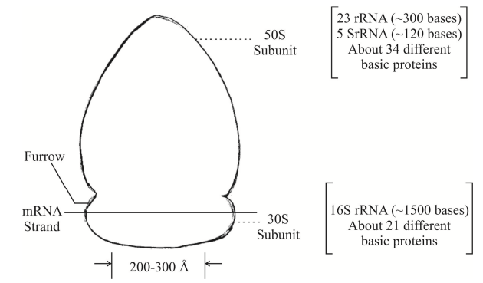
Structure of 70S ribosome of Escherichia coli, a colon bacilia

Slide 91
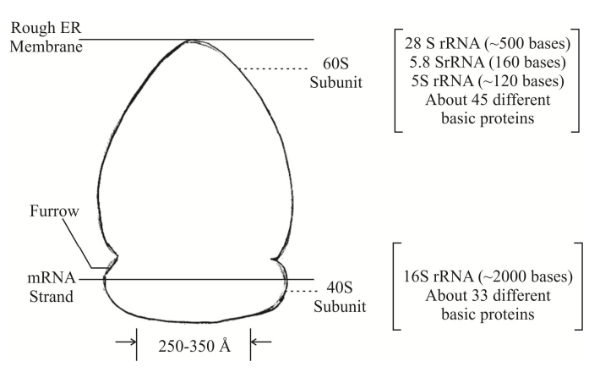
Structure of 80S ribosome of eukaryotic cell

Slide 92
Functions of the Ribosome
1. Attached Ribosomes- The ribosomes provide space and enzymes for the synthesis of proteins in the cell.
The ribosomes bound to the ER membranes synthesize:
(i) integral proteins for cellular membranes,
(ii) lysosomal proteins and
(iii) secretary proteins for export as secretions.
2. Free Ribosomes - The free ribosomes produce structural and enzymatic proteins for use in the cell itself.
These proteins include glycolytic enzymes and most extrinsic membrane proteins, such as spectrin.

Slide 93
Importance of Ribosome
Ribosomes are known as protein factories.
Ribosomal RNA molecules possibly serve as a skeletal framework in the ribosomes.
Smaller ribosomal subunit is required for the formation of initiation complex at the start of the protein synthesis.
Whereas larger ribosomal subunit is necessary for peptide bond formation and the elongation for the polypeptide. The ribosome function as a template in order to bring together various components involved in the synthesis of proteins.
Ribosomes co-ordinate the interaction of t-RNA- amino acid complex with m-RNA. This co-ordination results in the translation of genetic code forming specific proteins.
Since free ribosomes are not involved in protein synthesis, they are transported through endoplasmic reticulum membranes and assembled into globules within the cisternae and canals in the cells that produce 'proteins for transport’.
Proteins later appear in the form of granules outside the Golgi complex.

Slide 94
Golgi Complex
General History of Golgi Bodies
Camillo Golgi in 1898 discovered the Golgi apparatus in the nerve cells of barn owl and cat by metallic impregnation method.
After it's discoverer's name, the Golgi apparatus has been variously named as Golgisome, Golgi material, Golgi membranes, Golgi body, etc.
Structure of Golgi Bodies
Golgi bodies varies in size and form in different types of cells, but they have similar organization in all kinds of cells.
For example, it is well developed in secretory and nerve cells, but is rather small in muscle cells.
Golgi bodies are compiled as a central stack (pile) of flattened sacs or cisternae and many peripheral tubules and vesicles.

Slide 95
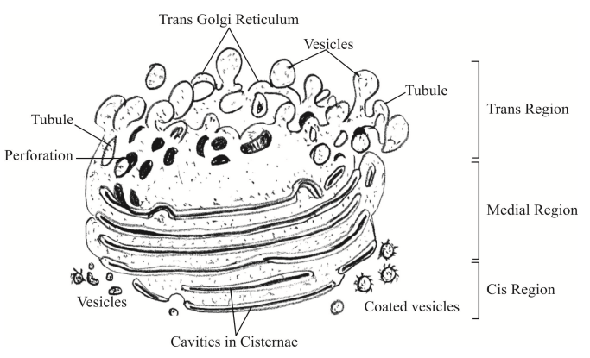
Golgi apparatus

Slide 96
1. Cisternae- The cisternae vary in number from 3 to 7 in most animal cells and from 10 to 24 in plant cells.
They are usually equally spaced in pile so that they are nearly parallel to one another, having 200-300Å wide inter-cisternal spaces containing a layer of parallel fibers called inter-cisternal elements. These support the cisternae and maintain regular spacing between them.
The cisternae may be flat, but are often curved, having a distinct polarity with a convex face towards the cell membrane and concave face towards the nucleus.
They are free of ribosomes and have swollen ends. They look like the smooth endoplasmic reticulum and are continuous with it at certain places.
This suggests that the Golgi apparatus is derived from the smooth endoplasmic reticulum.
A cisterna is about 0.5-1 µm in diameter and its cavity is about 100Å wide. It is fenestrated at the margin as here it passes into tubules. All the cisternae have a continuous lumen filled with a fluid.

Slide 97
2. Tubules- Short tubules arise from the periphery of the cisternae.
Some of these enlarge at their ends to form vesicles.
3. Vesicles- The vesicles lie near the ends and concave surface of the Golgi complex.
They are pinched off from the tubules of the cisternae. They are of three types: transitional, smooth or secretary and coated vesicles.
a. Transitional Vesicles: These are the small outgrowths formed from the transitional ER. They migrate to, converge and coalesce to cis face of Golgi, where they form new cisternae.
b. Smooth Vesicles: These have smooth surface and contain secretions of the cell and so they are also called secretary vesicles. They arise from the ends of the cisternae tubules.
c. Coated vesicles: These have rough surface and they also arise from the cisternae tubules. They play a role in intracellular traffic of secretary protein molecules.

Slide 98
The Golgi complex has 3 functional regions: cis region that lies nearest the ER, medial region in the middle, and Tran’s region with trans Golgi reticulum nearest to the plasma membrane.
These regions have different enzymes which introduce different modifications to secretary and membrane proteins passing through them.
The principal modification is glycosylation, i.e., addition of sugars to proteins, forming glycoproteins.
Glycosylation starts in the ER and is completed in the Golgi complex.
Modification of proteins in the Golgi apparatus also involves addition of lipids, forming lipoproteins (liposylation), and even the addition of other groups.

Slide 99
Functions of Golgi Bodies: Golgi apparatus is metabolically very active. Many functions have been assigned to it:
1. Formation of secretary vesicles - The Golgi complex processes and packages proteins and lipids coming from the ER for transport to other parts of the cell or out of the cell. Packaging involves wrapping the materials by a membrane, forming secretary vesicles. The materials so packed includes zymogen in pancreatic cells, mucus in goblet cells, lactoprotein in mammary gland cells, pigment granules in pigment cells, collagen in connective tissue cells, hormones in endocrine cells, etc.
2. Synthesis of carbohydrates - The Golgi apparatus synthesizes certain mucopolysaccharides from simple sugars.
3. Formation of Glycoproteins - The Golgi apparatus links the sugars with proteins coming from rough ER to form glycoproteins.
4. Formation of Lipoproteins - Lipids and proteins coming from the ER are complexed into lipoproteins in the Golgi apparatus.

Slide 100
5. Addition to Cell Membrane - The Golgi apparatus provides membrane material for the plasma membrane when the later must enlarge for the formation of pinocytotic and phagocytotic vesicles and for the formation of cleavage furrow during the division of animal cells.
As the secretary vesicles discharge their contents by exocytosis, their membranes are incorporated into the cell membrane. This enlarges the cell membrane. Since, endocytosis removes segments of the cell membrane, the latter's enlargement by exocytosis is temporary, rather compensatory. The transfer of membrane from the ER via transition vesicles, Golgi complex and secretary vesicles to the plasma membrane is called membrane flow.
6. Membrane Transformation - The Golgi apparatus changes one type of membrane into another type. Membranes are gradually modified from the ER type to one with characteristics of the plasma membrane as they shift through the Golgi complex.
7. Formation of cell wall - In some algae, cellulose plates for cell wall is synthesized in Golgi complex. In higher plants the Golgi complex
(a) synthesizes pectin and some carbohydrates necessary for the formation of cell wall and
(b) produces some secretions such as mucilage, gums, etc.

Slide 101
8. Formation of lysosomes - The Golgi complex gives rise to primary lysosomes by budding. The lysosomes may also arise from ER.
9. Acrosome Formation - The Golgi complex gives rise to the acrosome in a sperm.
10. Formation of Yolk and Cortical Granules - The Golgi complex produces yolk and cortical granules in the eggs. Formation of yolk is called vitellogenesis.
11. Formation of Nematocysts and Trichocysts - The Golgi apparatus gives rise to the nematocysts in Hydra and perhaps also in other coelenterates, and trichocysts in ciliates such as Paramecium.
12. Storage of Secretions - The Golgi complex stores cell secretions such as proteins and lipids.
13. Absorption of Materials - Golgi apparatus absorbs materials from the environment. For example, cells of the intestinal lining use Golgi apparatus to absorb lipids from the intestine.
14. Location of Enzymes - A variety of enzymes is localized in the Golgi complex to help in the cell's biochemical reactions.
Importance of Golgi Bodies
The Golgi apparatus is often referred to as the "traffic police" of the cell because its enzymes sort out and modify cell's secretary proteins passing through its lumen and membrane proteins in its membranes and directs them to their proper destination.

Slide 102
Glossary
Endoplasmic reticulum: It is a network of membranous tubules within the cytoplasm of a eukaryotic cell, continuous with the nuclear membrane. It usually has ribosomes attached and is involved in protein and lipid synthesis.
Ribosome: A ribosome is a protein synthesizing machine found within all living cells that serves as the site of biological protein synthesis.
Golgi Bodies: The Golgi bodies also called Golgi complex or Golgi apparatus is a system of membranes like ER. It receives proteins and lipids from rough endoplasmic reticulum, modifies some of them and sorts, concentrates and packs them into vesicles.
Mitochondria: It is an organelle bounded by double membrane in which the biochemical processes of respiration and energy production occur.
Plastids: Plastids are double membrane organelle found in the cells of plants and algae. They are the site of manufacture and storage of important chemical compounds like pigments used in photosynthesis.
Centrosomes: It is an organelle where cell microtubules get organized. It regulates the cell division cycle, the stage which lead up to cell division. They occur only in animal cells.

Slide 103
Lysosomes: A lysosome is a membrane bound cell organelle found in most animal cells. They are spherical vesicles containing hydrolytic enzymes capable of breaking down all kinds of biomolecules, including proteins, nucleic acids, carbohydrates, lipids and cellular debris..
Dictyosome: In invertebrates and plant cells, Golgi complex usually consists of many isolated units called dictyosome. They are scattered throughout the cytoplasm.
Cisternae: Cisternae refer to a flattened membrane discs lying stacked upon each other like pancakes. Tubules: These are the short structures arising from the periphery of the cisternae. Some of these enlarge at their ends to form vesicles
Vesicles: The vesicles are the spherical structures that lie near the ends and concave surface of the Golgi complex. They are pinched off from the tubules of the cisternae.
Interstitial cells: Any cells that lie between other cells are called interstitial cells. For e.g. Leydig cells that produce testosterone are found adjacent to the seminiferous tubules of testicle.
Electrolyte: An electrolyte is a substance that produces an electrically conducting solution when dissolved in a polar solvent, such as water. The dissolved electrolyte separate into cations and anions and are dispersed uniformly through the solute.
Goblet cells: A goblet cell is a glandular, columnar epithelial cell whose function is to secrete gel-forming mucins, the major components of mucus.

Slide 104
Metabolism: It is the process by which body converts the food into energy. During this complex biochemical process, calories in food are combined with oxygen to release the energy for the body to function.
Oxidation: Oxidation is the loss of electrons by a molecule, atom, or ion.
Exocytosis: Exocytosis is a process by which a cell directs the contents of secretary vesicles out of the cell membrane and into the extracellular space.
Desmotubules: The desmotubule is a tube of appressed endoplasmic reticulum that runs between two adjacent cells. Some molecules are known to be transported through this channel, but it is not thought to be the main route for plasmodesmatal transport.
Dalton: Dalton is the standard unit that is used for indicating mass on an atomic or molecular scale (atomic mass). One unified atomic mass unit is approximately the mass of one nucleon (either a single proton or neutron) and is equivalent to 1 g/mol.
Sedimentation Coefficient: The sedimentation coefficient of a particle is used to characterize its behavior in sedimentation processes, notably centrifugation. It is defined as the ratio of a particle's sedimentation velocity to the acceleration that is applied to it.
Ribonuclease: Ribonuclease is a type of nuclease that catalyzes the degradation of RNA into smaller components.

Slide 105
Self Assessment Questions and Possible Answers: Multiple Choice Questions
1. Endoskeleton of the cell is made of: (a) Endoplasmic reticulum (b) Mitochondria (c) Cell Wall (d) Cytoplasm
2. Metabolic enzymes bringing about synthesis of chemical components of unit membrane in cell occur in: (a) Rough Endoplasmic reticulum (b) Smooth Endoplasmic reticulum (c) Lysosomes (d) Mitochondria
3. What part of the cell forms the nuclear envelope during telophase? (a) Cytoskeleton (b) Centriole (c) Golgi complex (d) Endoplasmic reticulum
4. Pores in the cell membrane and outer membrane of nuclear envelope open into: (a) Golgi apparatus (b) Mitochondria (c) ER (d) Lysosome
5. A ribosome consists of: (a) Four subunits (b) Six subunits (c) Two subunits (d) three subunits

Slide 106
6. 70S ribosomes are found in: (a) Prokaryotic cells (b) Eukaryotic cells (c) Both of these (d) None of these
7. Ribosomes are composed of: (a) rRNA and proteins (b) rRNA and lipids (c) rRNA and carbohydrates (d) Proteins and lipids
8. The 80S ribosomes of eukaryotes break into: (a) 50S and 30S (b) 40S and 40S (c) 60S and 40S (d) 60S and 50S
9. Ribosome was discovered by: (a) Kollicker (b) Palade (c) de Duve (d) Porter 10. Ribosome helps in: (a) Lipogenesis (b) Cellular digestion (c) Protein synthesis (d) Photosynthesis
11. Golgi apparatus occurs in: (a) Bacteria (b) Human RBC (c) All the cells (d) All the cells except bacteria and RBC 12. Dictyosome is called: (a) Lysosome (b) Mitochondria (c) Golgi body (d) Ribosome
13. Cell secretion is carried out by: (a) Nucleolus (b) Plastids (c) E.R. (d) Golgi complex
14. Materials enter Golgi complex at: (a) Cis region (b) Medial region (c) Trans region (d) Trans Golgi reticulum
15. Proteins are modified in: (a) ER (b) Golgi complex (c) Both a and b (d) Neither in a nor in b

Slide 107
Very Short Questions
1. Who introduce the term Endoplasmic Reticulum?
2. Name two types of ER.
3. How does ER arise?
4. Which type of cells possesses smooth ER?
5. In which cells rough ER is well developed?
6. What are ribonucleoprotein particles?
7. Name two types of ribosomes.
8. Where are 70S ribosome found in eukaryotic cells?
9. Name the protein factories of the cell.
10. Which ribosomes produce proteins for export from the cell?
11. Name the chemical components of a ribosome.
12. Who discovered Golgi bodies?
13. Golgi apparatus in plants and invertebrate cells consists of several separate units. What are these called?
14. Name three types of elements that form the Golgi apparatus.
15. From where do the vesicles of Golgi apparatus arise?
16. What is the origin of Golgi bodies?
17. Name the organelle commonly referred to as the "traffic police" of the cell.
18. What is glycosylation?

Slide 108
Terminal and Model Questions
1. Give an account of history and structure of endoplasmic reticulum.
2. Show protein trafficking in a cell with the help of a labeled diagram.
3. Describe types and functions of ER.
4. Describe structure and functions of ribosomes.
5. Show the structure of 80S ribosome with the help of labeled diagram.
6. Give an account of history, structure and functions of Golgi bodies.
7. Describe the morphology of Golgi bodies.

Slide 109
LYSOSOME, CENTRIOLE, MICROTUBULE
Introduction to Lysosomes
The lysosomes are important products of the secretary pathway in cells.
Lysosomes are also known as "suicidal bags".
They are rounded, elliptical or highly irregular in shape.
They are single membrane bounded bodies having a multiple hydrolytic enzymes capable of digesting all kinds of materials inside or outside the cell.
Centrioles are also another cytoplasmic bodies found in most animal cells.
These are located at one pole of the cell just outside the nuclear envelop.

Slide 110
Higher plant cells lack centrioles, and the spindle is formed without their aid though lower plants do have centriole.
They are usually hollow cylinders 3000 to 5000Å long and 1200 to 1500Å in diameter composed of nine sets of hollow triple microtubules arranged in a circle and embedded in a dense granule or amorphous, electron dense matrix.
These may appear to be a granular disc, called satellites, around the centriole.
Each triplet formed of three microtubules run oblique towards the centre.
These nine triplets are considered to form the wall of the cylinder since centriole has no outer membrane.

Slide 111
Lysosomes
General history of Lysosomes
Lysosome is an organelle which unlike other organelles, first became known through the biochemical studies and thereafter their morphological identifications were made. Christian de Duve, a Belgian cytologist and biochemist, in 1955 reported the presence of lysosomes in the cells by biochemical studies. Later on, Novikoff in 1956 observed these lysosomes as distinct cell organelles with the help of electron microscope.
Structure of Lysosomes
Lysosomes are round tiny bags filled with dense material rich in acid phosphatase (tissue dissolving enzymes) and other hydrolytic enzymes. They consist of two parts: (i) limiting membrane and (ii) inner dense mass.
1. Limiting membrane: This membrane is single and is composed of lipoprotein. Chemical structure is homologous with unit membrane of plasmalemma, consisting of bimolecular layer.
2. Inner dense mass: This enclosed mass may be solid or of very dense contents. Some lysosomes have a very dense outer zone and a less dense inner zone. Some others have cavities or vacuoles within the inner granular material. Lysosomes are of various types and they help in intracellular digestion. Their contents vary with the stage of digestion.

Slide 112
Kinds of Lysosomes
There are four types of lysosomes: primary, secondary, residual bodies and cytolysosome or autophagosome.
1. Primary Lysosome (storage granules): It is a small sac like body. Its enzymatic contents are synthesized by ribosomes and accumulated in ER. From there, they enter the Golgi region, where acid phosphatase reaction takes place. The GERL region, i.e., acid phosphatase rich region of Golgi maturing face is thought to be involved in the production of lysosomes. The primary lysosome comprises only one type of enzyme or another.
2. Secondary Lysosome (digestive vacuole or heterophagosome): These are produced either from phagocytosis or pinocytosis of foreign material by the cell. Actually within the cell, after phagocytosis or pinocytosis, the foreign bodies or extra-cellular substances are enclosed within the membrane and these membranes bound structures are known as phagosome or pinosomes.
These ultimately fuse with primary lysosomes, thus forming secondary lysosome. This body having engulfed material within membrane has also full complements of acid hydrolases (hydrolytic enzymes). The digested material of these lysosomes passes through the lysosomal membrane and is incorporated into the cell so that they may be reused in metabolic pathways.

Slide 113
3. Residual bodies: These are formed in case the digestion is incomplete. In some cells, such as Amoeba and other protozoa, these residual bodies are eliminated by defecation. Hence, lysosomes having undigested material or debris are called residual bodies. These bodies are formed due to lack of certain enzymes in lysosomes. These are rejected from the cell by exocytosis and some time in certain cells these bodies remain in cells for long time causing ageing. These residual bodies also cause diseases in man such as fever, hepatitis, polynephritis, hypertension, congested heart failure etc. If the debris which is mostly lipid in nature may accumulate and condense into concentric lamella, it forms myelin figure.
4. Autophagic vacuole (cytolysosome or autophagosome): In this case, the lysosome digests a part of cell (e.g., mitochondria or portion of ER) by the process of autophagy. For example, liver cell shows numerous autophagosome during starvation among which remnants of mitochondria occur. This is a mechanism by which the cell can achieve degradation of its own constituents without irreparable damage.

Slide 114
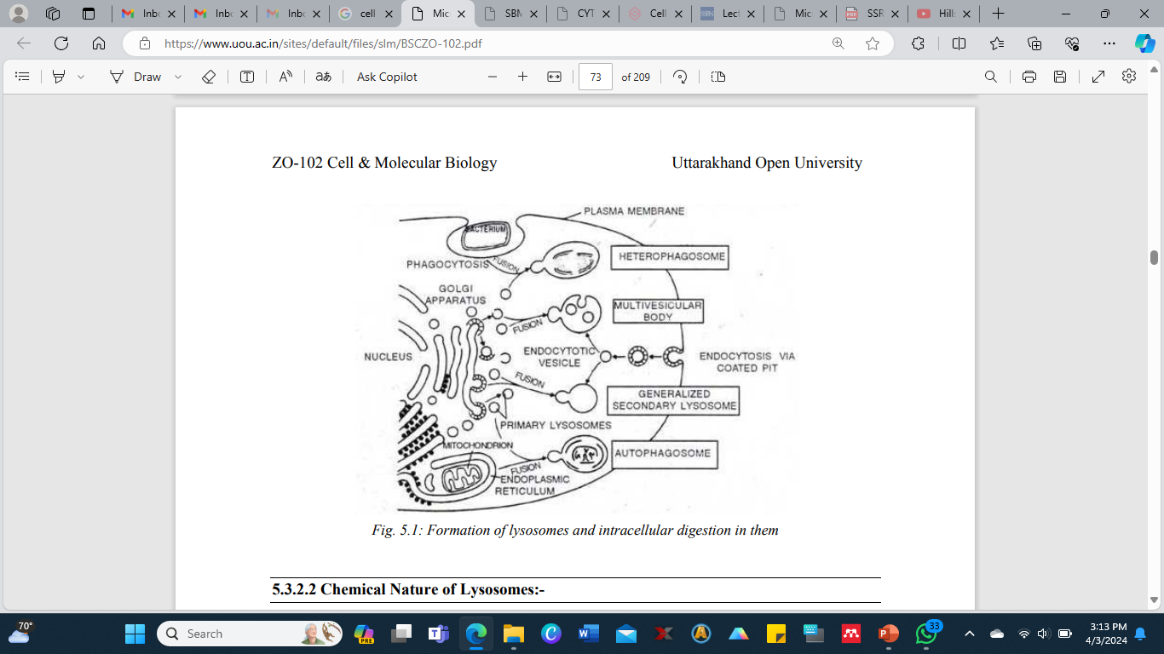
Formation of lysosomes and intracellular digestion in them

Slide 115
Chemical Nature of Lysosomes
Chemically lysosomes are defined as a body rich in acid hydrolases.
Acid phosphatase has been found in many cells of plant roots, fungi, liver, kidney and endocrine glands.
The lysosomal enzymes can break down all major biological macromolecules present in the cells or entering the cells from outside into their building block subunits by adding water.
The common enzymes in the lysosomes are proteases, nucleases (deoxyribonuclease and ribonuclease), glycosidase, lipases, sulphatases and phosphatase, which hydrolyses proteins, nucleic acids, polysaccharides, lipids, organic sulphatases and organic phosphates respectively.

Slide 116
Functions of Lysosomes
1. Digestion of useful materials: Intracellular digestion is a regular feature in protozoans and in lower invertebrates such as sponges and coelenterates. In this process the organic substances (food particles) taken up by the cells in vacuoles (pinosomes or phagosome) from the environment are digested.
2. Digestion of harmful materials: The foreign particles, such as viruses, bacteria and toxic molecules, are disposed of by hydrolyzing them in certain leucocytes and macrophages.
This is called natural defense of the body. This activity of lysosomes is characteristic of higher animals.
3. Digestion of unwanted materials: The dead cells and debris that accumulate at the sites of injury are destroyed in some white blood cells. This is called natural scavenging of the body.

Slide 117
4. Renewal of cells and organelles: The old worn out cells and cell organelles are broken down to make the component molecules available for formation of new cells and cell organelles. Thus, the lysosomes facilitate the turn-over of cells in normal tissues and of organelles in normal cells.
5. Feeding of starving animals: Food to a starving animal is provided by digesting the stored food materials (proteins, lipids and glycogen) and even the cells. This is called autophagy.
6. Autolysis: Autolysis caused by the lysosomal enzymes plays a role in normal developmental changes in both animals and plants. E.g., in the breakdown and absorption of tail during the metamorphosis of frog's tadpole. In autolysis, lysosome membrane ruptures and releases the enzymes into the surrounding cytoplasm. This kills and lyses the cell.
7. Aid in fertilization: The lysosome of sperms releases their enzymes to dissolve the egg membranes for the entry of the sperm into the ovum in fertilization. This is called extracellular digestion.

Slide 118
Importance of Lysosomes
As lysosomes store the hydrolyzing enzymes of the cell, they digest the incoming food materials and remove the foreign bodies and their organelles no longer required.
Their membrane prevents the enzymes from escaping into the cytoplasm and destroying it.
Malfunctioning of lysosomes may lead to diseases.
Abnormal rupturing of lysosomal membrane and release of enzymes may cause blood cancer, sunburn and genetic disorders.
The degenerative changes in bones and joints associated with arthritis are suspected to be the result of abnormal release of enzymes from the lysosomes of the bone cells or lymph cells into the extracellular fluid.

Slide 119
Centriole
General History of Centriole
Van Benden in 1880 discovered centrosome in cells of certain parasites of cephalopods.
Centrosome is the area of cytoplasm, often a clear zone, around the centriole.
It is found lying in the center of the cell, near the nucleus, in the cytoplasm.
In Metazoa, centrosome lies outside the nucleus, but in Protozoa it lies within the nucleus.
It is lacking in some plant cells. T. Boveri in 1888 described centrosome in detail.
The substance of centrosome also called kinoplasm consists of two parts:
- Smaller bodies or centrioles
- Surrounding mass or centrosphere

Slide 120
Structure of Centriole
The centrioles usually occur as paired hollow cylinders which are about 0.2µm in diameter and 0.3 to 0.5 µm in length.
The two centrioles usually lie at right angles to each other.
The centriole is composed of nine sets of microtubules triplets arranged in a ring and embedded in a dense granular or amorphous, electron dense matrix (Fig. 2).
There are no microtubules at the center of the ring giving the "9+0" pattern for the centriole.
Each microtubule in a triplet is about 250Å wide.
The triplets are tilted in such a way that each forms an angle of about 30 to 40° to the circumference of the cylinder, with the A sub tubule of each set nearest the center of the ring.
Membrane around the centrioles is absent.
Sometimes a granular disc, called satellites, appears around the centriole.

Slide 121
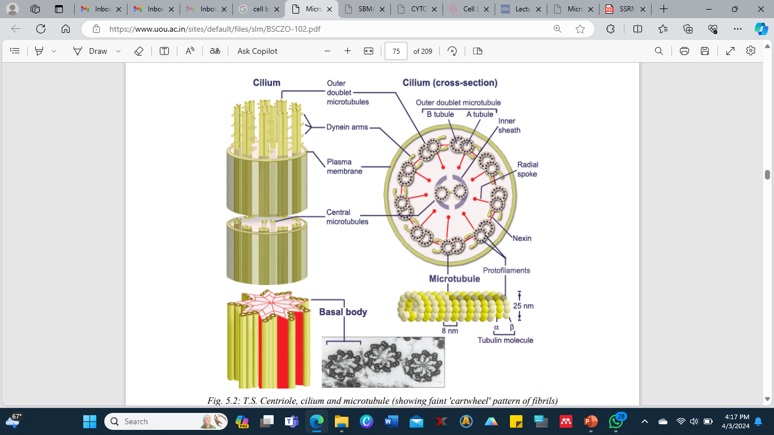
T.S. Centriole, cilium and microtubule
(showing faint 'cartwheel' pattern of fibrils)

Slide 122
All the triplets of centriole are similar and indistinguishable from one another. The three microtubules often called sub-tubules, of a triplet are named A, B and C, beginning from the inside of the cylinder.
A dense strand called A-C linker, connects the A sub-tubule of each triplet to the C sub-tubule of the adjacent triplet.
These A-C linkers cause the tilt of the triplets from the radii of the cylinder.
A fine radial fiber or spoke joins each A sub-tubule to the central hub of the cylinder.
Each radial fiber has a dense thickening, the foot, near the A sub-tubule. This “cart-wheel” configuration though not always presents and when present it is often confined to the denser p

Slide 123
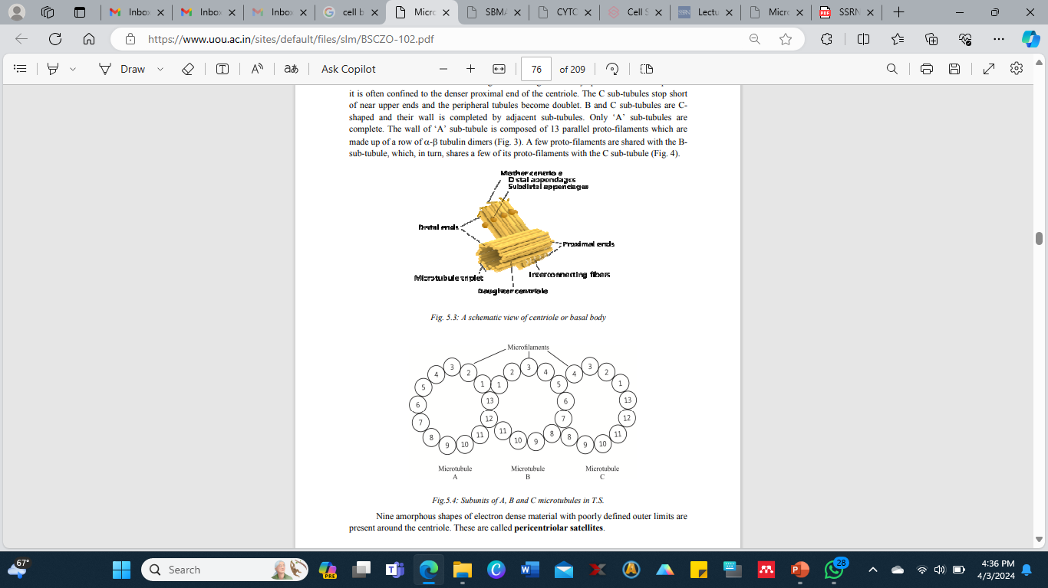
Nine amorphous shapes of electron dense material with poorly defined outer limits are present around the centriole. These are called pericentriolar satellites.

Slide 124
Chemical Composition
The microtubule of the centriole is composed of a protein tubulin and some lipids having a high concentration of ATPase enzymes. They seem to contain RNA and a small DNA molecule. Proteins encoded by this DNA are presumably translated on cytosolic ribosomes and then incorporated into the centriole.
Functions of Centriole: The centriole serves the following functions:
(i) They help in organizing spindle fibers and astral rays during mitosis and meiosis.
(ii) They provide basal bodies giving rise to cilia and flagella.
(iii) Pericentriolar material acts at the MTOC (microtubule-organizing centre) for the cytoplasmic microtubules.
Importance of Centriole: Centriole is involved in the formation of spindle and astral rays which are responsible for the chromosomal movements during cell division. Also, centrioles give rise to basal bodies (kinetosome) or cilia or flagella.

Slide 125
Microtubules
General History of Microtubule
The cytologists like Freud (1882), Ballowitz (1890) and Meves (1910) observed filamentous components of the cytoplasm and referred these as fibrils.
Later, with the improved microscopic techniques along with advancement made in the field of sectioning and staining, the ultra structure of these components was revealed.
These were found to be tubular in nature (Burgos and Fawcett, 1955; Palay, 1960; Harris, 1962).
De Robertis and Franchi (1953) reported the presence of microtubules in the axons of medullated nerve fibers and called them neurotubules.
Slautterback in 1963 describes them to be associated with the developing nematocysts of Hydra and he proposed the name microtubules to these components.

Slide 126
Structure of Microtubule
The microtubules are hollow, unbranched cylinders, generally about 200 to 270 Å thick and several micrometers long.
They may occur singly or in bundles, and radiate from the centriole to the periphery of the cell.
The microtubule is composed of 13 parallel protofilaments that run its entire length and enclose a central lumen about 150 Å wide.
Each proto-filament is made up of a row of globular subunits that have a diameter of about 40 to 50 Å.
There may be cross bridges between adjacent microtubules.

Slide 127
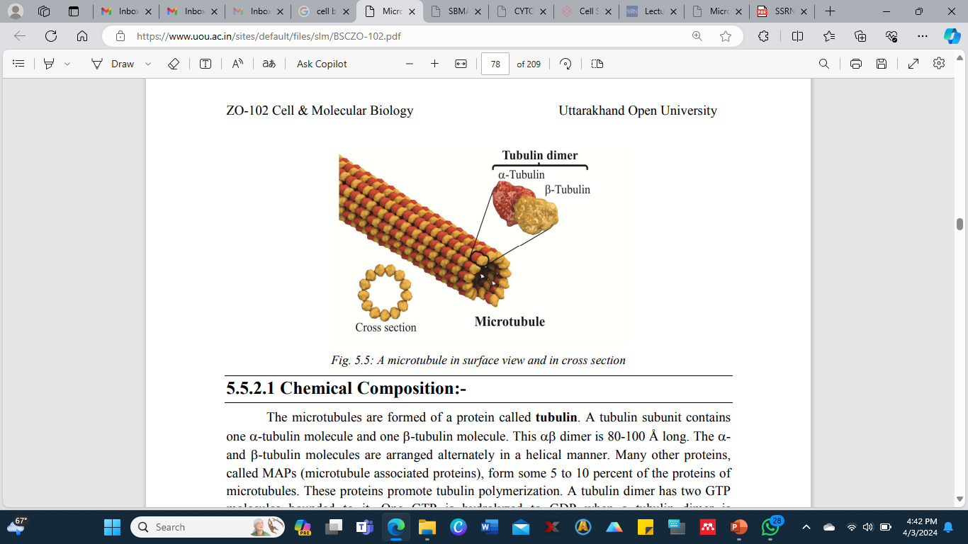
A microtubule in surface view and in cross section

Slide 128
Chemical Composition
The microtubules are formed of a protein called tubulin.
A tubulin subunit contains one α-tubulin molecule and one β-tubulin molecule.
This αβ dimer is 80-100 Å long.
The αand β-tubulin molecules are arranged alternately in a helical manner.
Many other proteins, called MAPs (microtubule associated proteins), form some 5 to 10 percent of the proteins of microtubules.
These proteins promote tubulin polymerization.
A tubulin dimer has two GTP molecules bounded to it. One GTP is hydrolyzed to GDP when a tubulin dimer is incorporated into a microtubule.
The α-β-α-β arrangement of the tubulin subunits gives polarity to the microtubule.

Slide 129
Functions of Microtubules
1. Form and support: The microtubules form a part of cytoskeleton which (a) maintains the shape of the cell and (b) provides mechanical support to the cell. This role of microtubules is especially evident in cells having long processes such as the axopodia of certain protozoans and axons of nerve cells. Red blood corpuscles of nonmammalian vertebrates are kept flat by peripheral band microtubules.
2. Movement: The microtubules form the motile elements of cilia and flagella. These bring about locomotion in protists and cause currents in the environment of animals.
3. Components of centriole and basal bodies: The microtubules are components of centriole and basal bodies. The centriole give rise to the mitotic spindle and the basal bodies produce cilia and flagella.
4. Formation of mitotic spindle: The microtubules forms the spindle and astral rays in cell division.
5. Chromosome movement: The chromosome fibers of spindle bring about movement of the chromosomes to the opposite poles of the cell in the anaphase.
6. Cell differentiation: The microtubules play a role in cell differentiation and determination of polarity.
7. Intracellular transport: Vesicles and protein molecules in the cell move along the "tracks" of microtubules. The movement is brought about by motor proteins kinesin and MAPIC (cytoplasmic dynin) powered by ATP.

Slide 130
Importance of Microtubules
Microtubules are very important for the cells as they provide internal framework serving as cytoskeleton to determine and maintain the cell form.
They also define pathway along which the particles move in cell.
The mitotic apparatus consisting of spindle fibers and astral rays is in fact bundles of microtubules.
The generation of bending movements in cilia and flagella is attributed to a sliding microtubule mechanism.

Slide 131
Glossary
Lysosome: an organelle in the cytoplasm of eukaryotic cells containing degrading or hydrolysing enzymes enclosed in a membrane.
Matrix: matrix is the material in animal or plant cells, in which more specialized structures are embedded. A specific part of the mitochondrion that is the site of oxidation of organic molecules is also called matrix.
Plasmalemma: Plasmalemma is the cell membrane that surrounds the cytoplasm of living cells, physically separating the intracellular components from the extracellular environment. Centriole: It is a cylindrical cell structure composed mainly of a protein called tubulin.
Phagocytosis: Phagocytosis is the process by which a cell engulfs a solid particle to form an internal vesicle known as a phagosome.
Pinocytosis: The ingestion of liquid into a cell by the budding of small vesicles from the cell membrane.

Slide 132
Autophagosome: Autophagy allows the orderly degradation and recycling of cellular components. During this process, targeted cytoplasmic constituents are isolated from the rest of the cell within a double-membrane vesicle known as an autophagosome.
Leucocytes: White blood cells are also called leucocytes. These are the cells of the immune system that are involved in protecting the body against both infectious diseases and foreign invaders.
Macrophages: Macrophages are the type of white blood cells that engulf and digest cellular debris, foreign substances, microbes, cancer cells, and anything else that does not have the types of proteins specific of healthy body cells on its surface.
Metamorphosis: Metamorphosis is a biological process by which an animal physically develops after birth or hatching, involving a conspicuous and relatively abrupt change in the animal's body structure through cell growth and differentiation.

Slide 133
Kinetosome: Kinetosome forms the base of the flagellum, consisting of a circular arrangement of microtubules.
Dimer: A dimer is a chemical structure formed from two similar subunits. Metabolic pathway: A sequence of chemical reactions undergone by a compound or class of compounds in a living organism.
Electron microscope: A microscope that uses a beam of accelerated electrons as a source of illumination is known as electron microscope. As the wavelength of an electron can be up to 100,000 times shorter than that of visible light photons, the electron microscope has a higher resolving power than a light microscope and can reveal the structure of smaller objects.
Pericentriolar satellite: Pericentriolar satellites are electron-dense granules that are concentrated around the centrosome. They are involved in the recruitment of centrosomal proteins and microtubule organization the interphase stage of the cells.

Slide 134
Self Assessment Questions and Possible Answers: Multiple Choice Questions:
1. Lysosomes arise from: (a) Smooth ER (b) Golgi complex (c) Both of these (d) None of these
2. Autophagic vesicles digest: (a) Pinosome contents (b) Cell organelles (c) Phagosome contents (d) Micro-organisms
3. Lysosome was discovered by: (a) de Duve (b) Robert Brown (c) Hooke (d) Robinson
4. Lysosomes are considered suicide bags because they contain: (a) Parasitic activity (b) Food vacuole (c) Catabolic enzymes (d) Hydrolytic enzymes
5. The pattern of organization in centriole is: (a) 9 + 0 (b) 9 + 1 (c) 9 + 2 (d) 9 + 3
6. Centriole occurs: (a) Singly (b) In pairs (c) In threes (d) In fours
7. Function of centriole is related with: (a) Initiation of cell division (b) Formation of cell plate (c) Formation of spindle fibers (d) Formation of nucleolus
8. Microtubules in cilia and flagella are formed of: (a) Actin (b) Myosin (c) Elastin (d) Tubulin
9. Arms of A sub-units are composed of: (a) Tubulin (b) Actin (c) Myosin (d) Dynein
10. The supporting framework of a cell consists of: (a) Microtubules (b) Intermediate filament (c) Microfilaments (d) All the above

Slide 135
Very Short Questions
1. Who gave the name lysosome?
2. How the cell is protected from the destructive effect of lysosomal enzymes?
3. Name different types of lysosomes.
4. Give the popular name for the lysosomes.
5. Name the protein of which microtubules in centriole, basal bodies, cilia and flagella are formed. 6. Who discovered the microtubules?
7. What are Kinetosomes?
8. Give the main function of centrioles.
9. Microtubules are hollow. Is it true?
10. What MTOC stands for?
Terminal and Model Questions
1. Define Lysosomes along with their detailed chemical structure.
2. Describe various types of lysosomes.
3. Write notes on: a. Functions of lysosomes b. chemical structure of centriole c. functions of centriole d. structure and function of microtubules e. types of lysosomes
4. Explain in detail the ultra structure centriole.
5. Explain in detail the ultra structure microtubules.

Slide 136
Nucleus
General History of Nucleus
Nucleus was observed by a Dutch Microscopist, Antonie van Leeuwenhoek in 1710, as a centrally placed clear area in the blood cells of amphibians and birds.
Fontana (1781) recorded an ovoid structure in each of the isolated epidermal cells of eel's skin.
However, Robert Brown (1831) was the first to use the term nucleus for a prominent body present in the orchid cell.
He stated that nucleus was the regular feature of the cells and initiated the concept of nucleated cells.

Slide 137
Structure of Nucleus
The nucleus consists of various parts.
It is bounded by a thin but clearly defined covering, the nuclear envelop or karyotheca.
Within the envelope is a clear fluid substance called nucleoplasm or nuclear sap or karyolymph is present in which the solutes of the nucleus are dissolved.
Suspended in the nucleoplasm are network of protein-containing fibrils called nuclear matrix; fine intermingled nucleoprotein filaments collectively referred to as the chromatin; and one or more spherical bodies known as nucleoli (singular, nucleolus).
There are no membranes or microtubules inside the nucleus.
Protozoans that form a mitotic spindle within the nuclear envelop, however, have microtubules in their nuclei.

Slide 138
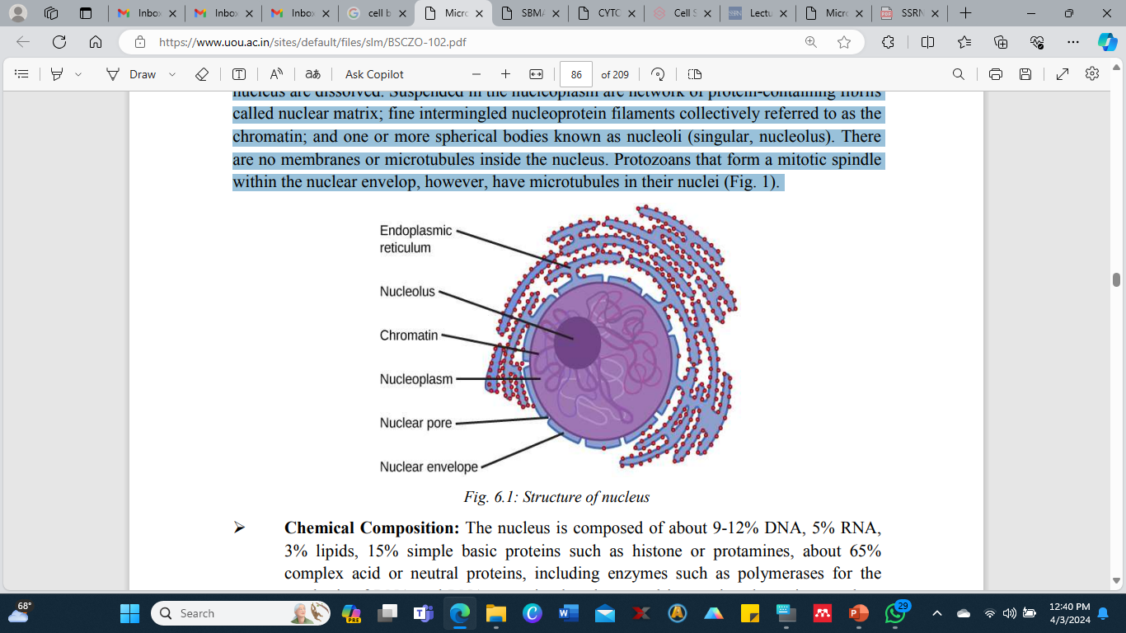
Structure of nucleus

Slide 139
Chemical Composition of the Nucleus
Is composed of about 9-12% DNA, 5% RNA, 3% lipids, 15% simple basic proteins such as histone or protamines, about 65% complex acid or neutral proteins, including enzymes such as polymerases for the synthesis of DNA and RNA, organic phosphates and inorganic salts or ions such as Mg++, Ca++ and Fe++ .
Functions of the Nucleus
The nucleus acts as a control center of the cell. It serves the following main functions:
• It maintains the cell by directing the synthesis of structural proteins.
• It regulates cell metabolism by directing the synthesis of enzymatic proteins.
• It contains genetic information for reproduction, development and behavior of the organism besides for structure and metabolism.
• It brings about cell replication when needed.
• It is the site for the formation of ribosome subunits.
• It brings about cell differentiation by keeping only certain genes operational.
• It develops genetic variations that result in evolution.

Slide 140
Nuclear Envelope
The nuclear envelop separates the nucleoplasm from the cytoplasm. It consists of two unit membranes: outer and inner. Each unit membrane is about 75Å thick, and is a trilaminar lipoprotein like the plasma membrane. The two unit membranes are separated by a space called the inter membrane or perinuclear space. It is about 250Å wide.
The outer or cytoplasmic surface of the outer membrane is studded with ribosomes and polysomes and is rough. These ribosomes carry on protein synthesis. The outer membrane is continuous with RER at certain places.
Thus, the perinuclear space is continuous with the channels of the RER. The inner membrane of the nuclear envelope is free of ribosomes, but has a dense layer, the nuclear lamina, closely associated with its inner or nucleoplasmic surface. The nuclear lamina is a 30 to 100 nm thick network of filaments composed of proteins named lamina A, B and C.
The nuclear lamina supports the inner membrane and gives shape to it. It connects chromatin to the inner membrane, keeping most of the chromosomes in the periphery of the nucleus. It also plays a role in the breakdown and reformation of nuclear envelope during mitosis.

Slide 141
Nuclear Pores
The nuclear envelope is generally perforated by minute apertures, the nuclear pores that control the passage of some molecules and particles. The pores are formed by fusion of the inner and outer membranes of the nuclear envelope.
There may be 1000 to 10,000 pores per nucleus. Each nuclear pore is fitted with an apparatus called the pore complex which fills considerable part of the pore.
The pore complex is nearly cylindrical, projects into both cytoplasm and nucleoplasm, and projects beyond the rim of the pore over the nuclear envelope. The pore complex consists of two rings, the annuli, one located at the cytoplasmic rim of the pore and the other at the nucleoplasmic rim.
Each annulus comprises eight symmetrically arranged subunits, and sends a spoke into the pore. The spoke encloses a channel about 100 to 200 Å wide.
Ions and small molecules of the size of monosaccharide, disaccharides or amino acids pass freely between the nucleus and cytoplasm.
The pore complexes do control the passage of larger molecules, such as RNA and proteins, and of ribosomal subunits. The pore complexes also act as a barrier to some molecules such as DNA of chromosomes.

Slide 142
Functions of the Nuclear Pores
It maintains the shape of the nucleus. It keeps the nuclear contents in place and distinct from cytoplasm.
It regulates the flow of materials into and out of the nucleus by active transport and out pocketing. Its pores allow the exit of ribosomal subunits formed in the nucleolus and tRNA and mRNA synthesized on the chromosomes.
Nucleoplasm
Nucleoplasm is a transparent fluid material in the nucleus. The chromatin fibers and nucleoli are suspended in it. It contains raw materials (nucleotides), enzymes (polymerases) and metal ions (Mn++, Mg++) for the synthesis of DNA and RNA. It also contains proteins and lipids. The proteins include basic histones and acidic or neutral non-histones that associate with the DNA molecules. There are proteins for the formation of ribosomal subunits also. The RNAs (rRNAs, tRNAs, mRNAs) and ribosomal subunits synthesized in the nucleoplasm pass into the cytoplasm via nuclear pores.
Functions of the Nucleoplasm
It is the seat for the synthesis of DNA, RNAs, ribosomal subunits, ATP and NAD.
It supports the nuclear matrix, chromatin material and nucleoli. It provides turgidity to the nucleus.

Slide 143
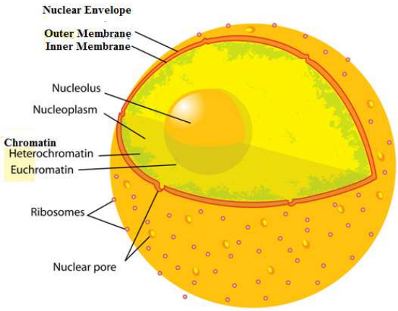
Ultra structure of nucleus

Slide 144
Nuclear Matrix
The nuclear matrix is a network of thin, criss-crossing, protein- containing fibrils that are connected at their ends to the nuclear envelope.
It forms a sort of nuclear skeleton. It remains intact after the chromatin and DNA have been removed.
Functions of the Nuclear Matrix
It maintains the shape of the nucleus.
Chromatin fibers are anchored to nuclear matrix.
The machinery for various nuclear activities, such as transcription and replication, is associated with the matrix.
It has also been implicated in the processing of newly formed RNA molecules and their transport through the nucleus.

Slide 145
Chromatin
The term chromatin was first coined by Flemming in 1879. The chromatin occurs in an interphase (non-dividing) nucleus as fine filaments, the chromatin fibers. The fibers lie criss-cross so as to give the appearance of a diffuse network often referred to as the nuclear or chromatin reticulum. The chromatin occupies most of the nucleus.
The chromatin fibers are simply extremely extended chromosomes. A chromatin fiber is normally about 100Å in diameter. A fiber thicker than 100Å appears to be coiled or folded, a fiber thinner than 100Å seems to have less protein content associated with it.
Chromatin fibers typically appear approximately 250Å in diameter.
During cell division, the chromatin fibers, by condensing and tight coiling, form short, thick, rod like bodies known as chromosomes. Upon staining, this diffuse network of chromatin material shows light stained and dark stained areas.
After cell division, the chromosomes change back into chromatin fibers. Most of the chromatin fibers become uncoiled, extended and scattered in the nucleoplasm.
These represent the euchromatin (true chromatin) of the interphase nucleus. They are stained lightly.

Slide 146
The term heterochromatin is applied to those chromosomal regions that stain darker than others. They remain coiled and compacted in the interphase too.
Heterochromatin represents relatively inactive parts of the chromosomes. It contains less DNA and more RNA than the euchromatin.
Few mutations occur in this region. Little or no mRNA is synthesized here. Most of the DNA in heterochromatin is highly repeated DNA which is never, or very seldom, transcribed.
Heterochromatin is of two types: constitutive and facultative.
The DNA of constitutive heterochromatin is permanently inactivated and remains in the condensed state at all times.
It occurs at several places: adjacent to the centromere of the chromosome, at the ends (telomeres) of the chromosomes, at certain portions within the euchromatin, and adjacent to the nuclear envelope.
Facultative heterochromatin is partly condensed and inactivated. One X-chromosome in female mammals is condensed to form the heterochromatic Barr body.

Slide 147
Nucleosomes
In 1974, Kornberg and Thomas proposed that a chromatin fiber is a chain of similar subunits called nucleosomes.
The nucleosome consists of a core particle wrapped by DNA strand.
The core particle is an octamer of 8 histone molecules, two each of the histones H2A, H2B, H3 and H4.
The DNA strand forms 1½ or 1¾ turns around the core and consists of 140 nucleotides.
Each nucleosome is connected to the next by a short DNA linker of 60 nucleotides.
A nucleosome and a linker together have a total average length of 200 nucleotides and are together referred to as a chromatosome.

Slide 148
A molecule of histone H1 is associated with each DNA linker and it serves to pack nucleosomes together.
Thus, a chromatin fiber is a chain of beads, a bead (nucleosome) is about 100Å wide and DNA linker is about 140Å long.
Nucleosomes represent the lowest level of chromatin organization.
Chromatin fiber appears about 250Å thick in electron micrographs. which suggests that the 100Å thick chromatin fiber is either packed into a spiral or solenoids, containing 6 nucleosomes per turn or 6 nucleosomes are organized into a cluster, or super bead, thereby increasing the DNA packing by 5 folds.
The thicker filament is maintained by H1 histone protein.
The non-histone proteins do not occur in the nucleosome structure of chromatin.
Nucleosomes are not formed in prokaryotes.

Slide 149
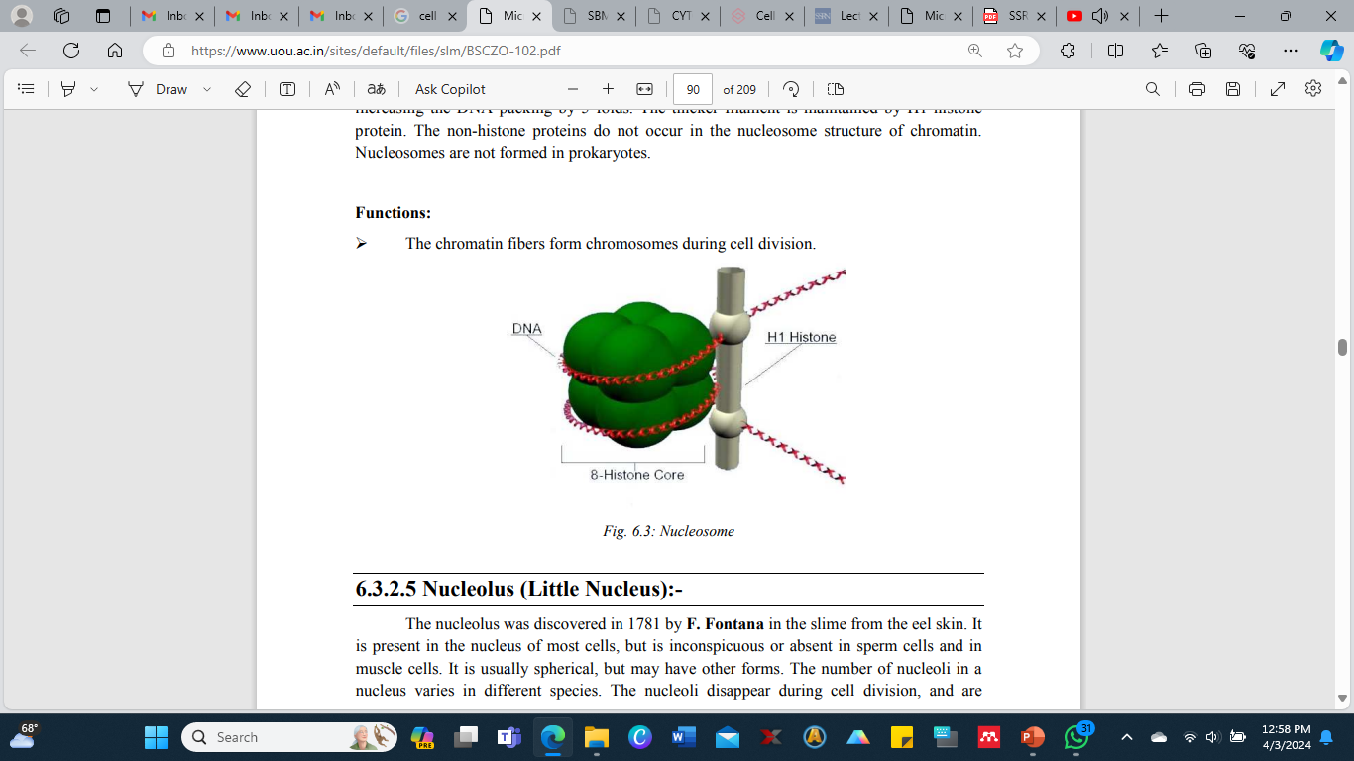
Functions of the Chromatin
The chromatin fibers form chromosomes during cell division.
Nucleosome

Slide 150
Nucleolus (Little Nucleus)
The nucleolus was discovered in 1781 by F. Fontana in the slime from the eel skin.
It is present in the nucleus of most cells, but is inconspicuous or absent in sperm cells and in muscle cells.
It is usually spherical, but may have other forms.
The number of nucleoli in a nucleus varies in different species.
The nucleoli disappear during cell division, and are reformed at specific sites, the nucleolar organizers or nucleolar organizer regions (NORs), of certain chromosomes, the nucleolar chromosomes, at the end of cell division before the chromosomes become diffuse.
Position of the nucleolus in the nucleus is often eccentric.
However, it occupies a specific position on its chromosome.
The nucleolus is a dense, somewhat rounded, dark staining organelle.
It is without a limiting membrane.
Calcium ions keep it intact.

Slide 151
The Nucleolus consists of four regions.
1. Fibrillar Region or Nucleolonema - It contains indistinct fibrils about 50-100Å in diameter. The fibrils represent the long rRNA precursor molecules in early stages of processing before the processing enzymes have cut off segments from them.
2. Granular Region - It contains spherical, electron dense particles, about 150-200 Å in diameter and with fizzy outline. The granules are ribosomal subunits (rRNA + ribosomal proteins) that are nearly ready for transport to the cytoplasm.
3. Amorphous Region or Pars Amorpha - It is a structure-less proteinaceous matrix in which the granular and fibrillar regions are suspended.
4. Nucleolar Chromatin - It consists of 100 Å thick chromatin fibers. The latter are a part of the nucleolar chromosome which follows a tortuous path through the granular and fibrillar components of the nucleolus.
This part contains many copies of DNA that directs the synthesis of ribosomal RNA. The rest of the nucleolar chromosome lies in the nucleoplasm.

Slide 152
Functions of the Nucleolus
The nucleolus synthesizes and stores rRNA.
It also stores ribosomal proteins received from the cytoplasm.
It forms ribosomal subunits by wrapping the rRNA by ribosomal proteins. The ribosomal subunits pass out through the nuclear pores into the cytoplasm. Here the subunits join to form ribosomes when needed. Thus, it is the nucleolus which provides machinery (ribosomes) for protein synthesis.
The nucleolus also plays a role in cell division.
Importance of Nucleus
The nucleus is the control center of a cell.
It regulates all metabolic activities of the cell and stores entire hereditary information.
A cell without nucleus cannot survive.

Slide 153
Glossary on the Nucleus Nucleolus
Neutrophil: Neutrophil are the most abundant type of granulocyte and the most abundant type of white blood cell in most mammals. They form an essential part of the innate immune system.
Karyotheca: A double membrane at the boundary of the nucleoplasm is called karyolymph. It has regularly spaced pores covered by a disc-like nuclear pore complex and a space between the two membranes; the outer membrane is continuous at intervals with the rough endoplasmic reticulum.
Karyolymph: It is the fluid or gel-like substance of the nucleus in which the chromatin material, nucleolus, and other particulate elements of the nucleus are suspended.
Annuli: It is a ring-shaped object, structure, or region.
Heterochromatin: Heterochromatin represents relatively inactive parts of the chromosomes. They stain darker than others and remain coiled and compacted in the interphase.

Slide 154
Euchromatin: The uncoiled chromatin fibers, extended and scattered in the nucleoplasm represent the euchromatin (true chromatin) of the interphase nucleus. They are stained lightly.
Constitutive heterochromatin: The DNA of constitutive heterochromatin is permanently inactivated and remains in the condensed state at all times.
Facultative heterochromatin: Heterochromatin that is partly condensed and inactivated is called facultative heterochromatin.
DNA linker: Linker DNA is double-stranded DNA in between two nucleosome cores that, in association with histone H1, holds the cores together.
Histone proteins: Histones are highly alkaline proteins found in eukaryotic cell nuclei that package and order the DNA into structural units called nucleosomes.

Slide 155
Self Assessment Questions and Possible Answers
Multiple Choice Questions:
1. Nucleus is separated from cytoplasm by nuclear membrane which is: (a) Double, non-porous (b) Single, non-porous (c) Single, porous (d) Double, porous
2. Nucleolus is especially rich in: (a) DNA and proteins (b) DNA and lipids (c) RNA and proteins (d) RNA and lipids
3. Nuclear membrane facilitates: (a) Synapses of homologous chromosomes (b) Nucleocytoplasmic exchange of materials (c) Anaphasic separation of daughter chromosomes (d) Organization of spindles
4. Nucleoplasm is continuous with cytoplasm through: (a) Centriole (b) Nucleopores (c) E.R. (d) Golgi Body
5. The major component of the nucleus is: (a) DNA (b) RNA (c) Lipids (d) Proteins 6. Chief role of nucleolus in a nucleus concerns: (a) Organization of chromosomes (b) DNA replication (c) Ribosomal synthesis (d) Chromatid separation
7. Nucleus was discovered by: (a) Robert Brown (b) Robert Hook (c) Virchow (d) De Duve
8. Nucleolar organizer is associated with: (a) Synthesis of plasma membrane (b) Ribosome formation (c) G6PD (d) Disappearance of nuclear membrane

Slide 156
Very Short Questions:
1. What the study of nucleus is called?
2. Who discovered the nucleus?
3. How many types of histones are found associated with DNA?
4. What is the composition of chromatin?
5. What are nucleosomes?
6. What is an interphase nucleus?
7. Give the role of DNA present in nucleolus?
8. Which has more DNA and less RNA, euchromatin or heterochromatin?
9. Where are nucleoli formed at the end of cell division?
10. Name two types of chromatin.
Terminal and Model Questions
1. Discuss the morphology, chemical organization and functions of the nucleus.
2. Give detailed account of nuclear envelope.
3. Give an account of nuclear matrix.
4. Describe the nuclear pore.
5. Write a short account of the ultra-structure of the nucleus. Mention its chemical composition.

Slide 157
Chromosomes
The word chromosome has been derived from two Greek words "Chroma" meaning colour and "Soma" meaning body.
They are the unique cell organelles made up of chromatin material which is the most important and permanent constituent of the cell nucleus.
They are capable of self-reproduction. They control cell's structure and metabolism, and play an important role in the differentiation, heredity, mutation and evolution.
General History of Chromosomes
W. Hofmeister in 1848, discovered nuclear filaments in the nuclei of pollen mother cells of Tradescantia.
First accurate count of chromosomes was made by W. Flemming in 1882, in the nucleus of a cell.
In 1884, W. Flemming, Evan Beneden and E. Strasburger demonstrated that the chromosomes double in number by longitudinal division during mitosis.
Beneden in 1887 found that the number of chromosomes for each species was constant.
The term "Chromosomes" was coined in 1888 by W. Waldeyer for the nuclear filaments. W.S. Sutton and T. Boveri suggested the role of chromosomes in heredity in 1902, which was confirmed by Morgan in 1933.

Slide 158
The structure of chromosomes varies in viruses, prokaryotes and eukaryotes.
1. Viral chromosome- In viruses there is a single chromosome bearing a single nucleic acid molecule (DNA or RNA) surrounded by a protein coat called Capsid.
It may be linear or circular.
The viruses having DNA as genetic material are called DNA viruses and those having RNA as genetic material are known as RNA viruses.
A limited amount of genetic information is present in the viral chromosome which codes for little more than the production of more virus particles of the same kind in the host cell.
In RNA viruses, often the RNA directs the synthesis of DNA complementary to itself by reverse transcription in the host.
The RNA is then transcribed by the DNA for the formation of new virus particles. Such ribovirus is called retrovirus.
The AIDS causing virus is a retrovirus.

Slide 159
The structure of chromosomes varies in viruses, prokaryotes and eukaryotes.
1. Viral chromosome - In viruses there is a single chromosome bearing a single nucleic acid molecule (DNA or RNA) surrounded by a protein coat called Capsid.
It may be linear or circular.
The viruses having DNA as genetic material are called DNA viruses and those having RNA as genetic material are known as RNA viruses.
A limited amount of genetic information is present in the viral chromosome which codes for little more than the production of more virus particles of the same kind in the host cell.
In RNA viruses, often the RNA directs the synthesis of DNA complementary to itself by reverse transcription in the host.
The RNA is then transcribed by the DNA for the formation of new virus particles.
Such ribovirus is called retrovirus.
The AIDS causing virus is a retrovirus.

Slide 160
2. Prokaryotic chromosomes - Prokaryotic chromosome (e.g., bacteria) has a single and circular two-stranded DNA molecule which is not enveloped by any membrane.
It lacks proteins and is in direct contact with the cytoplasm.
The bacterial chromosome is packed into the nucleoid by some RNA that appears to form a core.
It is attached to plasma membrane permanently at least at one point.
In addition to the main chromosome some extra-chromosomal DNA molecules may also be present in most of the bacterial cells they are also double stranded and circular, but are much smaller in size.
They are known as plasmids.
The plasmid may occur independently in the cytoplasm of calls or may also be found in association of main chromosomal DNA and called as episome.

Slide 161
3. Eukaryotic chromosomes - The eukaryotic chromosomes are present in nucleus and in certain other organelles, like mitochondria and plastids.
These chromosomes are called nuclear and extra nuclear chromosomes respectively.
Nuclear chromosomes are double stranded long DNA molecules of linear form.
Proteins are associated with them. They are surrounded by nuclear envelope. More DNA is involved in coding far more proteins than the prokaryotic chromosomes.
Extra nuclear chromosomes are present in mitochondria and plastids. They are double stranded short DNA molecules of circular form. They lack protein association.
Less genetic information is available for the synthesis of only some particles of proteins for the organelles containing them.
Other proteins are received from the cytoplasm where they are synthesized under the direction of nuclear chromosomes.

Slide 162
Morphology of Chromosomes
During the interphase stage, the eukaryotic chromosomes are extended into long and thin chromatin fibers where they lie criss-cross to form the chromatin reticulum.
They replicate in the S-phase and become double. At this stage they consist of two chromatids that are held together at one point called centromere.
At the time of cell division, the chromosomes condense and tightly coil up and become distinct at metaphase stage.
The eukaryotic chromosomes vary in number, size, shape and position but they have remarkably uniform structure.
1. Number - Eukaryotic chromosomes vary in number from two to a few hundred in different species. In a species all the individuals have same number of chromosomes in all of their cells, except the gametes.
Since the chromosome number is constant for a species, it is helpful in determining the phylogeny and taxonomic position of the species.

Slide 163
2. Size - In a species all the chromosomes are not of the same size. Their size also varies from species to species.
The particular chromosome of a species however has more or less a constant size.
The organisms having fewer chromosomes have large sized chromosomes than those having many.
Generally, plant chromosomes are larger than animal chromosomes and among plants the monocots have larger chromosomes than the dicots.
3. Shape - The chromosomes at metaphase stage look like slender rods that may be straight or curved to form an arc or a letter S. In anaphase stage they may assume J or V shapes, depending upon the position of the centromere.
4. Position - In a nucleus each chromosome is independent of all the other chromosomes in its location. Thus, they may occupy any region of the nucleus.

Slide 164
5. Structure- At metaphase stage, since the chromosome is a highly condensed nucleoprotein filament, it contains two greatly coiled sister chromatids. These chromatids that lie side by side along their length, are held together at a point called centromere, an area of the narrow region also called primary constriction of the metaphase chromosome. At the centromere each chromatid has a darkly staining, disc like, fibrous structure, called kinetochore, to which spindle microtubules attach during cell division.
Kinetochores are the sites where force is exerted to pull the chromatids towards the poles. One or more chromosomes may have additional narrow regions called the secondary constrictions. The part of the chromosome separated by secondary constrictions is termed as satellite. A chromosome with a satellite is called sat chromosome. The size and the shape of the satellite remain constant for a species. Secondary constrictions are associated with the nucleoli, and are known as the nucleolar organizers. The chromosomes which have nucleolar organizing regions are known as the nucleolar chromosomes.
Ends- The ends of chromosomes are called telomeres. The function of telomere varies from the rest of the chromosome. On exposure to X-rays a chromosome may break and its pieces may rejoin, but no segment connects to the telomere, showing that the telomere has a polarity, and it, somehow "seals" the end.

Slide 165
6. Ultra structure - A chromatid contains a very fine filament called chromonema which is a single, long, double stranded DNA molecule.
It is wrapped around histones to form nucleosomes.
The nucleosome and non-histone proteins together form the chromatin fiber.
The chromatin fiber has reactive groups, probably H1 histone molecules, which act as "folders" and crosslink the chromatin fiber changing it into a great coiled, compact metaphase chromatid.
7. Chemical composition - The chromatin in the eukaryotic chromosome consists chemically of about 35% DNA, about 60% proteins, about 5% RNA, some metal ions and certain enzymes.

Slide 166
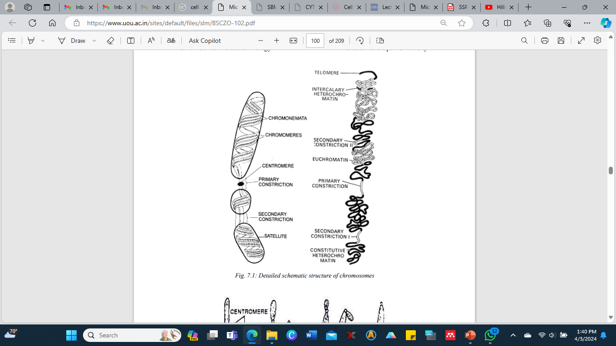
Detailed schematic structure of chromosomes

Slide 167
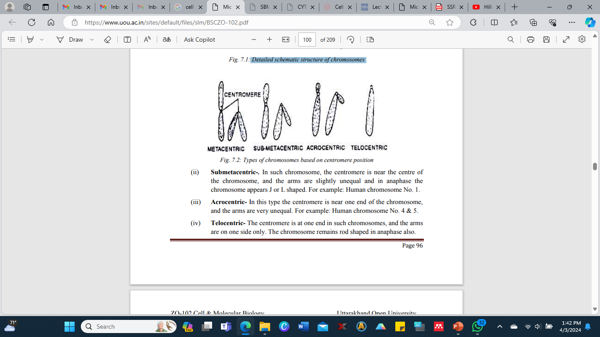
Types of chromosomes based on centromere position

Slide 168
8. Types of chromosomes
On the basis of the position and number of centromeres, the chromosomes are classified as below:
(i) Metacentric - In metacentric chromosomes the centromere is at the middle of the chromosome, and the arms are equal. In anaphase the chromosome appears V-shaped. For example: human chromosome no. 3.
(ii) Submetacentric - In such chromosome, the centromere is near the centre of the chromosome, and the arms are slightly unequal and in anaphase the chromosome appears J or L shaped. For example: Human Chromosome no. 1.
(iii) Acrocentric - In this type the centromere is near one end of the chromosome, and the arms are very unequal. For example: Human chromosome No. 4 & 5.
(iv) Telocentric - The centromere is at one end in such chromosomes, and the arms are on one side only. The chromosome remains rod shaped in anaphase also.

Slide 169
Depending upon the number of centromeres there are three types of chromosomes:
(i) Acentric - The chromosome is without a centromere, which is formed by breakage of the chromosome. It does not attach to spindle microtubules so it is lost in the cell division.
(ii) Monocentric - It is the chromosome with a single centromere and it is the most common type.
(iii) Dicentric - It is the chromosome with two centromeres and is formed by the fusion of two chromosome segments each having a centromere.
It is unstable and may break when the two centromeres are pulled to opposite poles in mitosis.

Slide 170
Functions of Chromosomes
(i) Chromosomes carry hereditary characters from parents to offspring.
(ii) They direct the synthesis of structural proteins and thus, help the cell grow, divide and maintain itself.
(iii) By directing the formation of necessary enzymes, they control metabolism.
(iv) They guide cell differentiation during development.
(v) They form nucleoli at nucleolar organizer sites in daughter cells.
(vi) They produce variations through changes in their genes and contribute to the evolution of the organisms.
(vii) They play role in sex determination.
(viii) They maintain the continuity of life by replication.

Slide 171
Clinical Correlates
Nondisjunction of Chromosomes
During prophase I of meiosis I, chromosome pairs align themselves at the equatorial plate and exchange genetic materials.
During anaphase I, the chromosome pairs will separate and begin their migrations to opposite poles.
Sometimes, the members of a pair fail to separate, resulting in one daughter cell containing an extra chromosome (n + 1 = 24), whereas the daughter cell at the opposite pole is minus a chromosome (n − 1 = 22).
This development is known as nondisjunction.
Upon fertilization with a normal gamete containing 23 chromosomes, the resulting zygote will contain either 47 chromosomes (trisomy for that extra chromosome) or 45 chromosomes (monosomy for that missing chromosome).

Slide 172
Clinical Correlates contd:
Chromosomes 8, 9, 13, 18, and 21 are most frequently affected by nondisjunction.
Aneuploidy, defined as an abnormal number of chromosomes, can be detected by karyotyping.
1. Down syndrome (trisomy 21) is characterized by mental retardation, short stature, stubby appendages, congenital heart malformations, and other defects.
2. Klinefelter syndrome (XXY) is aneuploidy of the sex chromosomes, characterized by infertility, variable degrees of masculinization, and small testes.
3. Turner syndrome (XO) is monosomy of the sex chromosomes, characterized by short stature, sterility, and various other abnormalities.

Slide 173
Giant Chromosomes
Giant chromosomes are special, enormously enlarged chromosomes about 100 times thicker than the ordinary mitotic chromosomes.
These are seen in certain tissues of varied groups of animals and plants.
They are easily visible under light microscope.
The giant chromosomes are of two types: polytene and lampbrush.

Slide 174
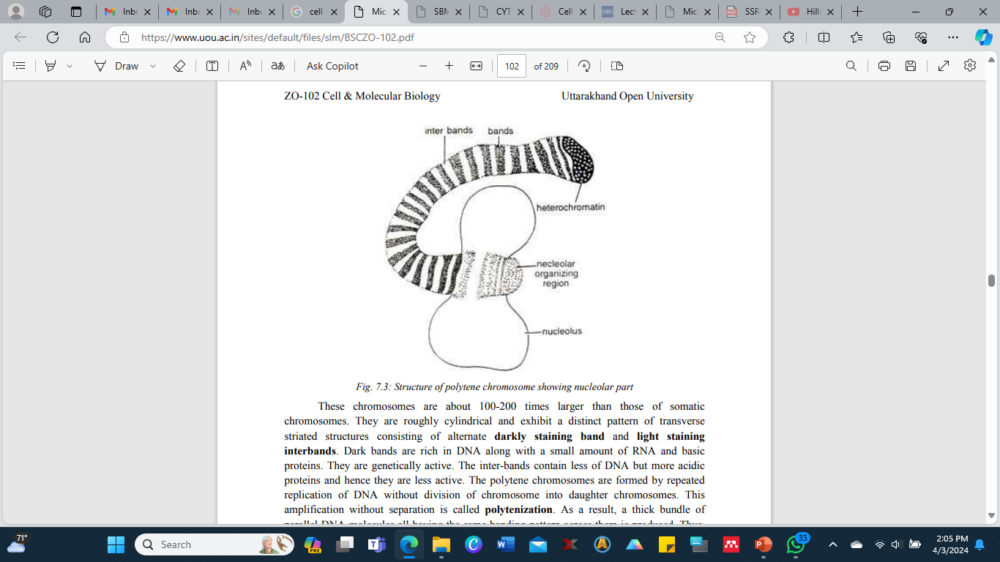
Polytene Chromosomes
Polytene chromosomes were first observed by Balbiani (1881) in Chironomus (a dipteran larva).
Because of their large size showing numerous strands these are named as polytene chromosomes by Kollar.
These banded chromosomes occur in the larval salivary glands, midgut epithelium, and rectum and Malpighian tubules of various genera of dipterans.
These are also known as salivary gland chromosomes because they have been best studied in the salivary gland cells of fly larvae.
Structure of polytene chromosome showing nucleolar part

Slide 175
These chromosomes are about 100-200 times larger than those of somatic chromosomes.
They are roughly cylindrical and exhibit a distinct pattern of transverse striated structures consisting of alternate darkly staining band and light staining interbands.
Dark bands are rich in DNA along with a small amount of RNA and basic proteins.
They are genetically active. The inter-bands contain less of DNA but more acidic proteins and hence they are less active.
The polytene chromosomes are formed by repeated replication of DNA without division of chromosome into daughter chromosomes.
This amplification without separation is called polytenization.
As a result, a thick bundle of parallel DNA molecules all having the same banding pattern across them is produced.
Thus, there can be as many as several thousands of chromonemata in a giant chromosome.

Slide 176
During the initial stages of development the bands or inter-bands of chromosomes exhibit swellings or puffs.
During development the puffs appear and disappear in definite patterns in response to the needs of developing larvae for the RNAs.
The puffs are genetic sites active in RNA synthesis.
In some regions of polytene chromosomes the chromonemata may give out a number of loops at certain places.
Such loops are known as the Balbiani rings.
These rings are formed by the lateral stretching of loops.
They are rich in mRNA like the chromosomal puffs.

Slide 177
Functions of the Giant Polytene Chromosomes
(i) Polytene chromosomes carry genes which ultimately control physiology of an organism.
These genes are formed of DNA molecules.
(ii) These chromosomes also help in protein synthesis indirectly.
The RNA present in the nucleolus serves as a means of transmission of genetic information to the cytoplasm, leading to the formation of specific protein.

Slide 178
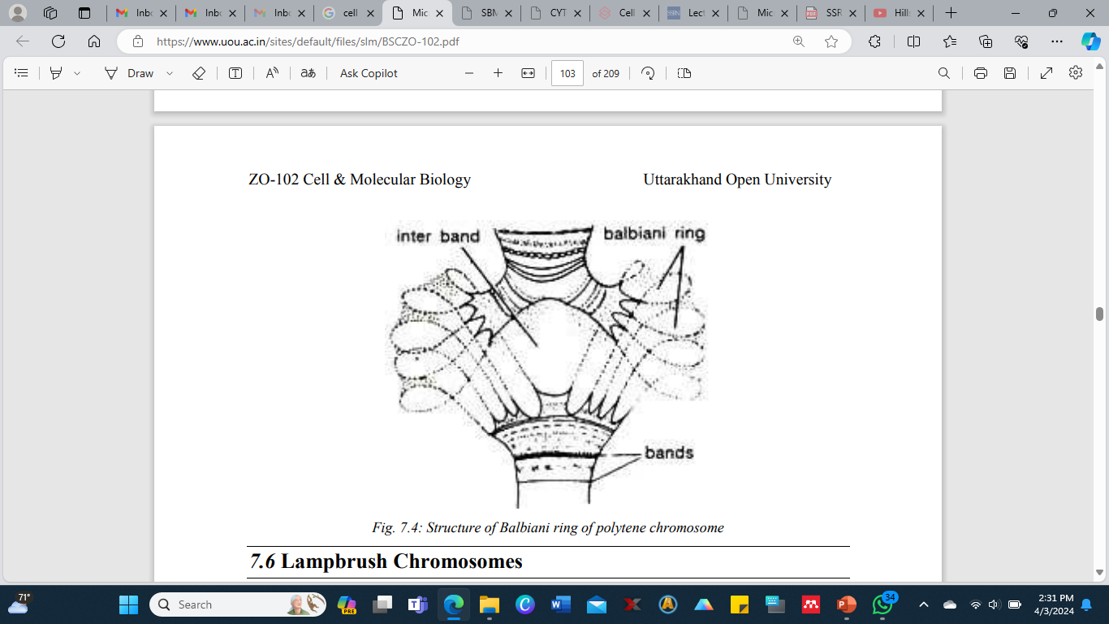
Structure of Balbiani ring of polytene chromosome

Slide 179
Lampbrush Chromosomes
These are the largest chromosomes which can be seen with naked eyes and are found in yolk rich oocytic nuclei of certain vertebrates such as fishes, amphibians, reptiles and birds.
They are characterized by the fine lateral loops, arising from the chromomeres, during first prophase of meiosis.
Because of these loops they appear like brush; that is why they are called lampbrush chromosomes first discovered by Flemming in 1882 and were described in shark oocytes by Ruckert (1892).
Lampbrush chromosome consists of longitudinal axis formed by a single DNA molecule along which hundreds of bead like chromomeres are distributed.
Two symmetrical lateral loops (one for each chromatid) emerge from each chromomere, which are able to expand or contract in response to various environmental conditions. About 5 to 10% of the DNA is in the lateral loops.
The axis having compacted DNA and tightly associated proteins is transcriptionally inactive. The loops consist of uncompacted DNA and proteins but have a good amount of RNA and they are transcriptionally active. A chromomere and its associated loop correspond with one gene.

Slide 180
In lampbrush chromosomes the DNA loops are the sites of intensive RNA synthesis. rRNA and mRNA are synthesized in large amount and the transcription of rRNA causes the enlargement of nucleolus, or formation of numerous additional nucleoli.
Due to the synthesis of large amounts of proteins, fats, carbohydrates and other molecules in the cytoplasm needed for further development of the embryo, the oocyte grows in size.
Synthesis of proteins occurs near the loops.
Functions of Lampbrush Chromosome
(i) These chromosomes are involved in the synthesis of RNA and proteins by their loops.
(ii) Lampbrush chromosomes probably help in the formation of certain amount of yolk material for the egg.

Slide 181
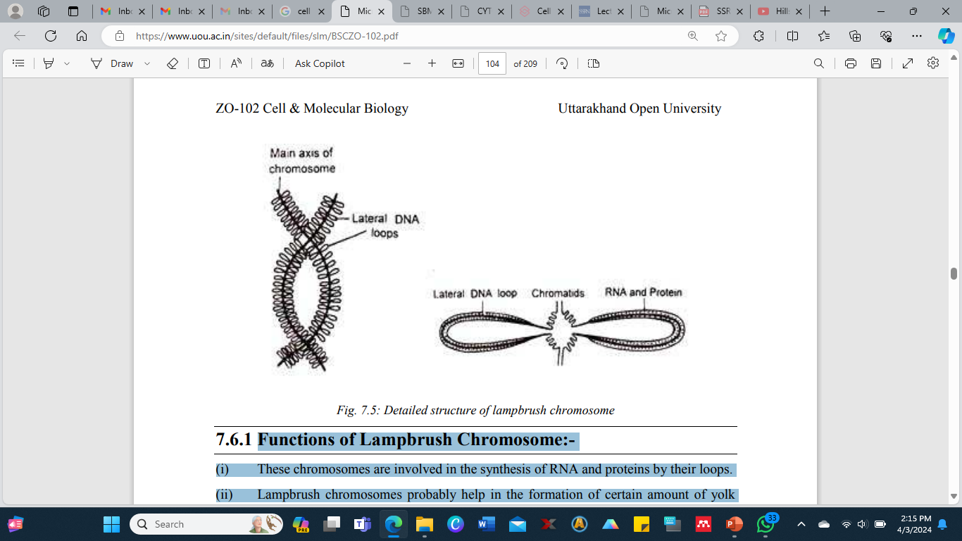
Detailed structure of lampbrush chromosome

Slide 182
Glossary on Chromosomes
Chromatin fiber: A complex of macromolecules found in cells consisting of DNA, RNA and proteins.
Nucleic acid: The biopolymers, which include DNA (deoxyribonucleic acid) and RNA (ribonucleic acid), made from nucleotides are known as nucleic acids.
Ribovirus: Any of a group of viruses whose nucleic acid core is composed of RNA, including the retroviruses and picornaviruses is known as ribovirus.
Nucleoid: The nucleoid is an irregularly shaped region within the cell of a prokaryote that contains all or most of the genetic material and it is not surrounded by a nuclear membrane. Extra nuclear
Chromosomes: Extra chromosomal DNA is any DNA that is found outside of the nucleus of a cell like in mitochondria and plastids.
Centrosome: The centrosome is an organelle that is the main place where cell microtubules get organized.
Kinetochore: A kinetochore is a protein structure that forms on a chromatid during cell division and allows it to attach to a spindle fiber on a chromosome.

Slide 183
Sat-chromosome: A satellite chromosome or SAT chromosome has a chromosome segment that is separated from the main body of the chromosome by a secondary constriction.
Nuclear organizer: A nucleolar organizer is a chromosomal region around which the nucleolus forms.
Telomere: At each end of a chromosome there is a region of repetitive nucleotide sequences which protects the end of the chromosome from deterioration or from fusion with neighboring chromosomes. This region is known as telomere.
Malpighian tubule: The Malpighian tubule system is a type of excretory and osmoregulatory system found in some insects, myriapods, arachnids, and tardigrades. It consists of branching tubules extending from the alimentary canal that absorbs solutes, water, and wastes from the surrounding haemolymph.
Chromomere: A chromomere is one of the serially aligned beads or granules of a eukaryotic chromosome, resulting from local coiling of a continuous DNA thread.

Slide 184
Self Assessment Questions and Possible Answers: Multiple Choice Questions:
1. Chromosomes are best seen in: (a) Interphase (b) Metaphase (c) Prophase (d) Telophase
2. A chromosome with terminal centromere is called: (a) Metacentric (b) Telocentric (c) Submetacentric (d) Acrocentric
3. A chromatid has: (a) One chromonema (b) Four chromonemata (c) Two chromonemata (d) Numerous chromonemata
4. In bacterial chromosomes, nucleic acid polymers are: (a) Linear RNA molecule (b) Linear DNA molecule (c) Two types of DNA and RNA (d) Circular DNA molecule
5. The component of chromosomes that controls heredity is: (a) Proteins (b) RNA (c) DNA (d) Metal ions
6. In which of the following organisms were discovered polytene chromosomes? (a) Musca (b) Cimex (c) Drosophila (d) Chironomus
7. Lampbrush chromosomes are found during: (a) Interphase (b) Metaphase of meiosis (c) Prophase of mitosis (d) First prophase of meiosis
8. Balbiani rings occur in: (a) Polytene chromosomes (b) Lampbrush chromosomes (c) Polysomes (d) Heterosomes
9. Chromosomes with equal arms are called: (a) Submetacentric (b) Metacentric (c) Telocentric (d) Acrocentric
10. An octamer of four histones complexed with DNA is called: (a) Nucleosome (b) Centrosome (c) Chromosome (d) Endosome

Slide 185
Very Short Questions on Chromosomes
1. Who discovered the chromosomes?
2. Name the part of a chromosome separated by a secondary constriction?
3. What is a SAT-Chromosome?
4. What are nucleolar chromosomes?
5. Name the four types of chromosomes with regard to the position of a centromere.
6. Give the terms used for a chromosome with numerous chromonemata.
7. Which component of the chromosomes is responsible for heredity?
8. Explain heterochromatin.
9. Define nucleolar organizing region?
10. Who discovered salivary gland chromosomes?

Slide 186
Terminal and Model Questions on Chromosomes
1. Describe the structure and functions of chromosomes.
2. Write an account of special type of chromosomes.
3. Give an account of Giant chromosomes.
4. Write down the properties and functions of chromosomes.
5. Describe the morphology and chemical composition of chromosomes.

Slide 187
Cell Division
Objectives
Define mitosis and meiosis.
Elucidate stages of cell cycle.
Explain cytokinesis.
Describe reproductive cycle stages and synaptonemal complex.
Discuss recombination nodules.
Compare between mitosis and meiosis.

Slide 188
Introduction to Cell Division
A multicellular organism starts its life as a single cell and it undergoes repeated division, thus, the growth and development of every living organism depends on the growth and multiplication of its cells.
The cell increase in size due to growth and it is the characteristic feature of all the living organisms.
After the cell attains maximum growth, it begins to divide.
The vegetative growth of an organism takes place by an increase in the number of cells through cell divisions which follows the geometrical progression.
The cell division is a continuous and dynamic process and it involves the following three stages:
1. DNA or genome replication
2. Nuclear division or karyokinesis
3. Cytoplasmic division or cytokinesis: The cell division is of two types on the basis of number of genomes present in the daughter cells in comparison to the dividing parent cell — mitosis and meiosis.

Slide 189
The cell division is of two types on the basis of number of genomes present in the daughter cells in comparison to the dividing parent cell — mitosis and meiosis.
1. Mitosis - The term mitosis was coined by W. Flemming in 1882.
The multiplication of a body cell into two daughter cells of equal size and containing the same number of chromosomes as in the parent cell is called mitosis or somatic division.
2. Meiosis - The term meiosis was first coined by J. B. Farmer (1905) with J. E. Moore.
Meiosis occurs only in gonads (in germ mother cells) during the formation of gametes like sperm and ovum.
Meiosis is a process by means of which double number or 2N or diploid chromosomes is reduced to its half number or N or haploid.
It is also called reduction process.

Slide 190
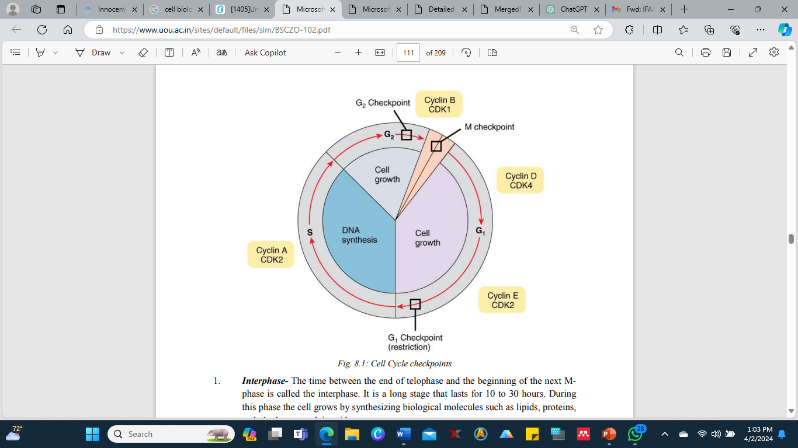
Cell Cycle Stages, Mitosis & Cytokinesis
Cell Cycle
Every cell having the capacity to divide passes through a regular cycle of changes known as cell cycle.
A cell starts its cycle in diploid condition.
Phases of cell cycle
Cell cycle consists of two stages: A long un-dividing stage called interphase or Iphase and a short dividing stage called mitotic or M-phase.
Cell Cycle checkpoints

Slide 191
1. Interphase - The time between the end of telophase and the beginning of the next Mphase is called the interphase.
It is a long stage that lasts for 10 to 30 hours.
During this phase the cell grows by synthesizing biological molecules such as lipids, proteins, carbohydrates, nucleic acids.
Interphase is further divided into three sub phases or periods: first gap or G1 phase, synthetic or S phase and second gap or G2 phase.
(i) G1 phase - The gap between previous mitosis and beginning of DNA synthesis is represented by G1 phase.
In this stage initial growth of a newly formed cell takes place.
Various biological molecules (carbohydrates, proteins, lipids, including some non-histones, RNAs) are synthesized in this phase.
Normal metabolism is carried out for the preparation for DNA replication that is to take place next to it. DNA synthesis does not occur in this phase.

Slide 192
(ii) S Phase - During this phase duplication of each chromosome take place by replication of new DNA molecule on the template of the existing DNA.
Synthesis of histone proteins and their mRNA, some non-histone proteins and formation of new nucleosome also occur in S-phase only.
In most of the eukaryotes the S-phase lasts for 6 to 8 hours.
(iii) G2 Phase - G2 phase is the gap between DNA synthesis and nuclear division.
RNA transcription and protein synthesis continues during this phase. Further growth of the cell and preparation for its division also takes place in this stage.
During this stage the cytoplasmic organelles such as centrioles, mitochondria and Golgi apparatus are doubled, proteins for spindle and asters are synthesized and active metabolism stores energy for the next mitosis.
The G2 phase in most cells lasts for 2 to 5 hours.

Slide 193
2. Mitotic Phase - Interphase is followed by mitotic phase.
During mitotic phase the already duplicated chromosomes are equally distributed to the daughter cells which contain exactly the same hereditary information as the parent cell.
Though, the other cell components (organelles and molecules) are also divided approximately equally between the daughter cells, but not as precisely as the DNA.
After the mitosis is over, the daughter cells enter the G1 phase of the next cell cycle.
During mitosis many structural and physiological changes take place in the cell, as the chromatin of the nucleus is packed into visible chromosomes, which are set free by breakdown of nuclear envelope.
An extensive reorganization of the membranous components and cytoskeletal elements takes place.
Endoplasmic reticulum and Golgi apparatus break down into small vesicles and stops the protein movement.
Microtubules dissociate into tubulin dimers and are assembled into the spindle which occupies most of the cell and helps in the distribution of chromosomes into the daughter cells.
Actin filaments get reorganized and form a contractile ring for the cytoplasmic division.

Slide 194
Control of Cell Cycle/ Cell Cycle Regulation
1. Nucleo-cytoplasmic Ratio - In 1910, Hertwig proposed that the cell division starts when the ratio between the volume of the nucleus and the volume of the cytoplasm is upset.
As the cell grows, the synthesis of proteins, nucleic acids, lipids and other cellular components takes place.
During synthesis of these molecules, the back and forth movements of materials through the nuclear and the cell membranes occurs.
With the growth of the cell, its volume increases more than the surface of the nucleus and the cell, and at a critical point, the surface of the nucleus become inadequate for the exchange of materials between the nucleus and the cytoplasm required for further growth.
The cell divides at this stage and regains the optimum and efficient nucleo-cytoplasmic ratio that allows the growth.
Although the cell division usually occurs after a cell has grown to a certain size, there are important exceptions to this pattern.

Slide 195
2. Surface-Volume Ratio - With the growth of the cell size, its volume increases more than its surface area. All the materials of the cell required for its maintenance and growth are drawn through its surface.
A stage will reach when the surface area is insufficient to supply the large volume of the cell. It is thought that there is a critical point at which the cell division starts and the division of the cell greatly increases the surface without increasing the volume. This theory fails in case of starved cells, which may divide without doubling their size and form smaller daughter cells.
3. Nucleolus - Damage to nucleolus at a certain critical time (telophase or mid prophase) stops cell division.
4. Cyclic Nucleotides - Concentration of cAMP and cGMP vary regularly during the cell division. Concentration of cAMP is high during G1 phase, but it falls as the cell enters the S phase and mitosis. However the concentration of cGMP often varies in the reverse pattern.
Thus, addition or removal of any of these nucleotides can start or stop entry of many cells into S phase and the subsequent M phase. The concentration of these cyclic nucleotides remains constant throughout the cell cycle in many cells. Also, plant cells do not have cyclic nucleotides.
On the basis of these facts, cyclic AMP and GMP are no longer thought to regulate the cell cycle.

Slide 196
5. Phosphorylation- During cell cycle the phosphate groups are added to the histone groups particularly to H1 as the cell enters S phase, increases during M phase, and are removed on the completion of mitosis before G1 starts.
Phosphate groups are also added and removed to non-histone proteins during cell cycle. Thus, it is believed that the changes in the histones and non-histones may have a role in the control of cell cycle because these proteins have been found to regulate the activity of genes in RNA transcription during interphase.
6. Cyclin: The concentration of the protein called cyclin appears to control mitosis as it builds up during interphase and is degraded during mitosis.

Slide 197
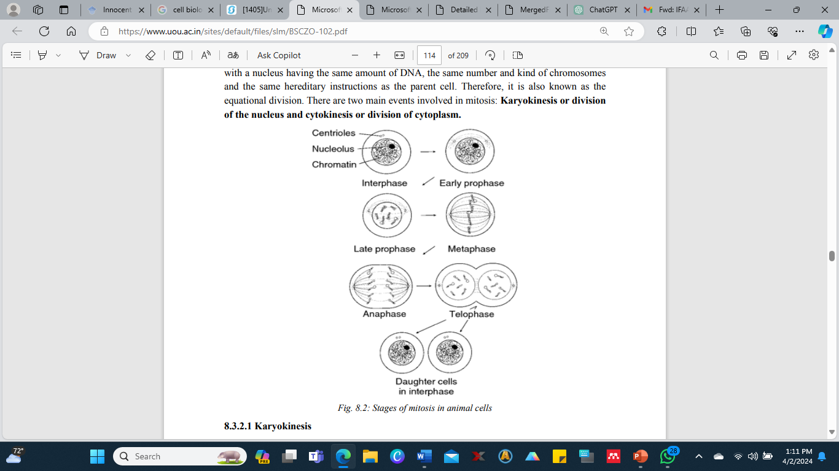
Mitosis
A German biologist Eduard Strasburger described mitosis for the first time in 1875.
Same was described later in 1879 by Walther Flemming who also termed it "mitosis" in 1882.
It is the most common method of cell division in eukaryotes that takes place in somatic cells of the body and hence it is also known as somatic division.
However in gonads it occurs in undifferentiated germ cells.
In plants it takes place in the cells of meristematic tissues.
The duration of mitosis on an average is from 30 minutes to 3 hours.
Mitosis is defined as the division of a parent cell into two identical daughter cells each with a nucleus having the same
Stages of mitosis in animal cells

Slide 198
Karyokinesis
In eukaryotes, karyokinesis is a complex process due to the presence of many chromosomes.
It is a continuous process which may be divided into four stages: prophase, metaphase, anaphase and telophase.
1. Prophase - In an interphase cell the chromosomes are throughout the space in the nuclear compartment.
Approximately 4 meters of DNA organized into 46 duplicated chromosomes is present in the nucleus of a human cell.
The prophase is long and complex that lasts for about 50 m divided into 3 sub stages: early prophase, middle prophase and late prophase.
A) Early prophase - During the early prophase of mitosis the following events take place:
(i) The shape of cell becomes almost rounded and the cytoplasm become viscous.

Slide 199
(ii) The centrioles lie close to the nucleus and around them assembles the short radiating microtubules by polymerization of the tubulin dimers.
Both pairs of centrioles also called diplosomes, start moving to the opposite ends of the cell.
The microtubules surrounding each pair of centrioles appear like a star body, and are called the aster.
The microtubules which are also termed as astral rays, are not in contact with the centrioles, but are separated from them by an amorphous zone of cytoplasm known as pericentriolar cloud.
The microtubules stretching between the diplosomes moving apart increase in number and length by incorporating more tubulin dimers.
Thus, asters shift the duplicated centrioles to the opposite ends of the cell from where the centriole pair will pass into separate daughter cells when cytokinesis occurs.
Though the centrioles have no role in the formation of the spindle but they may be concerned with orienting the spindle.

Slide 200
(iii) Long microtubules assemble on one side of the nucleus to form mitotic spindle. Microtubules are arranged in bundles called spindle fibers and at each pole of the spindle lies the mother-daughter centriole pair.
(iv) The chromosomes that appear like threads in the nucleus gradually change into short, thick rods by loss of water and progressive coiling and become visible.
Due to the duplication of DNA and chromosomal proteins during the interphase, each chromosome appears longitudinally double, consisting of two identical sister chromatids which are held together at the narrow region called primary constriction or centromere.
Each chromatid has a disc like structure at centromere, where the spindle microtubules join it. This disc is called as kinetochore.
B) Middle prophase- It includes the following events:
(i) The chromosomes further get shorter, thicker and their chromatids become uncoiled and finally they assume their characteristics sizes and become distinguishable individually.
(ii) Nucleoli progressively become smaller and finally disappear. Nuclear envelope begins to breakdown into small vesicles which disperse into the cytoplasm. The lamina dissociates into its protein subunits.

Slide 201
C) Late Prophase- This phase involves the following events:
(i) The nuclear envelope breaks completely thus, releasing the chromosomes and other nuclear contents into the cytoplasm.
(ii) The spindle gains their proper shape and size.
(iii) The growing spindles push the centriole pairs to the opposite ends of the cell.
2. Metaphase- The metaphase being short and simple lasts for 2 to 10 minutes and it involves the following events:
A. The spindle occupies the region of the nucleus.
B. The chromosomes move to the equatorial plane of the spindle.
C. Some spindle microtubules extend to and join the chromosomes. These are called chromosomal or kinetochore microtubules.
D. The chromosomes get aligned at the middle of the spindle in the form of a plate called equatorial or metaphase plate. This plate is formed by the kinetochores, the arms of the chromatids trailing away on the sides. It is at the right angles of the long axis of the spindle. During metaphase the chromosomes have fully aligned into a plate and await the separation of their chromatids.

Slide 202
3. Anaphase
Anaphase lasts only 2 to 3 minutes and it comprises the following events:
A. The sister chromatids of each chromosome slightly separate at the primary constriction so that their kinetochores stretch towards the opposite poles of the spindle.
In all the chromosomes separation of chromatids occurs almost simultaneously. The chromatids are now referred to as chromosomes because they are no longer held to their duplicates.
B. After a short time, the chromatids separate completely from their former mates, and start moving to opposite poles of the spindle. As each chromosome is being pulled by its attached microtubules, its kinetochore leads and arms trail behind. As a result the chromosomes are pulled into V, J and I shapes, depending upon the position of the kinetochore. (Metacentric, sub metacentric or telocentric respectively)
C. As the chromosomes move toward their respective poles, the two poles move farther apart by elongation of spindle. The anaphase ends when all the chromatids reach the opposite poles. Each pole of the spindle receive one chromatid from every metaphase chromosome, the two groups of chromatids have exactly the same hereditary information.

Slide 203
4. Telophase - The telophase is long and complex and lasts for an hour or so. In this phase nucleus is reconstructed from each group of chromosomes. It involves the following events:
A. The chromosomes at each pole unfold, and become long and slender. Finally, they become indistinguishable as were in an interphase cell.
B. Nuclear envelope is reconstructed around each group of chromosomes gradually. First, the membrane vesicles associate with the individual unfolding chromosomes, partially enclosing each chromosome.
Then they fuse to form an envelope surrounding the entire set of chromosomes at each pole. The lamina proteins re-associate simultaneously with the reconstruction of nuclear envelope and form a complete lamina within the nuclear envelope
C. Nucleolar material, composed of partially processed ribosomal subunits and processing enzymes, dispersed into the cytoplasm in the prophase return to the nucleolar organizer site and forms a small nucleolus. Processing of this preexisting material then continues. Transcription of new rRNA also begins at this time; it gradually speeds up until it attains the high level of characteristic of interphase cell.

Slide 204
Along with this, the nucleolus grows and attains its normal size. The nucleolus reformed at telophase, thus contains both old and new rRNA and ribosomal proteins.
With the transformation of chromosomes into chromatin and reconstruction of nucleoli, transcription of all the three RNA types gradually becomes normal.
The spindle begins to disappear and the asters become small by depolymerization of microtubules and the centrioles take up their characteristic interphase position close to the one side of the nucleus.
Short spindle microtubules persist for sometime at the spindle equator to mark the region where the cytoplasm will later divide.
Cytokinesis
Cytokinesis is the division of cytoplasm. It encloses the daughter nuclei formed by the karyokinesis in separate cells, thus completing the process of cell division.
Cytokinesis is signaled at the metaphase by cytoplasmic movements that bring about equal distribution of mitochondria and other cell organelles in the two halves of the cell. Division occurs differently in animal cells and the plant cells.

Slide 205
Significance of Mitosis
Mitosis has manifold significance anmely;
Maintenance of Size - Mitosis helps maintaining the size of the cell. A cell, when full grown, divides by mitosis instead of growing further.
Growth - A fertilized egg develops into an embryo and finally into an adult by repeated mitotic cell division.
Maintenance of Chromosome Number - Mitosis keeps the number of chromosomes equal in all the cells of an individual. Thus mitosis provides a complete set of genetic information to each cell, since DNA is duplicated in S phase prior to mitosis.
Repair - Mitosis provides new cells to replace the old worn out and dying cells.
Healing and Regeneration - Mitosis produces new cells for the healing of wounds and regeneration.
Reproduction - Mitosis brings about multiplication in the acellular organisms. In multicellular organisms also, it plays an important role in reproduction, asexual as well as sexual.
Evidence of Basic Relationship of Organisms - Mitosis, being essentially similar in many kinds of organisms, supports the basic relationship of all living things.

Slide 206
Meiosis
In 1887, August Weismann predicted on theoretical grounds that the number of chromosomes must be reduced by one-half during gamete formation. Edouard Van Beneden demonstrated reduction division in1887. J.B. Farmer and Moore introduced the term "meiosis" in 1905.
Mitosis occurs in all kinds of eukaryotic cells, while meiosis is confined to certain cells and takes place at a particular time.
Only the cells of sexually reproducing organisms undergo meiosis, and only special cells in the multicellular organisms switch over from mitosis to meiosis at the specific time in the life cycle.
Meiosis produces gametes or gametic nuclei in animals, some lower plants, and various protists and fungus groups. Meiosis forms spore in higher plants. The spores give rise to gamete producing structure called gametophytes, which produces gametes by mitosis.
Meiosis consists of two divisions that take place in rapid succession, with the chromosomes replicating only once.
Thus, a parent cell produces four daughter cells, each having half the number of chromosomes and half of the nuclear DNA amount present in the parent cell. Meiosis is therefore also known as reduction division.
The two divisions of meiosis are known as the first and the second meiotic divisions or meiosis-I and meiosis-II.

Slide 207
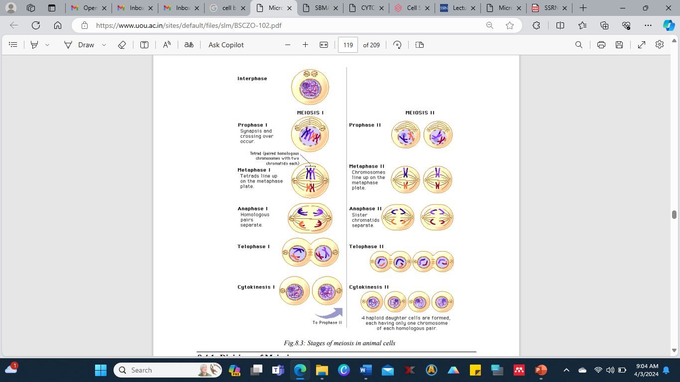
Stages of meiosis in animal cells

Slide 208
Divisions of Meiosis
First meiotic division or Meiosis-I: During the first meiotic division, the two homologous chromosomes of each pair separate from each other and go to separate daughter cells.
This reduces the number of chromosomes from diploid to haploid condition.
Meiosis-I is therefore known as heterotypic division.
The four phase of this division are called Prophase-1, metaphase-1, anaphase-1 and telophase-1.
1. Prophase
The meiotic prophase-1 is more complex than the mitotic prophase because of the process of recombination that occurs in it.
It also lasts much longer than the mitotic prophase in the same organism. It may extend over weeks, months or even years. Although it is more or less a continuous process, it is divided into 5 substages: leptotene, zygotene, pachytene, diplotene and diakinesis.
(a) Leptotene - Leptotene begins when chromosomes appear as thin threads by condensation. The chromosomes become thicker as condensation proceeds. They lie jumbled up so that it is not possible to trace individual chromosomes. Each chromosome is double, consisting of two chromatids due to DNA replication during premeiotic interphase. However, the chromatids are closely adhered together and are not distinguishable.

Slide 209
(b) Zygotene - The homologous chromosomes come to lie side by side in pairs.
The pairing of homologous chromosomes is called Synapsis or conjugation.
A pair of homologous chromosome lying together is termed as a bivalent.
Pairing is so through that the corresponding ends and all the corresponding genes of the two homologous chromosomes lie exactly opposite to each other.
The centrosome of the chromosomes also lies adjacent to one another. The chromatids are still not visible.
A regular space of about 0.15 to 0.2 µm wide exists between the synapsed homologous chromosomes, bearing a highly specialized fibrillar organelle, the synaptonemal complex.
The synaptonemal complex consists of three parallel and equally spaced longitudinal filaments flanked by chromatin and interconnected by short transverse filaments.
The complex contains DNA and some specific proteinaceous material. It was discovered by Montrose J. Moses in 1955 in crayfish.

Slide 210
(c) Pachytene - The synapsed chromosomes continue to become short and thick. The chromatids of each synapsed chromosome slightly separate and become visible.
A chromosome with two visible chromatids is known as dyad. A group of four homologous chromatids (two dyads) is called a tetrad. The number of tetrads equals the haploid number of chromosomes.
The two chromatids of the same chromosomes are called are called sister chromatids and those of the two homologous chromosomes are called non-sister chromatids.
The leptotene and the zygotene stages last for a few hours, the pachytene may take weeks, months or even years. It is prolonged because recombination or crossing over occurs in it.

Slide 211
Recombination involves mutual exchange of the corresponding segments of non-sister chromatids of homologous chromosomes.
It occurs by breakage and reunion of non sister chromatid segments. Certain structures mediate the meiotic recombination by marking the sites of crossing over. These are known as recombination nodules (RNs).
They are multicomponent proteinaceous ellipsoids found in association with the synaptonemal complex during prophase-I of meiosis (Carpenter, 1975b).
The synaptonemal complex, a protein structure, helps in recombination by keeping the homologous chromosomes in paired state for the required period and also by containing and aligning the enzymes needed for breakage and union.

Slide 212
(d) Diplotene - At this stage the homologous chromosomes separate at many places. This is called disjunction. It occurs because the synaptic forces and the synaptonemal complex disappear. The chromatids become more distinct and tetrads seem very clear. The homologous chromosomes do not separate at certain points. These points are called chiasmata.
The chiasmata mark the sites where the exchange of chromatids occurred during pachytene. The number of chiasmata is related to the length of the chromosomes. Longer chromosomes have more chiasmata than the shorter ones. In case of single chiasmata, the bivalent looks like a cross; in case of two chiasmata, it looks like a ring; and in case of many it shows series of loops.
(e) Diakinesis - In this stage the chromosomes condense again into short, thick rods. The chiasmata disappear by sliding towards the tips of chromosomes due to tight condensation. This process is called terminalization.
The centrioles already duplicated in premeiotic interphase, move apart in pairs to the opposite ends of the cell. Asters form around each centriole pair. Spindle develops between the centriole pairs. The nucleolus disintegrates. The nuclear envelope breaks down into vesicles. The tetrads are released into the cytoplasm.

Slide 213
2. Metaphase - The spindle shifts to the position that is earlier occupied by the nucleus. The tetrads scattered in the cytoplasm move to the equator of the spindle.
Here, they align in two parallel metaphase plates, one formed by chromosomes and other by their homologous.
The attachment of the tetrads to the spindle microtubules in metaphase-I is different from that of mitotic metaphase chromosomes.
Each homologous chromosome has two kinetochores, one for each of its two chromatids Both the kinetochores of a homologous chromosome connect to the same spindle pole. The two kinetochores of its homologue join the opposite spindle pole.
3. Anaphase-I- From each tetrad, two chromatids of a chromosome move as a unit (dyad) to one pole of the spindle, and the other two chromatids of its homologue migrate to the opposite pole.

Slide 214
Thus, the two homologous chromosomes of each pair are separated in the anaphase-I of meiosis. The process is also called as disjunction. As a result half of the chromosomes, which appear in early prophase, go to each pole.
Thus, it is during anaphase-I that the real reduction in the chromosome number occurs. Each chromosome at the pole is still double and consists of two chromatids. Thus, the group of chromosomes at each pole though has only one member of each homologous pair still contains twice the haploid amount of DNA.
4. Telophase - During telophase-I, the chromosome at each pole of the spindle partly unfold and elongate, and form a nucleus with nucleolus and nuclear envelope. The spindle and asters disappear. The cytoplasm divides at its middle by constriction in an animal cell and by cell plate formation in a plant cell.
This produces, two daughter cells, each with one nucleus. The nucleus of each daughter cell has received only one chromosome from each homologous pair.
Thus, it has half the number of chromosome, but double the amount of nuclear DNA as each chromosome is double.

Slide 215
First meiotic division or Meiosis-II
The meiosis-II is similar to mitosis as in this division, the two chromatids of each chromosome separate from each other and go to separate daughter cells. With the result, the number of chromosomes remains the same as produced by meiosis-I. Meiosis-II is, therefore, known as homotypic division. The four stages of this division are called prophase-II, metaphase-II, anaphase-II and telophase-II.
1. Prophase-I- When there is no interkinesis, the telophase-I spindle is replaced by two new spindles; and the centrioles and asters, if present, duplicate and one copy of each comes to lie at each pole of the new spindles. The telophase-I chromosomes move from the poles of the old spindle to the equators of the new spindles.
If decondensation has occurred during telophase-I, the chromosome recondense to short rod lets as they migrate to the metaphase-II spindles. If interkinesis is present, centrioles move apart and asters are formed around them. A spindle is formed between the centrioles. Chromosomes each consisting of two chromatids, appear in the nucleus. They are set free in the cytoplasm by breakdown of the nuclear envelope. Nucleus disappears.
2. Metaphase-II- The chromosomes get arranged at the equator of the spindle as a metaphase plate. The chromatids of each chromosome are joined at their kinetochores by chromosomal microtubules extending from the opposite poles of the spindle as in mitosis.

Slide 216
3. Anaphase-II- The two chromatids of each chromosome separate and move to the opposite poles of the spindles. Here they are called chromosomes. Each pole has haploid number of chromosomes and haploid amount of DNA. This amount is one-fourth of the DNA present in the original cell which entered meiosis.
4. Telophase-I-: The chromosome at each pole decondenses, and nuclear envelope develops around them. This produces two nuclei. Nucleolus is formed in each nucleus. Spindle and asters disappear. In cases that lack interkinesis, four nuclei are formed in telophase-II.
Cytokinesis: Cytoplasm divides at its middle by constriction in an animal cell and by cell plate formation in a plant cell. This produces two daughter cells.
The later have half the number of chromosomes, and half the amount of nuclear DNA, i.e., in Reduction division is complete when this point is reached.
The cells formed by meiosis-II in animals are mature gametes. They do not divide further. A gamete must fuse with another suitable gamete before a new individual can develop. The cells formed by meiosis-II in plants are the spores.
The spores can develop into new individuals without fusing in pairs. In fact the main difference between a spore and a gamete is the ability of the spore to develop directly into a new individual.

Slide 217
Comparison between Mitosis and Meiosis
S/N. | Mitosis | Meiosis
1. | It occurs in all kinds of cells and may continue throughout life. | It occurs only in special cells (gamete mother cells or spore mother cells) and at specific times
2. | It involves a single division, resulting in two daughter cells only. | It involves two successive divisions, resulting in four daughter cells.
3. | A cell can repeat mitosis almost indefinitely. | Meiosis takes place only once in a cell.
4. | All mitotic divisions are alike. | Two meiotic divisions are dissimilar, first is reductional and second equational.
5. | Each mitotic division is preceded by an interphase | The second meiotic division is generally not preceded by an interphase.
6. | Chromosomes replicate before each mitotic division. | Chromosome do not replicate before second meiotic division.
7. | Prophase is relatively short and simple. | Prophase-1 is very long and elaborate, comprising 5 sub phases.

Slide 218
S/N. | Mitosis | Meiosis
8. | Prophase chromosomes appear double from the very start. | Prophase-1 chromosomes do not look double in the beginning.
9. | There is no pairing of homologous chromosomes, hence no chance of crossing over. | Homologous chromosomes pair and often undergo crossing over in prophase-1.
10. | No chiasmata are formed. | Chiasmata form temporarily where crossing over occurs.
11. | Chromatids are genetically similar to chromosomes they arise from. | Chromatids may differ genetically from the chromosomes they arise from due to crossing over.
12. | No synaptonemal complex forms between chromosomes. | Synaptonemal complex forms between synapsed homologous chromosomes.
13. | Chromosomes do not unfold, and no transcription and protein synthesis occur in prophase. | Chromosomes unfold and, transcription and protein synthesis may occur in diplotene of prophase-I.

Slide 219
S/N. | Mitosis | Meiosis
14. | All chromosomes form a single plate in metaphase. | Chromosomes form two parallel plates in metaphase-I and one plate in metaphase-II.
15. | The two kinetochores of a chromosome connect to both the poles of the spindle. | The kinetochores of a chromosome connect to the same spindle pole in metaphase-I and to both the poles in metaphase-II.
16. | Anaphase involves separation of chromatids of each chromosome. | Anaphase-I involves separation of homologous chromosomes. The chromatids move apart in anaphase-II.
17. | Telophase occurs in all cases. | Telophase-I is eliminated in some cases.
18. | Daughter cells have diploid number of chromosomes like the parent cell. | Daughter cells have haploid number of chromosomes unlike the parent cell.
19. | Daughter cells have 2n amount of DNA unlike 4n amount in the parent cell. | Daughter cells have 1n amount of DNA unlike the 4n amount in the parent cell.
20. | Daughter cells divide again after interphase. | Daughter cells, if gametes, do not divide further.

Slide 220
S/N. | Mitosis | Meiosis
20. | Daughter cells divide again after interphase. | Daughter cells, if gametes, do not divide further.
21. | Mitosis brings about growth, repair and healing. | Meiosis forms gametes or spores, helps maintain the number of chromosomes constant from generation to generation, and introduces variation
22. | Mitosis is much shorter than meiosis in the same animal. | Meiosis is much longer than mitosis in the same animal.
23. | Cytokinesis usually follows karyokinesis. | Cytokinesis often doesn't occur after meiosis-I, but always occur after meiosis-II, forming four cells simultaneously.
24. | Mitosis may occur in haploid or diploid cells. | Meiosis always occurs in diploid cells.
25. | Chromosomes do not show chromomeres. | Chromosomes may show chromomeres.

Slide 221
Glossary
Karyokinesis: It is the division of nucleus during cell cycle.
Cytokinesis: Division of cytoplasm that separates the daughter cells following division of parent cells.
Genome: Genome is defined as complete set of gene or genetic material present in a cell.
Spindles: A protein structure that divides the genetic material in a cell. The spindle is necessary to equally divide the chromosomes in a parental cell into two daughter cells during both types of nuclear division: mitosis and meiosis.
Asters: Asters are star like cellular structures, formed around each centrosome during mitosis in an animal cell. Astral rays, composed of microtubules, radiate from the centrospheres.
Meristematic tissues: A meristematic tissue in most plants contains undifferentiated cells and is found in zones of the plant where growth can take place.
Gonads: The organs that produces gametes (sperms and ovum); i.e. testis or ovary.
Nucleosomes: In eukaryotic cells the chromosomes consisting of a length of DNA are coiled around a core of histones. This structural unit is called nucleosome.

Slide 222
Glossary contd:
Cytoskeleton: It is a microscopic network of protein filaments and tubules in the cytoplasm of many living cells.
Somatic cell: The cells of a living organism other than the reproductive cells are known as somatic cells.
Germ cell: These are haploid cells that have the capacity to unite with the germ cell of the opposite sex and reproduce new individual. These are also called gametes.
Kinetochore: It is a protein structure present on chromosomes and is a by which they are attached to spindle fibers.
Spores: It is a minute, one-celled, reproductive unit that is capable of giving rise to a new individual without sexual fusion and is the characteristic of protozoans, fungi and lower plants.
Bivalent: A pair of homologous chromosomes.
Chiasmata: During the first metaphase of meiosis, chromosomes remain in contact at certain points at which crossing over and exchange of genetic material occur between the strands. These points are called chiasmata.

Slide 223
Self Assessment Questions and Possible Answers
Multiple Choice Questions:
1. The proper sequence of cell cycle is: (a) S, M, G1, G2 (b) M, G1, G2, S (c) S, G1, G2, M (d) G1, S, G2, M
2. Karyokinesis refers to the division of: (a) Cytoplasm into two (b) Nucleus into two (c) Protoplasm into two (d) None of them
3. The spindle fibers attach chromosomes with: (a) Chromo center (b) Centriole (c) Kinetochore (d) Telocentric
4. Who proposed the term mitosis? (a) Farmer and Moore (b) Flemming (c) Nigeli (d) Brown
5. Chromosomes reach equator during cell division at: (a) Prophase (b) Metaphase (c) Anaphase (d) Telophase
6. Mitosis occurs in: (a) Roots (b) Shoots (c) Germ cells (d) Somatic cells
7. Nuclear membrane disappears at which stage: (a) Metaphase (b) Anaphase (c) Early prophase (d) Late prophase
8. Chromosomes move towards different poles, during cell division, due to: (a) Centrioles (b) Vacuoles (c) Cytokinesis (d) Microtubules
9. In cell cycle DNA replication takes place in: (a) M-phase (b) S-phase (c) G1 -phase (d) G2-phase
10. Anaphase of mitosis differs from metaphase in: (a) Half the number of chromosomes (b) Half the number of chromatids in each chromosome (c) Half the number of chromosomes but doubles the number of chromatids in each chromosome (d) Half the number of chromosomes and half the number of chromatids in each chromosome.

Slide 224
11. Synaptonemal complex is associated with: (a) Mitotic chromosomes (b) Paired meiotic chromosomes (c) Lampbrush chromosomes (d) polytene chromosomes
12. The term meiosis was coined by: (a) Leeuwenhoek (b) Beadle and Tatum (c) Hooke and Brown (d) Farmer and Moore
13. During meiosis exchange of paternal and maternal chromosomes is called: (a) Recombination (b) Linkage (c) Segregation (d) Crossing over
14. Crossing over and unzipping of homologous chromosomes in meiosis occurs at: (a) Diplotene (b) Pachytene (c) Zygotene (d) Leptotene
15. Synapsis occurs during: (a) Leptotene (b) Zygotene (c) Pachytene (d) Diplotene
16. Crossing over occurs at: (a) One stranded stage (b) Two stranded stage (c) Three stranded stage (d) four stranded stage
17. Advantage of crossing over is that it causes: (a) Linkage (b) Stability (c) Inbreeding (d) Variation
18. At the end of first meiotic division, number of chromosomes is: (a) Halved (b) Doubled (c) Remains same (d) tripled
19. Second meiotic division results: (a) Separation of homologous chromosomes (b) Separation of chromatids and centromeres (c) Synthesis of fresh DNA (d) Separation of sex chromosomes
20. Anaphase in second meiotic division is characterized by: (a) Separation of non-homologous chromosomes (b) Separation of homologous chromosomes (c) Separation of chromatids (d) All of them

Slide 225
Cell Division: Very short questions
1. In which period of interphase DNA duplicates?
2. What is G1 period?
3. In which cell mitosis occurs?
4. Who proposed the term mitosis?
5. What are different stages of mitosis?
6. Which stage of mitosis is of longest duration?
7. What is cytokinesis?
8. At which stage centrioles replicate?
9. In which cell meiotic divisions occur?
10. What are the various sub-stages of meiotic prophase?
11. Who gave the term meiosis?
12. In which stage of meiosis, homologous chromosomes form pair?
Cell Division: Terminal and model questions
1. Explain in details cell cycle.
2. Describe the various phases involved in the mitotic division of an animal cell.
3. Elucidate the process of mitosis with neat and labeled diagram.
4. What is the significance of mitosis?
5. Give an account of meiotic type of cell division.
6. Describe the changes that occur in nucleus during meiosis.
7. Write about synaptonemal complex and chiasma formation.
8. Differentiate between the mitotic and meiotic division.

Slide 226
References
Kumari M and Bhandari S. (2017). Cell and Molecular Biology (BSCZO 102) ISBN : 978-93-85740-54-1. Copyright : Uttarakhand Open University.
Dudek R. W. and Fix J. D. (2005). Embryology, Board Review Series. Third Edition, Lippincottt, Williams and Wilkins.
Eroschenko, V. P. (2012). Difiore’s Atlas of Histology with Functional Correlations, Eleventh Edition
Mescher, A. L. (2013). Junqueira’s Basic Histology Text and Atlas. Thirteenth Edition, McGraw-Hill Education

Slide 227


