Slide 1

OVERVIEW OF HUMAN EMBRYOLOGY
(WEEKS 1 – 8; Germinal and Embryogenesis/Organogenesis Periods) WITH CLINICAL CORRELATES
Prof. IA Edagha, PhD
Fulbright Fellow, NYU
Dept of Human Anatomy, MUSOM

Slide 2
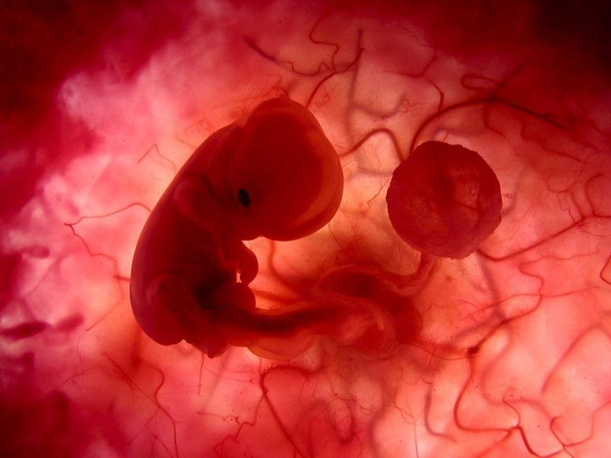
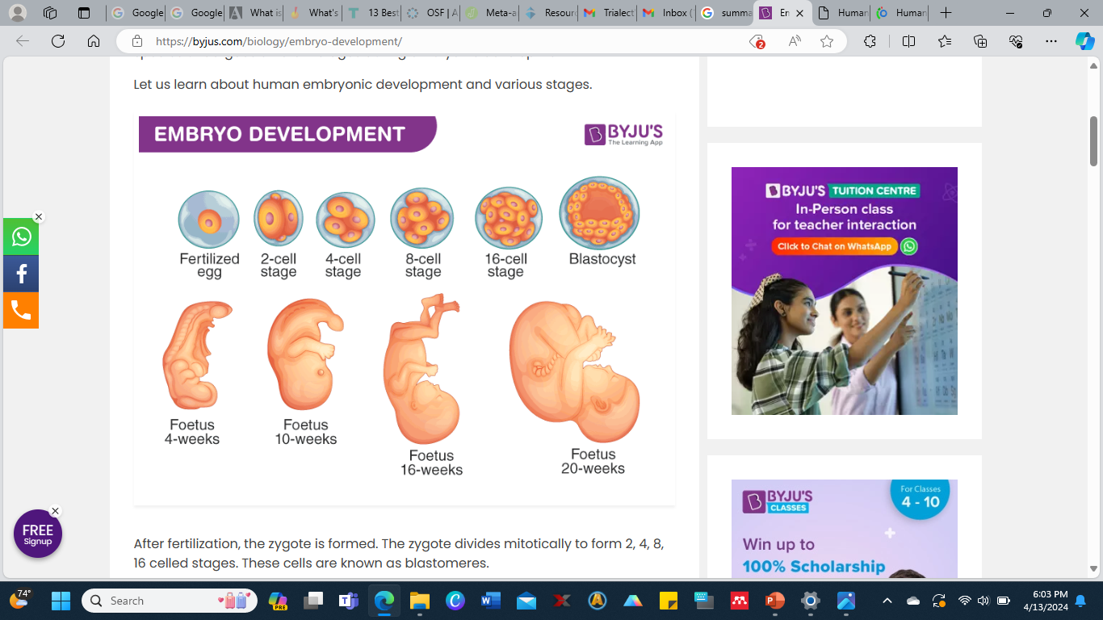

Slide 3
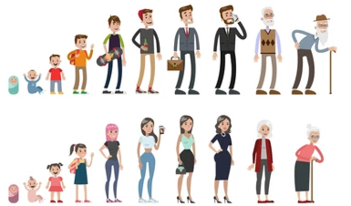

Slide 4
Outline
Overview of the Menstrual Cycle
Maturation of gametes & Sexuality
Fertilization
First week
Second week
Third to Eight Week
Clinical Correlates
Knowledge is essential for creating healthcare strategies for better reproductive outcomes in terms of ** Improved birth outcomes and ** Modified prenatal experience
Most healthcare providers interact with women of child-bearing age and hence can impact the outcome of the developmental processes and their sequelae.

Slide 5
Development of Gonads & Sexuality
Sex is assigned around week seven of gestation.
Originates from the urogenital ridge that is derived from mesoderm.
It is also characterized by migration of cells from the York sac to form epithelia of endodermal origin.
The SRY gene on the Y chromosome codes for:
testes determining factor thus emergence of Leydig and Sertoli cells that produce dihydrotestosterone and Mullerian inhibiting factor respectively.
Once the SRY gene has been expressed sufficiently the male sex will be determined.
Gonads that arise from above processes then engaged in the production gametes by meiosis.

Slide 6
Events at Meiosis
Male
Spermatozoa
The parent cell is spermatogonia
Meiosis does not begin until puberty
Maturation is completed in the testis
Each division results in 4 mature gamete
Female
Oogonia
Meiosis begins intrauterine and arrested at prophase 1 until puberty
Maturation occurs after fertilization (ovum is ovulated in metaphase 2)
Each cell division results in one haploid mature gamete

Slide 7
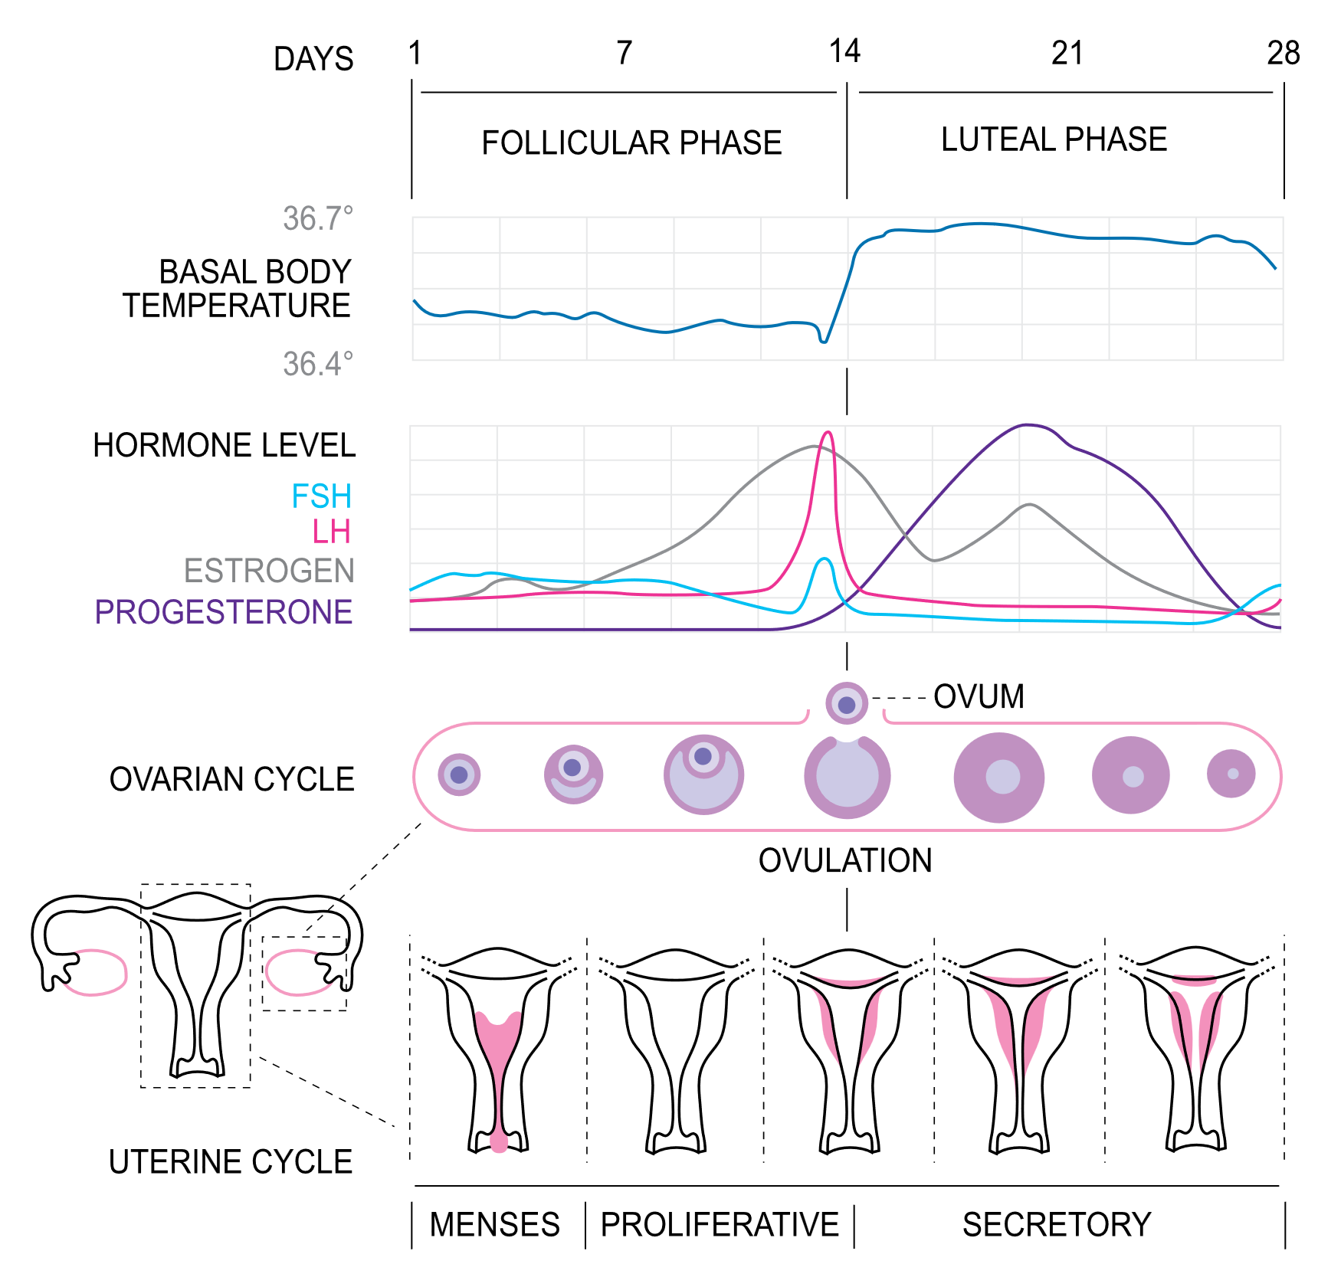
28 Day Menstrual Cycle

Slide 8
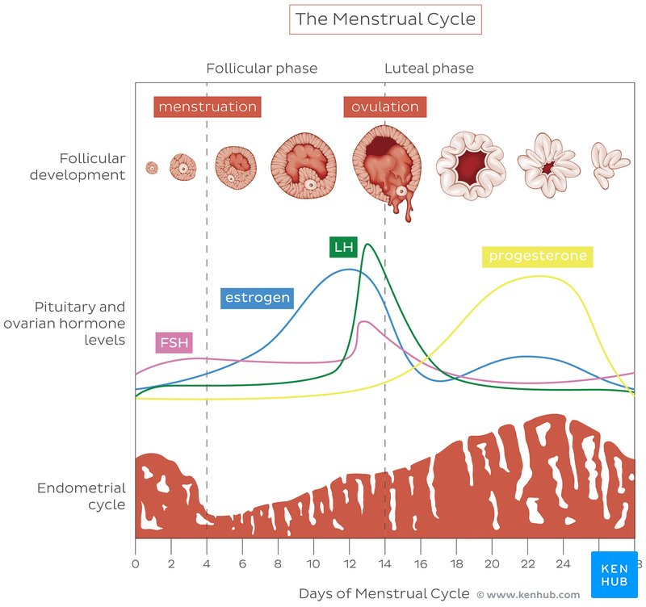
28 Day Menstrual Cycle

Slide 9
Ovulation
The expelled secondary oocyte is surrounded by zona pellucida and a layer of follicular cells which are radially arranged as the corona radiata.
Corpus luteum
Folds of the walls of the ovarian follicle
It secretes progesterone and some estrogen
If fertilization occurs it remains active for the 1st 20 weeks
If fertilization does not occur it degenerates into corpus albicans, scar tissue

Slide 10
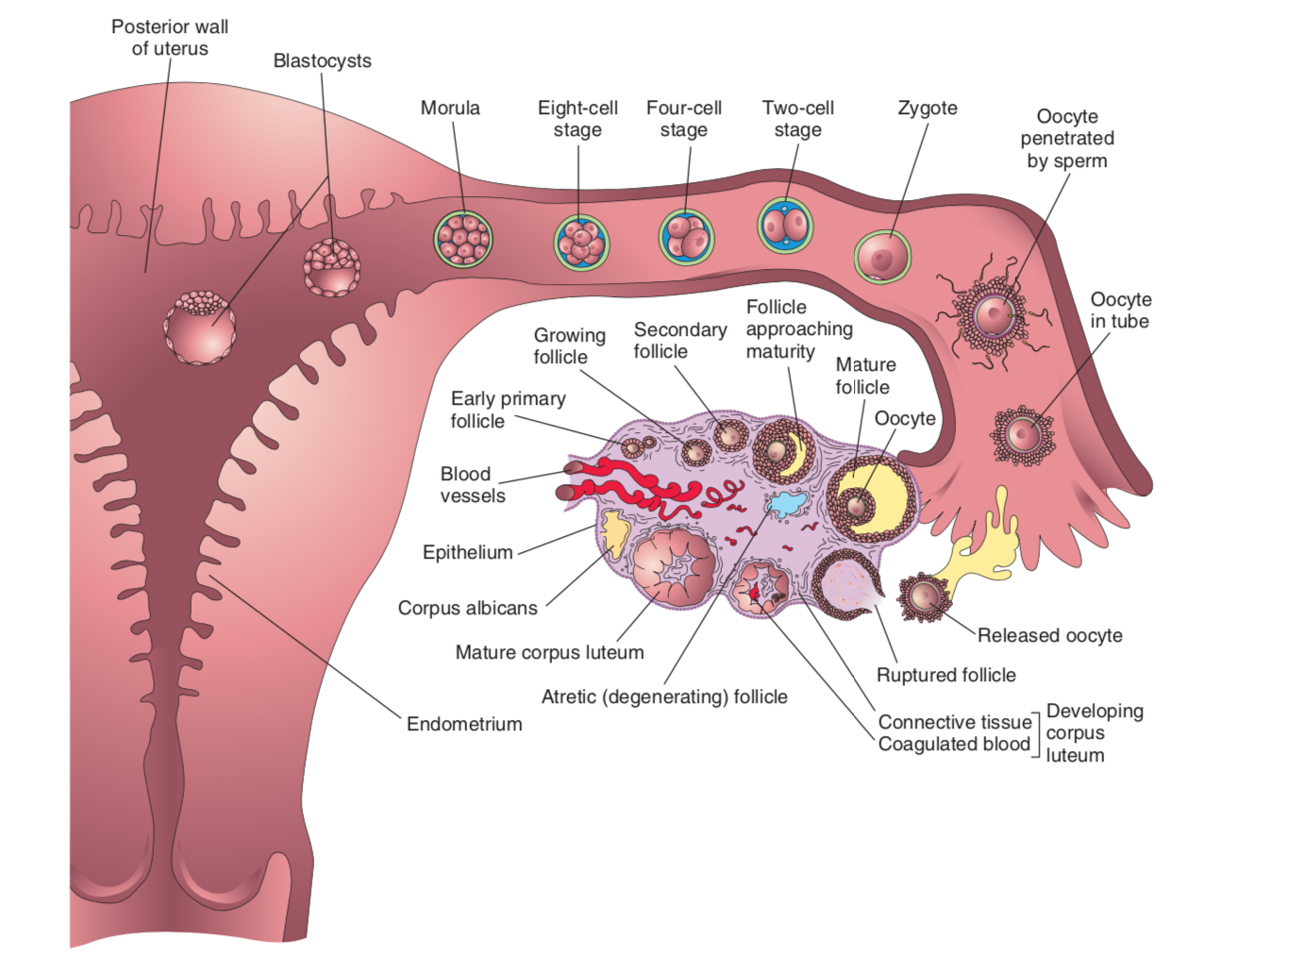

Slide 11
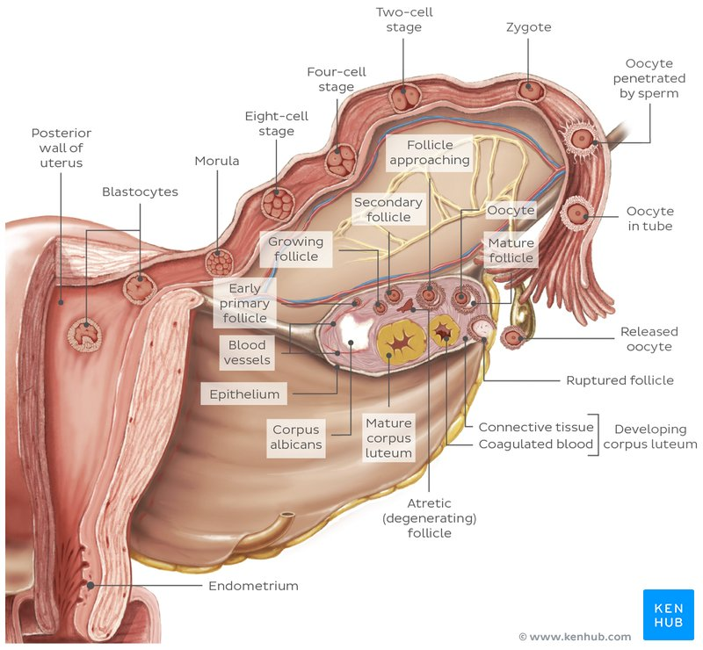

Slide 12
Fertilization (In-vivo)
Capacitation of Sperm
Freshly ejaculated sperm undergo about 7hours of capacitation in the uterine cavity
Seminal proteins from the surface of the acrosome are removed
There are no morphologic changes but the sperm are more active
Capacitated sperm binds with zona pellucida via glycoprotein ZP3. Enzyme tyrosine kinase facilitates this fusion
The process for sperm-oocyte fusion happens 12 – 24 hrs after ovulation.

Slide 13
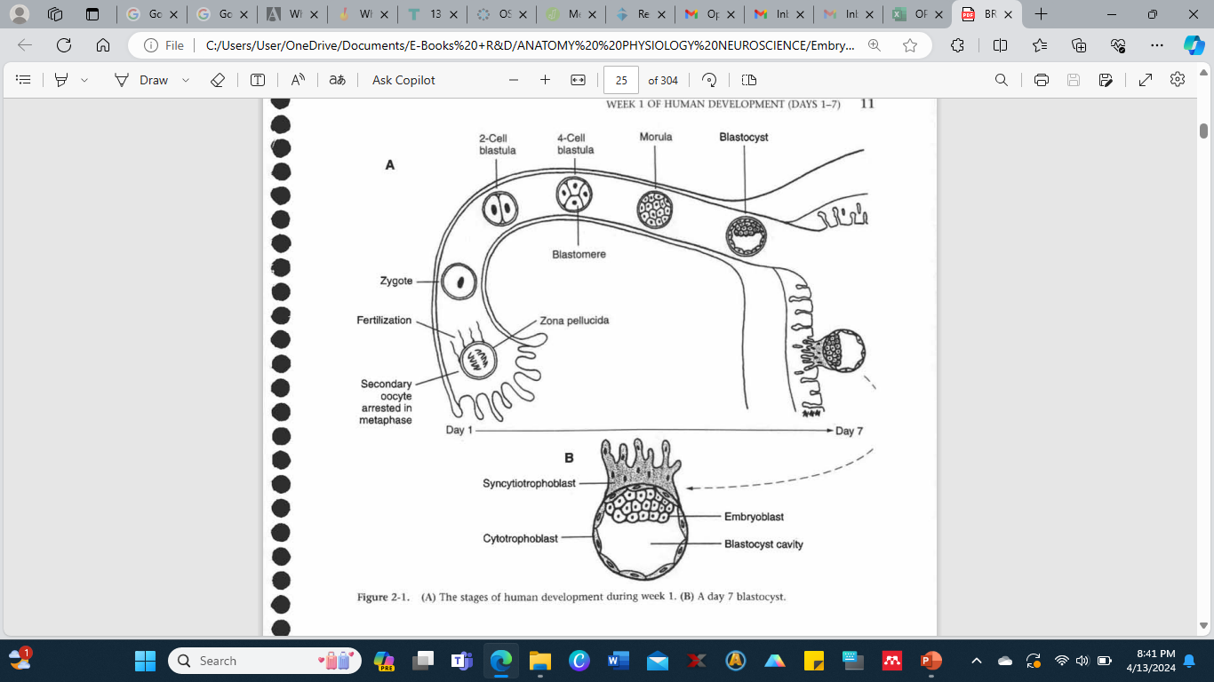
(A) The stages of human development during week 1. (B) A day 7 blastocyst

Slide 14
If fertilization occurs; corpus luteum under influence of hCG continues to secret estrogen and progesterone, the luteal phase persists and menstruation does not occur.
The endometrium passes into the pregnancy phase.
If fertilization dose not occur; corpus luteum degenerates, with fall of estrogen and progesterone level, menstruation occurs.
Ischemic phase; due to hormonal withdrawal as a result of non-fertilization of the oocyte, shrinkage of the endometrium, with patchy ischemic necrosis, results in bleeding in the uterine cavity.
Thus, menstrual cycle keeps being repeated until fertilization or menopause occurs.

Slide 15
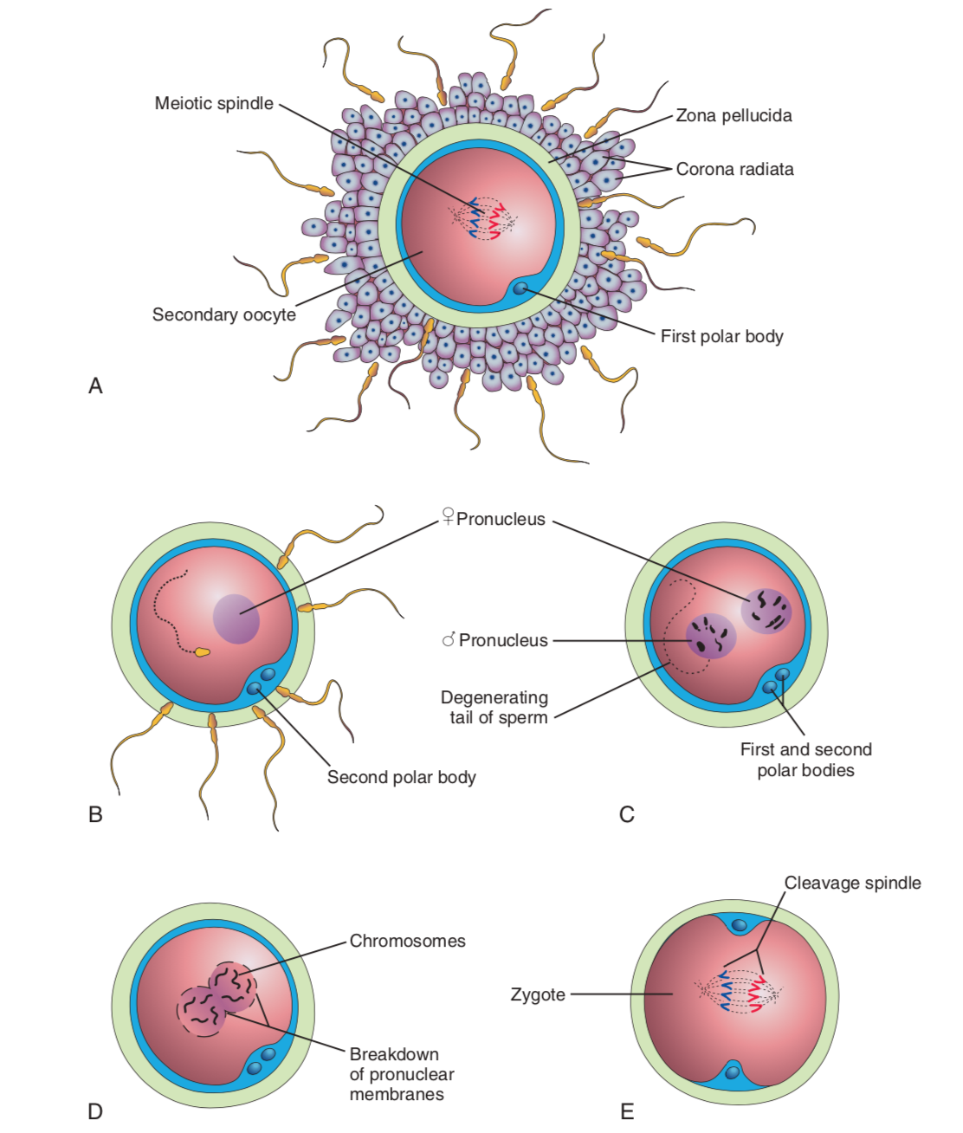

Slide 16
Phases of Fertilization
Carbohydrates binding molecules and gamete specific antigens on sperm are involved in sperm-egg recognition.
Passage through the corona radiata.
Penetration of the Zona pellucida.
Sperm acrosome releases enzymes such as esterase, acrosin, neuraminidase that facilitate dissolution of zona pellucida
Zona reaction ensues once sperm enters the oocyte
Fusion of cell membranes
Completion of second meiotic division and production of second polar body

Slide 17
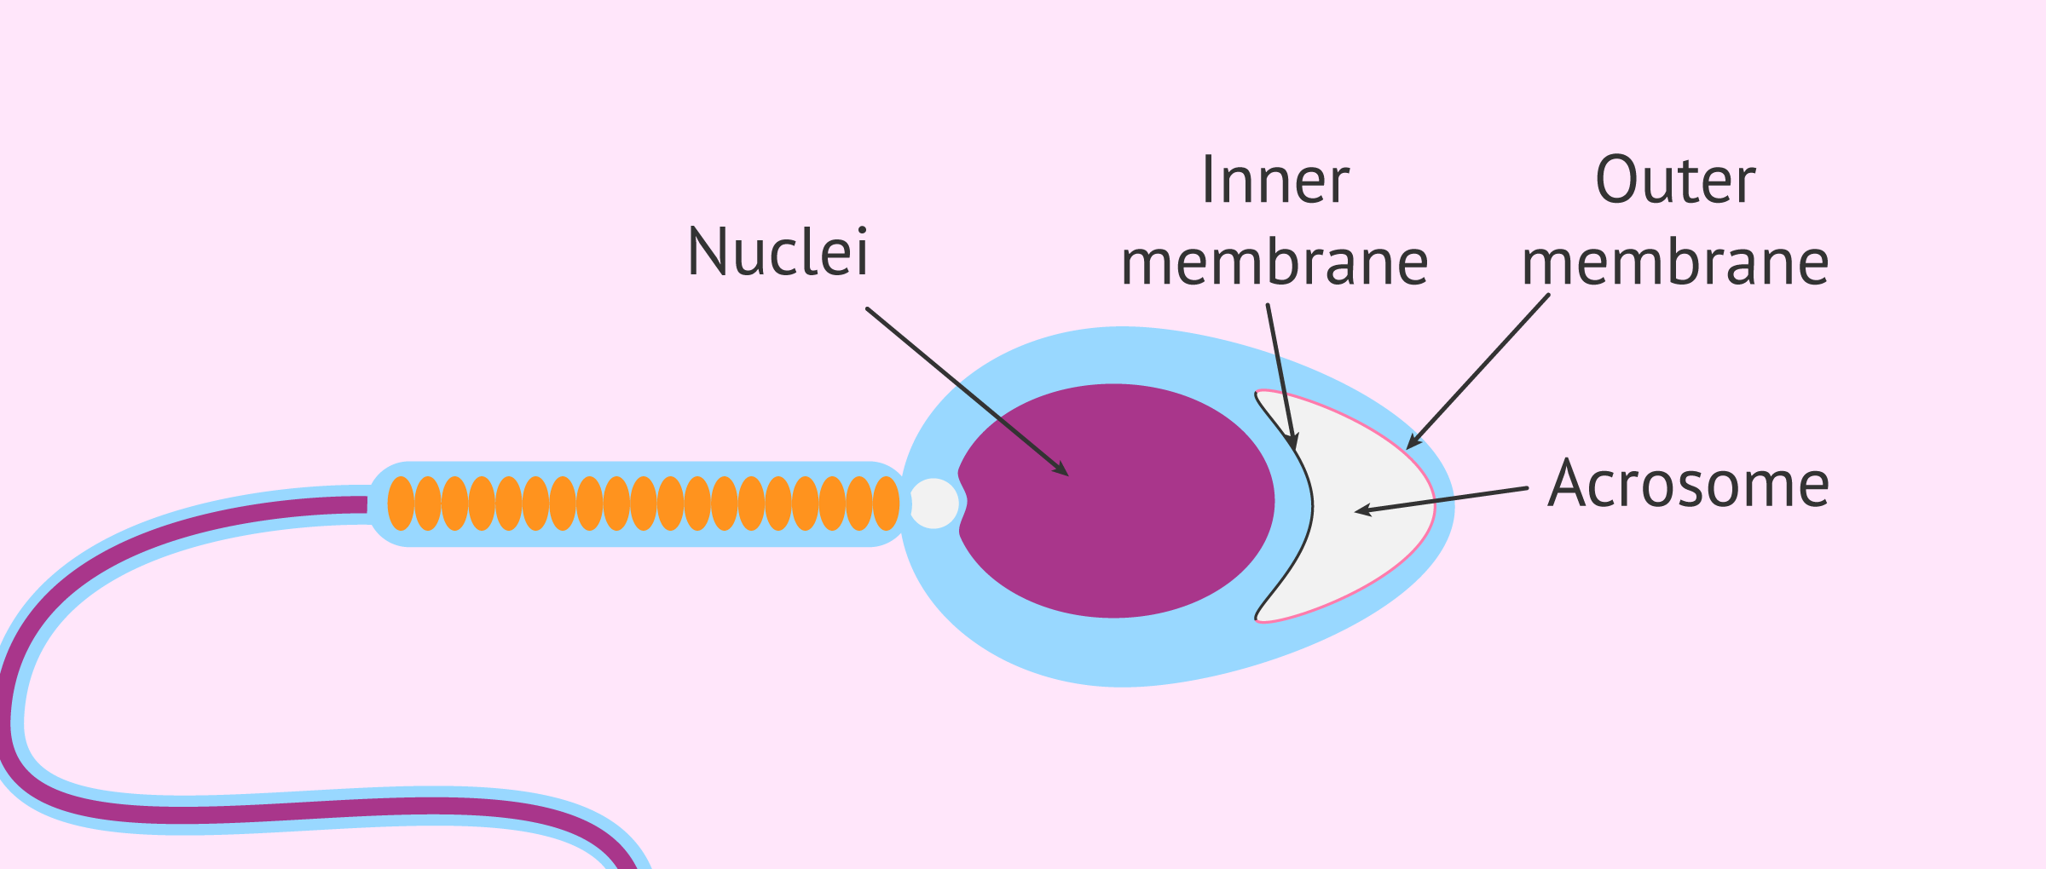
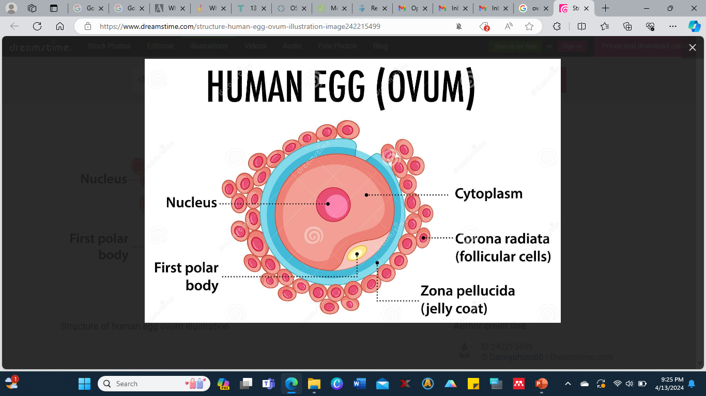

Slide 18
Fusion of the Pronuclei
Within the cytoplasm of the oocyte the nucleus of the sperm enlarges to for the male pronucleus.
The tail of the sperm degenerate
The oocyte containing two haploid nuclei is called the ootid.
Once the nuclei fuse into a single diploid nucleus, the ootid becomes a zygote. Fertilization is complete at this stage.

Slide 19
Cleavage
Cleavage begins approximately 30 hrs after fertilization.
Cleavage consists of repeated mitotic divisions of the zygote resulting in rapid increase in number of cells, blastomeres.
Cleavage occurs as the zygote passes through the uterine tube towards the uterus.
The zygote is within zona pellucida during cleavage.
At 9 cell stage the blastomeres align themselves against each other to form a compact ball of cells as prerequisite to form embryoblast.
12-32 blastomeres the developing human is called morula approximately 3 days after fertilization.

Slide 20
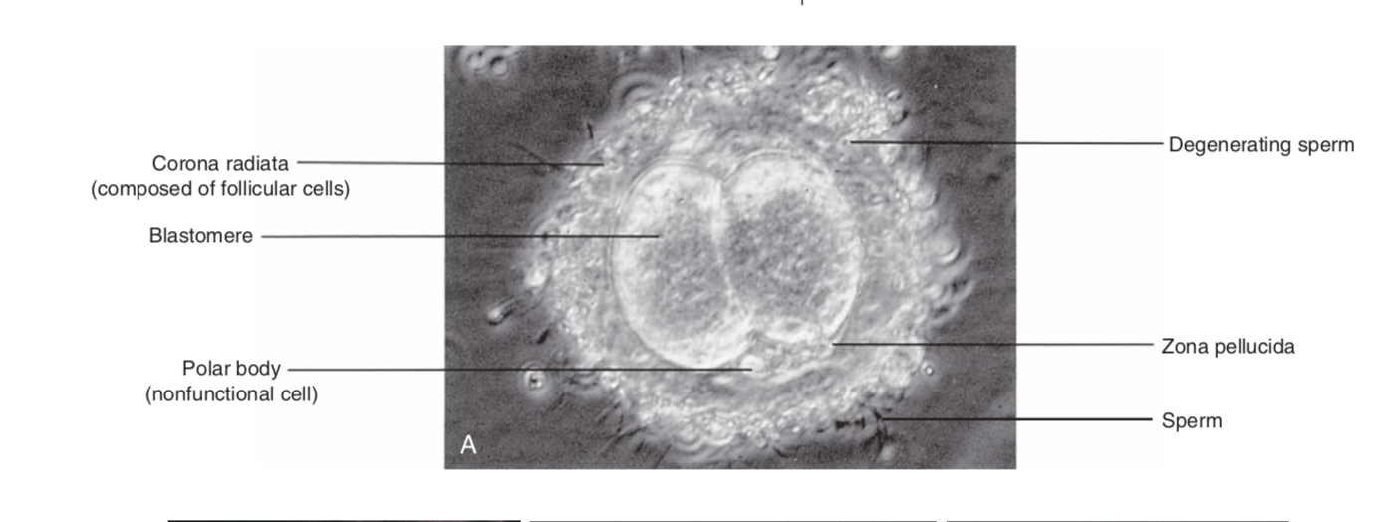

Slide 21
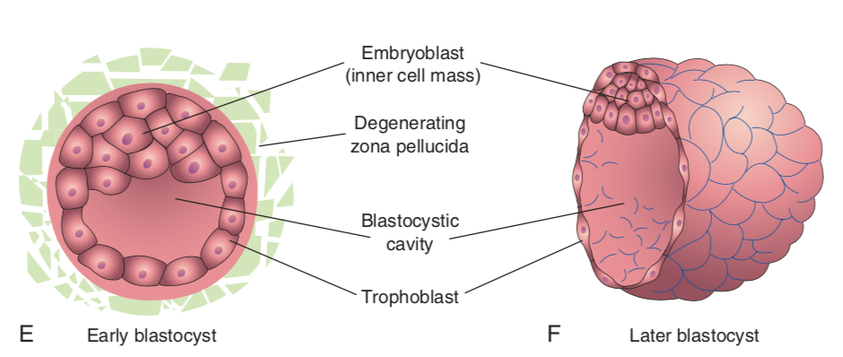

Slide 22
Cleavage contd:
Day 4 - blastocyst formation
A small space appears inside the morula as fluid makes way from the uterine cavity through zona pellucida and divides the blastomeres into 2 layers
*** The embryoblast and
*** Trophoblast
Early pregnancy factor is secreted by trophoblastic cells- and immune suppressant protein.
At this stage of development the developing human is called the blastocyst.
It starts to float on the endometrium and the zona pellucida also begins to degenerate.
Shedding of the zona pellucida causes rapid increase in size of the blastocyst.

Slide 23
Day 6
The blastocyst attaches to the endometrial epithelium and trophoblast proliferates rapidly into two layers
Cytotrophoblast
Syncytiotrophoblast (cell mass with no cell boundries)
Finger-like projections of the syncytiotrophoblast are visible modulated by a matrix of factors such as:
Transforming growth factors.
Serine/threonine protein kinases.

Slide 24
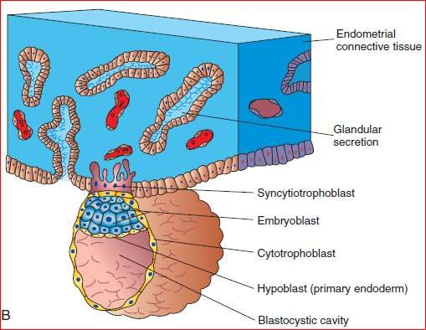

Slide 25
Day 7
Endometrial invasion by syncytiotrophoblast - the blastocyst burrows into the endometrial wall
Hypoblast begins to appear - a result of delamination of some cells from the epiblast.
Potential Issues in the Week
Dispermy & Triplody
Triploid conceptions account for approximately 20% of chromosomally abnormal spontaneous abortions.
Triploid embryos almost always abort spontaneously in the 1st trimester or demise soon after birth
Mosaicism
Non-disjunction during mitosis may produce genetic mosaics
Assisted Reproductive Technologies

Slide 26
Assisted Reproductive Technologies
In-vitro fertilization
Stimulation of ovarian follicles by clomiphene citrate or gonadotropin
Aspiration of oocytes into a petri dish containing capacitated sperms
Microscopic monitoring of conceptus for 3 - 5 days
Artificial implantation at 4 - 8 cell stage
Conservation of gametes & embryos
Frozen in liquid nitrogen
Sperm can last up to 21 years

Slide 27
Assisted Reproductive Technologies contd:
Intracytoplasmic cell injection
Treatment for couples whose IVF has failed
Assisted In Vivo fertilization
Involves superovulation and placement of gametes in the ampulla
Surrogacy

Slide 28
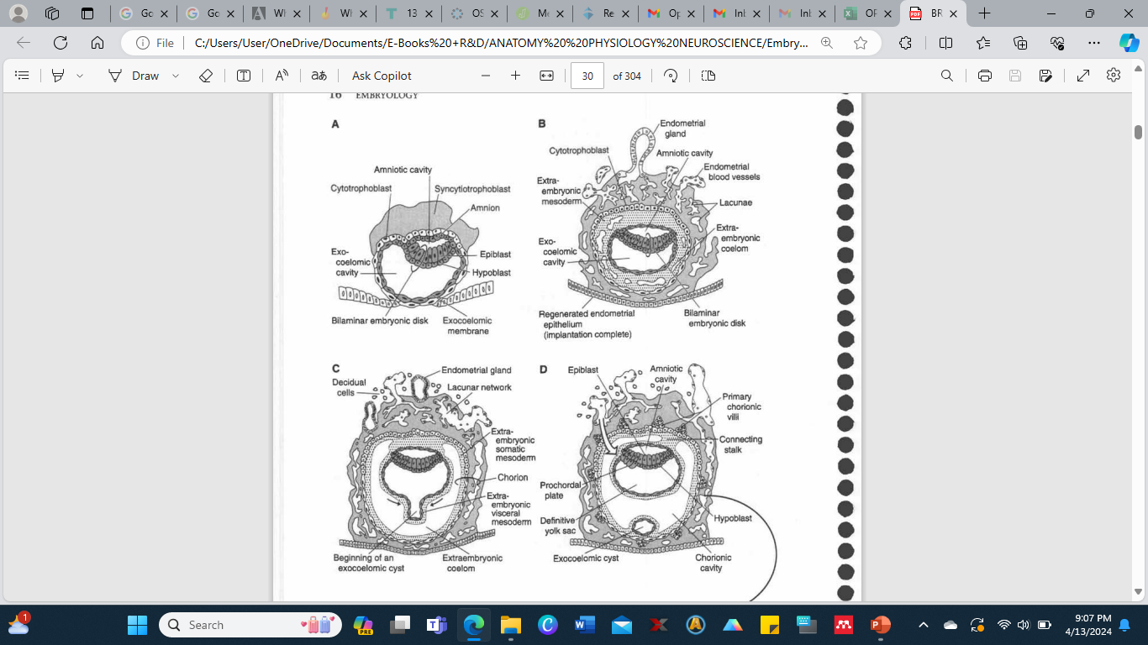
(A) Day 8 blastocyst is shown partially implanted into the endometrium. Extraembryonic mesoderm (EEM) has not formed yet. (B) Day 12 blastocyst is shown completely implanted within the endometrium, and epithelium has regenerated. This type of implantation is known as interstitial implantation. EEM begins to form. (C) Day 13 blastocyst. A lacunar network forms, establishing an early uteroplacental circulation. An exocoelomic cyst begins to pinch off (small arrows). (D) Day 14 blastocyst. The embryoblast can be described as two balloons (amniotic cavity and yolk sac) pressed together at the bilaminar embryonic disk. The curved open arrow indicates that the embryoblast receives maternal nutrients via diffusion.

Slide 29
Week 2 – Implantation (Day 8 – 14)
Implantation of blastocyst usually occurs in the uterine endometrium in the superior part of the body of the uterus, slightly more often on the posterior wall than on the anterior wall of the uterus.
As the syncytiotrophoblast invades the endometrium, its cells displaces the endometrial cells causing apoptosis thus facilitating invasion.
Integrins, cytokines, prostaglandins hCG, protein kinase play role in synchronizing the molecular mechanisms of implantation.
Being receptiveness of the endometrium against invasiveness of the blastocyst.

Slide 30
Implantation contd:
Connective tissue around implantation site accumulate glycogen and the syncytiotrophoblast cells engulfs the cell debris thus providing source of embryonic nutrition.
Syncytiotrophoblast cells produce glycoprotein hCG which enters maternal circulation and maintains the corpus luteum of pregnancy.
At the end of 2nd week hCG in maternal circulation is enough to cause positive pregnancy test.

Slide 31
Clinical Correlates
Implantation Spotting
The events of the first week of pregnancy often goes unnoticed.
The expectant mother will continue her regular routines, unaware of the intricately orchestrated events that are underway.
On rare occasions, some females may notice implantation spotting towards the end of the first week.
This phenomenon occurs as the blastocyst begins to burrow into the endometrial lining.
The enzymes secreted from the syncytiotrophoblast layer of the blastocyst causes breakdown of the capillary beds at the implantation site.
As a result, the capillaries are converted into sinuses into which the blood will drain.
The nutrients subsequently diffuses across the trophoblast membrane to nourish the blastocyst.
The debris generated from the process is shed via the vaginal os, similar (but lighter than) to the natural menstrual flow.
However, this may be misinterpreted as the onset of their monthly menses.

Slide 32
Formation of the Embryonic Disc
Epiblast- thick highly columnar cells related to the amniotic cavity.
Hypoblast- consists of small cuboidal cells adjacent to the exocoelomic cavity.
As implantation progresses, a small space appears in the embryoblast, which is the future amniotic cavity.
Soon amnioblasts separate from the epiblast and form amnion.

Slide 33
Bilaminar Layer
The hypoblast forms the roof of the exocoelomic cavity and is continuous with the thin exocoelomic membrane.
The exocoelomic membrane and hypoblast lines the primary umbilical vesicle
Cells from the vesicle endoderm form a layer of connective tissue, the extraembryonic mesoderm that surrounds the umbilical vesicle and amnion.
As the bilaminar layer gets more pronounced lacunae in the syncytiotrophoblast receives more embryotroph from maternal circulation and feeds the bilaminar embryonic disc by diffusion.

Slide 34
Uteroplacental Circulation
The communication of the eroded endometrial capillaries with the lacunae establishes basis of uteroplacental circulation.
At 10 days, the conceptus is completely embedded in the uterine endometrium initially with a closing plug
By day 12, the closing plug is replaced by endometrium.
Accumulation of glycogen and lipid causes the endometrial cells to swell
Formation of blood vessels in the endometrial stroma is under the influence of estrogen and progesterone. Expression of connecxin 43 (Cx43) , a gap junction protein plays critical role in angiogenesis.
The 12 days embryo protrudes into the uterine cavity
Extraembyonic mesoderm increases and results in formation of the extra embryonic coelom. Surrounds the amnion and umbilical vesicles.

Slide 35
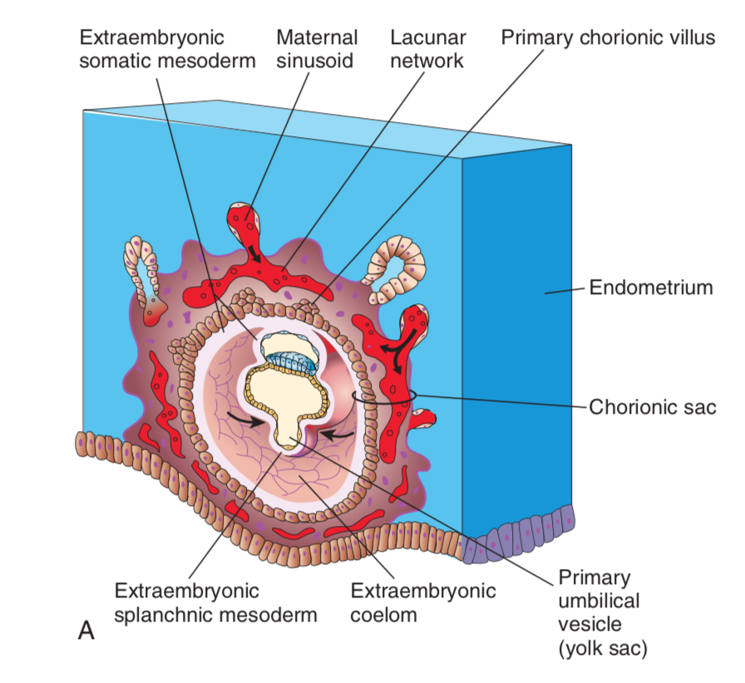
Implanted Zygote

Slide 36
Extrauterine Implantation
Statistically ranges between 1/80 to 1/250 pregnancies, mostly tubal pregnancies
A result of failure to migrate due to scarring or inflammatory diseases of the uterine tubes.

Slide 37
Inhibition of Implantation
Morning after pill
A high dose of diethylbestrol given daily immediately after unprotected intercourse disturbs balance of oestrogen-progesterone thus inhibiting endometrial preparation for iplantation.
Use of IUCD
Causes localized inflammatory process in the endometrium thus inhibiting implantation.
Exists in copper and hormonal forms.

Slide 38
Pregnancy Test
The human chorionic gonadotropin is regarded as the hormone of pregnancy, thus used to confirm pregnancy.
Produced by placental tissue, rises gradually in serum shortly after implantation. It is a glycoprotein composed of two subunits, the beta and alpha subunit.
Normally undetectable in non-pregnant females
BhCG can be detectable in serum and in urine

Slide 39
Urine Pregnancy Test
This is a qualitative test.
Reports as negative or positive.
Early morning specimens are ideal.
Over the counter test kits are available
Threshold for detection is safely put at greater than 20mIU/mL
Blood in the urine may cause a false positive test
hyperglycosylated hormone may be undetectable.
Serum Pregnancy Test
This is a quantitative test
It is an immunoassay (electrochemiluminescenence)
May detect serum levels as low as 1-2mIU/ml
A qualitative test may also be used.

Slide 40
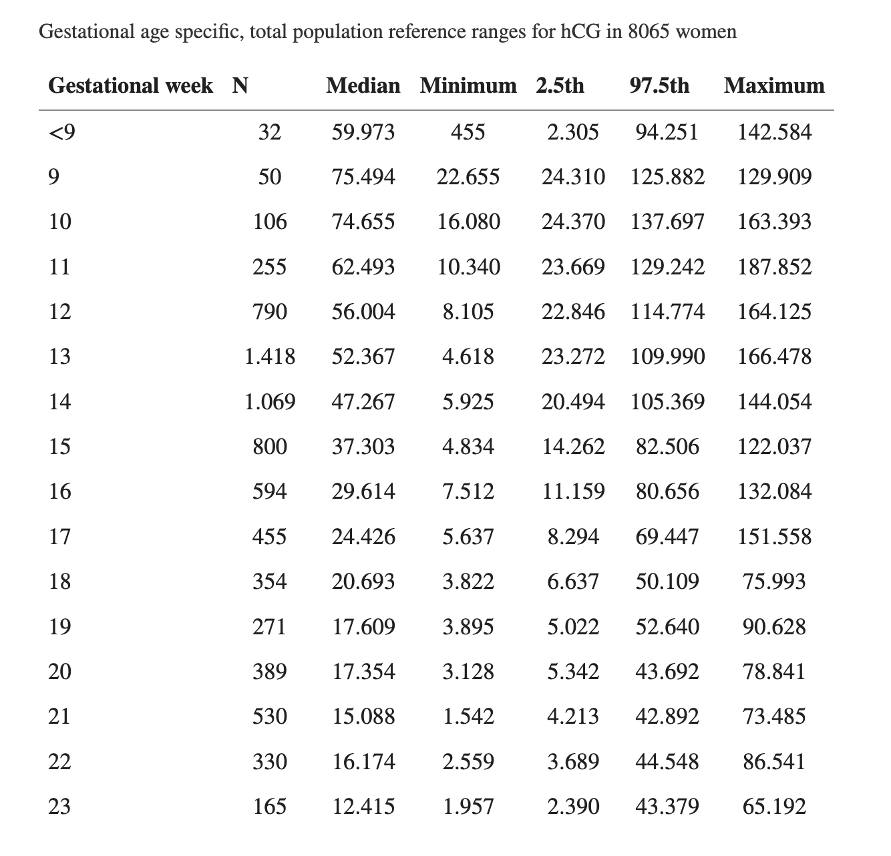
Beta Hcg Levels By Gestational Age

Slide 41
Interference with Pregnancy Testing
Females aged > 55yrs
Trophoblastic malignancies
Testicular cancers
Ovarian malignancies
Bladder cancers

Slide 42
Multiple Pregnancies
The subtle events present an even more exhilarating surprise if the conceptus is actually a multiple pregnancy (ie twins, triplets, etc).
Multiple pregnancies either result from more than one oocytes being released at the time of ovulation and each being fertilized by an individual sperm ( dizygotic ) or a single oocyte that was fertilized divides into two separate zygotes ( monozygotic ).
TWINS
Monozygotic twins are also referred to as identical twins, as their genetic composition contains very little disparity.
This phenomenon arises after the zygote is formed and undergoes its first cell division.
At the two cell stage the cells partition into separate zygotes, each of which will continue to undergo typical development.

Slide 43
The resulting embryo may either have one inner cell mass and two embryonic discs, or two inner cell masses and two embryonic discs.
Both these embryos will share a chorion (ie monochorionic ).
However, the conceptus with two inner cell masses will have their own amniotic sac (diamniotic), while the conceptus with one inner cell mass will share an amniotic sac (monoamniotic).
The occurrence of dizygotic/ fraternal twins depends on polyovulation; where the expectant mother would have released at least two oocytes during a single ovulatory period and both would have been successfully fertilized.
The series of events (cell division, implantation, etc) would occur for each zygote as it usually does in a singleton pregnancy.
All dizygotic twins are dichorionic, and will have their own amniotic sac as well.

Slide 44
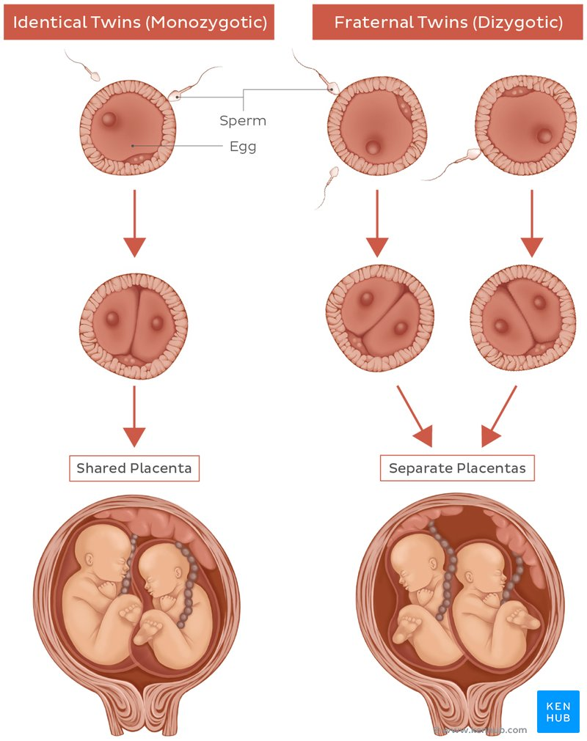

Slide 45
PRACTICE QUESTIONS
1. A 20-year-old woman presents at the emergency department with severe abdominal pain on the right side with signs of internal bleeding. She indicated that she has been sexually active without contraception and missed her last menstrual period. Based on this information, which of the following disorders must be included as an option in the diagnosis?
(A) Ovarian cancer (B) Appendicitis (C) Normal pregnancy (D) Ectopic tubal pregnancy (E) Toxemia of pregnancy
2. When does a secondary oocyte complete its second meiotic division to become a mature ovum?
(A) At ovulation; (B) Before ovulation; (C) At fertilization
(D) At puberty; (E) Before birth
3. How soon after fertilization occurs within the uterine tube does the blastocyst begin implantation?
(A) Within minutes; (B) By 12 hours; (C) By day 1; (D) By day 2; (E) By day 7
4. Where does the blastocyst normally implant?
(A) Functional layer of the cervix; (B) Functional layer of the endometrium
(C) Basal layer of the endometrium; (D) Myometrium
(E) Perimetrium
5. Which of the following events is involved in cleavage of the zygote during week 1 of development?
(A) A series of meiotic divisions forming blastomeres
(B) Production of highly differentiated blastomeres
(C) An increased cytoplasmic content of blastomeres
(D) An increase in size of blastomeres (E) A decrease in size of blastomeres
6. Which of the following structures must degenerate for blastocyst implantation to occur?
(A) Endometrium in progestational phase (B) Zona pellucida (C) Syncytiotrophoblast (D) Cytotrophoblast (E) Functional layer of the endometrium

Slide 46
7. Which of the following is the origin of the mitochondrial DNA of all human adult cells?
(A) Paternal only
(B) Maternal only
(C) Combination of paternal and maternal
(D) Either paternal or maternal
(E) Unknown origin
8. Individual blastomeres were isolated from a blastula at the 4-cell stage. Each blastomere was cultured in vitro to the blastocyst stage and individually implanted into four pseudopregnant foster mothers. Which of the following would you expect to observe 9 months later?
(A) Birth of one baby
(B) Birth of four genetically different babies
(C) Birth of four genetically identical babies
(D) Birth of four grotesquely deformed babies
(E) No birth
9. Embryonic carcinoma (EC) cells were isolated from a yellow-coated mouse with a teratocarcinoma. The EC cells were then microinjected into the inner cell mass of a blastocyst isolated from a black-coated mouse. The blastocyst was subsequently implanted into the uterus of a white-coated foster mouse. Which of the following would be observed after fullterm pregnancy?
(A) A yellow-coated offspring
(B) A black-coated offspring
(C) A white-coated offspring
(D) A yellow- and black-coated offspring
(E) A yellow- and white-coated offspring

Slide 47
PRACTICE QUESTIONS
1. Which of the following components plays the most active role in invading the endometrium during blastocyst implantation? (A) Epiblast (B) Syncytiotrophoblast (C) Hypoblast (D) Extraembryonic somatic mesoderm (E) Extraembryonic visceral mesoderm
2. Between which two layers is the extraembryonic mesoderm located? (A) Epiblast and hypoblast (B) Syncytiotrophoblast and cytotrophoblast (C) Syncytiotrophoblast and endometrium (D) Exocoelomic membrane and syncytiotrophoblast (E) Exocoelomic membrane and cytotrophoblast
3. During week 2 of development, the embryoblast receives its nutrients via (A) diffusion (B) osmosis (C) reverse osmosis (D) fetal capillaries (E) yolk sac nourishment.
4. The prochordal plate marks the site of the future (A) umbilical cord (B) heart (C) mouth (D) anus (E) nose
5. Which of the following are components of the definitive chorion? (A) Extraembryonic somatic mesoderm and epiblast (B) Extraembryonic somatic mesoderm and cytotrophoblast (C) Extraembryonic somatic mesoderm and syncytiotrophoblast (D) Extraembryonic somatic mesoderm, cytotrophoblast, and syncytiotrophoblast (E) Extraembryonic visceral mesoderm, cytotrophoblast, and syncytiotrophoblast.
6. A 16-year-old girl presents on March 10 in obvious emotional distress. On questioning, she relates that on March 1 she experienced sexual intercourse for the first time, without any means of birth control. Most of her anxiety stems from her fear of pregnancy. What should the physician do to alleviate her fear? (A) Prescribe diazepam and wait to see if she misses her next menstrual period (B) Use ultrasonography to document pregnancy (C) Order a laboratory assay for serum hCG (D) Order a laboratory assay for serum progesterone (E) Prescribe diethylstilbestrol ("morning after pill")

Slide 48
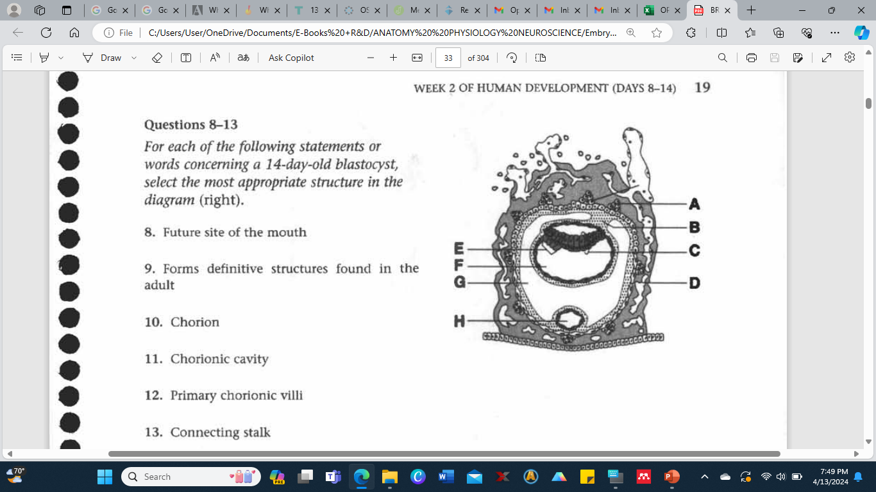
7. Carcinoembryonic antigen (CEA) is an oncofetal antigen that is generally associated with which one of the following tumors? (A) Hepatoma (B) Germ cell tumor (C) Squamous cell carcinoma (D) Colorectal carcinoma (E) Teratocarcinoma
Questions 8-13
For each or the following statements or words concerning a 14-day-old blastocyst, select the most appropriate structure in the diagram (right).
8. Future site of the mouth
9. Forms definitive structures found in the adult
10. Chorion
11. Chorionic cavity
12. Primary chorionic villi
13. Connecting stalk

Slide 49
Embryological Period or Period of Organogenesis
(Weeks 3 – 9)

Slide 50
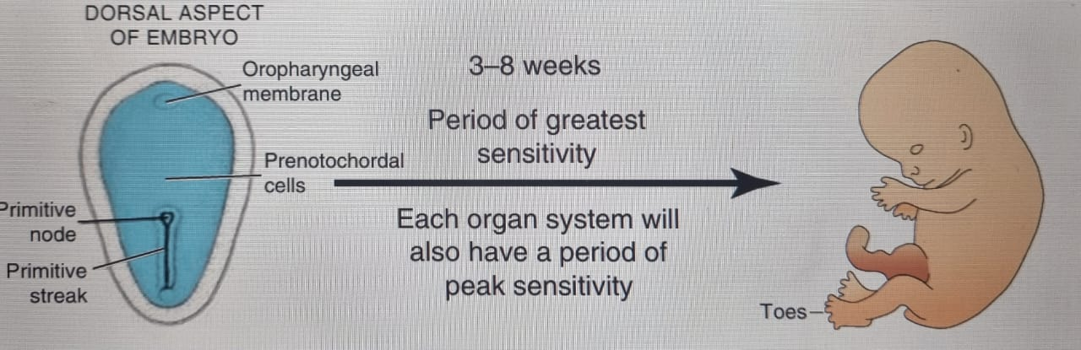
Embryological Period
This is the period of greatest susceptibility to teratogenesis.
By the end of this period, the embryo begins to look human, and the nervous and cardiovascular systems start to develop.
Week 3 corresponds to the first missed menstrual period.

Slide 51
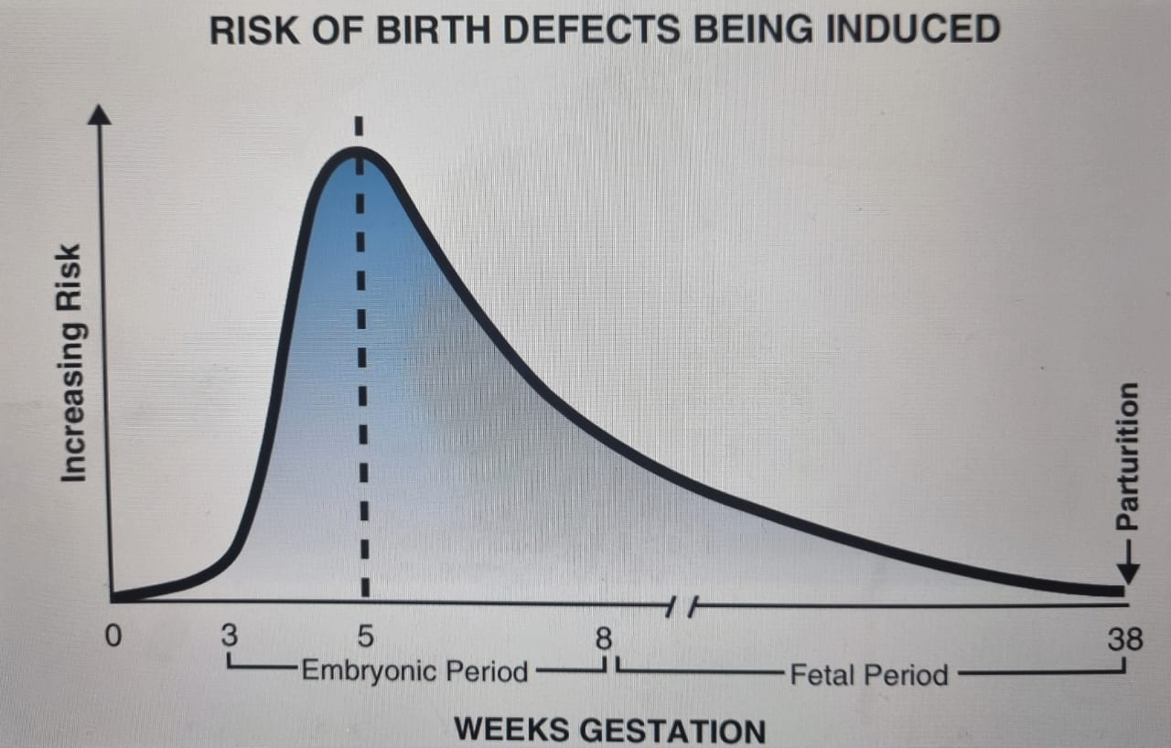
The risk of birth defects being induced peaks at 5 weeks IUL.

Slide 52
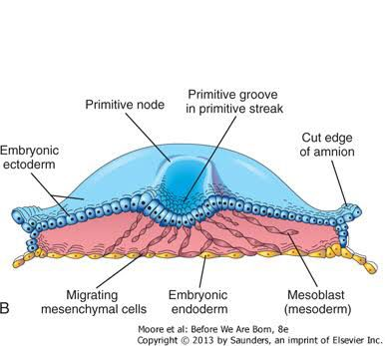
Period of embryogenesis
Period of organogenesis - the formation of organs and organ systems from the three germ layers.
Sequence:
Week 1 – Ovulation and Implantation
Week 2 – Bilaminar germ disc
Week 3 – Trilaminar Germ Disc

Slide 53
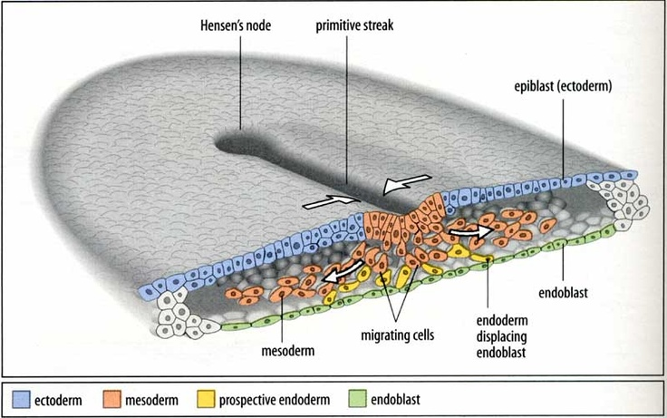
Gastrulation
This is a process of active movement of groups of cells (in the blastula/blastocyst), resulting in conversion of a blastula (or blastocyst in human) into a gastrula.
The process that establishes all 3 germ layers in the embryo:
Ectoderm
Mesoderm
Endoderm

Slide 54
Gastrulation contd:
Formation of the Primitive Streak
Appears on the surface of the epiblast as a shallow, narrow groove with slightly bulging extensions on either side in the caudal region of the embryo.
Cephalic end – Primitive Node – A slightly elevated are surrounding the primitive pit.
Invagination – Cells of the epiblast migrate towards the primitive streak, form a flask shape, then detach from the epiblast and slip beneath it.

Slide 55
After invagination, some cells displace the hypoblast, creating the embryonic endoderm.
Other epiblast cells lie between the epiblast and endoderm to form the mesoderm.
The cells remaining in the epiblast form the ectoderm.
These 3 germ layers (trilaminar disc) will give rise to all the tissues and organs of the embryo.
Cells spread laterally and cranially until beyond the margin of the embryonic disc, establishing contact with extraembryonic mesoderm covering the yolk sac and amnion.

Slide 56
Pre-Chordal Plate
Forms between the tip of the notochord and the oropharyngeal membrane.
Derived from some cells that migrate through the node in the midline and move in a cephalic direction.
Region of induction of the forebrain.
The migrating cells pass on each side of the pre-chordal plate in a cephalic direction.

Slide 57
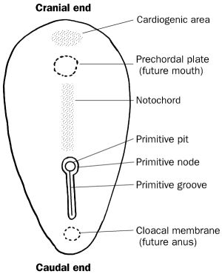
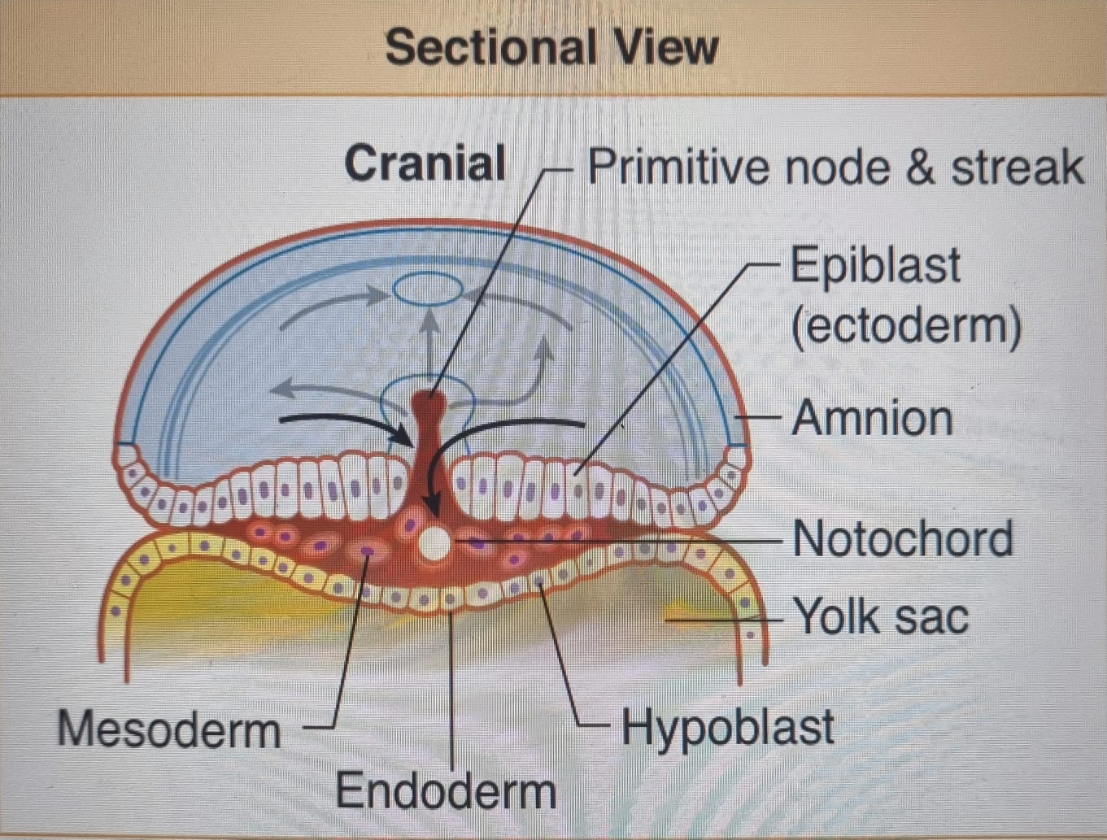

Slide 58
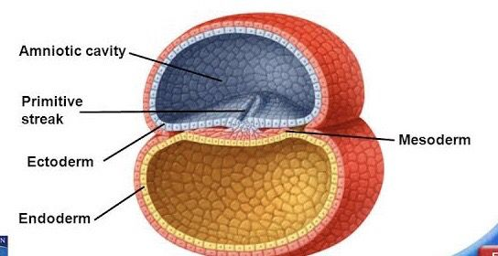
Oropharyngeal Membrane
At the cranial end of the embryonic disc.
Region of tightly adherent ectoderm and endoderm cells that represents the future opening of the oral cavity (stomodaeum = future site of mouth).

Slide 59
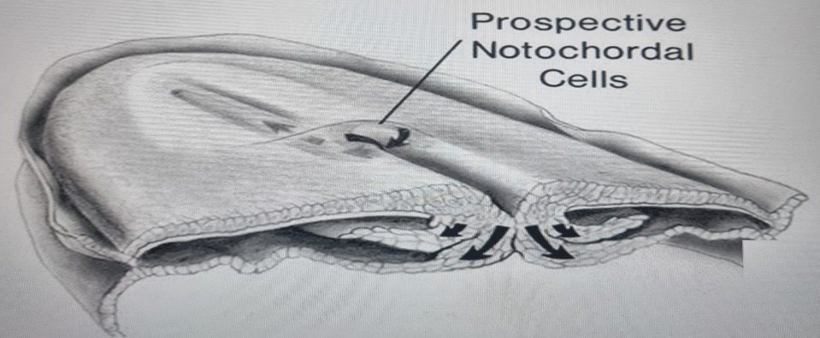
Formation of Notochord
A pre-chordal plate formed from early migrating cells from the primitive streak between the cranial end of the notochord and the oropharyngeal membrane.
Pre-notochordal cells invaginating in the primitive pit move cranially in the midline until they reach the pre-chordal plate, as well as in a cephalic direction on each side of the prechordal plate.
They become intercalated in the hypoblast to form the notochordal plate (process) that is bilayered.
As the hypoblast is replaced with endodermal cells, the notochordal plate proliferates and detaches itself from the endoderm to form a solid chord of cells, or definitive notochord (filled with mesodermal cells).

Slide 60
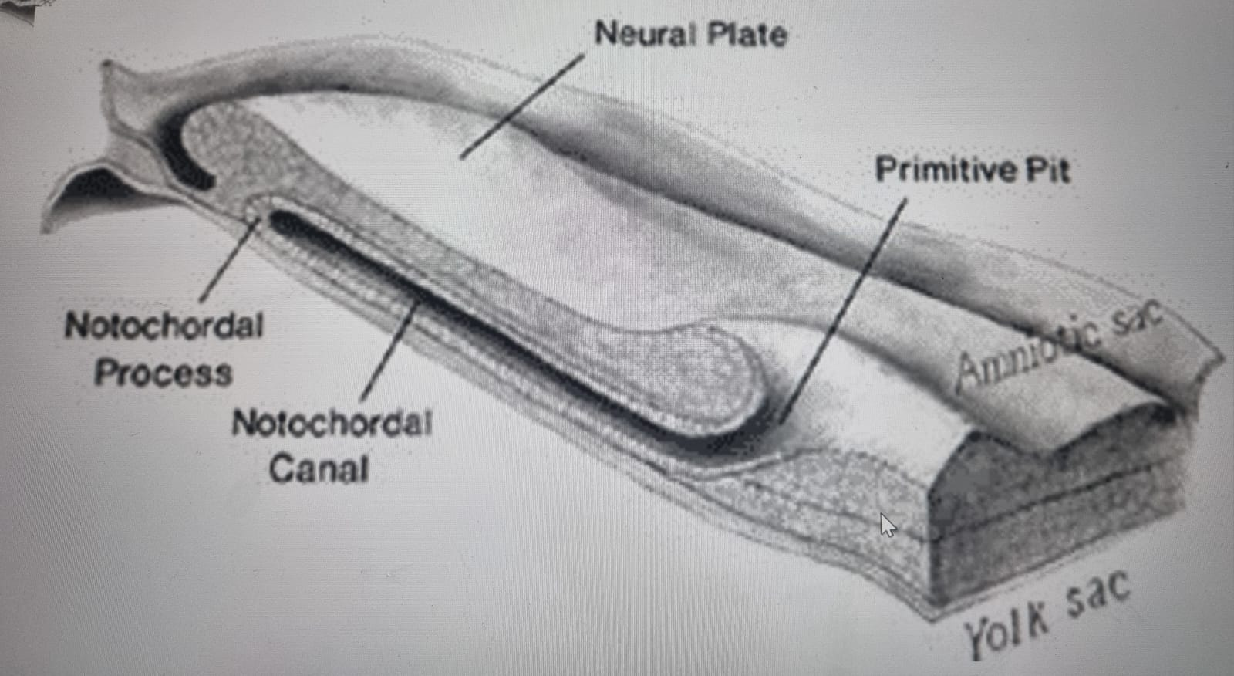
The definitive notochord underlies the neural tube and forms the basis for the axial skeleton.

Slide 61
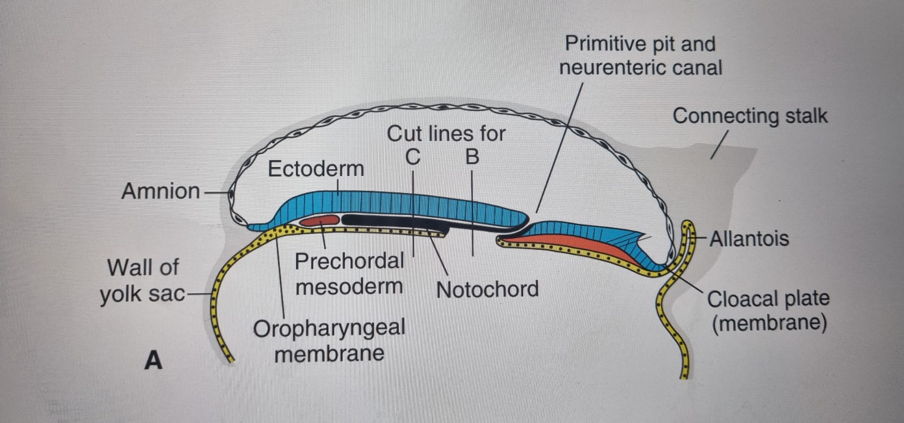
The cranial end of the notochord forms first and extends cranially to the pre-chordal plate, caudal to the oropharyngeal membrane.
It elongates and the caudal regions are added as the primitive streak assumes a more caudal position, to the primitive pit.
At the point where the pit forms an indentation in the epiblast, the neurenteric canal temporarily connects the amniotic and yolk sac cavities.

Slide 62
At the caudal end of the primitive streak the ectoderm is also fused directly to the endoderm; known as the cloacal membrane (proctodaeum) of the primordial anus.
When it appears, the posterior wall of the yolk sac forms a diverticulum that extends into the connecting stalk - allantoenteric diverticulum/ allantois.
This is at day 16 of development.
Remains rudimentary in humans, but may be involved in abnormalities of the bladder.

Slide 63
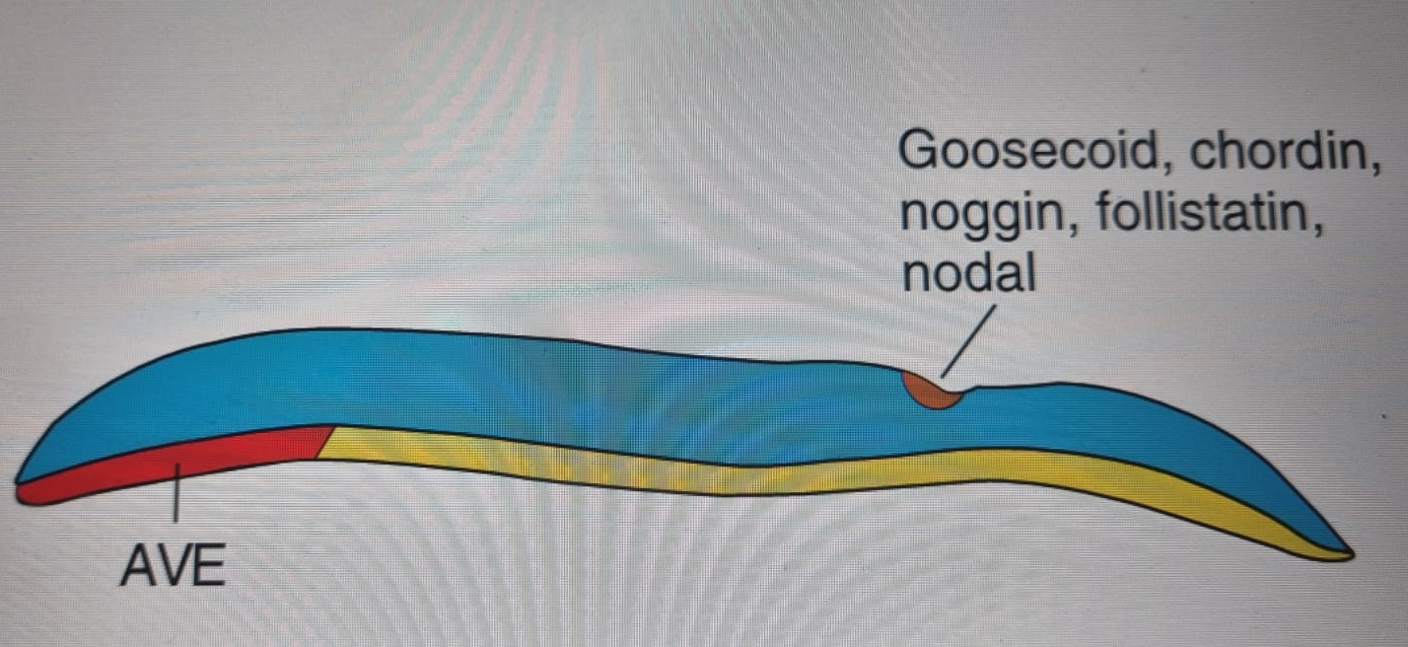
Establishment of Body Axes
Happens before and during the period of gastrulation, resulting in:
Anteroposterior; Dorsoventral and Left-right axes

Slide 64
Anteroposterior Axis
Signaled by cells at the cranial margin of the embryonic disc, the anterior visceral endoderm(AVE), which expresses genes essential for head formation.
Transcription factors OTX2, LIM1, HESX1 and Cerberus inhibit the activity of nodal in the cranial end of the embryo before gastrulation.
Nodal
Initiates and maintains the primitive streak.
Member of the transforming growth factor-beta (TGF-B) family.
Upregulates genes responsible for dorsal and ventral mesoderm and head and tail structures.

Slide 65
Dorsoventral Axis
Bone Morphogenetic Protein 4(BMP4)
Member of TGF-B family secreted throughout the embryonic disc
Together with fibroblast growth factor(FGF) causes mesoderm to be ventralised to contribute to kidneys (intermediate mesoderm), blood and body wall mesoderm (lateral plate mesoderm).
Chordin, Noggin and Follistatin
Genes expressed in the primitive node( the organizer)
Antagonize the activity of BMP4 such that not all mesoderm gets ventralised.
Cranial mesoderm is dorsalised into the notochord, somites and somitomeres in the head region.
Chordin is activated by transcription factor Goosecoid.
Later, these 3 are expressed in the notochord – neural induction in the cranial region.

Slide 66
Genetic Regulation
HNF-3B maintains the primitive node after Nodal initiates and maintains the primitive streak.
Induces regional specificity in the forebrain and midbrain areas
Lack of HNF-3B – failure of embryo to gastrulate properly and lack of forebrain and midbrain structures.
Goosecoid – Activates inhibitors of BMP4 and contributes to regulation of head development.
Its over/under-expression in lab animals results in severe malformations of the head region such as duplications similar to some types of conjoined twins.

Slide 67
Genetic Regulation contd:
Brachyury T Gene
Expressed in the node, notochord precursor cells and notochord.
Regulates formation of dorsal mesoderm in the middle and caudal regions of the embryo.
Essential for cell migration through the primitive streak.
Encodes the T-box, a sequence –specific DNA binding protein that functions as a transcription factor.
More that 20 genes that influence mesoderm formation in these regions.
Absence results in shortening of the embryonic axis(caudal dysgenesis).
Degree of shortening depends on time at which Brachyury becomes deficient.

Slide 68
Laterality (Left-Right-Sidedness)
Cells in the node & primitive streak secrete FGF8 which induces expression of Nodal, only on the left side of the embryo.
As neural plate is established, Nodal & LEFTY2 upregulate PITX 2, a homebox containing transcription factor responsible for establishing left-sidedness.
Its expression is repeated on the left side of the heart, stomach & gut primordia as they assume their normal asymmetrical positions.
Ectopic expression - laterality defects occur
Situs inversus
Dextocardia (placement of the heart to the right)

Slide 69
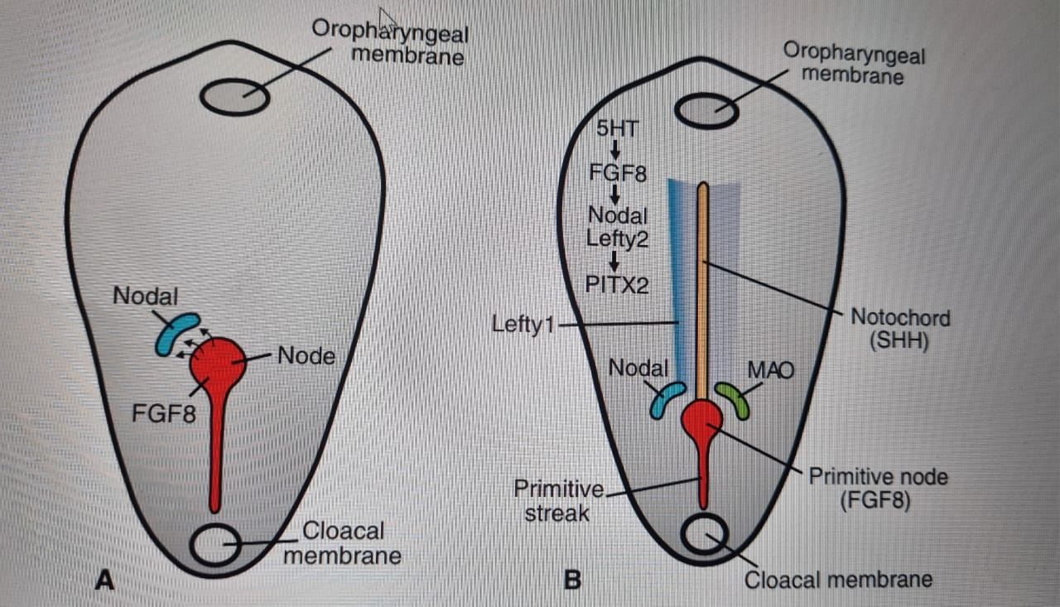
Genetic Regulation
Repressors for left-ssided gene expression on the right:
LEFTY expressed on the left side of the floor plate of the neural tube
Sonic hedgehog (SHH)
Brachyury (T) gene essential for expression of Nodal, LEFTY-1 and LEFTY-2

Slide 70
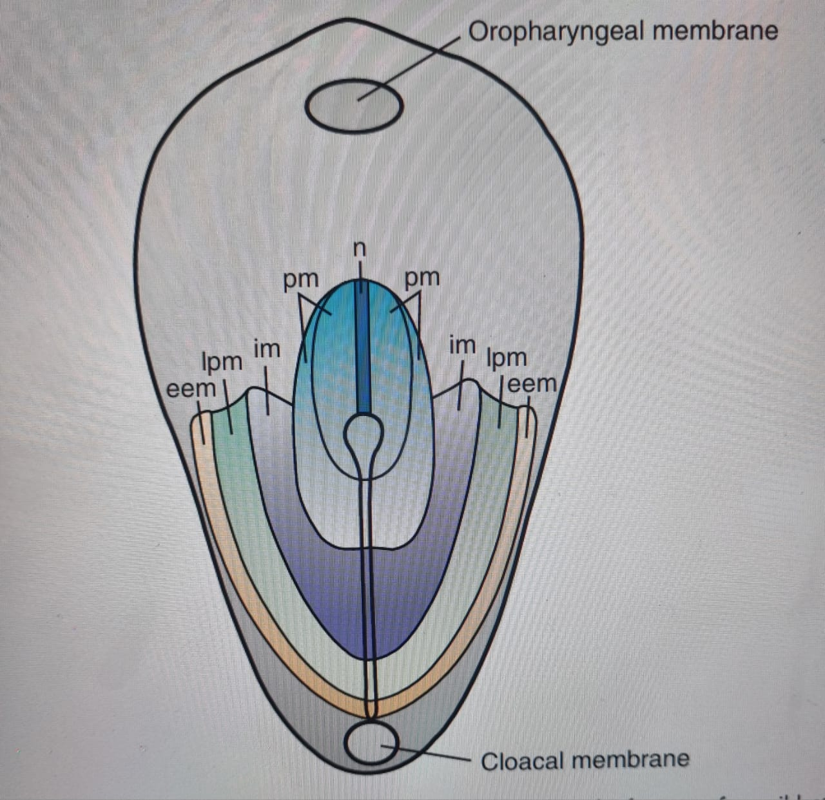
Fate of Epiblast Cells

Slide 71
Cranial region – prechordal plate and notochord
Lateral edges of the node and cranial end of the streak - Paraxial mesoderm -somitomeres and somites
Midstreak region- Intermediate mesoderm – Urogenital system
Caudal part of the streak- Lateral plate mesoderm –Body wall
Caudal-most part - Extraembryonic mesoderm –Chorion

Slide 72
Growth of Embryonic Disc
Initially flat and almost round
Gradually elongates with a broad cephalic end and narrow caudal end until the end of week 4.
Streak then regresses until it disappears.
Differentiation in the cranial region begins by mid-week 3 and end of week 4 in caudal region.
Embryo develops cranio-caudally.

Slide 73
Clinical Correlates
Highly sensitive to teratogenic insult such as high doses of alcohol.
Many women may still be expecting menses and may nit take necessary precaution.
Holoprosencephaly – deficiency in the midline in craniofacial structures
Small forebrain
Lateral ventricles merge into one
Hypotelorism

Slide 74
Disruption of Gastrulation
Caudal Dysgenesis (Sirenomelia)
Insufficient mesoderm formed in the caudalmost region.
Abnormalities in lower limb, urogenital system(intermediate mesoderm) and lumbosacral vertebrae.
Defects: hypoplasia and fusion of lower limbs; vertebral abnormalities; renal agenesis; imperforate anus; anomalies of genital organs
Associated with maternal diabetes.

Slide 75
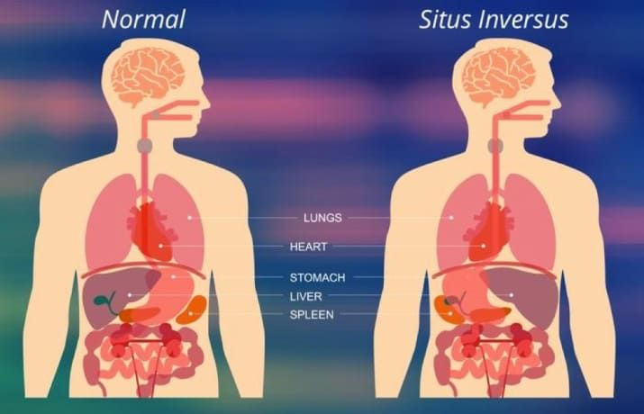
Situs Inversus
Transposition of viscera in the thorax and abdomen and other structural abnormalities.
20% with complete situs inversus have Kartagener’s syndrome( abnormal cilia)

Slide 76
Laterality Sequences
No complete Situs inversus
Predominantly bilaterally left or right sided
Spleen
Left-sided bilaterality - Polysplenia
Right-sided – Asplenia/ hypoplastic spleen
Other malformations, especially heart defects
Disruption of the neurotransmitter serotonin (5HT) signaling results in cases of situs inversus, dextocardia and heart defects as seen in children born to mothers who take antidepressants(SSRIs)

Slide 77
Tumors of Gastrulation
Persistent remnants of the primitive streak in the sacrococcygeal region.
Clusters of pluripotent cells proliferate and form sacrococcygeal teratomas
Most common tumor in newborns(1 in 37000)
Cells from all 3 germ layers
Primordial germ cells that fail to migrate to gonadal ridge may give rise to teratomas
Chordoma: a tumor that arises from remnants of the notochord, found either intracranially or in the sacral region

Slide 78
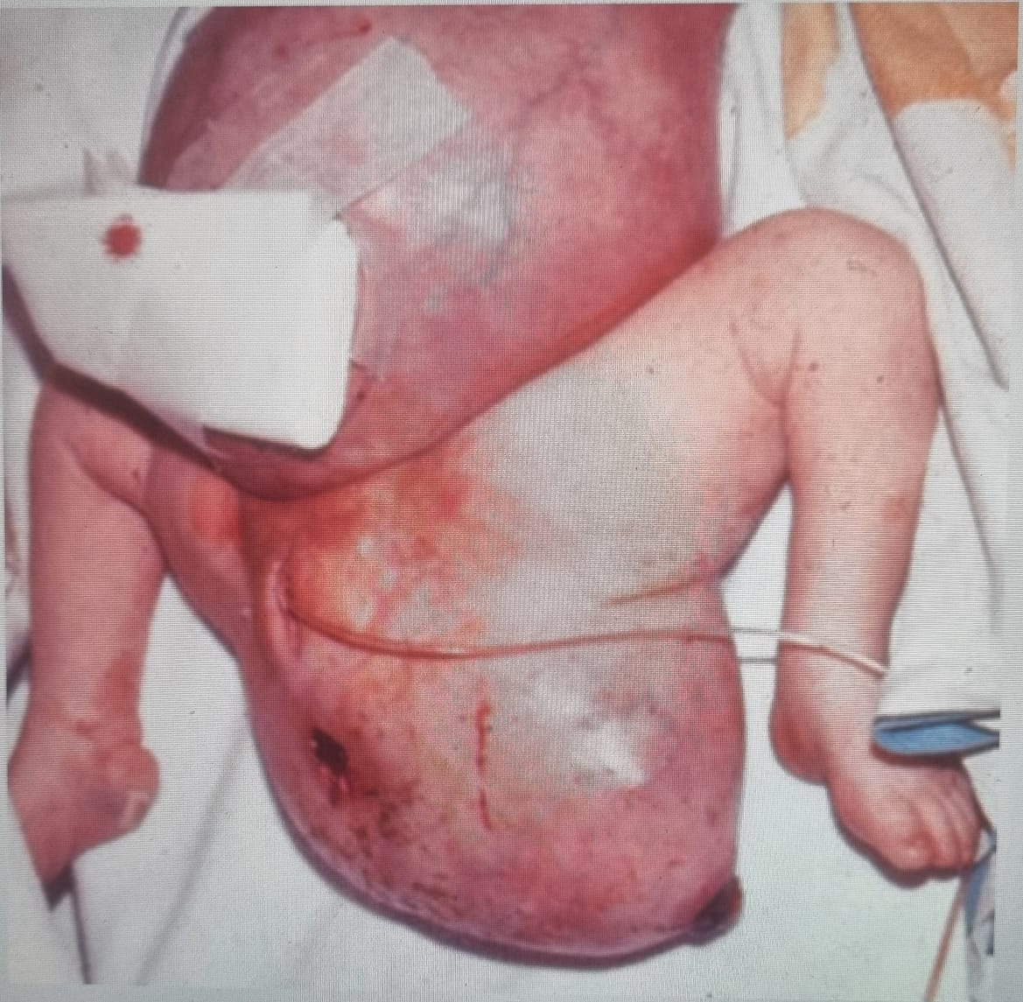
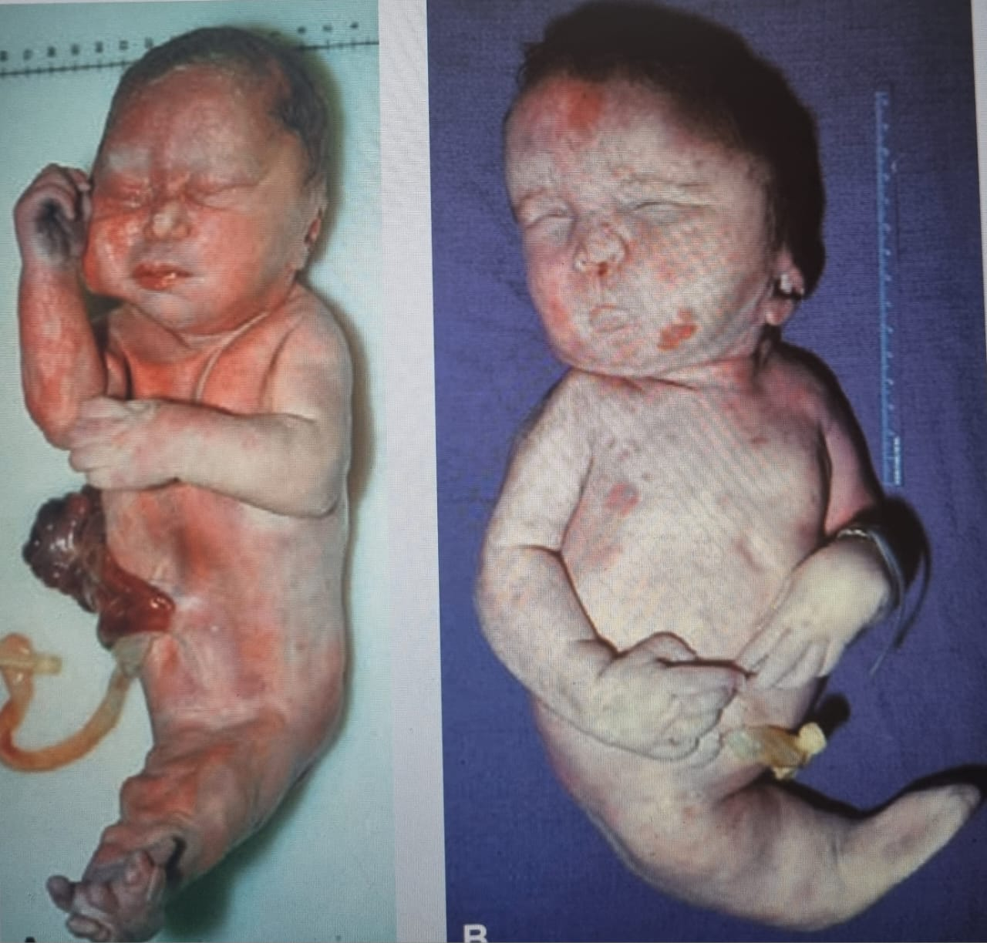
Disruption of gastrulation

Slide 79
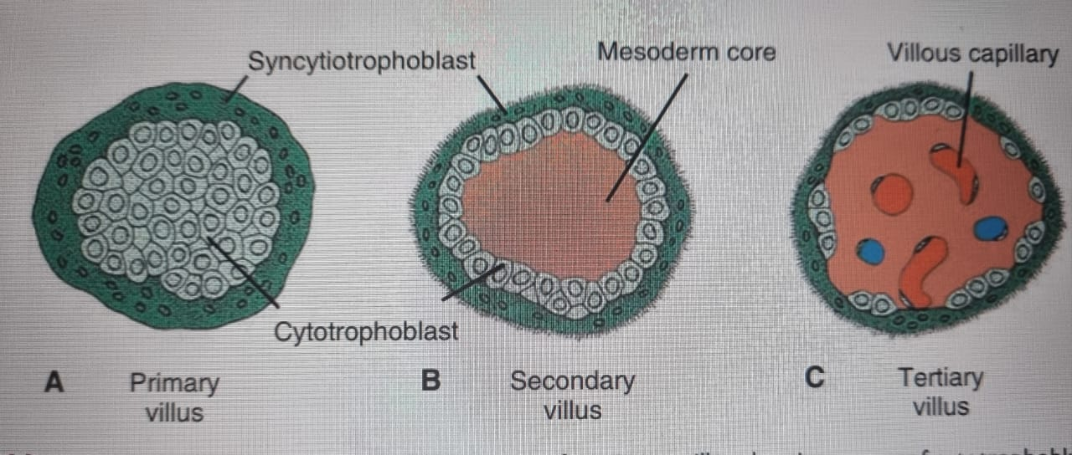
Development of Trophoblast
Simultaneously, the trophoblast progresses rapidly.
Primary villi obtain a mesenchymal core in which small capillaries arise.
These villous capillaries will make contact with capillaries in the chorionic plate and connecting stalk, rendering the villous system ready to supply the embryo with its nutrients and oxygen.

Slide 80
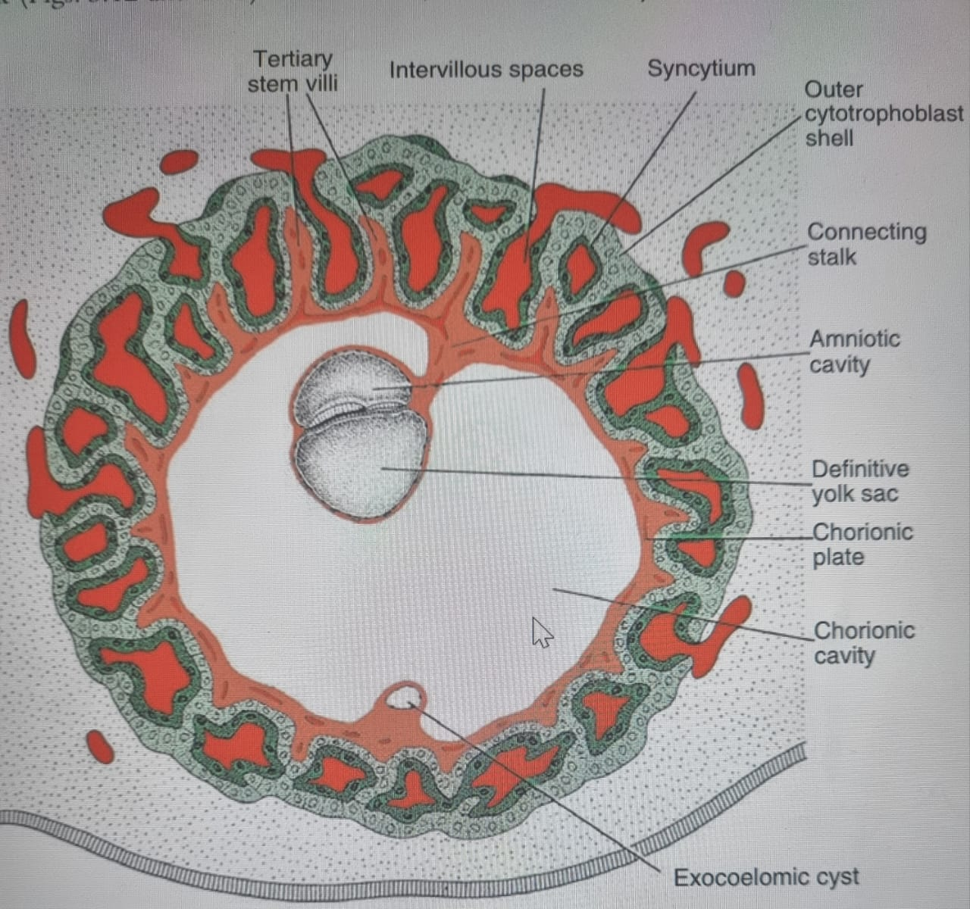
Development of Trophoblast

Slide 81
Hydatidiform mole: results from the partial or complete replacement of the trophoblast by dilated villi
In a complete mole, there is no embryo; a haploid sperm fertilizes a blighted ovum and reduplicates so that the karyotype is 46,XX, with all chromosomes of paternal origin.
In a partial mole, there is a haploid set of maternal chromosomes and usually 2 sets of paternal chromosomes so that the typical karyotype is 69,XXY.
Molar pregnancies have high levels of hCG, and 20% develop into a malignant trophoblastic disease, including choriocarcinoma

Slide 82
Derivatives of the Ectodermal Germ Layer
Specialization of the Ectoderm

Slide 83
Specialization of the Ectoderm
Neurulation (Formation of the Neural Tube/Nervous System)
First major event of organogenesis that takes place in the embryo.
Formation of the neural tube, that later develops into the central nervous system.
Beginning of week 3, the notochord and its overlying mesoderm induce the overlying ectoderm to thicken and form the neural plate, whose cells become neuroectoderm.
Series of molecular induction and regulation.

Slide 84
Neural Induction
Fibroblast growth factor (FGF) signaling
Bone morphogenetic protein 4 (BMP4) of the transforming growth factor B (TGF-B) family
Ectoderm protected from exposure to BMPs becomes neural tissue - noggin, chordin, Follistatin
Neuralize ectoderm
Dorsalizes mesoderm - notochord and paraxial mesoderm
Induce forebrain and midbrain tissues
WNT3a and FGF regulate caudal neural plate structure formation-hindbrain and spinal chord.
Retinoic acid (RA) organizes cranial-to-caudal axis.
Respecification.

Slide 85
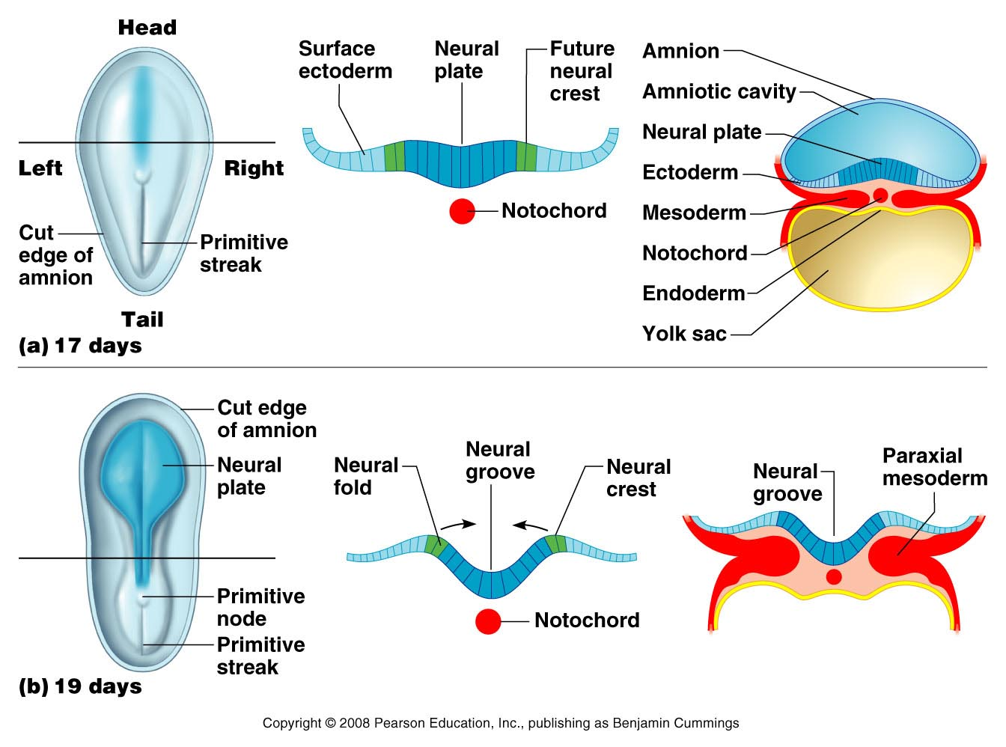
Neurulation

Slide 86
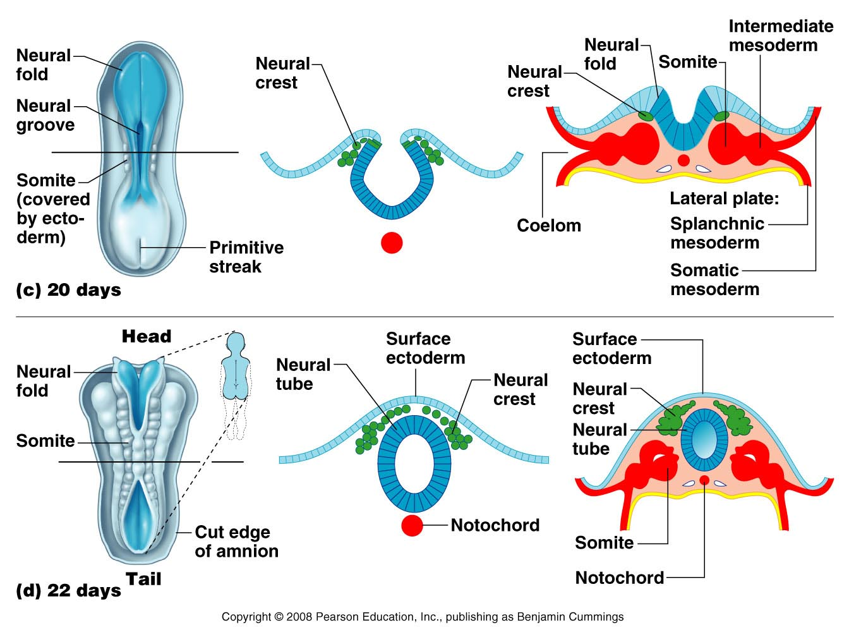
Neurulation contd:

Slide 87
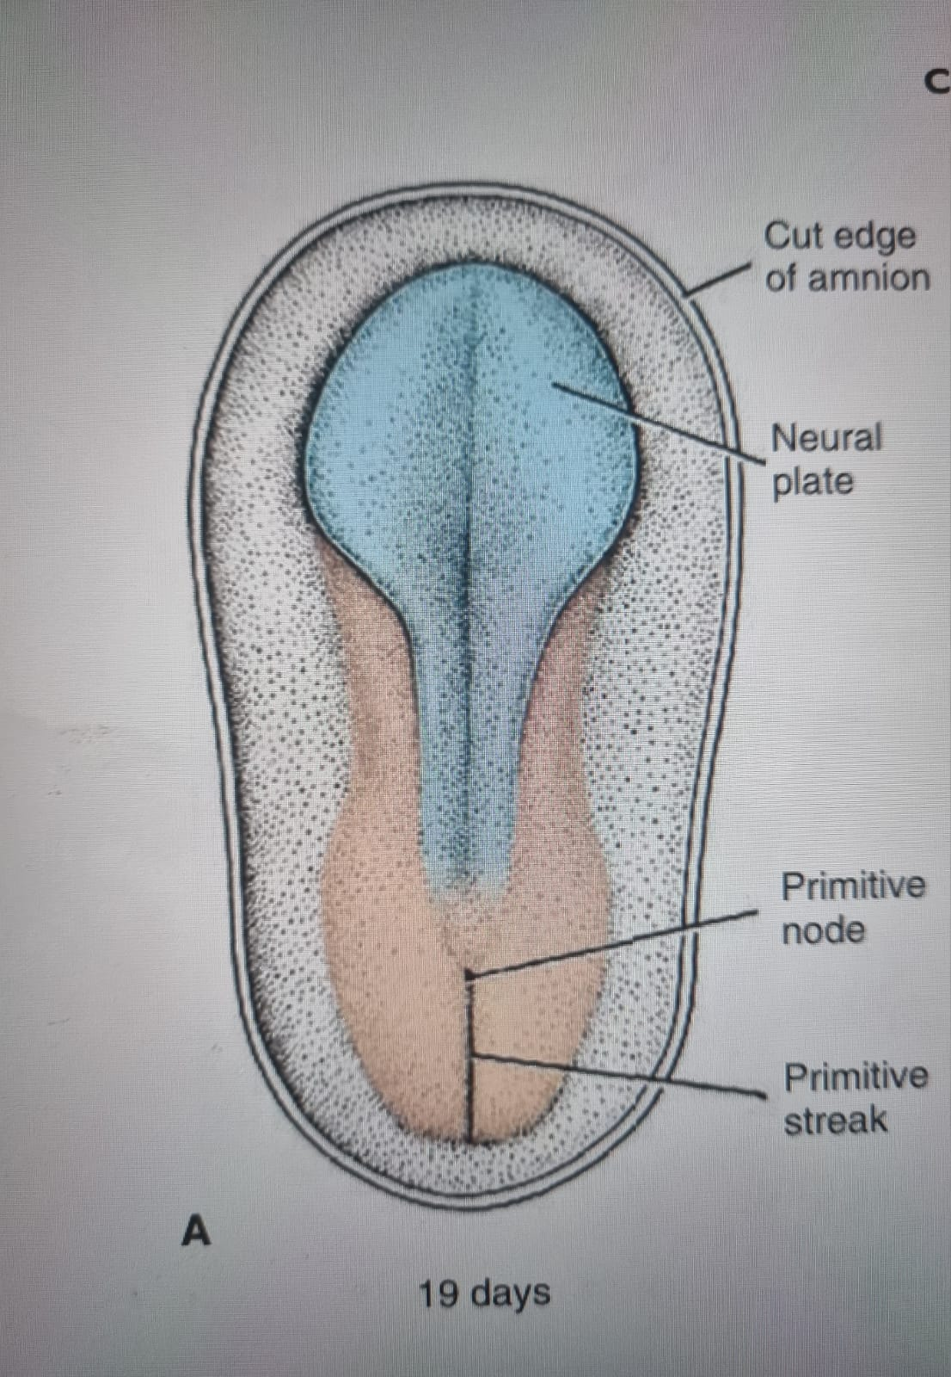
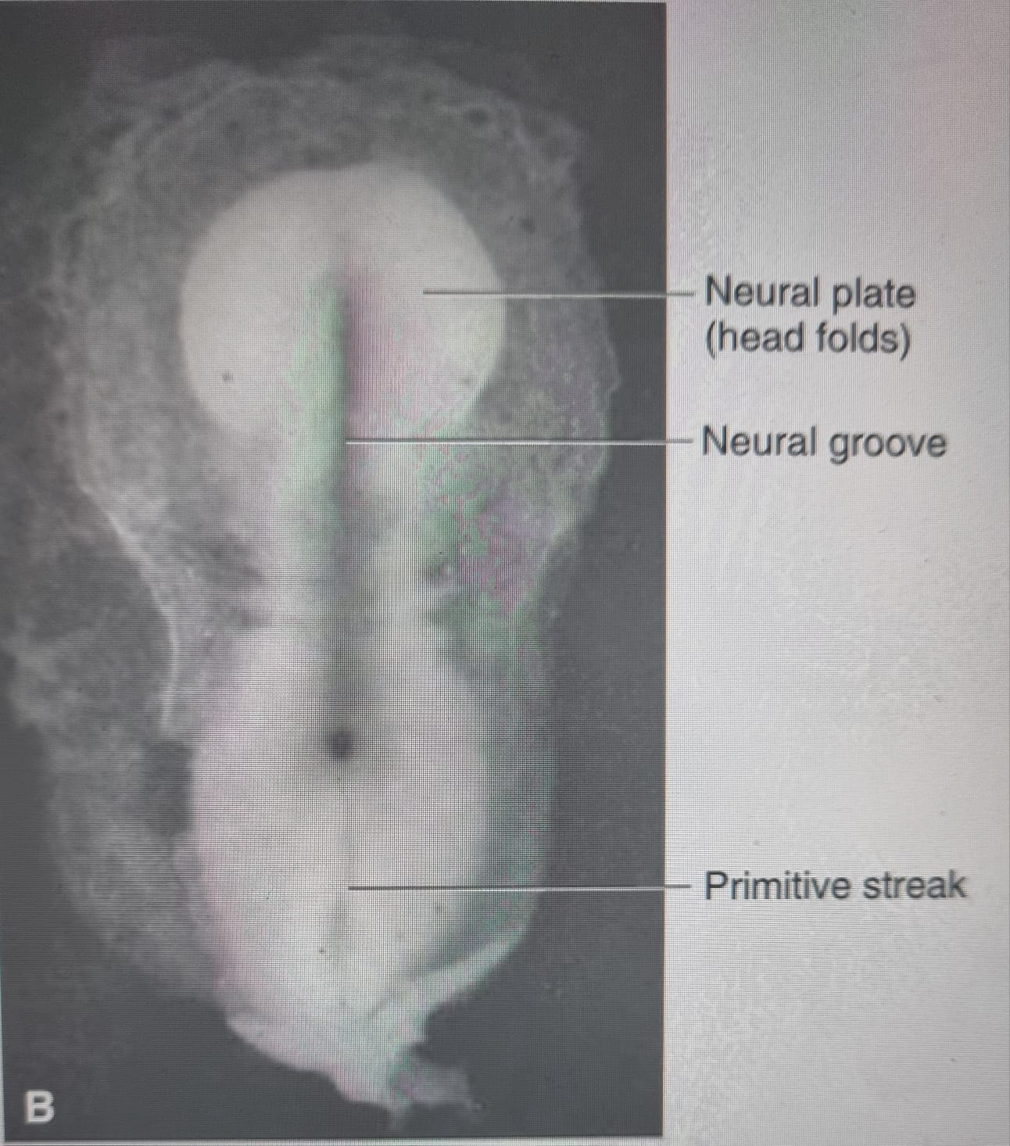
End of week 3
Elevation of lateral edges of neural plate- neural folds

Slide 88
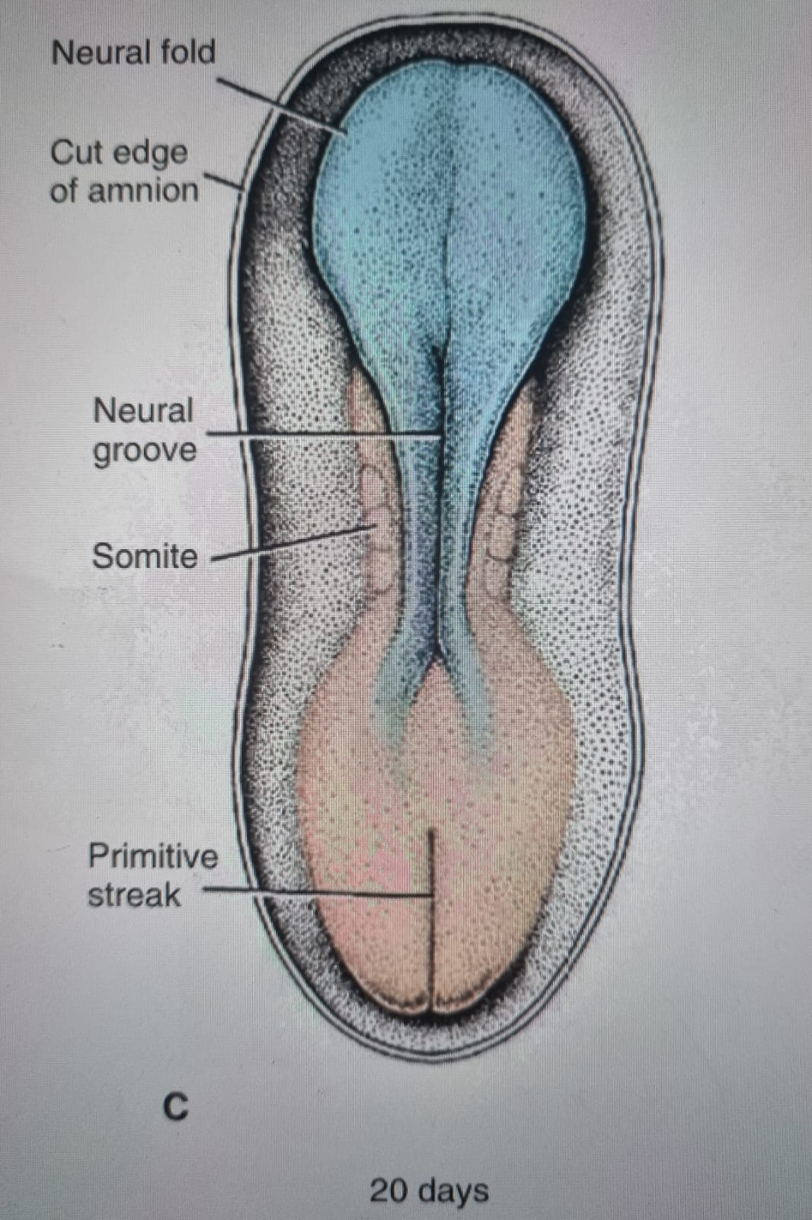
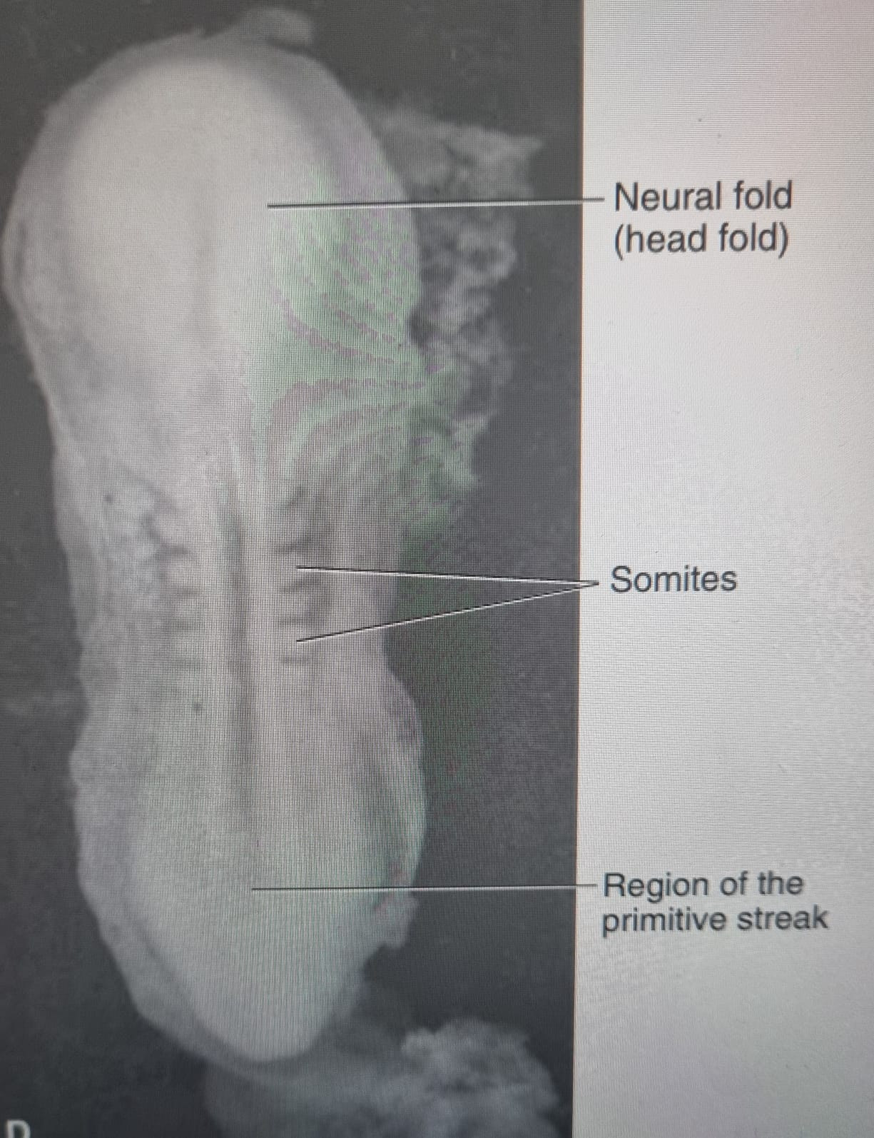
Approximation of neural folds in the midline

Slide 89
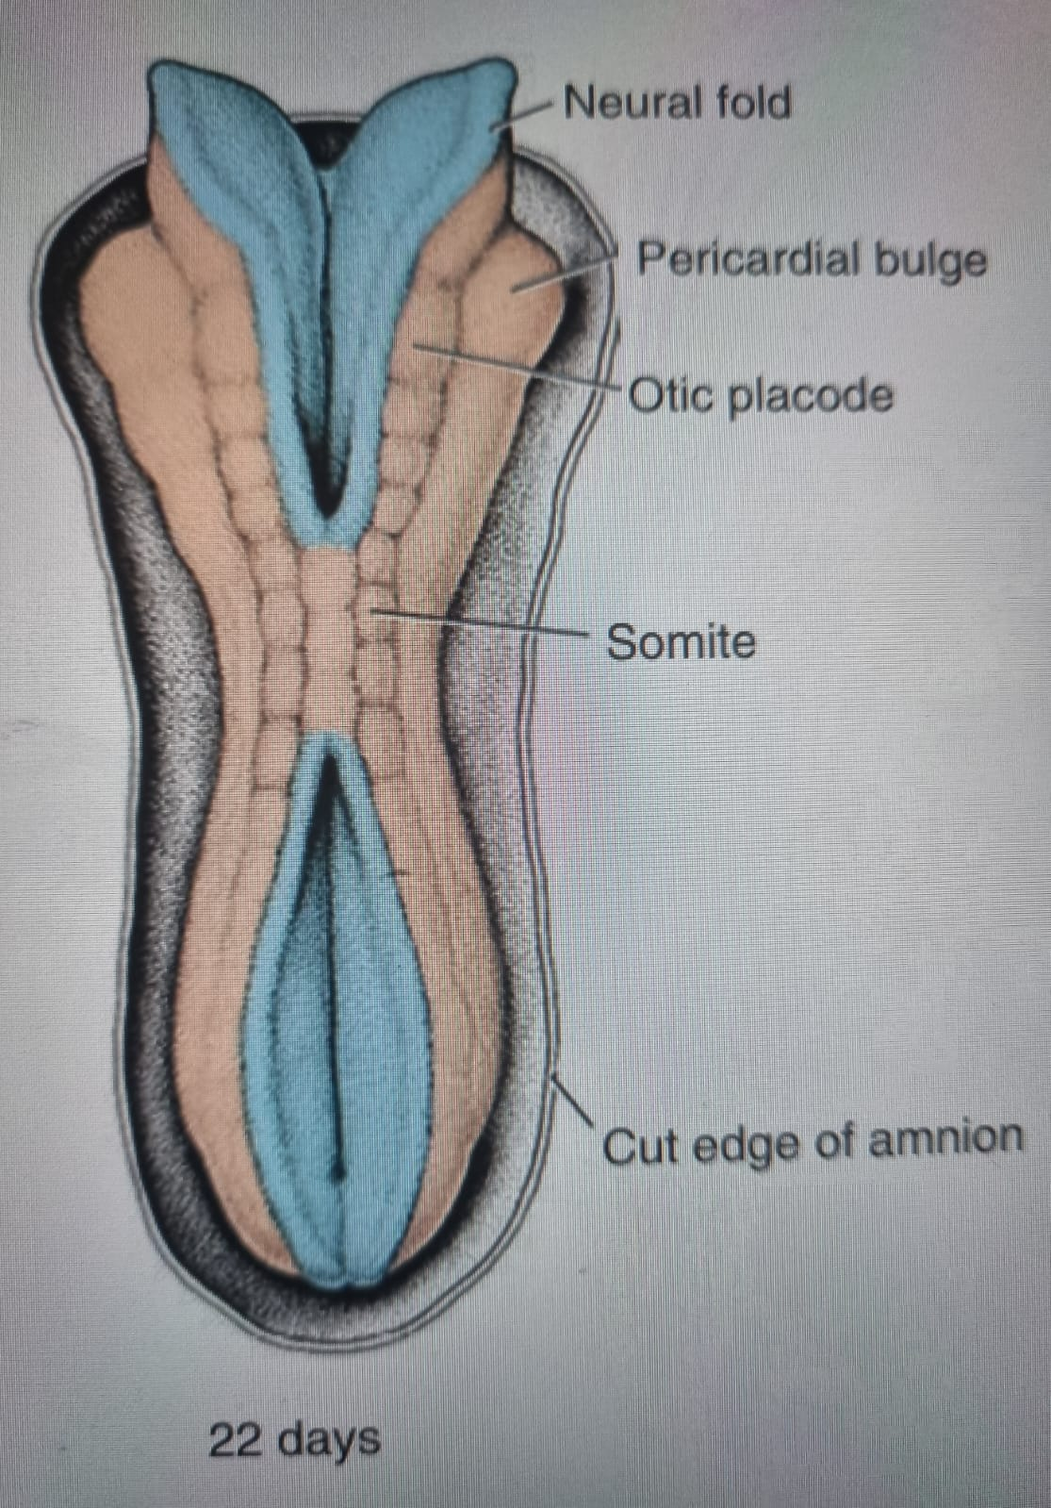
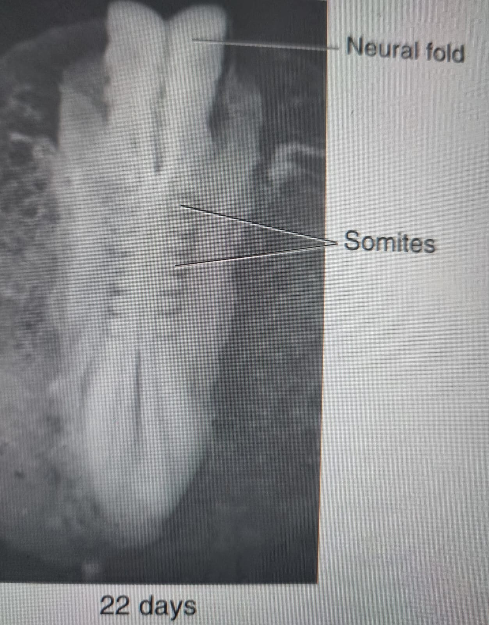
Fusion of the neural folds begins at the cervical region (5th somite) and proceeds cranio-caudally.

Slide 90
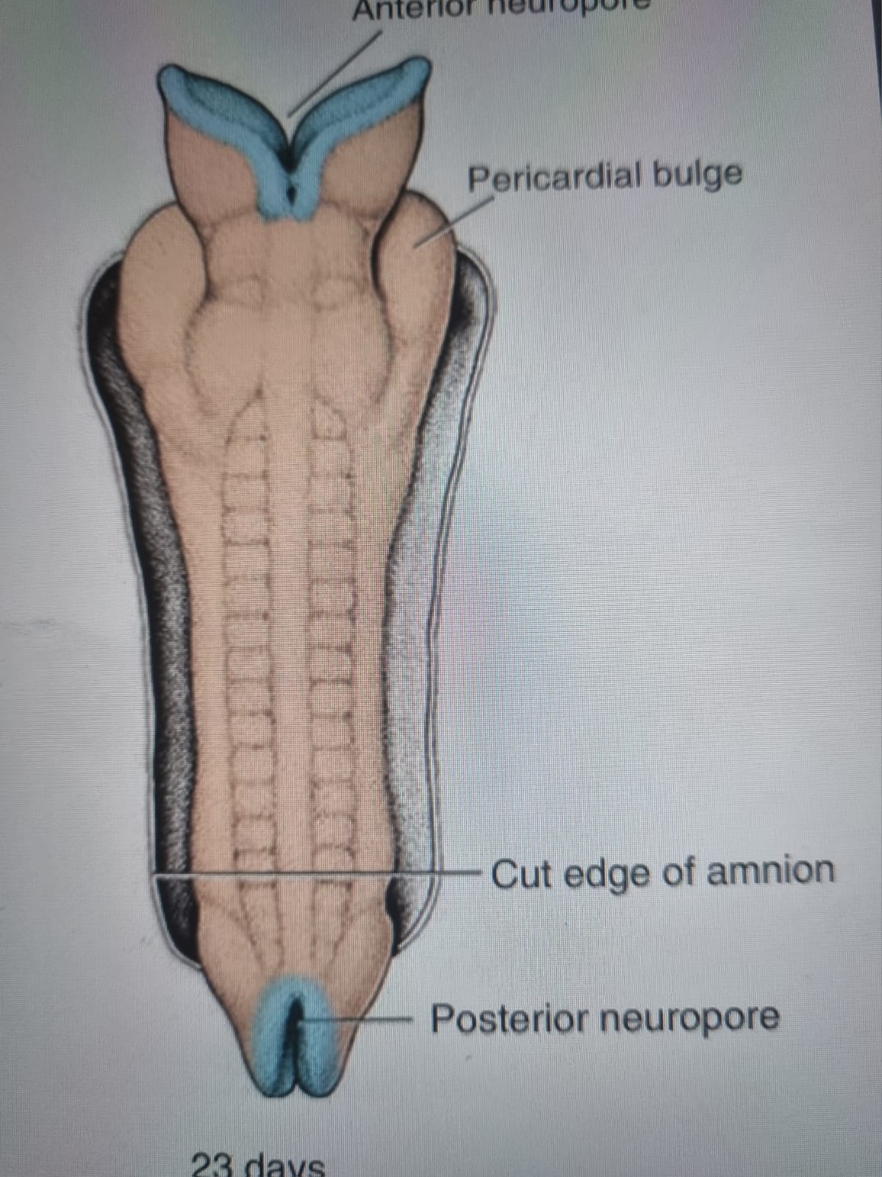
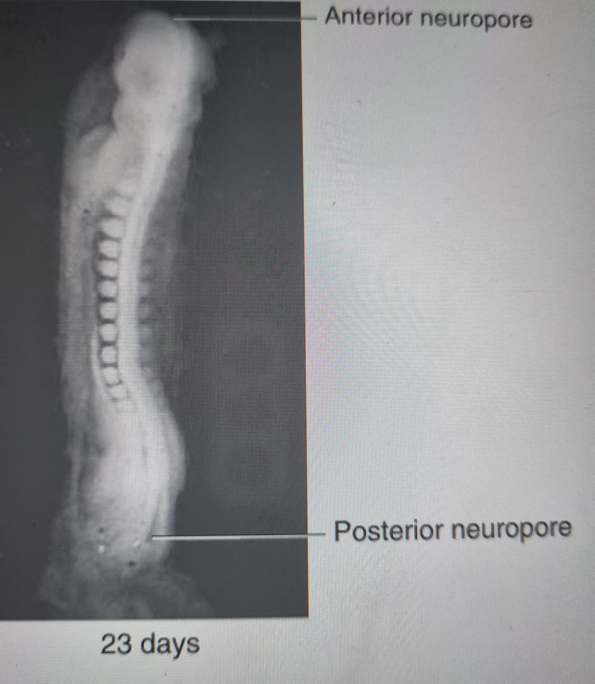
Cephalic and caudal ends of the neural tube communicate with the amniotic cavity by way of the anterior(cranial) and posterior(caudal) neuropores.

Slide 91
Anterior neuropore closes at 18-20 soimite stage (approximately day 25).
Posterior closes at day 28 (25 somite stage) marking the end of neurulation.
CNS represented by a closed tubular structure with a narrow caudal portion(spinal cord) and a broader cephalic portion characterized by dilatations(brain vesicles)

Slide 92
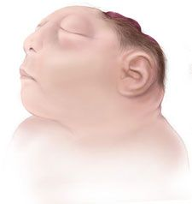
Neural tube defect (NTD)
Incidence - 2.6 in 1000 worldwide.
Anencephaly
Failure of the anterior neuropore to close, resulting in a failure of the brain to develop.
Lethal defect.
Diagnosed prenatally and pregnancies terminated

Slide 93
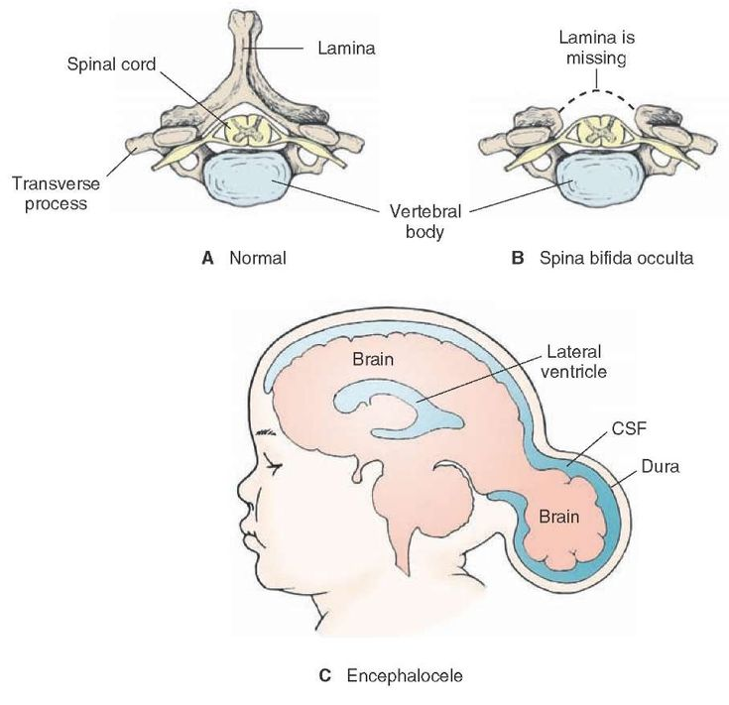
NTDs contd:
Encephalocele

Slide 94
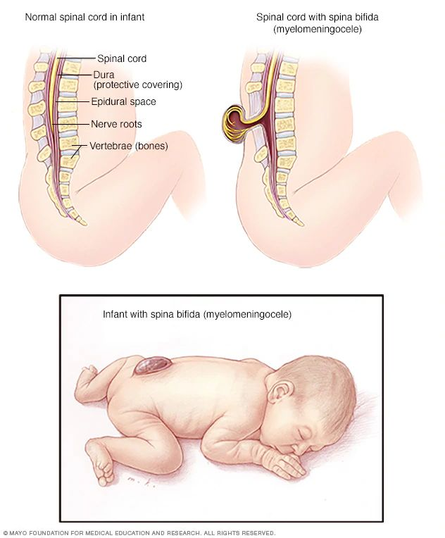
NTDs contd:
Spina Bifida
Defects usually occur in the cervical and/or lumbar regions and may cause neurological deficits in the lower limbs and urinary bladder., based
Neural tube defects can be detected by the presence of alpha-fetoprotein (AFP) in the foetal circulation after the fourth week of development.

Slide 95
Folic Acid Administration in Early Pregnancy
400 micrograms (µg) daily beginning 3 months prior to conception and continuing throughout pregnancy
Women of childbearing age need to consume the daily recommended dose of folic acid – unplanned pregnancy
A woman with a child with a NTD or history of such defects in her family - more

Slide 96
Neural Crest Cells
Cells at the lateral border / crest cells of the neuroectoderm dissociate from their neighbours.
Undergo epithelial-to-mesenchymal transition and actively migrate into underlying mesoderm after closure of the neural tube.
Those from the trunk migrate along either
Dorsal pathway through the dermis to form melanocytes in the skin and hair follicles
Ventral pathway through the anterior half of each somite to become sensory ganglia, sympathetic and enteric neurons, Schwann’s cells and cells of the adrenal medulla

Slide 97
Those from the cranial folds leave neural tube before closure and contribute to
Craniofacial skeleton
Neurons for cranial ganglia
Glial cells
Melanocytes
Other cell types
Neural crest cells may be referred to as 4th germ layer.
Contribute to many organs and tissues.

Slide 98
Molecular Regulation of Neural Crest Induction
Exposure to very low levels of BMPs regulated by noggin and chordin.
SNAIL and FOXD3 specify cells as neural crest.
SLUG promotes cell migration from neuroectoderm.
BMPs, TGF-B members and FGFs regulate migration, proliferation and differentiation.
Their abnormal concentration causes neural crest defects in the craniofacial region.

Slide 99
Derivatives of the Embryonic Ectoderm
Organs and structures that maintain contact with the outside
CNS
Peripheral nervous system
Sensory epithelium of ear, nose and eye
Epidermis+ hair and nails
Subcutaneous glands-sweat glands
Mammary glands
Pituitary gland
Enamel of teeth

Slide 100
Neural Crest derivatives
Connective tissue of craniofacial bones
Cranial nerve ganglia
C cells of thyroid gland
Conotruncal septum in the heart
Odontoblasts
Dermis in the face and neck
Spinal(dorsal root) ganglia
Sympathetic chain and preaortic ganglia
Parasympathetic ganglia of the GIT
Adrenal medulla
Schwann cells
Glial cells
Meninges of the forebrain
Melanocytes
Smooth muscle cells to blood vessels of the face and forebrain

Slide 101

Differentiation of the Embryonic Mesoderm

Slide 102
Differentiation of the Embryonic Mesoderm
Day 17 – paraxial mesoderm and lateral plate mesoderm connected by intermediate mesoderm.
Appearance and coalescence of intercellular cavities divides lateral plate mesoderm into 2
Somatic/parietal mesoderm-continuous with mesoderm covering the amnion
Splanchnic/Visceral mesoderm-continuous with mesoderm covering the yolk sac
These line the intraembryonic cavity which is continuous with the extraembryonic cavity on each side.

Slide 103

Differentiation of the Embryonic Mesoderm

Slide 104
Paraxial Mesoderm
Week 3 – Organized into somitomeres which 1st appear in the cephalic region.
Consist of mesodermal cells arranged in concentric whorls around the centre of the unit.
Head region – form in association with segmentation of neural plate into neuromeres – mesenchyme in the head.
Occipital and caudal- somites appear in a craniocaudal sequence
4 occipital, 8 cervical, 12 thoracic, 5 lumbar, 5 sacral, 8-10 coccygeal pairs.
1st occipital and last 5-7 coccygeal somites disappear.
The rest form axial skeleton.
Aging of the embryo by counting somites.

Slide 105
Molecular Regulation of Somite Formation
Segmentation clock established by cyclic expression of genes
Notch and WNT signaling pathways in presomitic mesoderm in an oscillating pattern.
Retinoic acid (RA)+ FGF8 and WNT3a regulate boundaries of each somite.
High concentration cranially. Decreases caudally.

Slide 106

Somite Differentiation
Initially a ball of mesoderm (fibroblast-like cells)
Undergo epithelialization, arranging themselves in a donut shape around a lumen.
Week 4 – Ventral and medial cells become mesenchymal again and shift to surround the neural tube and notochord.-Sclerotome
Differentiates into vertebrae and ribs

Slide 107
Somite Differentiation
Dorsomedial and ventrolateral edge cells of the upper somite- precursors of muscle cells
Cells between them form the dermatome
The muscle precursor cells become mesenchymal and migrate beneath the dermatome – dermomyotome.
Cells from ventrolateral edge migrate into parietal layer of lateral plate mesoderm-most musculature for the body wall
External and internal obliques and transversus abdominis muscles, and most of the limb muscles
Cells from dermomyotome form dermis of the skin of the back and muscles for the back and intercostal muscles and some limb muscles.

Slide 108

Segmental nerve component
Each somite forms its
Sclerotome- tendon cartilage and bone
Myotome- muscle
Dermatome – dermis of the back

Slide 109
Molecular Regulation of Somite differentiation
Sonic Hedgehog (SHH) and noggin induce ventromedial somite portion to become sclerotome.
Sclerotome cells express PAX1-cartilage-and-bone-forming gene cascade.
PAX3 regulated by WNT demarcates the dermomyotome
WNT proteins cause dorsomedial portion to express MYF5 to form primaxial muscle precursors
MYOD – muscle specific.
Primaxial and abaxial muscle precursors.
Neurotropin 3 (NT-3) - dermis from midportion of dorsal epithelium

Slide 110

Molecular regulation of Somite differentiation

Slide 111
Intermediate Mesoderm
Differentiates into the urogenital system- excretory units and gonads.
Cervical and upper thoracic regions- segmental cell clusters – future nephrotomes
Caudally- unsegemented mass of tissue- nephrpogenic cord

Slide 112
Lateral Plate Mesoderm
Splits into
Parietal (somatic) layer – lines the intraembryonic cavity. Formed by mesoderm.
Visceral (splanchnic) layer - surrounds the organs.
Lateral body wall folds are formed by the parietal mesoderm layer and the overlying ectoderm.
Lateral body wall folds together with head(cephalic) and tail(caudal) folds close the ventral body wall.

Slide 113

Lateral Plate Mesoderm

Slide 114
Differentiation of Lateral Plate Mesoderm
Parietal layer
Dermis of the skin in the body wall and limbs
Connective tissue of the limbs and sternum
Sclerotome and muscle precursor cells migrating into parietal layer
Costal cartilage
Limb muscles
Most body wall muscles
Visceral Layer + embryonic endoderm
Wall of gut tube
Mesoderm cells of parietal layer
Mesothelial/serous membranes which will line the peritoneal, pleural and pericardial cavities and secrete serous fluid.
Those of visceral layer form a thin serous membrane around each organ.

Slide 115
Formation of Blood and Blood Vessels
Mesodermal origin
2 ways
Vasculogenesis - vessels arise from blood islands
Angiogenesis - sprouting from existing vessels
3 weeks IUL – Transitory blood islands in mesoderm surrounding the yolk sac
Later in lateral plate mesoderm
Hemangioblasts – precursor for vessel and blood cell formation
Definitive hematopoietic stem cells from mesoderm surrounding the aorta in the aorta-gonad-mesonephros (AGM) region
Colonize the liver- major hematopoietic organ of the embryo
Stem cells from the liver colonize the bone marrow - definitive blood forming tissue from 7 months gestation.

Slide 116

A schematic diagram showing the contribution of various organs to hematopoiesis during development. During the period of yolk sac hematopoiesis, the earliest embryonic form of hemoglobin is synthesized called hemoglobin C2€2 . During the period of liver hematopoiesis, the fetal form of hemoglobin (HbF) is synthesized called hemoglobin azy 2 During the period of bone marrow hematopoiesis (about week 30), the adult form of hemoglobin (HbA) is synthesized called hemoglobin n 2 13 2, which gradually replaces hemoglobin etz-Y2 . Hemoglobin azy 2 is the predominant form of hemoglobin during pregnancy because it has a higher affinity for oxygen than the adult form of hemoglobin and thereby "pulls" oxygen from the maternal blood into fetal blood

Slide 117

Molecular Regulation of Blood and Blood Vessels

Slide 118
Vasculogenesis, FGF2 binds to its receptor FGFR on subpopulations of mesoderm cells and induces them to form hemangioblasts.
Under the influence of VEGF acting through two different receptors (VEGF-R2 VEGF-R1), these cells become endothelial and coalesce to form vessels.
Angiogenesis is also regulated by VEGF, which stimulates proliferation of endothelial cells at points where new vessels will sprout from existing ones.
Final modeling and stabilization of the vasculature are accomplished by PDGF and TGF-b.

Slide 119
Clinical Correlate
Capillary Hemangioma
Abnormally dense collections of capillary blood vessels
Most common tumors of infancy( app 10% of all births)
Occur anywhere
Associated with craniofacial structures
Focal or diffuse
Diffuse lesions cause more secondary complications; ulceration. Scarring, airway obstruction
Insulin-like growth factor implicated.

Slide 120
Derivatives of Embryonic Endoderm
The gastrointestinal system
Cephalocaudal folding and closure of the lateral body folds incorporates a larger portion of the endoderm to form the gut tube.
Divided into 3
Foregut
Midgut - Communicates with the yolk sac through the vitelline(yolk sac) duct.
Hindgut

Slide 121

Differentiation of Embryonic Endoderm

Slide 122


Slide 123
Differentiation of Embryonic Endoderm
Cephalic end - oropharyngeal membrane – separates stomodeum from pharynx.
Ruptures at 4 weeks
Caudal end- cloacal membrane-separates upper anal from proctodaeum.
Breaks down at 7 weeks
Incorporation of allantois into the body of the embryo – forms the cloaca
Week 5- vitelline duct, allantois ad umbilical vessels restricted to the umbilical region.

Slide 124
Role of Yolk Sac
Unclear
Protective compartment
Nutritive organ prior to establishment of blood vessels
Contributes the 1st transitory blood vessels
Provide germ cells that reside in its posterior wall and late migrate to the gonads to for eggs and sperm.

Slide 125
Derivatives of the Embryonic Endoderm
Epithelial lining of the primitive gut and intraembryonic portions of the allantois and vitelline duct.
Epithelial lining of the respiratory tract.
Parenchyma of the thyroid, parathyroids, liver and pancreas.
Reticular stroma of the tonsils and thymus.
Epithelial lining of the urinary bladder and the urethra.
Epithelial lining of the tympanic cavity and auditory tubes.
Pharyngeal pouches.

Slide 126

Derivatives of the Embryonic Endoderm

Slide 127

External Appearance During the Second Month

Slide 128
External Appearance During the Second Month
Age of embryo expressed in somites
Counting them is difficult during the 2nd month
Age then indicated as crown-rump length(CRL) – a measurement from the vertex of the skull to the midpoint between the apices of the buttocks.
Increase in head size.
Formation of limbs, face ,ears, nose and eyes.

Slide 129
Clinical Correlate
Stem cell populations establishing each organ primordia appear during embryogenesis/organogenesis( week 3 - 8).
Sensitive to insult from genetic and environmental influences.
Mother may not realize she is pregnant yet especially during weeks 3 and 4 and may not take necessary precautions.

Slide 130
Summary of Weeks 3 - 9
Days | Somites | Length (mm) | Characteristic Features
14–15 | 0 | 0.2 | Appearance of primitive streak
16-18 | 0 | 0.4 | Notochordal process appears; hemopoietic cells in yolk sac
19-20 | 0 |  | Intraembryonic mesoderm spread under cranial ectoderm; primitive streak continues; umbilical vessels and cranial neural folds beginning to form
20-21 | 1-4 | 2.0-3.0 | Cranial neural folds elevated and deep neural groove established; embryo beginning to bend
22-23 | 5-12 | 3.0-3.5 | Fusion of neural folds begins in cervical region; cranial and caudal neuropores open widely; visceral arches 1 and 2 present; heart tube beginning to fold
24-25 | 13-20 | 3.0-4.5 | Cephalocaudal folding under way; cranial neuropore closing or closed; optic vesicles formed; otic placodes appear

Slide 131
Days | Somites | Length (mm) | Characteristic Features
26-27 | 21-29 | 3.5-5.0 | Caudal neuropore closing or closed; upper limb buds appear; three pairs of visceral arches
28-30 | 30-35 | 4.0-6.0 | Fourth visceral arch formed; hindlimb buds appear; otic vesicle and lens placode
31-35 | 7.0-10 | 7.0-10.0 | Forelimbs paddle-shaped; nasal pits formed; embryo tightly C-shaped
36-42 |  | 9.0-14.0 | Digital rays in hand and foot plates; brain vesicles prominent; external auricle forming from auricular hillocks; umbilical herniation initiated
43-49 |  | 13.0-22.0 | Pigmentation of retina visible; digital rays separating; nipples and eyelids formed; maxillary swellings fuse with medial nasal swellings as upper lip forms; prominent umbilical herniation
50-56 |  | 21.0-31.0 | Pigmentation of retina visible; digital rays separating; nipples and eyelids formed; maxillary swellings fuse with medial nasal swellings as upper lip forms; prominent umbilical herniation

Slide 132


Slide 134
PRACTICE QUESTIONS
1. Which germ layers are present at the end of week 3 of development (day 21)? (A) Epiblast only (B) Epiblast and hypoblast (C) Ectoderm and endoderm (D) Ectoderm, mesoderm, and endoderm (E) Epiblast, mesoderm, and hypoblast
2. Which process establishes the three definitive germ layers? (A) Neurulation (B) Gastrulation (C) Craniocaudal folding (D) Lateral folding (E) Angiogenesis
3. The first indication of gastrulation in the embryo is (A) formation of the primitive streak (B) formation of the notochord (C) formation of the neural tube (D) formation of extraembryonic mesoderm (E) formation of tertiary chorionic villi
4. Somites may differentiate into which of the following? (A) Urogenital ridge (B) Kidneys (C) Notochord (D) Epimeric and hypomeric muscles (E) Epithelial lining of the GI tract
5. Intermediate mesoderm gives rise to the (A) neural tube (B) heart (C) kidneys and gonads (D) somites (E) notochord
6. The developing embryo has a distinct human appearance by the end of (A) week 4 (B) week 5 (C) week 6 (D) week 7 (E) week 8

Slide 135
7. The lateral mesoderm is divided into two distinct layers by the formation of the
(A) extraembryonic coelom
(B) intraembryonic coelom
(C) cardiogenic region
(D) notochord
(E) yolk sac
8. Very often the first indication that a woman has that she is pregnant is a missed menstrual period. In which week of embryonic development does a woman experience her first missed menstrual period?
(A) Start of week 3
(B) Start of week 4
(C) Start of week 5
(D) Start of week 8
(E) End of week 8
9. A female newborn was found to have a large midline tumor in the lower sacral area, which was diagnosed as a sacrococcygeal tumor. Which of the following courses of treatment is recommended for this child?
(A) Immediate chemotherapy and radiation treatment (B) Surgical removal of the tumor by age 6 months (C) Surgical removal of the tumor at age 4-5 years (D) Surgical removal of the tumor at age 13-15 years (E) No treatment because this tumor normally regresses with age
10. A woman has her pregnancy suddenly terminated because of intrauterine fetal death. At autopsy, the fetus shows severe pallor, generalized edema, and hepatosplenomegaly. Which of the following would you suspect?
(A) VATER; (B) 13-Thalassemia minor
(C) 13-Thalassemia major (D) Hydrops fetalis
(E) VACTERL

Slide 136
REFERENCES
Dudek R. W. and Fix J. D. (2005). Embryology, Board Review Series. Third Edition, Lippincottt, Williams and Wilkins.
Moore K. L and Persaud T. V. N. (2012). The Developing Human, Clinical Oriented Embryology Eight Edition, Saunders, Elsevier
Sadler, T. W. (2012). Langman’s Medical Embryology. Twelfth Edition. Wolters Kluwer and Lippincottt, Williams and Wilkins.
Keith L. M, Persaud MD, Mark G. Torchia MSc - The Developing Human Clinically Oriented Embryology, 10e-Elsevier
Betz D, Fane K. Human Chorionic Gonadotropin. [Updated 2023 Aug 14]. In: StatPearls [Internet]. Treasure Island (FL): StatPearls Publishing; 2024 Jan-. Available from: https://www.ncbi.nlm.nih.gov/books/NBK532950/
Korevaar TI, Steegers EA, de Rijke YB, Schalekamp-Timmermans S, Visser WE, Hofman A, Jaddoe VW, Tiemeier H, Visser TJ, Medici M, Peeters RP (2015). Reference ranges and determinants of total hCG levels during pregnancy: the Generation R Study. Eur J Epidemiol. 30(9):1057-66. doi: 10.1007/s10654-015-0039-0.

Slide 137


